Slide 1

Unit-3 Combinational Digital Circuits
Digital Fundamentals (DF)
DU #2101CS303
Prof. Krunal D Vyas
Computer Science & Engineering
krunal.vyas@darshan.ac.in
9601901005

Slide 2

Outline
Multiplexer, De-Multiplexer
Decoders, Encoders, Priority encoders
Adders, Subtractors
Digital comparator
Parity generator
Code converters
Looping

Slide 3
Multiplexer, De-Multiplexer
Section - 1

Slide 4
Multiplexer
A multiplexer(MUX) is a device that allows digital information from several sources to be routed onto a single line for transmission over that line to a common destination.
Consider an integer ‘m’, which is constrained by the following relation:
m = 2^{n}, where m and n are both integers.
A m-to-1 Multiplexer has
m Inputs: I₀, I₁, I₂, ................ I_{(m-1)}
One Output: Y
n Control inputs: S₀, S₁, S₂, ...... S_{(n-1)}
One (or more) Enable input(s)
Such that Y may be equal to one of the inputs, depending upon the control inputs.

Slide 5
4-to-1 Multiplexer
2^{n} inputs
I₀
Select Inputs |  | Output
S₁ | S₀ | Y
0 | 0 | I₀
0 | 1 | I₁
1 | 0 | I₂
1 | 1 | I₃
I₁
I₀
4 x 1 MUX
Y
I₂
1 output
I₃
Enable (G)
S₁
S₀
0
0
Y = S₁’S₀’I₀ + S₁’S₀I₁ + S₁S₀’I₂ + S₁S₀I₃
n control inputs

Slide 6
4 x 1 MUX Actual Circuit
I₃
I₂
Y
I₁
I₀
S₁
S₀
Enable (G)

Slide 7

Logic function generator using Multiplexer
Implement the following function using 8 to 1 MUX
F(x,y,z) = $\sum_{m}{(0,2,3,5)}$
S₂ | S₁ | S₀ | F
x | y | z
0 | 0 | 0 | 1
0 | 0 | 1 | 0
0 | 1 | 0 | 1
0 | 1 | 1 | 1
1 | 0 | 0 | 0
1 | 0 | 1 | 1
1 | 1 | 0 | 0
1 | 1 | 1 | 0
z
S₀
y
S₁
x
S₂
1
D₀
0
D₁
8 x 1 MUX
1
D₂
Output = F
1
D₃
0
D₄
1
D₅
0
D₆
0
D₇

Slide 8
Logic function generator using Multiplexer (Method)
Multiplexer with n-data select inputs can implement any function of n + 1 variables.
The first n variables of the function as the select inputs and to use the least significant input variable and its complement to drive some of the data inputs.
If the single variable is denoted by D, each data output of the multiplexer will be D, D’, 1, or 0.
Suppose, we wish to implement a 4-variable logic function using a multiplexer with three data select inputs.
Let the input variables be A, B, C, and D; D is the LSB.
A truth table for the function F(A, B, C, D) is constructed with ABC has the same value twice once with D = 0 and again with D = 1.

Slide 9
Logic function generator using Multiplexer (Method)
The following rules are used to determine the connections that should be made to the data inputs of the multiplexer.
If F = 0 both times when the same combination of ABC occurs, connect logic 0 to the data input selected by that combination.
If F = 1 both times when the same combination of ABC occurs, connect logic 1 to the data input selected by that combination.
If F is different for the two occurrences of a combination of ABC, and if F = D in each case, connect D to the data input selected by that combination.
If F is different for the two occurrences of a combination of ABC, and if F = D’ in each case, connect D’ to the data input selected by that combination.

Slide 10
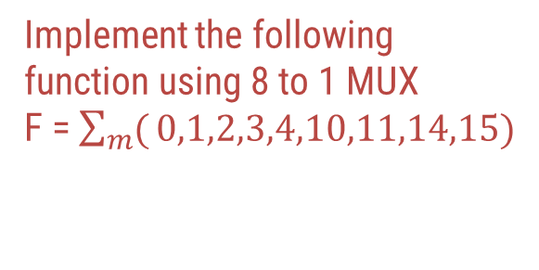
Implement the following function using 8 to 1 MUX
F = $\sum_{m}{(}0,1,2,3,4,10,11,14,15)$
S₂ | S₁ | S₀ | D | F
A | B | C
0 0 | 0 0 | 0 0 | 0 1 | 1 1 | F = 1
0 0 | 0 0 | 1 1 | 0 1 | 1 1 | F = 1
0 0 | 1 1 | 0 0 | 0 1 | 1 0 | F = D’
0 0 | 1 1 | 1 1 | 0 1 | 0 0 | F = 0
1 1 | 0 0 | 0 0 | 0 1 | 0 0 | F = 0
1 1 | 0 0 | 1 1 | 0 1 | 1 1 | F = 1
1 1 | 1 1 | 0 0 | 0 1 | 0 0 | F = 0
1 1 | 1 1 | 1 1 | 0 1 | 1 1 | F = 1
C
S₀
B
S₁
A
S₂
1
D₀
1
D₁
8 x 1 MUX
Output = F
D’
D₂
0
D₃
0
D₄
1
D₅
0
D₆
1
D₇

Slide 11
Demultiplexer
A demultiplexer(DEMUX) is a device that allows digital information from one source to be routed onto a multiple lines for transmission over different destinations.
Consider an integer ‘m’, which is constrained by the following relation:
m = 2^{n}, where m and n are both integers.
A 1-to-m Demultiplexer has
One Input: D
m Outputs: O₀, O₁, O₂, ................ O_{(m-1)}
n Control inputs: S₀, S₁, S₂, ...... S_{(n-1)}
One (or more) Enable input(s)
Such that D may be transfer to one of the outputs, depending upon the control inputs.

Slide 12
1-to-4 Demultiplexer
O₀
D
S₁
S₁’
S₀
S₀’
1x4 DEMUX
O₁
D
O₂
O₀ = D S ₁’ S₀’
O₃
O₁ = D S ₁’ S₀
S₁
S₀
O₂ = D S ₁ S₀’
Select code |  | Outputs
S₁ | S₀ | O₃ | O₂ | O₁ | O₀
0 | 0 | 0 | 0 | 0 | D
0 | 1 | 0 | 0 | D | 0
1 | 0 | 0 | D | 0 | 0
1 | 1 | D | 0 | 0 | 0
O₃ = D S ₁ S₀

Slide 13
Decoders, Encoders, Priority encoders
Section - 2

Slide 14
Decoder
A decoder is a logic circuit that accepts a set of inputs which represents a binary number and activates the only output that corresponds to the input number.
In other words, a decoder circuit looks at its inputs, determines which binary number is present there, and activates the specific output which corresponds to that number; all other outputs remain inactive.
In its general form, a decoder has N input lines to handle N bits and M output lines such that only one output line is activated for each one of the possible combinations of inputs.
I₀
O₀
I₁
O₁
I₂
O₂
.
.
.
.
.
.
M = 2^{N}
N inputs
Decoder
M outputs
I_{N-2}
O_{M-2}
I_{N-1}
O_{M-1}

Slide 15
3-Line to 8-Line Decoder
Inputs |  |  | Outputs
A | B | C | D₀ A’B’C’ | D₁ A’B’C | D₂ A’BC’ | D₃ A’BC | D₄ AB’C’ | D₅ AB’C | D₆ ABC’ | D₇ ABC
0 | 0 | 0 | 1 | 0 | 0 | 0 | 0 | 0 | 0 | 0
0 | 0 | 1 | 0 | 1 | 0 | 0 | 0 | 0 | 0 | 0
0 | 1 | 0 | 0 | 0 | 1 | 0 | 0 | 0 | 0 | 0
0 | 1 | 1 | 0 | 0 | 0 | 1 | 0 | 0 | 0 | 0
1 | 0 | 0 | 0 | 0 | 0 | 0 | 1 | 0 | 0 | 0
1 | 0 | 1 | 0 | 0 | 0 | 0 | 0 | 1 | 0 | 0
1 | 1 | 0 | 0 | 0 | 0 | 0 | 0 | 0 | 1 | 0
1 | 1 | 1 | 0 | 0 | 0 | 0 | 0 | 0 | 0 | 1
3 to 8 line decoder can be implemented using AND gates to achieve active-HIGH output.
For active-LOW outputs, NAND gates are used.

Slide 16
A
A’
B
B’
C
C’
D₇ = ABC
D₆ = ABC’
D₅ = AB’C
D₄ = AB’C’
D₃ = A’BC
D₂ = A’BC’
D₁ = A’B’C
D₀ = A’B’C’

Slide 17
Encoder
Device to convert familiar numbers or symbols into coded format.
It has a number of input lines, only one of which is activated at a given time, and produces an N-bit output code depending on which input is activated.
Figure shows the block diagram of an encoder with M inputs and N outputs.
I₀
O₀
I₁
O₁
I₂
O₂
.
.
.
.
.
.
M = 2^{N}
M inputs
Encoder
N outputs
I_{M-2}
O_{N-2}
I_{M-1}
O_{N-1}

Slide 18



Priority Encoder
A priority encoder is a logic circuit that responds to just one input in accordance with some priority system, among all those that may be simultaneously HIGH.
The most common priority system is based on the relative magnitudes of the inputs; whichever decimal input is the largest, is the one that is encoded.
For example, if both decimal 3 and decimal 4 are activated simultaneously, then a priority encoder would encode decimal 4.
Inputs |  |  |  | Outputs
D₀ | D₁ | D₂ | D₃ | A | B | V
0 | 0 | 0 | 0 | x | x | 0
1 | 0 | 0 | 0 | 0 | 0 | 1
x | 1 | 0 | 0 | 0 | 1 | 1
x | x | 1 | 0 | 1 | 0 | 1
x | x | x | 1 | 1 | 1 | 1
$$A= \sum_{m}{(1, 2, 3, 5, 6, 7, 9, 10, 11, 13, 14, 15)}$$
$$B= \sum_{m}{(1, 3, 4, 5, 7, 9, 11, 12, 13, 15)}$$
$$V= \sum_{m}{(1, 2, 3, 4, 5, 6, 7, 8, 9, 10, 11, 12, 13, 14, 15)}$$

Slide 19


Priority Encoder
$$A= \sum_{m}{(1, 2, 3, 5, 6, 7, 9, 10, 11, 13, 14, 15)}$$
$$B= \sum_{m}{(1, 3, 4, 5, 7, 9, 11, 12, 13, 15)}$$
D₀D₁
D₀D₁
00
01
11
10
00
01
11
10
D₂D₃
D₂D₃
0
4
12
8
0
4
12
8
00
x
00
x
1
1
1
5
13
9
1
5
13
9
01
1
1
1
1
01
1
1
1
1
3
7
15
11
3
7
15
11
11
1
1
1
1
11
1
1
1
1
2
6
14
10
2
6
14
10
10
1
1
1
1
10
A = D₃ + D₂
B = D₃ + D₂’ D₁

Slide 20

Priority Encoder
$$V= \sum_{m}{(1, 2, 3, 4, 5, 6, 7, 8, 9, 10, 11, 12, 13, 14, 15)}$$
D₀D₁
D₃
B = D₃ + D₂’ D₁
00
01
11
10
D₂D₃
0
4
12
8
D₂
00
0
1
1
1
D₁
1
5
13
9
01
1
1
1
1
A = D₃ + D₂
3
7
15
11
11
1
1
1
1
V = D₃ + D₂ + D₁ + D₀
D₀
2
6
14
10
10
1
1
1
1
V = D₃ + D₂ + D₁ + D₀

Slide 21
Adders, Subtractors
Section - 3

Slide 22
Half Adder
A combinational circuit which adds two one-bit binary numbers is called a half-adder.
The sum column resembles like an output of the XOR gate.
The carry column resembles like an output of the AND gate.
Limitations:
In multi-digit addition we have to add two bits along with the carry of previous digit addition. Such addition requires addition of 3 bits. This is not possible in half-adders.
Inputs |  | Outputs
A | B | Sum | Carry
0 | 0 | 0 | 0
0 | 1 | 1 | 0
1 | 0 | 1 | 0
1 | 1 | 0 | 1
A
S = A ⊕ B
B
C = AB

Slide 23
Full Adder
The full-adder adds the bits A and B and the carry from the previous column called carry-in C_{in} and outputs the sum bit S and the carry bit called carry-out C_{out}.
Inputs |  |  | Outputs
A | B | C_{in} | S | C_{out}
0 | 0 | 0 | 0 | 0
0 | 0 | 1 | 1 | 0
0 | 1 | 0 | 1 | 0
0 | 1 | 1 | 0 | 1
1 | 0 | 0 | 1 | 0
1 | 0 | 1 | 0 | 1
1 | 1 | 0 | 0 | 1
1 | 1 | 1 | 1 | 1
S = A’B’C_{in} + A’BC_{in}’ + AB’C_{in}’ + ABC_{in}
= (AB’ + A’B)C_{in}’ + (AB + A’B’)C_{in}
= (A ⊕ B)C_{in}’ + (A ⊕ B)’C_{in}
= A ⊕ B ⊕ C_{in}
C_{out} = A’BC_{in} + AB’C_{in} + ABC_{in}’ + ABC_{in}
= AB + (A ⊕ B)C_{in}

Slide 24
Full Adder – Logical Diagram
S = A ⊕ B ⊕ C_{in}
C_{out} = AB + (A ⊕ B)C_{in}
A
B
S = A ⊕ B ⊕ C_{in}
C_{in}
C_{out} = AB + (A ⊕ B)C_{in}
Half Adder
Half Adder

Slide 25
Half Subtractor
Subtracts one bit from the other and produces the difference.
Other output is to specify if 1 is borrowed.
Limitation:
Half subtractor can be used only for LSB subtraction.
Inputs |  | Outputs
A | B | d | b
0 | 0 | 0 | 0
0 | 1 | 1 | 1
1 | 0 | 1 | 0
1 | 1 | 0 | 0
A
d = A ⊕ B
B
b = A’B

Slide 26
Full Subtractor
Full subtractor is a combinational circuit with 3 inputs (A, B, b_{i})
Subtraction = A – B – b_{i}
Inputs |  |  | Outputs
A | B | b_{i} | d | b
0 | 0 | 0 | 0 | 0
0 | 0 | 1 | 1 | 1
0 | 1 | 0 | 1 | 1
0 | 1 | 1 | 0 | 1
1 | 0 | 0 | 1 | 0
1 | 0 | 1 | 0 | 0
1 | 1 | 0 | 0 | 0
1 | 1 | 1 | 1 | 1
d = A’B’b_{i} + A’Bb_{i}’ + AB’b_{i}’ + ABb_{i}
= (AB’ + A’B)b_{i}’ + (AB + A’B’)b_{i}
= (A ⊕ B)b_{i}’ + (A ⊕ B)’b_{i}
= A ⊕ B ⊕ b_{i}
b = A’B’b_{i} + A’Bb_{i}’ + A’Bb_{i} + ABb_{i}
= A’B(b_{i} + b_{i}’) + (AB + A’B’)b_{i}
= A’B + (A ⊕ B)’b_{i}

Slide 27
Full Subtractor – Logical Diagram
d = A ⊕ B ⊕ b_{i}
b = A’B + (A ⊕ B)’b_{i}
A
B
d = A ⊕ B ⊕ b_{i}
b_{i}
b = A’B + (A ⊕ B)’b_{i}

Slide 28
Binary Parallel Adder
1
1
1
0
0
1
1
0
B₄
A₄
B₃
A₃
B₂
A₂
B₁
A₁
0
0
0
C₃
C₂
C₁
0
FA₄
FA₃
FA₂
FA₁
C_{in}
C₄
S₄
S₃
S₂
S₁
1
0
1
1
1
Example: A = 1010, B = 1101
A₄ A₃ A₂ A₁ = 1010
B₄ B₃ B₂ B₁ = 1101

Slide 29
Binary Parallel Subtractor
1
1
0
1
1
0
1
1
B₄
A₄
B₃
A₃
B₂
A₂
B₁
A₁
0
1
0
0
1
0
1
C₃
C₂
C₁
C_{in}= 1
FA₄
FA₃
FA₂
FA₁
C_{out}
S₄
S₃
S₂
S₁
1
0
0
1
0
Example: A = 1101, B = 1011
A₄ A₃ A₂ A₁ = 1101
B₄ B₃ B₂ B₁ = 1011

Slide 30
Binary Adder-Subtractor
B₄
A₄
B₃
A₃
B₂
A₂
B₁
A₁
M
M | B_{i} | O/P
0 | 0 | 0
0 | 1 | 1
1 | 0 | 1
1 | 1 | 0
C₃
C₂
C₁
C_{in}
FA₄
FA₃
FA₂
FA₁
C₄
S₄
S₃
S₂
S₁
When M = 0, Circuit is an adder.
When M = 1, Circuit becomes a subtractor.

Slide 31
Digital comparator
Section - 4

Slide 32
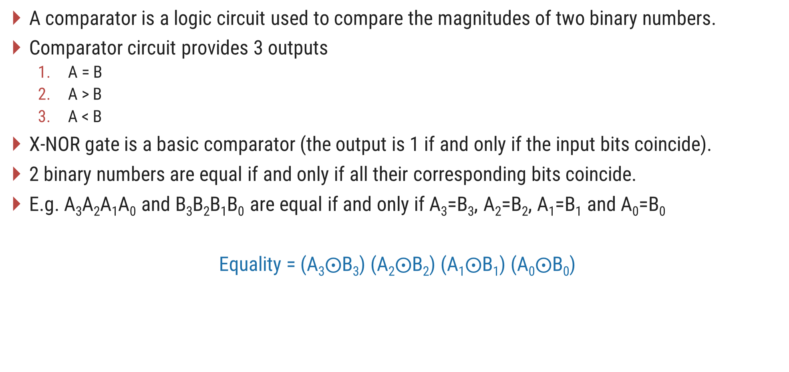
Comparators
A comparator is a logic circuit used to compare the magnitudes of two binary numbers.
Comparator circuit provides 3 outputs
A = B
A > B
A < B
X-NOR gate is a basic comparator (the output is 1 if and only if the input bits coincide).
2 binary numbers are equal if and only if all their corresponding bits coincide.
E.g. A₃A₂A₁A₀ and B₃B₂B₁B₀ are equal if and only if A₃=B₃, A₂=B₂, A₁=B₁ and A₀=B₀
Equality = (A₃$⨀$B₃) (A₂$⨀$B₂) (A₁$⨀$B₁) (A₀$⨀$B₀)

Slide 33
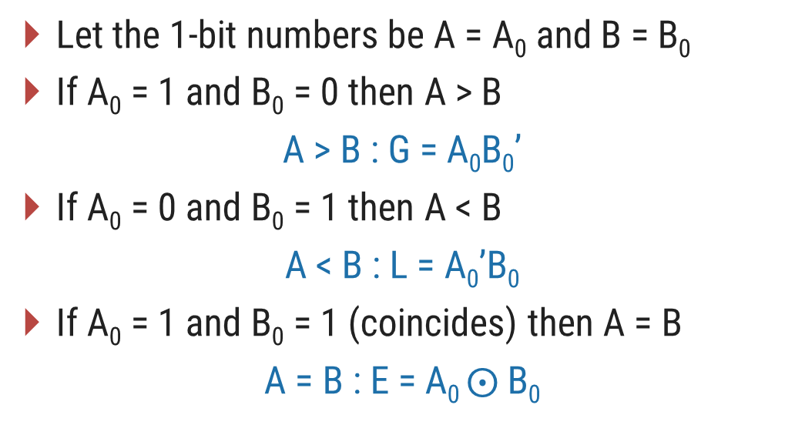
1-bit Magnitude Comparator
Let the 1-bit numbers be A = A₀ and B = B₀
If A₀ = 1 and B₀ = 0 then A > B
A > B : G = A₀B₀’
If A₀ = 0 and B₀ = 1 then A < B
A < B : L = A₀’B₀
If A₀ = 1 and B₀ = 1 (coincides) then A = B
A = B : E = A₀ $⨀$B₀
A < B(L)
A₀
B₀
A = B(E)
A > B(G)
A₀ | B₀ | L | E | G
0 | 0 | 0 | 1 | 0
0 | 1 | 1 | 0 | 0
1 | 0 | 0 | 0 | 1
1 | 1 | 0 | 1 | 0

Slide 34
2-bit Magnitude Comparator
Let the two 2-bit numbers be A = A₁A₀ and B = B₁B₀
If A₁ = 1 and B₁ = 0, then A > B or
If A₁ and B₁ coincide and A₀ = 1 and B₀ = 0, then A > B.
A > B : G = A₁B₁’ + (A₁ ⊙ B₁) A₀B₀’
If A₁ = 0 and B₁ = 1, then A < B or
If A₁ and B₁ coincide and A₀ = 0 and B₀ = 1, then A < B.
A < B : L = A₁’B₁ + (A₁ ⊙ B₁) A₀’B₀
If A₁ and B₁ coincide and if A₀ and B₀ coincide then A = B.
A = B : E = (A₁ ⊙ B₁)(A₀ ⊙ B₀)

Slide 35
2-bit Magnitude Comparator
A₁
B₁’
A₀
A > B(G)
B₀’
A₁
B₁
A = B(E)
A₀
B₀
A₀’
B₀
A < B(L)
A₁’
B₁

Slide 36
Parity generator
Section - 5

Slide 37
Parity Generator
Binary data, when transmitted and processed is susceptible to noise that can alter its 1s to 0s and 0s to 1s.
To detect such errors, an additional bit called parity bit is added to the data bits and the word containing the data bits and the parity bit is transmitted.
At the receiving end the number of 1s in the word received are counted and the error, if any, is detected.
Even Parity
Odd Parity
0 | 0 | 1 | 1
0 | 0 | 1 | 0
Data
Parity bit
Data
Parity bit

Slide 38







3-bit parity generator using even parity bit
Inputs |  |  | Outputs parity bit (f)
A | B | C
0 | 0 | 0 | 0
0 | 0 | 1 | 1
0 | 1 | 0 | 1
0 | 1 | 1 | 0
1 | 0 | 0 | 1
1 | 0 | 1 | 0
1 | 1 | 0 | 0
1 | 1 | 1 | 1
AB
00
01
11
10
C
0
1
1
A
B
f
C
1
1
1
$$f=A^{′}B^{′}C$$
$$+ A^{′}BC′$$
$$+ ABC$$
$$+ AB′C′$$
$$f=A^{′}\left(B^{′}C+BC^{′}\right)+A(BC+B^{′}C^{′})$$
$$f=A^{′}\left(B ⨁ C\right)+A\left(B ⨁ C\right)′$$
$$f=A⊕B ⨁ C$$

Slide 39
Code converters
Section - 6

Slide 40
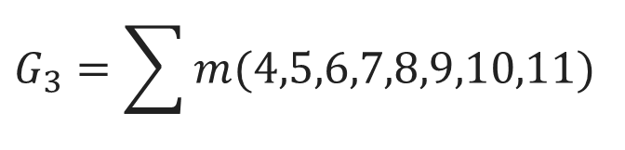
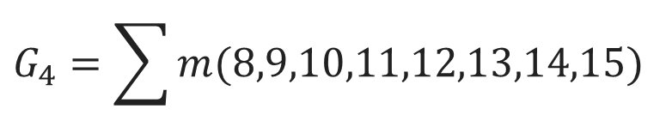
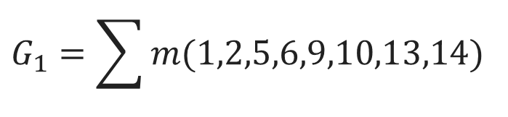
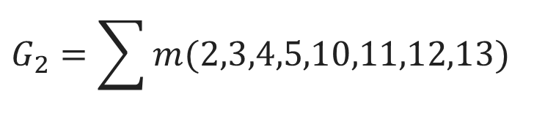
Binary to Gray Code Converter
4-bit Binary |  |  |  | 4-bit Gray
B₄ | B₃ | B₂ | B₁ | G₄ | G₃ | G₂ | G₁
0 | 0 | 0 | 0 | 0 | 0 | 0 | 0
0 | 0 | 0 | 1 | 0 | 0 | 0 | 1
0 | 0 | 1 | 0 | 0 | 0 | 1 | 1
0 | 0 | 1 | 1 | 0 | 0 | 1 | 0
0 | 1 | 0 | 0 | 0 | 1 | 1 | 0
0 | 1 | 0 | 1 | 0 | 1 | 1 | 1
0 | 1 | 1 | 0 | 0 | 1 | 0 | 1
0 | 1 | 1 | 1 | 0 | 1 | 0 | 0
1 | 0 | 0 | 0 | 1 | 1 | 0 | 0
1 | 0 | 0 | 1 | 1 | 1 | 0 | 1
1 | 0 | 1 | 0 | 1 | 1 | 1 | 1
1 | 0 | 1 | 1 | 1 | 1 | 1 | 0
1 | 1 | 0 | 0 | 1 | 0 | 1 | 0
1 | 1 | 0 | 1 | 1 | 0 | 1 | 1
1 | 1 | 1 | 0 | 1 | 0 | 0 | 1
1 | 1 | 1 | 1 | 1 | 0 | 0 | 0
$$G_{4}=\sum{m(8,9,10,11,12,13,14,15)}$$
$$G_{3}=\sum{m(4,5,6,7,8,9,10,11)}$$
$$G_{2}=\sum{m(2,3,4,5,10,11,12,13)}$$
$$G_{1}=\sum{m(1,2,5,6,9,10,13,14)}$$

Slide 41
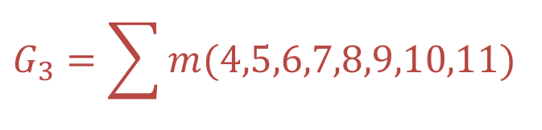
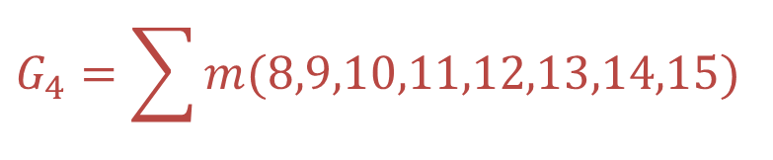
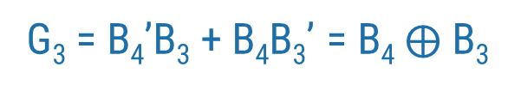
Binary to Gray Code Converter
K-Map for G₄, G₃, G₂, G₁ function and their minimization are as follows:
$$G_{4}=\sum{m(8,9,10,11,12,13,14,15)}$$
$$G_{3}=\sum{m(4,5,6,7,8,9,10,11)}$$
B₄B₃
B₄B₃
00
01
11
10
00
01
11
10
B₂B₁
B₂B₁
0
4
12
8
0
4
12
8
00
1
1
00
1
1
1
5
13
9
1
5
13
9
01
1
1
01
1
1
3
7
15
11
3
7
15
11
11
1
1
11
1
1
2
6
14
10
2
6
14
10
10
1
1
10
1
1
G₄ = B₄
G₃ = B₄’B₃ + B₄B₃’ = B₄$⨁$ B₃

Slide 42
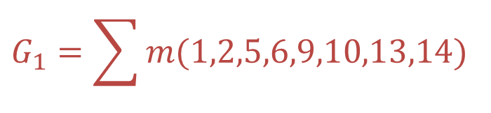
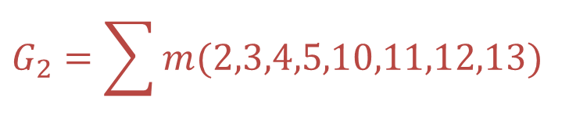
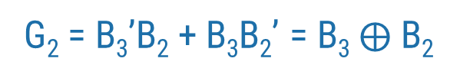
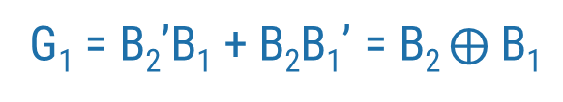
Binary to Gray Code Converter
$$G_{2}=\sum{m(2,3,4,5,10,11,12,13)}$$
$$G_{1}=\sum{m(1,2,5,6,9,10,13,14)}$$
B₄B₃
B₄B₃
00
01
11
10
00
01
11
10
B₂B₁
B₂B₁
0
4
12
8
0
4
12
8
00
1
1
00
1
5
13
9
1
5
13
9
01
1
1
01
1
1
1
1
3
7
15
11
3
7
15
11
11
1
1
11
2
6
14
10
2
6
14
10
10
1
1
10
1
1
1
1
G₂ = B₃’B₂ + B₃B₂’ = B₃$⨁$ B₂
G₁ = B₂’B₁ + B₂B₁’ = B₂ $⨁$ B₁

Slide 43
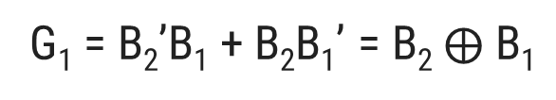
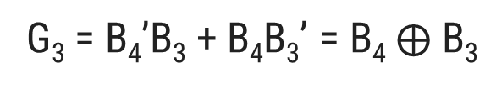
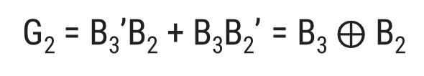
Binary to Gray Code Converter
Logic diagram for binary to Gray code converter is as follows:
G₄ = B₄
B₄
G₄
G₃ = B₄’B₃ + B₄B₃’ = B₄$⨁$ B₃
G₃
B₃
G₂ = B₃’B₂ + B₃B₂’ = B₃$⨁$ B₂
G₂
G₁ = B₂’B₁ + B₂B₁’ = B₂$⨁$ B₁
B₂
G₁
B₁

Slide 44
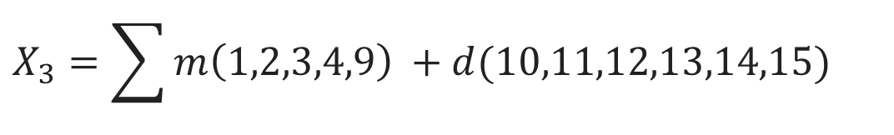
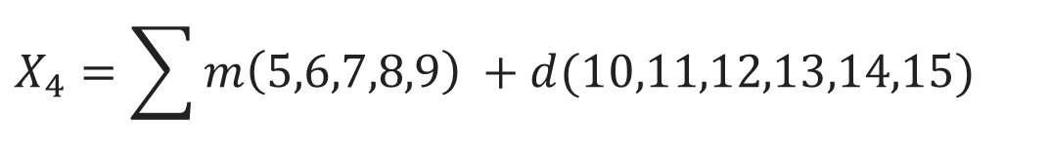
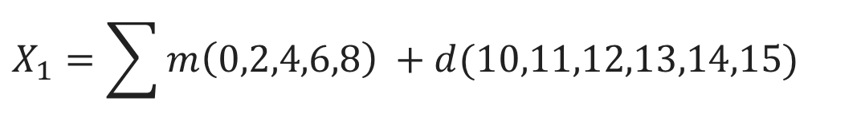
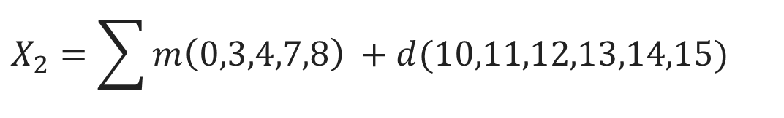
BCD to Excess-3 Code Converter
8421 BCD |  |  |  | XS - 3
B₄ | B₃ | B₂ | B₁ | X₄ | X₃ | X₂ | X₁
0 | 0 | 0 | 0 | 0 | 0 | 1 | 1
0 | 0 | 0 | 1 | 0 | 1 | 0 | 0
0 | 0 | 1 | 0 | 0 | 1 | 0 | 1
0 | 0 | 1 | 1 | 0 | 1 | 1 | 0
0 | 1 | 0 | 0 | 0 | 1 | 1 | 1
0 | 1 | 0 | 1 | 1 | 0 | 0 | 0
0 | 1 | 1 | 0 | 1 | 0 | 0 | 1
0 | 1 | 1 | 1 | 1 | 0 | 1 | 0
1 | 0 | 0 | 0 | 1 | 0 | 1 | 1
1 | 0 | 0 | 1 | 1 | 1 | 0 | 0
$$X_{4}=\sum{m\left(5,6,7,8,9\right)} +d(10,11,12,13,14,15)$$
$$X_{3}=\sum{m\left(1,2,3,4,9\right)} +d(10,11,12,13,14,15)$$
$$X_{2}=\sum{m\left(0,3,4,7,8\right)} +d(10,11,12,13,14,15)$$
$$X_{1}=\sum{m\left(0,2,4,6,8\right)} +d(10,11,12,13,14,15)$$

Slide 45
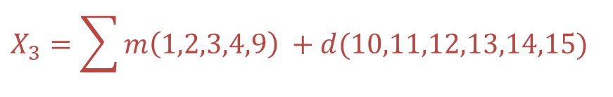
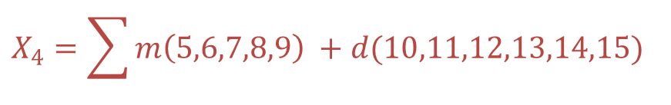
BCD to Excess-3 Code Converter
K-Map for X₄, X₃, X₂, X₁ function and their minimization are as follows:
$$X_{4}=\sum{m\left(5,6,7,8,9\right)} +d(10,11,12,13,14,15)$$
$$X_{3}=\sum{m\left(1,2,3,4,9\right)} +d(10,11,12,13,14,15)$$
B₄B₃
B₄B₃
00
01
11
10
B₂B₁
00
01
11
10
B₂B₁
0
4
12
8
0
4
12
8
00
x
1
00
1
x
1
5
13
9
1
5
13
9
01
1
x
1
01
1
x
1
3
7
15
11
3
7
15
11
11
1
x
x
11
1
x
x
2
6
14
10
2
6
14
10
10
1
x
x
10
1
x
x
X₄ = B₄ + B₃B₂ + B₃B₁
X₃ = B₃B₂’B₁’ + B₃’ B₁ + B₃’ B₂

Slide 46
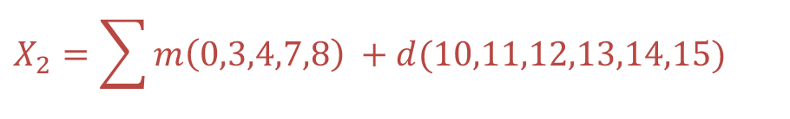
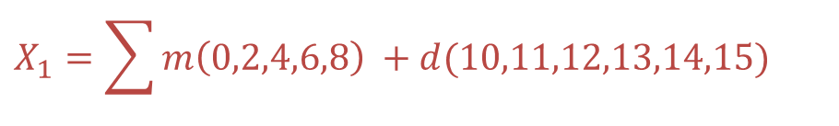
BCD to Excess-3 Code Converter
$$X_{2}=\sum{m\left(0,3,4,7,8\right)} +d(10,11,12,13,14,15)$$
$$X_{1}=\sum{m\left(0,2,4,6,8\right)} +d(10,11,12,13,14,15)$$
B₄B₃
B₄B₃
00
01
11
10
B₂B₁
00
01
11
10
B₂B₁
0
4
12
8
0
4
12
8
00
1
1
x
1
00
1
1
x
1
1
5
13
9
1
5
13
9
01
x
01
x
3
7
15
11
3
7
15
11
11
1
1
x
x
11
x
x
2
6
14
10
2
6
14
10
10
x
x
10
1
1
x
x
X₂ = B₂’B₁’ + B₂B₁
X₁ = B₁’

Slide 47
BCD to Excess-3 Code Converter
Logic diagram for a BCD to Excess-3 is as follows
B₄
B₃
B₂
X₄
B₃
B₁
B₃
B₂’
B₁’
B₃’
B₁
X₃
B₃’
B₂
B₂’
B₁’
X₂
B₂
B₁
B₁’
X₁

