Slide 1

Unit-4 Memory Management
Operating System (OS)
2101CS403
Prof. Firoz A Sherasiya
Computer Engineering Department
firoz.sherasiya@darshan.ac.in
9879879861

Slide 2

Looping
Outline
Concept of Memory
Memory abstraction
Logical and Physical address map
Memory allocation
Virtual Memory: Basics of Virtual Memory
Paging
Page Replacement Algorithms
Segmentation

Slide 3
Concept of Memory
Section - 1

Slide 4
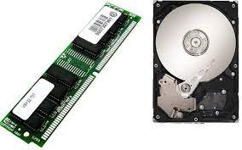
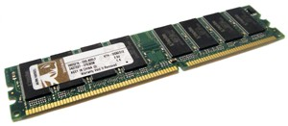
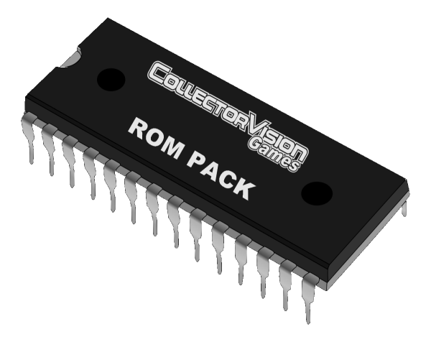
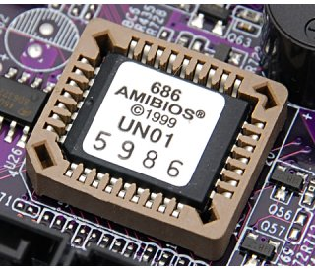
What is Memory?
Computer memory is any physical device capable of storing information temporarily or permanently.
Types of memory
Random Access Memory (RAM), is a volatile memory that loses its contents when the computer or hardware device loses power.
Read Only Memory (ROM), is a non-volatile memory, sometimes abbreviated as NVRAM, is a memory that keeps its contents even if the power is lost.
Computer uses special ROM called BIOS (Basic Input Output System) which permanently stores the software needed to access computer hardware such as hard disk and then load an operating system into RAM and start to execute it.

Slide 5
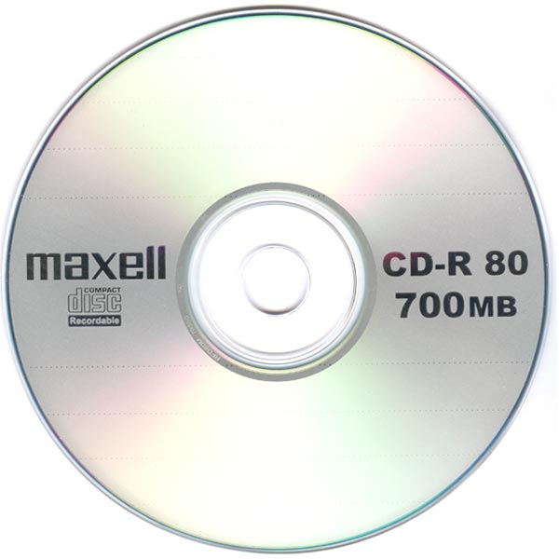
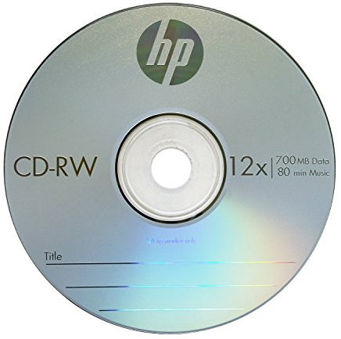

What is Memory?
Computer memory is any physical device capable of storing information temporarily or permanently.
Types of memory
Programmable Read-Only Memory (PROM), is a memory chip on which you can store a program. But once the PROM has been used, you cannot wipe it clean and use it to store something else. Like ROMs, PROMs are non-volatile. E.g CD-R
Erasable Programmable Read-Only Memory (EPROM), is a special type of PROM that can be erased by exposing it to ultraviolet light. E.g CD-RW
Electrically Erasable Programmable Read-Only Memory (EEPROM), is a special type of PROM that can be erased by exposing it to an electrical charge. E.g Pendrive

Slide 6
What is Memory Hierarchy?
The hierarchical arrangement of storage in current computer architectures is called the memory hierarchy.
Register
Local secondary storage
Remote secondary storage
L2 Cache
Main Memory
L1 Cache
Faster
Expensive
Less Capacity
Slower
Cheaper
More Capacity

Slide 7
Memory abstraction
Section - 2

Slide 8
No memory abstraction
In this model the memory presented to the programmer was simply a single block of physical memory.
having a set of addresses from 0 to some maximum
with each address corresponding to a cell containing some number of bits, commonly eight.
When program execute instruction like MOV REGISTER1, 1000
If at the same time another program execute same instruction then value of first program will be overwrite. So only one process at a time can be running.
0xFFF…
OS in ROM
0xFFF…
Driver in ROM
0xFFF…
User Program
User Program
User Program
OS in RAM
0
0
OS in RAM
0
Even with no abstraction, we can have several setups!

Slide 9
No memory abstraction
What if we want to run multiple programs?
OS saves entire memory on disk
OS brings next program
OS runs next program
We can use swapping to run multiple programs concurrently.
The process of bringing in each process in its entirely in to memory, running it for a while and then putting it back on the disk is called swapping.
0xFFF…
User Program
Swapped out
Hard Disk
Swapped in
OS in RAM
0

Slide 10
Ways to implement swapping system
Two different ways to implement swapping system
Multiprogramming with fixed partitions
Multiprogramming with dynamic partitions

Slide 11
Multiprogramming with fixed partitions
Here memory is divided into fixed sized partitions.
Size can be equal or unequal for different partitions.
Generally unequal partitions are used for better utilizations.
Each partition can accommodate exactly one process, means only single process can be placed in one partition.
The partition boundaries are not movable.
Whenever any program needs to be loaded in memory, a free partition big enough to hold the program is found. This partition will be allocated to that program or process.
If there is no free partition available of required size, then the process needs to wait. Such process will be put in a queue.
Partition 5
Partition 4
Partition 3
Partition 2
Partition 1
OS

Slide 12
Multiprogramming with fixed partitions
There are two ways to maintain queue
Using Multiple Input Queues
Using Single Input Queue
Partition 5
Partition 5
Partition 4
Partition 4
Partition 3
Partition 3
Partition 2
Partition 2
Partition 1
Partition 1
OS
OS

Slide 13
Multiprogramming with dynamic partitions
Here, memory is shared among operating system and various simultaneously running processes.
Initially, the entire available memory is treated as a single free partition.
Process is allocated exactly as much memory as it requires.
Whenever any process enters in a system, a chunk of free memory big enough to fit the process is found and allocated. The remaining unoccupied space is treated as another free partition.
If enough free memory is not available to fit the process, process needs to wait until required memory becomes available.
Whenever any process gets terminate, it releases the space occupied. If the released free space is contiguous to another free partition, both the free partitions are merged together in to single free partition.
Better utilization of memory than fixed sized size partition.
User
Program
OS

Slide 14
Multiprogramming with dynamic partitions
C
C
C
C
C
B
B
B
B
A
A
A
A
D
D
D
OS
OS
OS
OS
OS
OS
OS

Slide 15
Memory compaction
When swapping creates multiple holes in memory, it is possible to combine them all in one big hole by moving all the processes downward as far as possible. This techniques is known as memory compaction.
It requires lot of CPU time.
Process - B
Process - B
Process - A
Process - A
OS
OS

Slide 16
Multiprogramming without memory abstraction
0
32764
.
.
Partition 5 (150)
We can use static relocation at program load time
Using absolute address is wrong here
CMP
JMP 28
16412
16408
16404
16400
16392
16388
16384
Program 2
Partition 4 (400)
Program 1
Program 2
0
16380
0
16380
0
16380
Partition 3 (300)
.
.
.
.
.
.
ADD
MOV
JMP 24
28
24
20
16
8
4
0
CMP
JMP 28
28
24
20
16
8
4
0
ADD
MOV
JMP 24
28
24
20
16
8
4
0
Partition 2 (200)
Program 1
Partition 1 (100)
OS

Slide 17
Static relocation
When program was loaded at address 16384, the constant 16384 was added to every program address during the load process.
Slow
Required extra information from program
0
32764
.
.
Partition 5 (150)
CMP
JMP 16412
16412
16408
16404
16400
16392
16388
16384
Program 2
Partition 4 (400)
Program 1
Program 2
0
16380
0
16380
0
16380
Partition 3 (300)
.
.
.
.
.
.
ADD
MOV
JMP 24
28
24
20
16
8
4
0
CMP
JMP 28
28
24
20
16
8
4
0
ADD
MOV
JMP 24
28
24
20
16
8
4
0
Partition 2 (200)
Program 1
Partition 1 (100)
OS

Slide 18
Logical and Physical address map
Section - 3

Slide 19
Base and Limit register
An address space is set of addresses that a process can use to address memory.
An address space is a range of valid addresses in memory that are available for a program or process.
Two registers: Base and Limit
Base register: Start address of a program in physical memory.
Limit register: Length of the program.
For every memory access
Base is added to the address
Result compared to Limit
Only OS can modify Base and Limit register.
0
32764
.
.
CMP
JMP 16412
16412
16408
16404
16400
16392
16388
16384
0
16380
.
.
ADD
MOV
JMP 24
28
24
20
16
8
4
0

Slide 20
Dynamic relocation
Dynamic relocation refers to address transformations being done during execution of a program.
Steps in dynamic relocation
Hardware adds relocation register (base) to virtual address to get a physical address
Hardware compares address with limit register; address must be less than or equal limit
If test fails, the processor takes an address trap and ignores the physical address.
Base
Register
Limit
Register
CPU
Logical
Address
Physical
Address
Yes
MEMORY
+
<=
No
Trap: Address error

Slide 21
Managing free memory
Two ways to keep track of memory usage (free memory)
Memory management with Bitmaps
Memory management with Linked List

Slide 22
Memory management with Bitmaps
A |  |  |  | B | C |  |  | D | E |  |  |  | …….
0
8
16
24
32
1
1
1
1
0
0
0
1
1
0
1 | 1 | 1 | 1 | 1 | 0 | 0 | 0
1 | 1 | 1 | 1 | 1 | 1 | 1 | 1
1 | 1 | 0 | 0 | 1 | 1 | 1 | 1
1 | 1 | 1 | 1 | 1 | 0 | 0 | 0
: :
OS

Slide 23
Memory management with Bitmaps
A |  |  |  | B | C |  |  | D | E |  |  |  | …….
0
8
16
24
32
1 | 1 | 1 | 1 | 1 | 0 | 0 | 0
1 | 1 | 1 | 1 | 1 | 1 | 1 | 1
1 | 1 | 0 | 0 | 1 | 1 | 1 | 1
1 | 1 | 1 | 1 | 1 | 0 | 0 | 0
With bitmap, memory is divided into allocation units.
Corresponding to each allocation unit there is a bit in a bitmap.
Bit is 0 if the unit is free and 1 if unit is occupied.
The size of allocation unit is an important design issue, the smaller the size, the larger the bitmap.
The main problem is that when it has been decided to bring a k unit process, the memory manager must search the bitmap to find a run of k consecutive 0 bits in the map.
Searching a bitmap for a run of a given length is a slow operation.
: :

Slide 24
Memory management with Bitmaps
A |  |  |  | B | C |  |  | D | E |  |  |  | …….
0
8
16
24
32
(9) 1
(8) 1
(7) 1
(6) 1
(5) 0
(4) 0
(3) 0
(2) 1
1
(0) 0
P3
1 | 1 | 1 | 1 | 1 | 0 | 0 | 0
1 | 1 | 1 | 1 | 1 | 1 | 1 | 1
1 | 1 | 0 | 0 | 1 | 1 | 1 | 1
1 | 1 | 1 | 1 | 1 | 0 | 0 | 0
P2
: :
P1
H | 0 | 1
P | 1 | 2
H | 3 | 3
P | 6 | 2
P | 8 | 2
OS

Slide 25
Memory management with Linked List
Another way to keep track of memory is to maintain a linked list of allocated and free memory segments, where segment either contains a process or is an empty hole between two processes.
Each entry in the list specifies a hole (H) or process (P), the address at which it starts the length and a pointer to the next entry.
The segment list is kept sorted by address.
Sorting this way has the advantage that when a process terminates or is swapped out, updating the list is straightforward.
A terminating process normally has two neighbors (except when it is at the very top or bottom of memory).
P | 0 | 5
H | 5 | 3
P | 8 | 6
P | 14 | 4
H | 18 | 2
P | 20 | 6
P | 26 | 3
H | 29 | 3 | X
Hole
Starts at 18
Length 2
Process

Slide 26
Memory management with Linked List
P | 0 | 5
H | 5 | 3
P | 8 | 6
P | 14 | 4
H | 18 | 2
P | 20 | 6
P | 26 | 3
H | 29 | 3 | X
Neighbors
Before P terminate
After P terminate
A | P | B
P is replaced by H
A |  | B
P is replaced by H
and two H are merged
A | P
A
P is replaced by H
and two H are merged
 | P | B
 | B
P is replaced by H
and three H are merged
 | P

Slide 27
Memory allocation
Section - 4

Slide 28
Multiprogramming with fixed partitions
Partition 5 (150)
Process 6 (195)
Partition 4 (400)
Process 5 (295)
Partition 3 (300)
Partition 2 (200)
Process 2 (295)
Process 3 (125)
Process 4 (125)
Partition 1 (100)
Process 1 (95)
OS

Slide 29
Memory allocation
Four memory allocation algorithms are as follow
First fit
Next fit
Best fit
Worst fit

Slide 30
First fit
Search starts from the starting location of the memory.
First available hole that is large enough to hold the process is selected for allocation.
The hole is then broken up into two pieces, one for process and another for unused memory.
Example: Processes of 212K, 417K, 112K and 426K arrives in order.
Here process of size 426k will not get any partition for allocation.
Fastest algorithm because it searches as little as possible.
Memory loss is higher, as very large hole may be selected for small process.
100k
500k
200k
300k
600k
100k
500k
288k
176k
200k
300k
600k
183k
212k
112k
417k

Slide 31
Next fit
It works in the same way as first fit, except that it keeps the track of where it is whenever it finds a suitable hole.
The next time when it is called to find a hole, it starts searching the list from the place where it left off last time.
Example: Processes of 212K, 417K, 112K and 426K arrives in order.
Here process of size 426k will not get any partition for allocation.
Search time is smaller.
Memory manager must have to keep track of last allotted hole to process.
It gives slightly worse performance than first fit.
100k
500k
200k
300k
600k
100k
500k
288k
200k
300k
600k
183k
71k
212k
417k
112k

Slide 32
Best fit
Entire memory is searched here.
The smallest hole, which is large enough to hold the process, is selected for allocation.
Example: Processes of 212K, 417K, 112K and 426K arrives in order.
Search time is high, as it searches entire memory every time.
Memory loss is less.
100k
500k
200k
300k
600k
100k
500k
83k
200k
88k
300k
88k
600k
174k
417k
112k
212k
426k

Slide 33
Worst fit
Entire memory is searched here also. The largest hole, which is largest enough to hold the process, is selected for allocation.
Example: Processes of 212K, 417K, 112K and 426K arrives in order.
Here process of size 426k will not get any partition for allocation.
Search time is high, as it searches entire memory every time.
This algorithm can be used only with dynamic partitioning.
100k
500k
200k
300k
600k
100k
500k
83k
200k
300k
600k
388k
276k
417k
212k
112k

Slide 34
Virtual Memory: Basics of Virtual Memory
Section - 5

Slide 35
Virtual Memory
Memory is hardware that your computer uses to load the operating system and run programs.
Computer consists of one or more RAM chips that each have several memory modules.
The amount of real memory in a computer is limited to the amount of RAM installed. Common memory sizes are 1GB, 2GB, and 4GB.
Because your computer has a finite amount of RAM, it is possible to run out of memory when too many programs are running at one time.
This is where virtual memory comes into the picture.
Virtual memory increases the available memory of your computer by enlarging the "address space," or places in memory where data can be stored.
It does this by using hard disk space for additional memory allocation.
However, since the hard drive is much slower than the RAM, data stored in virtual memory must be mapped back to real memory in order to be used.

Slide 36
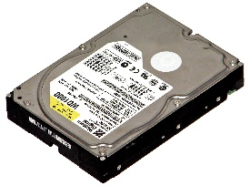
Virtual Memory
Each program has its own address space, which is broken up into pages.
Each page is a contiguous range of addresses.
These pages are mapped onto the physical memory but, to run the program, all pages are not required to be present in the physical memory.
The operating system keeps those parts of the program currently in use in main memory, and the rest on the disk.
In a system using virtual memory, the physical memory is divided into page frames and the virtual address space is divided in into equally-sized partitions called pages.
Virtual memory works fine in a multiprogramming system, with bits and pieces of many programs in memory at once.
RAM
RAM
HDD
RAM
HDD
Another Process’s Memory
RAM
Virtual Address space
HDD

Slide 37
Paging
Section - 6

Slide 38
Paging
Paging is a storage mechanism used to retrieve processes from the secondary storage (Hard disk) into the main memory (RAM) in the form of pages.
40K – 44K
36K – 40K
32K – 36K
28K – 32K
24K – 28K
20K – 24K
16K – 20K
12K – 16K
8K – 12K
4K – 8K
0K – 4K
Page 11
Page 10
Page 9
Page 8
Page 7
Page 6
Page 5
Page 4
Page 3
Page 2
Page 1
The main idea behind the paging is to divide each process in the form of pages. The main memory will also be divided in the form of frames.
One page of the process is to be stored in one of the frames of the memory.
Virtual page
Virtual Address Space
Physical Memory Address
Page frame
Frame 6
Frame 5
Frame 4
Frame 3
Frame 2
Frame 1
20K – 24K
16K – 20K
12K – 16K
8K – 12K
4K – 8K
0K – 4K

Slide 39
Paging
The pages can be stored at the different locations of the memory but the priority is always to find the contiguous frames or holes.
Pages of the process are brought into the main memory only when they are required otherwise they reside in the secondary storage.
The sizes of each frame must be equal. Considering the fact that the pages are mapped to the frames in Paging, page size needs to be as same as frame size.
Different operating system defines different frame sizes.

Slide 40
Paging
Process 4
Frame 12
Frame 11
Frame 10
Frame 9
Frame 8
Frame 7
Frame 6
Frame 5
Frame 4
Frame 3
Frame 2
Frame 1
Process 3
Page 3
Page 2
Page 1
Page 3
Page 2
Page 1
Process 1 and process 4 are moved out from memory and process 5 enters into memory.
Process 1
Process 2
Page 3
Page 2
Page 1
Page 3
Page 2
Page 1

Slide 41
Paging
Process 5
Frame 12
Frame 11
Frame 10
Frame 9
Frame 8
Frame 7
Frame 6
Frame 5
Frame 4
Frame 3
Frame 2
Frame 1
Process 3
Page 6
Page 5
Page 4
Page 3
Page 2
Page 1
Page 3
Page 2
Page 1
Process 2
We have 6 non contiguous frames available in the memory and paging provides the flexibility of storing the process at the different places.
Page 3
Page 2
Page 1

Slide 42
Paging
Size of Virtual Address Space is greater than that of main memory, so instead of loading entire address space in to memory to run the process, MMU copies only required pages into main memory.
In order to keep the track of pages and page frames, OS maintains a data structure called page table.
40K – 44K
36K – 40K
32K – 36K
28K – 32K
24K – 28K
20K – 24K
16K – 20K
12K – 16K
8K – 12K
4K – 8K
0K – 4K
5
3
4
0
1
2
Virtual page
Virtual Address Space
Physical Memory Address
Page frame
5
4
3
2
1
0
20K – 24K
16K – 20K
12K – 16K
8K – 12K
4K – 8K
0K – 4K

Slide 43
Logical Address vs Physical Address
Logical Address is generated by CPU while a program is running. The logical address is virtual address as it does not exist physically therefore it is also known as Virtual Address.
Physical Address identifies a physical location of required data in a memory. The user never directly deals with the physical address but can access by its corresponding logical address.
The hardware device called Memory-Management Unit is used for mapping (converting) logical address to its corresponding physical address.

Slide 44
Conversion of virtual address to physical address
When virtual memory is used, the virtual address is presented to an MMU (Memory Management Unit) that maps the virtual addresses onto the physical memory addresses.
We have a computer generated 16-bit addresses, from 0 up to 44K. These are the virtual addresses.
40K – 44K
36K – 40K
32K – 36K
28K – 32K
24K – 28K
20K – 24K
16K – 20K
12K – 16K
8K – 12K
4K – 8K
0K – 4K
5
3
4
0
1
2
With 44 KB of virtual address space , we get 11 virtual pages and with 24 KB of physical memory, we get 6 page frames.
Virtual page
Virtual Address Space
Physical Memory Address
Page frame
5
4
3
2
1
0
20K – 24K
16K – 20K
12K – 16K
8K – 12K
4K – 8K
0K – 4K

Slide 45
Conversion of virtual address to physical address
However, only 24KB of physical memory is available, so although 44KB programs can be written, they cannot be loaded in to memory in their entirety and run.
A complete copy of a program’s core image, up to 44 KB, must be present on the disk.
Only required pages are loaded in the physical memory.
Transfers between RAM and disk are always in units of a page.
40K – 44K
36K – 40K
32K – 36K
28K – 32K
24K – 28K
20K – 24K
16K – 20K
12K – 16K
8K – 12K
4K – 8K
0K – 4K
5
3
4
0
1
2
Virtual page
Virtual Address Space
Physical Memory Address
Page frame
5
4
3
2
1
0
20K – 24K
16K – 20K
12K – 16K
8K – 12K
4K – 8K
0K – 4K

Slide 46
Internal operation of the MMU
Outgoing physical address (24580)
1 | 1 | 0
0 | 0 | 0 | 0 | 0 | 0 | 0 | 0 | 0 | 1 | 0 | 0
15
14
13
12
11
10
9
8
7
6
5
4
3
2
1
0
000 | 0
000 | 0
000 | 0
000 | 0
111 | 1
000 | 0
101 | 1
000 | 0
000 | 0
000 | 0
011 | 1
100 | 1
000 | 1
110 | 1
001 | 1
010 | 1
12 bit offset
copied directly from input to output
Page Table
Virtual page=2
is used as an index into the page table
110
Present/
Absent bit
0 | 0 | 1 | 0 | 0 | 0 | 0 | 0 | 0 | 0 | 0 | 0 | 0 | 1 | 0 | 0
Incoming logical address (8196)

Slide 47
Internal operation of the MMU
The virtual address is split into a virtual page number (high order bits) and an offset (low-order bits).
With a 16-bit address and a 4KB page size, the upper 4 bits could specify one of the 11 virtual pages and the lower 12 bits would then specify the byte offset (0 to 4095) within the selected page.
The virtual page number is used as an index into the Page table.
If the present/absent bit is 0, it is page-fault; a trap to the operating system is caused to bring required page into main memory.
If the present/absent bit is 1, required page is there with main memory and page frame number found in the page table is copied to the higher order bit of the output register along with the offset.
Together Page frame number and offset creates physical address.
Physical Address = Page frame Number + offset of virtual address.

Slide 48
Page table
Page table is a data structure which translates virtual address into equivalent physical address.
The virtual page number is used as an index into the Page table to find the entry for that virtual page and from the Page table physical page frame number is found.
Thus the purpose of page table is to map virtual pages onto page frames.
The page table of the process is held in the kernel space.

Slide 49
Page table
Page frame Number: It gives the frame number in which the current page you are looking for is present.
Present/Absent bit: Present or absent bit says whether a particular page you are looking for is present or absent. If it is not present, that is called Page Fault. It is set to 0 if the corresponding page is not in memory. Sometimes this bit is also known as valid/invalid bits.
Protection bits: Protection bit says that what kind of protection you want on that page. In the simplest form, 0 for read/write and 1 for read only.
Modified bit: Modified bit says whether the page has been modified or not. If the page in memory has been modified, it must be written back to disk. This bit is also called as dirty bit as it reflects the page’s state.
Referenced bit: A references bit is set whenever a page is referenced, either for reading or writing. Its value helps operating system in page replacement algorithm.
Cashing Disabled bit: This feature is important for pages that maps onto device registers rather than memory. With this bit cashing can be turned off.
 |  |  |  |  |  | Page frame number
Caching Disabled
Referenced
Modified
Protection
Present/ absent

Slide 50
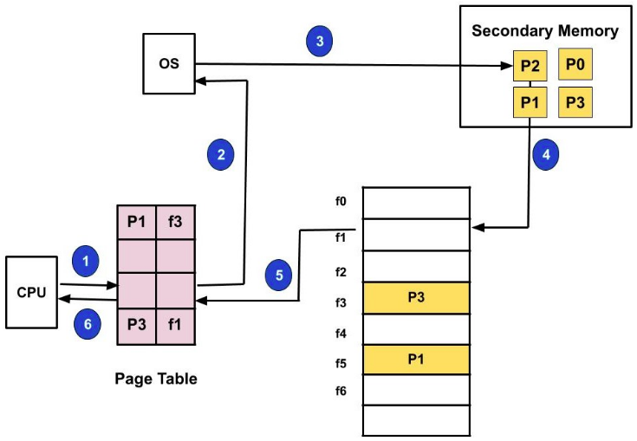
Definitions (Demand paging)
Demand paging: Demand paging is a technique used in virtual memory systems where the pages are brought in the main memory only when required or demanded by the CPU.
Suppose we have to execute a process P having four pages as P0, P1, P2, and P3.
We have page P1 and P3 in the page table.
Now, if the CPU wants to access page P2 of a process P
search the page in the page table
P2 is not available in page table so page fault
OS bring P2 from HDD to RAM
OS will update page table
Process P will be executed.

Slide 51
Demand paging
Now, if the CPU wants to access page P2 of a process P, first it will search the page in the page table.
As the page table does not contain this page so it will be a trap or page fault. As soon as the trap is generated and context switching happens and the control goes to the operating system.
The OS system will put the process in a waiting/ blocked state. The OS system will now search that page in the backing store or secondary memory.
The OS will then read the page from the backing store and load it to the main memory.
Next, the OS system will update the page table entry accordingly.
Finally, the control is taken back from the OS and the execution of the process is resumed.
Hence whenever a page fault occurs these steps are followed by the operating system and the required page is brought into memory.

Slide 52
Definitions
Pre-paging: Many paging systems try to keep track of each process‘s working set and make sure that it is in memory before letting the process run. Loading pages before allowing processes to run is called pre-paging.
Working Set: The set of pages that a process is currently using is known as working set.
Thrashing: Thrashing is a condition or a situation when the system is spending a major portion of its time in servicing the page faults, but the actual processing done is very negligible.

Slide 53
Issues in Paging
In any paging system, two major issues must be faced:
The mapping from virtual address to physical address must be fast.
If the virtual address space is large, the page table will be large.

Slide 54
Mapping from virtual address to physical address must be fast
Logical Address
P
D
F3
D
Physical Address
P2
Memory
Performance is reduced by half
CPU
For every instruction
Memory reference occur two time
Use a hardware
TLB (Translation Lookaside Buffer)
Page Table
Page | Frame
P1 | F2
P2 | F3
P3 | F1

Slide 55
Mapping from virtual address to physical address must be fast
Logical Address
P
D
F3
Physical Address
F1
D
P3
P2
TLB
Memory
Page | Frame
P1 | F2
P2 | F3
CPU
Hardware
Page Table
Page | Frame
P1 | F2
P2 | F3
P3 | F1
Data Structure
Inside kernel

Slide 56
Mapping from virtual address to physical address using TLB
Steps in TLB hit:
CPU generates virtual address.
It is checked in TLB (present).
Corresponding frame number is retrieved, which now tells where in the main memory page lies.
Steps in Page miss:
CPU generates virtual address.
It is checked in TLB (not present).
Now the page number is matched to page table residing in main memory.
Corresponding frame number is retrieved, which now tells where in the main memory page lies.
The TLB is updated with new Page Table Entry (if space is not there, one of the replacement technique comes into picture i.e either FIFO, LRU or MFU etc).

Slide 57
Virtual address space is large, the page table will be large
Two different ways to deal with large page table problems:
Multilevel Page Table
Inverted Page Table

Slide 58
Multilevel Page Table
Logical Address
PT1
10 bit
PT2
10 bit
Offset
12 bits
F202
D
Physical Address
2
P2
Page | Frame
P1 | F101
P2 | F102
Memory
CPU
Page | Pointer
1
2
3
Page | Frame
P1 | F201
P2 | F202
Page | Frame
P1 | F301
P2 | F302

Slide 59
Inverted Page Table
Current process ID - 245
Process IDs do not match.
So follow chaining pointer
Page No 2 | Offset
Frame No | Page No | Process ID | Pointer
1 | 2 | 211
2
3
4 | 2 | 245
5
6
Hash Function
Process IDs match.
So frame no added to physical address.
Frame No 4 | Offset
Physical Address

Slide 60
Inverted Page Table
Each entry in the page table contains the following fields.
Page number – It specifies the page number range of the logical address.
Process id – An inverted page table contains the address space information of all the processes in execution.
Since two different processes can have similar set of virtual addresses, it becomes necessary in Inverted Page Table to store a processID of each process to identify it’s address space uniquely.
This is done by using the combination of PID and Page Number. So this Process Id acts as an address space identifier and ensures that a virtual page for a particular process is mapped correctly to the corresponding physical frame.
Control bits – These bits are used to store extra paging-related information. These include the valid bit, dirty bit, reference bits, protection and locking information bits.
Chained pointer – It may be possible sometime that two or more processes share a part of main memory.
In this case, two or more logical pages map to same Page Table Entry then a chaining pointer is used to map the details of these logical pages to the root page table.

Slide 61
Segmentation
Section - 8

Slide 62
Segmentation
Process P
Segment Map Table
Segmentation is a memory management technique in which each job is divided into several segments of different sizes, one for each module that contains pieces that perform related functions.
Each segment is actually a different logical address space of the program.
When a process is to be executed, its corresponding segmentation are loaded into non-contiguous memory though every segment is loaded into a contiguous block of available memory.
Segmentation memory management works very similar to paging but here segments are of variable-length where as in paging pages are of fixed size.
Segment 1
Sr | Size | Memory Address
1 | 300 | 100
2 | 500 | 400
3 | 100 | 900
N | X | NM
Physical Memory
100
200
300
400
500
600
700
800
900
1000
1100
Segment 2
Segment 3
Segment N

Slide 63
Segmentation
Process P
Segment Map Table
A program segment contains the program's main function, utility functions, data structures, and so on.
The operating system maintains a segment map table for every process.
Segment map table contains list of free memory blocks along with segment numbers, their size and corresponding memory locations in main memory.
For each segment, the table stores the starting address of the segment and the length of the segment.
A reference to a memory location includes a value that identifies a segment and an offset.
Segment 1
Sr | Size | Memory Address
1 | 300 | 100
2 | 500 | 400
3 | 100 | 900
N | X | NM
Physical Memory
100
200
300
400
500
600
700
800
900
1000
1100
Segment 2
Segment 3
Segment N

Slide 64
Paging VS Segmentation
Paging | Segmentation
Paging was invented to get large address space without having to buy more physical memory. | Segmentation was invented to allow programs and data to be broken up into logically independent address space and to add sharing and protection.
The programmer does not aware that paging is used. | The programmer is aware that segmentation is used.
Procedure and data cannot be distinguished and protected separately. | Procedure and data can be distinguished and protected separately.
Change in data or procedure requires compiling entire program. | Change in data or procedure requires compiling only affected segment not entire program.
Sharing of different procedures not available. | Sharing of different procedures available.

Slide 65
Page Replacement Algorithms
Section - 7

Slide 66
Page replacement algorithms
Frame
Page
RAM
Hard Disk
0xFFF…
Program 1
Program 2
Program 1
Program 2
Program 3
Program 4
Program 3
Program 4
OS in RAM
0

Slide 67
Page replacement algorithms
Following are different types of page replacement algorithms
Optimal Page Replacement Algorithm
FIFO Page Replacement Algorithm
The Second Chance Page Replacement Algorithm
The Clock Page Replacement Algorithm
LRU (Least Recently Used) Page Replacement Algorithm
NRU (Not Recently Used)

Slide 68
FIFO Page Replacement Algorithm
The first in first out page replacement algorithm is the simplest page replacement algorithm.
The operating system maintains a list of all pages currently in memory, with the most recently arrived page at the tail and least recent at the head.
On a page fault, the page at head is removed and the new page is added to the tail.
When a page replacement is required the oldest page in memory needs to be replaced.
The performance of the FIFO algorithm is not always good because it may happen that the page which is the oldest is frequently referred by OS.
Hence removing the oldest page may create page fault again.

Slide 69
FIFO Page Replacement Algorithm
Page Reference String:
7, 0, 1, 2, 0, 3, 0, 4, 2, 3, 0, 3, 2, 1, 2, 0, 1, 7, 0, 1
Three frames
Page Request | 7 | 0 | 1 | 2 | 0 | 3 | 0 | 4 | 2 | 3 | 0 | 3 | 2 | 1 | 2 | 0 | 1 | 7 | 0 | 1
Frame – 1 | 7 | 7 | 7 | 2 | 2 | 2 | 2 | 4 | 4 | 4 | 0 | 0 | 0 | 0 | 0 | 0 | 0 | 7 | 7 | 7
Frame – 2 |  | 0 | 0 | 0 | 0 | 3 | 3 | 3 | 2 | 2 | 2 | 2 | 2 | 1 | 1 | 1 | 1 | 1 | 0 | 0
Frame – 3 |  |  | 1 | 1 | 1 | 1 | 0 | 0 | 0 | 3 | 3 | 3 | 3 | 3 | 2 | 2 | 2 | 2 | 2 | 1
Page Faults (15) | F | F | F | F |  | F | F | F | F | F | F |  |  | F | F |  |  | F | F | F

Slide 70
Optimal Page Replacement Algorithm
The moment a page fault occurs, some set of pages will be in the memory.
One of these pages will be referenced on the very next instruction.
Other pages may not be referenced until 10, 100, or perhaps 1000 instructions later.
Each page can be labeled with the number of instructions that will be executed before that page is first referenced.
The optimal page algorithm simply says that the page with the highest label should be removed.
The only problem with this algorithm is that it is unrealizable.
At the time of the page fault, the operating system has no way of knowing when each of the pages will be referenced next.

Slide 71
Optimal Page Replacement Algorithm
Page Reference String:
7, 0, 1, 2, 0, 3, 0, 4, 2, 3, 0, 3, 2, 0, 2, 0, 1, 7, 0, 1
Three frames
Page Request | 7 | 0 | 1 | 2 | 0 | 3 | 0 | 4 | 2 | 3 | 0 | 3 | 2 | 0 | 2 | 0 | 1 | 7 | 0 | 1
Frame – 1 | 7 | 7 | 7 | 2 | 2 | 2 | 2 | 2 | 2 | 2 | 2 | 2 | 2 | 2 | 2 | 2 | 1 | 1 | 1 | 1
Frame – 2 |  | 0 | 0 | 0 | 0 | 0 | 0 | 4 | 4 | 4 | 0 | 0 | 0 | 0 | 0 | 0 | 0 | 0 | 0 | 0
Frame – 3 |  |  | 1 | 1 | 1 | 3 | 3 | 3 | 3 | 3 | 3 | 3 | 3 | 3 | 3 | 3 | 3 | 7 | 7 | 7
Page Faults (9) | F | F | F | F |  | F |  | F |  |  | F |  |  |  |  |  | F | F

Slide 72
Second Chance Page Replacement Algorithm
It is modified form of the FIFO page replacement algorithm.
It looks at the front of the queue as FIFO does, but instead of immediately paging out that page, it checks to see if its referenced bit is set.
If it is not set (zero), the page is swapped out.
Otherwise, the referenced bit is cleared, the page is inserted at the back of the queue (as if it were a new page) and this process is repeated.
Page loaded
first
1
0
1
0
1
Most recently loaded page
A
B
C
D
E
0
1
0
1
0
Remove
B
C
D
E
A
Add at end
1
0
1
0
1
C
D
E
A
F

Slide 73
Second Chance Page Replacement Algorithm
If all the pages have their referenced bit set, on the second encounter of the first page in the list, that page will be swapped out, as it now has its referenced bit cleared.
If all the pages have their reference bit cleared, then second chance algorithm degenerates into pure FIFO.
1
1
1
1
1
A
B
C
D
E
0
0
0
0
0
A
B
C
D
E
0
0
0
0
1
B
C
D
E
F

Slide 74
Clock Page Replacement Algorithm
In second chance algorithm pages are constantly moving around on its list. So it is not working efficiently.
A better approach is to keep all the page frames on a circular list in the form of a clock.
When a page fault occurs, the page being pointed to by the hand is inspected.
If its R bit is 0, the page is evicted, the new page is inserted into the clock in its place, and the hand is advanced one position.
If R is 1, it is cleared and the hand is advanced to the next page.
1
A
1
1
0
G
G
F
B
1
A hand points to the oldest page.
1
0
E
C
H
0
1
H
D

Slide 75
LRU (Least Recently Used) Page Replacement Algorithm
A good approximation to the optimal algorithm is based on the observation that pages that have been heavily used in last few instructions will probably be heavily used again in next few instructions.
When page fault occurs, throw out the page that has been used for the longest time. This strategy is called LRU (Least Recently Used) paging.
To fully implement LRU, it is necessary to maintain a linked list of all pages in memory, with the most recently used page at the front and the least recently used page at the rear.
The list must be updated on every memory reference.
Finding a page in the list, deleting it, and then moving it to the front is a very time consuming operations.

Slide 76
LRU (Least Recently Used) Page Replacement Algorithm
Page Reference String:
7, 0, 1, 2, 0, 3, 0, 4, 2, 3, 0, 3, 2, 1, 2, 0, 1, 7, 0, 1
Three frames
Page Request | 7 | 0 | 1 | 2 | 0 | 3 | 0 | 4 | 2 | 3 | 0 | 3 | 2 | 1 | 2 | 0 | 1 | 7 | 0 | 1
Frame – 1 | 7 | 7 | 7 | 2 | 2 | 2 | 2 | 4 | 4 | 4 | 0 | 0 | 0 | 1 | 1 | 1 | 1 | 1 | 1 | 1
Frame – 2 |  | 0 | 0 | 0 | 0 | 0 | 0 | 0 | 0 | 3 | 3 | 3 | 3 | 3 | 3 | 0 | 0 | 0 | 0 | 0
Frame – 3 |  |  | 1 | 1 | 1 | 3 | 3 | 3 | 2 | 2 | 2 | 2 | 2 | 2 | 2 | 2 | 2 | 7 | 7 | 7
Page Faults (12) | F | F | F | F |  | F |  | F | F | F | F |  |  | F |  | F |  | F

Slide 77
NRU (Not Recently Used) Page Replacement Algorithm
NRU makes approximation to replace the page based on R (referenced) and M (modified) bits.
When a process is started up, both page bits for all pages are set to 0 by operating system.
Periodically, the R bit is cleared, to distinguish pages that have not been referenced recently from those that have been.
When page fault occurs, the operating system inspects all the pages and divide them into 4 categories based on current values of their R and M bits
Case 0 : not referenced, not modified
Case 1 : not referenced, modified
Case 2 : referenced, not modified
Case 3 : referenced, modified
The NRU (Not Recently Used) algorithm removes a page at random from the lowest numbered nonempty class.

Slide 78
NRU (Not Recently Used) Page Replacement Algorithm
For example if,
Page-0 is of class-2 (referenced, not modified)
Page-1 is of class-1 (not referenced, modified)
Page-2 is of class-0 (not referenced, not modified)
Page-3 is of class-3 (referenced, modified)
So lowest class page-2 needs to be replaced by NRU.

Slide 79
Belady’s Anomaly (in FIFO Page Replacement Algorithm)
Page Reference String: 1, 2, 3, 4, 1, 2, 5, 1, 2, 3, 4, 5
Page Faults of 4 Frame > Page Faults of 3 Frame
Page Request | 1 | 2 | 3 | 4 | 1 | 2 | 5 | 1 | 2 | 3 | 4 | 5
Three Frames
Frame – 1 | 1 | 1 | 1 | 4 | 4 | 4 | 5 | 5 | 5 | 5 | 5 | 5
Frame – 2 |  | 2 | 2 | 2 | 1 | 1 | 1 | 1 | 1 | 3 | 3 | 3
Frame – 3 |  |  | 3 | 3 | 3 | 2 | 2 | 2 | 2 | 2 | 4 | 4
Page Faults (9) | F | F | F | F | F | F | F |  |  | F | F
Page Request | 1 | 2 | 3 | 4 | 1 | 2 | 5 | 1 | 2 | 3 | 4 | 5
Frame – 1 | 1 | 1 | 1 | 1 | 1 | 1 | 5 | 5 | 5 | 5 | 4 | 4
Frame – 2 |  | 2 | 2 | 2 | 2 | 2 | 2 | 1 | 1 | 1 | 1 | 5
Frame – 3 |  |  | 3 | 3 | 3 | 3 | 3 | 3 | 2 | 2 | 2 | 2
Frame – 4 |  |  |  | 4 | 4 | 4 | 4 | 4 | 4 | 3 | 3 | 3
Four Frames
Page Faults (10) | F | F | F | F |  |  | F | F | F | F | F | F

Slide 80
Belady’s Anomaly (in FIFO Page Replacement Algorithm)
Belady’s anomaly is the phenomenon in which increasing the number of page frames results in an increase in the number of page faults for certain memory access patterns.
This phenomenon is commonly experienced when using the First-In First-Out (FIFO) page replacement algorithm.
In FIFO, the page fault may or may not increase as the page frames increase, but in Optimal and stack-based algorithms like LRU, as the page frames increase the page fault decreases.

Slide 81
Sum
A computer has four page frames. The time of loading, time of last access and the R and M bit for each page given below. Which page FIFO, LRU and NRU will replace.
Page | Loaded | Last used | R | M
0 | 126 | 280 | 1 | 0
1 | 230 | 265 | 0 | 1
2 | 140 | 270 | 0 | 0
3 | 110 | 285 | 1 | 1
FIFO:- Page which is arrived first needs to be removed first, so page-3 needs to replace.
LRU:- When page fault occurs, throw out the page that has been used for the longest time.
Page-1 is not used for the long time from all four, so LRU suggest replacing page-1.
NRU:-
Page-0 is of class-2 (referenced, not modified)
Page-1 is of class-1 (not referenced, modified)
Page-2 is of class-0 ( not referenced, not modified)
Page-3 is of class-3 (referenced, modified)
So lowest class page-2 needs to be replaced by NRU

Slide 82
IMP Questions
Explain multiprogramming with fixed partition.
Explain link list method for dynamic memory management.
How free space can be managed by OS.
Explain Swapping and Fragmentation in detail.
What is Paging? Explain paging mechanism in MMU with example.
Explain TLB and Virtual Memory.
Discuss demand paging.
Define following Terms: Thrashing
List different Page Replacement Algorithms? Discuss it in terms of page faults.
What is Belady’s anomaly? Explain with suitable example.
Consider (70120304230321201701) page reference string: How many page fault would occur for following page replacement algorithm. Consider 3 frames and 4 frames.
1. FIFO 2. LRU 3. Optimal

Slide 83
IMP Questions
Given six Partition of 300KB, 600KB, 350KB, 200KB, 750KB and 125KB(in order), how would the first-fit, best-fit and worst-fit algorithms places processes of size 115 KB, 500KB, 358KB, 200KB and 375KB(in order)? Which algorithm is efficient for the use of memory?
Calculate the page fault rates for below reference string in case of FIFO and Optimal page replacement algorithm. Assume the memory size is 4 page frames and all frames are initially empty. 0,2,1,6,4,0,1,0,3,1,2,1
Consider the following reference string. Calculate the page fault rates for FIFO and OPTIMAL page replacement algorithm. Assume the memory size is 4 page frame.
1,2,3,4,5,3,4,1,6,7,8,7,8,9,7,8,9,5,4,5,4,2
Consider the page reference string: 1,2,3,4,5,3,4,1,6,7,8,7,8,9,7,8,9,5,4,5,4,2 With four Frames How many page faults would occur for the FIFO, Optimal page replacement algorithms? which algorithm is efficient? (assume all frames are initially empty)

Slide 84
Operating Systems (OS)
2101CS403
Prof. Firoz A Sherasiya
Computer Engineering Department
firoz.sherasiya@darshan.ac.in
9879879861

