Slide 1

Unit-5 I/O Management and File Management
Operating System (OS)
2101CS403
Prof. Firoz A Sherasiya
Computer Engineering Department
firoz.sherasiya@darshan.ac.in
9879879861

Slide 2
✓
Looping
Outline
I/O Devices
Organization of I/O functions
Operating System Design issues
I/O Buffering
Disk Arm Scheduling Algorithm
FCFS/FIFO
SSTF
SCAN
C-SCAN
LOOK
C-LOOK
RAID

Slide 3
I/O devices
Section - 1

Slide 4
I/O devices
External devices that engage in I/O with computer systems can be grouped into 3 categories:
Human readable, suitable for communicating with the computer user.
Examples: printers, terminals, video display, keyboard, mouse
Machine readable, suitable for communicating with electronic equipment.
Examples: disk drives, USB keys, sensors, controllers
Communication, suitable for communicating with remote devices.
Examples: modems, digital line drivers

Slide 5
Organization of I/O functions
Section - 2

Slide 6
Organization of I/O functions
Three techniques for performing I/O are:
Programmed I/O, the processor issues an I/O command on behalf of a process to an I/O module; that process then busy waits for the operation to be completed before proceeding.
Interrupt-driven I/O, the processor issues an I/O command on behalf of a process
if non-blocking – processor continues to execute instructions from the process that issued the I/O command
if blocking – the next instruction the processor executes is from the OS, which will put the current process in a blocked state and schedule another process
Direct Memory Access (DMA), a DMA module controls the exchange of data between main memory and an I/O module

Slide 7
Direct Memory Access
Feature of computer systems that allows certain hardware subsystems to access main memory (RAM), independent of the central processing unit (CPU).
Without DMA, when the CPU is using programmed input/output, it is typically fully occupied for the entire duration of the read or write operation, and is thus unavailable to perform other work.
With DMA, the CPU first initiates the transfer, then it does other operations while the transfer is in progress, and it finally receives an interrupt from the DMA controller when the operation is done.
This feature is useful when the CPU needs to perform useful work while waiting for a relatively slow I/O data transfer.
Many hardware systems such as disk drive controllers, graphics cards, network cards and sound cards use DMA.

Slide 8
Disk read-write without a DMA
The disk controller reads the block from the drive serially, bit by bit, until the entire block is in the controller’s buffer.
Next, it computes the checksum to verify that no read errors have occurred.
Then the controller causes an interrupt, so that OS can read the block from controller’s buffer (a byte or a word at a time) by executing a loop.
After reading every single part of the block from controller device register, the operating system will store them into the main memory.
Drive
Buffer
Disk
Controller
Main
Memory
CPU
Bus

Slide 9
Disk read-write using DMA
1. CPU programs DMA controller
Drive
Buffer
DMA Controller
Disk
Controller
Main
Memory
CPU
Bus
Step 1: First the CPU programs the DMA controller by setting its registers so it knows what to transfer where.
It also issues a command to the disk controller telling it to read data from the disk into its internal buffer and verify the checksum.
When valid data are in the disk controller’s buffer, DMA can begin.

Slide 10
Disk read-write using DMA
1. CPU programs DMA controller
Drive
Buffer
2. DMA requests transfer to memory
DMA Controller
Disk
Controller
Main
Memory
CPU
Bus
Step 2: The DMA controller initiates the transfer by issuing a read request over the bus to the disk controller.
This read request looks like any other read request, and the disk controller does not know (or care) whether it came from the CPU or from a DMA controller.

Slide 11
Disk read-write using DMA
1. CPU programs DMA controller
Drive
Buffer
2. DMA requests transfer to memory
DMA Controller
Disk
Controller
3. Data transferred
Main
Memory
CPU
Bus
Typically, the memory address to write to is on the bus’ address lines, so when the disk controller fetches the next word from its internal buffer, it knows where to write it.
Step 3: The write to memory is another standard bus cycle.

Slide 12
Disk read-write using DMA
1. CPU programs DMA controller
Drive
Buffer
4. ACK
2. DMA requests transfer to memory
DMA Controller
Disk
Controller
3. Data transferred
Main
Memory
CPU
Bus
Step 4: When the write is complete, the disk controller sends an acknowledgement signal to the DMA controller, also over the bus.
The DMA controller then increments the memory address to use and decrements the byte count.
If the byte count is still greater than 0, steps 2 to 4 are repeated until it reaches 0.

Slide 13
Disk read-write using DMA
1. CPU programs DMA controller
Drive
Buffer
4. ACK
2. DMA requests transfer to memory
DMA Controller
Disk
Controller
3. Data transferred
Main
Memory
CPU
Bus
At that time, the DMA controller interrupts the CPU to let it know that the transfer is now complete.
When the OS starts up, it does not have to copy the disk block to memory; it is already there.

Slide 14
Operating System Design issues
Section - 3

Slide 15
Operating System Design issues
Design objectives: Two objectives are paramount in designing the I/O facility.
Efficiency
The system should minimize resource usage, such as CPU time and memory, and maximize throughput.
Efficiency is concerned with minimizing resource usage, such as CPU time and memory, and maximizing throughput, which means the system can perform a larger number of I/O operations in a given amount of time.
Efficiency is important because I/O operations often form a bottleneck in a computing system.
Most I/O devices are extremely slow compared with main memory and the processor.
Generality
The system should be able to handle a wide range of devices and types of I/O operations in a consistent manner.
It is desirable to handle all devices in a uniform manner.
Applies to the way processes view I/O devices and the way the operating system manages I/O devices and operations.
Because of the diversity of device characteristics, it is difficult in practice to achieve true generality.
What can be done is to use a hierarchical, modular approach to the design of the I/O function.
This approach hides most of the details of device I/O in lower-level routines so that user processes and upper levels of the OS see devices in terms of general functions, such as read, write, open, close, lock, and unlock.

Slide 16
I/O Buffering
Section - 4

Slide 17
Buffering
Perform input transfers in advance of requests being made and perform output transfers some time after the request is made is called buffering.
Types of I/O devices:
Block oriented: A block-oriented device stores information in blocks that are usually of fixed size, and transfers are made one block at a time.
Generally, it is possible to reference data by its block number.
Hard disks, floppy disks and optical drives such as DVD-ROM and CD-ROM are examples of block oriented devices.
Stream oriented: A stream-oriented device transfers data in and out as a stream of bytes, with no block structure.
Terminals, printers, communications ports, keyboard, mouse and other pointing devices, and most other devices that are not secondary storage are stream oriented.

Slide 18
I/O buffering
Operating System
User Process
Without a buffer, Operating system directly accesses the device when it needs
I/O
Device
IN
Operating System
User Process
Single buffer, Operating system assigns a buffer in the main memory for an I/O request
I/O
Device
IN
MOVE
Operating System
User Process
Double buffer, Operating system use two system buffers instead of one, also known as buffer swapping. A process can transfer data to or from one buffer while the operating system empties or fills the other buffer
I/O
Device
IN
MOVE
Operating System
User Process
Circular buffer, Operating system uses two or more buffers. Each individual buffer is one unit in a circular buffer. Used when I/O operation must keep up with process
I/O
Device
IN
MOVE
..

Slide 19
Disk Arm Scheduling Algorithm
Section - 5

Slide 20
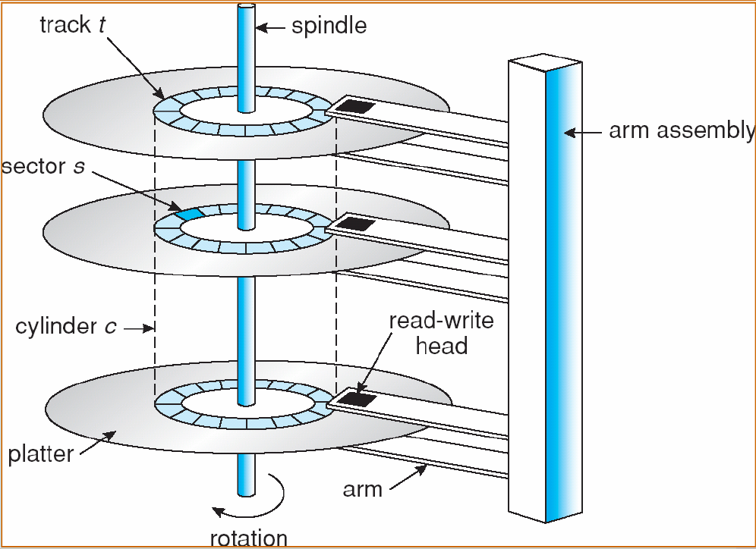
Definitions (Internal structure of HDD)
When the disk drive is operating, the disk is rotating at constant speed.
To read or write the head must be positioned at the desired track and at the beginning of the desired sector on that track
Track selection involves moving the head in a movable-head system or electronically selecting one head on a fixed-head system
On a movable-head system the time required to move the disk arm to the required track is known as seek time.
The delay waiting for the rotation of the disk to bring the required disk sector under the read-write head is called rotational delay.
The sum of the seek time and the rotational delay equals the access time.

Slide 21
Disk Arm Scheduling Algorithm
Following are different types of Disk Arm Scheduling Algorithm
FCSC (First Come First Serve) / FIFO (First In First Out)
SSTF (Shorted Seek Time First)
SCAN
C-SCAN
LOOK (Elevator)
C-LOOK

Slide 22
Example for Disk Arm Scheduling Algorithm
Consider an imaginary disk with 51 cylinders. A request comes in to read a block on cylinder 11. While the seek to cylinder 11 is in progress, new requests come in for cylinders 1, 36, 16, 34, 9, and 12, in that order.
Starting from the current head position, what is the total distance (in cylinders) that the disk arm moves to satisfy all the pending requests, for each of the following disk scheduling Algorithms?

Slide 23
FCSC (First Come First Serve) / FIFO (First In First Out)
Here requests are served in the order of their arrival.
Disk movement will be 11, 1, 36, 16, 34, 9 and 12.
Total cylinder movement: (11-1) + (36-1) + (36-16) + (34-16) + (34-9) + (12-9) = 111
0
1
9
12
16
34
36
50
11
1, 36, 16, 34, 9, 12
1
36
16
34
9
12

Slide 24
SSTF (Shortest seek time first)
We can minimize the disk movement by serving the request closest to the current position of the head.
Disk movement will be 11, 12, 9, 16, 1, 34 and 36.
Total cylinder movement: (12-11) + (12-9) + (16-9) + (16-1) + (34-1) + (36-34) = 61
0
1
9
12
16
34
36
50
11
1, 36, 16, 34, 9, 12
12
9
16
1
34
36

Slide 25
LOOK
Keep moving in the same direction until there are no more outstanding requests pending in that direction, then algorithm switches the direction.
After switching the direction the arm will move to handle any request on the way. Here first it moves in up direction then goes in down direction.
In this algorithm, the software maintains 1 bit: the current direction bit, which takes the value either UP or DOWN.

Slide 26
LOOK
Here first it moves in up direction then goes in down direction
Disk movement will be 11, 12, 16, 34, 36, 9 and 1.
Total cylinder movement: (12-11) + (16-12) + (34-16) + (36-34) + (36-9) + (9-1) = 60
0
1
9
12
16
34
36
50
11
1, 36, 16, 34, 9, 12
12
16
34
36
9
1

Slide 27
C-LOOK
Keep moving in the same direction until there are no more outstanding requests pending in that direction, then algorithm switches direction.
When switching occurs the arm goes to the lowest numbered cylinder with pending requests and from there it continues moving in upward direction again.

Slide 28
C-LOOK
Here first it moves in up direction then goes in down direction
Disk movement will be 11, 12, 16, 34, 36, 1 and 9.
Total cylinder movement: (12-11) + (16-12) + (34-16) + (36-34) +(36-1)+(9-1) = 68
0
1
9
12
16
34
36
50
11
1, 36, 16, 34, 9, 12
12
16
34
36
1
9

Slide 29
SCAN
From the current position disk arm starts in up direction and moves towards the end, serving all the pending requests until end.
At that end arm direction is reversed (down) and moves towards the other end serving the pending requests on the way.
This is also called as elevator algorithm.

Slide 30
SCAN
Here first it moves in up direction then goes in down direction
Disk movement will be 11, 12, 16, 34, 36, 50, 9 and 1.
Total cylinder movement: (12-11) + (16-12) + (34-16) +(36-34) +(50-36) + (50-9) + (9-1) = 88
0
1
9
12
16
34
36
50
11
1, 36, 16, 34, 9, 12
12
16
34
36
9
50
1

Slide 31
C-SCAN
From the current position disk arm starts in up direction and moves towards the end, serving request until end.
At the end the arm direction is reversed (down), and arm directly goes to other end and again continues moving in upward direction.

Slide 32
C-SCAN
Here first it moves in up direction then goes in down direction
Disk movement will be 11, 12, 16, 34, 36, 50, 0, 1 and 9.
Total cylinder movement: (12-11) + (16-12) + (34-16) +(36-34) +(50-36) + (50-0) + (1-0)+ (9-1) = 98
0
1
9
12
16
34
36
50
11
1, 36, 16, 34, 9, 12
12
16
34
36
0
50
1
9

Slide 33
Example for Disk Arm Scheduling Algorithm [Exercise]
Suppose that a disk drive has 200 cylinders, numbered 0 to 199 and order of request is: (82,170,43,140,24,16,190). And current position of Read/Write head is : 50.
Starting from the current head position, what is the total distance (in cylinders) that the disk arm moves to satisfy all the pending requests, for each of the following disk scheduling Algorithms?
FCFS/FIFO (642)
SSTF (208)
SCAN (332)
C-SCAN (391)
LOOK (314)
C-LOOK (341)

Slide 34
RAID
Section - 6

Slide 35
RAID
RAID (Redundant Array of Independent Disks)
RAID is a data storage virtualization technology that combines multiple physical disk drive components into a single logical unit for the purposes of data redundancy, performance improvement, large storage capacity or all.
Data is distributed across the drives in one of several ways, referred to as RAID levels, depending on the required level of redundancy and performance.
All RAID have the property that the data are distributed over drives, to allow parallel operation.
There are 7 levels of RAID.

Slide 36
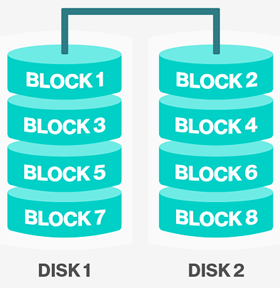
RAID 0 (Striping)
It splits data (file) into blocks of data.
Stripe the blocks across disks in the system.
In the diagram to the right, the odd blocks are written to disk 1 and the even blocks to disk 2.
It is easy to implement.
No parity calculation overhead is involved.
It provides good performance by spreading the load across many channels and drives.
It provides no redundancy or error detection.
Not true RAID because there is no fault tolerance. The failure of just one drive will result in all data in an array being lost.
After certain amount of drives, performance does not increase significantly.
It requires minimum 2 drives to implement.

Slide 37
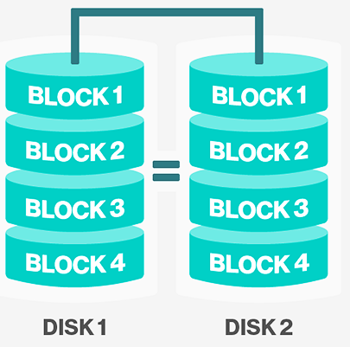
RAID 1 (Mirroring)
A complete file is stored on a single disk.
A second disk contains an exact copy of the file.
It provides complete redundancy of data.
Read performance can be improved
same file data can be read in parallel
Write performance suffers
must write the data out twice
Most expensive RAID implementation.
It requires twice as much storage space.
In case a drive fails, data do not have to be rebuild, they just have to be copied to the replacement drive.
The main disadvantage is that the effective storage capacity is only half of the total drive capacity because all data get written twice.

Slide 38
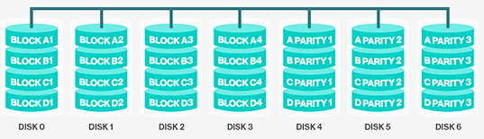
RAID 2 (Bit-level striping using a Hamming Code parity)
It stripes data at bit level (rather than block level) with some disks storing error checking and correcting (ECC) information.
It uses ECC (Error Correcting Code) to monitor correctness of information on disk.
A parity disk is then used to reconstruct corrupted or lost data.

Slide 39
RAID 2 (Bit-level striping using a Hamming Code parity)
Imagine splitting each byte into a pair of 4-bit nibbles, then adding Hamming code to each one to form a 7-bit word, of which bit 1, 2 and 4 were parity bits.
In RAID 2 each of seven drives needs synchronized in terms of arm position and rotational position, and then it would be possible to write the 7-bit Hamming coded word over the seven drives.
Here, losing one drive did not cause problem, which can be handled by Hamming code on the fly.
Big problem is performance
must have to read data plus ECC code from other disks
for a write, must have to modify data, ECC, and parity disks

Slide 40
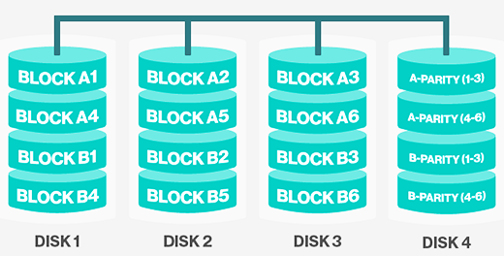
RAID 3 (Byte-level striping with a dedicated parity)
It uses striping and dedicates one drive for storing parity information.
Here single parity bit is computed for each data word and written to a parity drive.
The embedded ECC information is used to detect errors.
As in RAID level 2 the drives must be exactly synchronized.

Slide 41
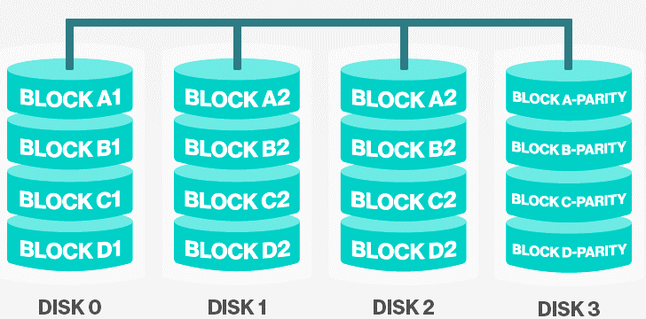
RAID 4 (Block-level striping with dedicated parity)
It uses large stripes (block level striping), which means you can read records from any single drive.
They do not require synchronization of drives.
RAID 4 is like RAID 0, with strip-for-strip parity written onto an extra drive.
If a drive crashes, the lost bytes can be recomputed from the parity drive by reading the entire set of drives.
This design protects against the loss of a drive but performs poorly for small updates, if one sector is changed, it is necessary to read all the drives in order to recalculate the parity.
It creates heavy load on parity drive.

Slide 42
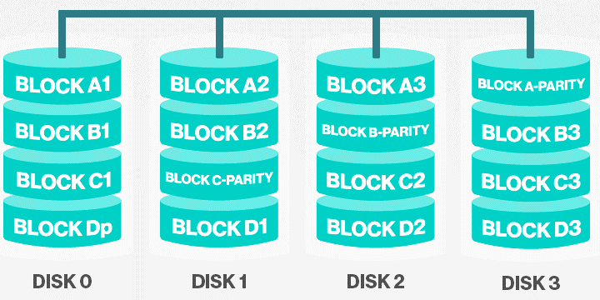
RAID 5 (Block-level striping with distributed parity)
This level is based on block-level striping with parity.
The parity information is striped across each drive.
As with RAID level 4, there is a heavy load in the parity drive, it may become bottleneck.
This bottleneck can be eliminated in RAID level 5 by distributing the parity bits uniformly over all the drives.

Slide 43
IMP Questions
Write a short note on DMA.
Briefly describe all Disk Arm Scheduling Algorithm.
Write short note on RAID.
Suppose Disk drive has 300 cylinders. The current position of head is 90. The queue of pending request is 36,79,15,120,199,270,89,170 Calculate head movement for the following algorithms. 1. FCFS 2. SSTF
Suppose that a disk drive has 200 cylinders from 0 to 199. The drive is currently at cylinder 53 and previous request at 43. The queue of pending requests in FIFO order is 98, 183, 37, 122, 14, 124, 65, 67.Starting from the current head position what is the total distance (in cylinder ) that the disk arm moves to satisfy all the pending requests for each of the following disk scheduling algorithms: FCFS, SSTF, SCAN, LOOK, CLOOK, CSCAN.

Slide 44
IMP Questions
Define seek time and rotational latency. Assume that a disk drive has 200 cylinders, numbered 0 to 199. The drive is currently serving a request at cylinder 100. The queue of pending requests is 23, 89, 132, 42, 189. Calculate seek time for FCFS and SSTF disk scheduling algorithm.
Suppose that a disk drive has 5000 cylinders, numbered 0 to 4999. The drive is currently serving a request at cylinder 143,. The queue of pending requests, in FIFO order,86, 1470, 913, 1774, 948, 1509, 1022, 1750, 130Starting from current head position what is total distance (in cylinders) that disk arm moves to satisfy all the pending request for FCFS and SSTF disk scheduling algorithm?

Slide 45
✓
Looping
Outline
File concept
File attributes
Access methods
File types
File operation
Directory structure
File System structure
Allocation methods (contiguous, linked, indexed)
Free-space management (bit vector, linked list, grouping)
Directory implementation (linear list, hash table)

Slide 46
File concept
Section - 1

Slide 47
File concept
A file is a unit of storing data on a secondary storage device such as a hard disk or other external media.
Every file has a name and its data.
Operating system associates various information with files. For example the date and time of the last modified file and the size of file etc….
This information is called the file’s attributes or metadata.
The attributes varies considerably from system to system.

Slide 48
File attributes
Section - 2

Slide 49
File attributes
Below attributes tell who may access it and who may not:
Protection - Who can access the file and in what way.
Password - Password needed to access the file.
Creator - ID of the person who created the file.
Owner - Current owner.
Flags are bits or short fields that control or enable some specific property.
Read only flag - 0 for read/write, 1 for read only.
Hidden flag - 0 for normal, 1 for do not display the listings.
System flag - 0 for normal, 1 for system file.
Archive flag - 0 for has been backed up, 1 for needs to be backed up.
Random access flag - 0 for sequential access only, 1 for random access.
Temporary flag - 0 for normal, 1 for delete file on process exit.
Lock flag - 0 for unlocked, 1 for locked.

Slide 50
File attributes
Below attributes are only present in files whose record can be looked up using the key. They provide the information required to find the keys.
Record length - Number of bytes in a record.
Key position - Offset of the key within each record.
Key length - Number of bytes in key field.
Various attributes keeps times track of when the file was created, most recently accessed and most recently modified.
Creation time - Date and time the file was created.
Time of last access - Date and time of file was last accessed.
Time of last change - Date and time of file was last changed.
Various attributes keeps track of file size.
Current size - Number of bytes in the file.
Maximum size - Number of bytes the file may grow to.

Slide 51
Access methods
Section - 3

Slide 52
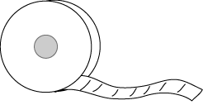
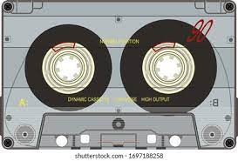
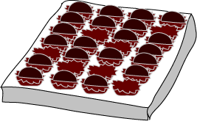
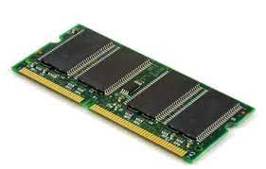
Files access methods (Sequential File Access VS Random File Access)
Sequential File Access
A sequential file works like a reel of tape.
Data in a sequential file are processed in order or sequence, starting with the first item, the processing the second, then the third and so on.
To reach data in the middle of the file you must go through all the data that precedes it.
Example: Magnetic tape
Random File Access
A random access file works like a sampler box of chocolate. You can access a particular item by going directly to it.
Data in a random access file may be accessed in any order. To read data in the middle of the file you can go directly to it. Random access files are sometimes called direct access files.
Example: Semi-conductor memories

Slide 53
File types
Section - 4

Slide 54
Types of files
File Type
Regular File
Directories
ASCII File
Binary File

Slide 55
Regular file Vs Directories
Regular File
Regular files are the ones that contain user information.
Regular file, as a randomly accessible sequence of bytes, has no other predefined internal structure.
Application programs are responsible for understanding the structure and content of any specific regular file.
Directories
Directories are system files for maintaining the structure of the file system.
To keep track of files, file systems normally have directories or folder.

Slide 56
Different types of files
ASCII files
ASCII file consists of line of text.
Advantage of ASCII files is that they can be displayed & printed as it is & they can be edited with ordinary text editor.
If number of programs use ASCII files for input and output, it is easy to connect the output of one program to the input of another.
C/C++/Perl/HTML files are all examples of ASCII files.
Binary Files
Binary files contain formatted information that only certain applications or processors can understand.
Binary files must be run on the appropriate software or processor before humans can read them.
Executable files, compiled programs, spreadsheets, compressed files, and graphic (image) files are all examples of binary files.

Slide 57
Different types of files
Device Files
Under Linux and UNIX each and every hardware device is treated as a file. A device file allows to accesses hardware devices so that end users do not need to get technical details about hardware.
In short, a device file (also called as a special file) is an interface for a device driver that appears in a file system as if it were an ordinary file.
This allows software to interact with the device driver using standard input/output system calls, which simplifies many tasks.
Character Special Files
It is a type of device file which talks to devices in a character by character (1 byte at a time).
Character Special files are related to input/output and use to model serial I/O devices, such as terminals, printers, and networks.
Block Special Files
It is a type of device file which talks to devices 1 block at a time (1 block = 512 bytes to 32KB).
Block special files are used to model disks, DVD/CD ROM, and memory regions etc.

Slide 58
File operations
Section - 5

Slide 59
File operations
Create
The purpose of the call is to announce that the file is coming and to set some attributes.
Delete
When the file is no longer needed, it has to be deleted to free up disk space.
Open
The purpose of the open call is to allow the system to fetch the attributes.
Close
When all accesses are finished, the attributes and disk addresses are no longer needed, so the file should be closed to free up table space.
Read
Data are read from file. Usually the bytes come from the current position.
Write
Data are written to the file, usually at the current position.

Slide 60
File operations
Append
This call is restricted form of write. It can only add data to the end of file.
Seek
For a random access files, a method is needed to specify from where to take the data.
Seek repositions the file pointer to a specific place in the file.
Get attributes
Processes often need to read the file attributes to do their work.
Set attributes
Some of the attributes are user settable and can be changed after the file has been created. This system call makes that possible.
Rename
It frequently happens that a user needs to change the name of an existing file. This system call makes it possible.

Slide 61
Directory operations
Create
A directory is created. It is empty except for dot and dotdot, which are put there automatically by the system.
Delete
A directory is deleted. Only an empty directory can be deleted.
A directory containing only dot and dotdot is considered as an empty directory.
Opendir
Directories can be read.
For example, to list all the files in a directory, a listing program opens the directory to read out the names of all the files it contains.
Before a directory can be read, it must be opened.
Closedir
When a directory has been read, it should be closed to free up space.
Rename
In many respects, directories are just like files and can be renamed the same way files can be.

Slide 62
Directory operations
Readdir
This call returns the next entry in an open directory.
It was possible to read directories using the usual read system call, but that approach has the disadvantage of forcing the programmer to know and deal with the internal structure of directories.
In contrast, readdir always returns one entry in a standard format, no matter which of the possible directory structure is being used.
Link
Linking is a technique that allows a file to appear in more than one directory.
This system call specifies an existing file and a path name, and creates a link from the existing file to the name specified by the path.
In this way, the same file may appear in multiple directories.
Unlink
A directory entry is removed.
If the file being unlinked is only present in one directory (the normal case), it is removed from the file system.
If it is present in multiple directories, only the path name specified is removed. The others remain.

Slide 63
Directory structure
Section - 6

Slide 64

Directory structure
Single level directory system
The simplest form of directory system is having one directory containing all the files. This is some time called as root directory.
Here directory contain three files.
The advantages of this scheme are its simplicity and the ability to locate files quickly there is only one directory to look, after all.
The single level is used for simple dedicated application, but for modern user with thousands of files, it would be impossible to find anything if all files were in a single directory.

Slide 65
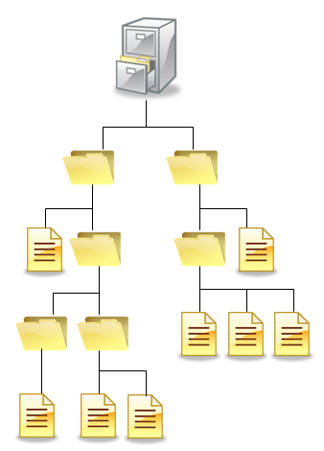
Directory structure
Hierarchical directory system
In this system user can create an arbitrary number of subdirectories to organize their work.
When the file system is organized as a directory tree, some way is needed for specifying file names.
Two methods are used commonly
Absolute path name
Relative path name

Slide 66
Absolute path name V/S Relative path name
Absolute path name
An absolute path name consisting of the path from the root directory to the file.
As an example, the path /usr /ast/mailbox means that the root directory contains a subdirectory usr, which in turn contains a subdirectory ast, which contain the file mailbox.
Relative path name
Relative path name is used in conjunction with the concept of the working directory.
User can designate one directory as the current working directory, in which case, all path names not beginning at the root directory are taken relative to working directory.
For example if the current working is /usr/ast, then the file whose absolute path is /usr/ast/mailbox can be referenced simply as mailbox.
Most operating systems that support a hierarchical directory system have two special entries in every directory,
“.” or “dot” refers to current directory
“..” or “dotdot” refers to parent directory

Slide 67
File System structure
Section - 7

Slide 68
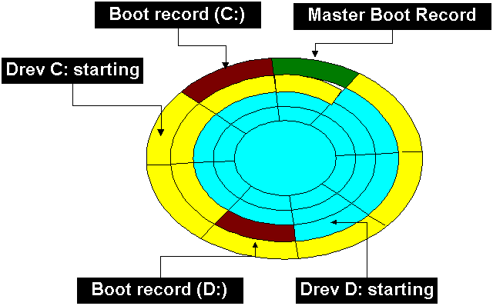
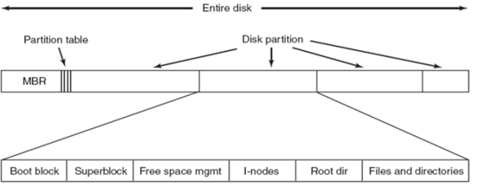
File system structure
MBR (Master Boot Record)
The Master Boot Record (MBR) is the information in the first sector (sector 0) of hard disk.
It identifies how and where an operating system is located so that it can be boot (loaded) into the computer's main storage or random access memory (RAM).
It is used to boot the computer.
The end of the MBR contains the partition table which gives the starting and ending addresses of each partition

Slide 69
File system
It is group of files and information regarding them.
The disk space allotted to file system is made up of blocks, each of which are 512 bytes.
All the blocks belonging to file system are logically divided into:
Boot block
Super block
Inode table
Data block

Slide 70
File system
Boot block
It represent the beginning of file system.
It contains a program “bootstrap loader”.
This program is executed when we boot the machine.
All the file system contain one boot block.
Super block
It describe the state of file system.
How large file system is
How many maximum files it can accommodate
How many more files can be created
List of free and allocated blocks
Modification time of the file system

Slide 71
File system
Inode table
The information related to all file (not the content) is stored in an inode table on the disk.
For each file, there is an inode entry in table.
Each entry is made up of 64 bytes and contain the detail for that file.
These details are:
Owner of file
Group to which the owner belongs
Types of file and its size
File access permission
Date and time of last access and last modification
Address of blocks where the file is physically present
Data block
It contains actual file content.
An allocated block can belong to only one file in the file system.
This block can’t be used for storing any other file’s content unless the file to which it originally belonged is deleted.

Slide 72
Allocation methods (contiguous, linked, indexed)
Section - 8

Slide 73
Allocation methods
Various methods to implement files are listed below,
Contiguous allocation
Linked list allocation
Linked list allocation using a table in memory
I-nodes

Slide 74


Contiguous allocation
The simplest allocation scheme is to store each file as a contiguous run of disk block.
State of the disk after files D and F have been removed

Slide 75
Contiguous allocation
It is simple to implement because we need to keep track of only the first block and the number of blocks in the file.
Read performance is excellent because the entire file can be read from the disk in a single operation.
Only one seek is needed (to the first block).
Once the disk is filled, reusing the space requires maintaining a list of hole.
However, when a new file is to be created, it is necessary to know its final size in order to choose a hole of the correct size to place it in.

Slide 76
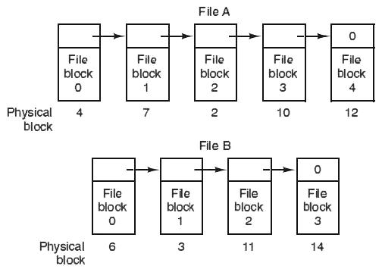
Linked list allocation
Another method for storing files is to keep each one as a linked list of the disk blocks.
The first word of each block is used as a pointer to the next one. The rest of the block is for data.
No space is lost to disk fragmentation.
Reading a file is extremely slower than Contiguous Allocation.
Less data occupied in block.

Slide 77
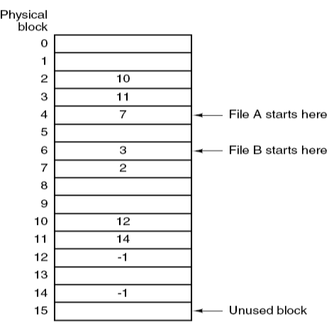
Linked list allocation using a table in memory
In this method instead of a pointer, a table in memory called file allocation table is used.
Take the pointer word from each block and put it in a table in memory.
Advantage of this method is that random access of files is faster.
The only disadvantage of this method is that the entire table should always be in the memory.

Slide 78
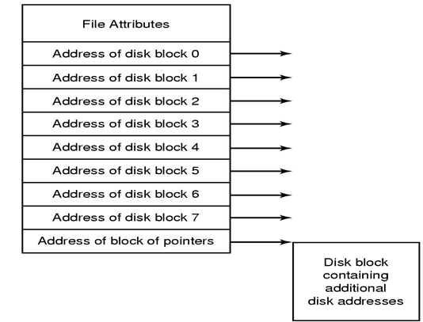
I-node
I-node (Index-node) is a data structure used for storing attributes and disk address of a block in memory.
A method for keeping track of which blocks belong to which file is to associate with each file a data structure called an i-node (index-node), which lists the attributes and disk addresses of the file’s blocks.
Here, only the i-node should be in the memory at all times.

Slide 79
Free-space management (bit vector, linked list, grouping)
Section - 9

Slide 80
Free-space management
Techniques to manage free space are:
bit vector
linked list
grouping

Slide 81
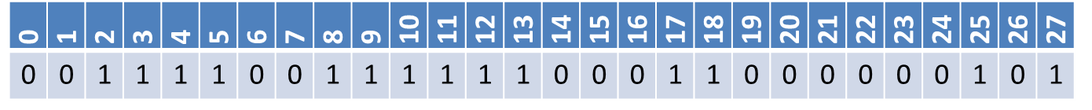
Bit vector
In this method free space list (block) is implemented as a bit map or bit vector.
If the block is free the bit is set to 1.
If the block is allocated the bit is set to 0.
Example:
Consider a disk, where blocks 2, 3, 4, 5, 8, 9, 10, 11, 12, 13, 17, 18, 25, 27 are free and rest of blocks are allocated.
The free space bit map would be:
Advantages
Relatively simple and efficient
Easy to get contiguous files

Slide 82
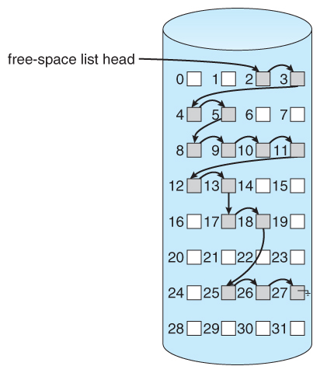
Linked list
It links all free disk blocks together.
Each block contain a pointer to next free blocks, and so on
In figure there is a pointer to block 2, as the first free block.
Block 2 would contain a pointer to block 3.
Which would point 4,5,8,9,10,11,12,13,17,18,25,26,27
Can’t get continuous space easily.
No waste of space.
Not efficient for faster access.

Slide 83
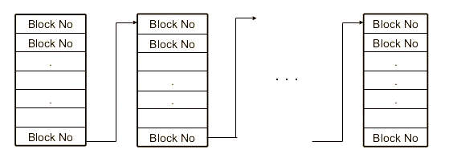
Grouping
It stores addresses of n free blocks in the first free block.
First n-1 of these block are address of free blocks.
Last block contains the pointer of another free block.
Large number of free blocks can be found quickly.

Slide 84
Directory implementation (linear list, hash table)
Section - 10

Slide 85
Directory implementation
Linear list
Linear list of file names with pointer to the data blocks
It is simple to program
It is time-consuming to execute
Hash table
It uses hash table – linear list with hash data structure
It decreases directory search time
It may cause collisions – situations where two file names hash to the same location

Slide 86
IMP Questions
Differentiate Sequential File Access and Random File Access.
List and explain different file operations.
List and explain different attributes of file.
Explain different types of files.
Differentiate Absolute path name and Relative path name.
Explain Boot block, Super block, Inode table and Data block.
Explain various methods to implement files.
Explain techniques to manage free space.

Slide 87
Operating System (OS)
2101CS403
Prof. Firoz A Sherasiya
Computer Engineering Department
firoz.sherasiya@darshan.ac.in
9879879861

