Slide 1

Unit : 4 Accessing Rest API
Mobile Application Development using Flutter
(MADF) (2105CS303)
Prof. Mehul Bhundiya
Computer Science & Engineering Department
mehul.bhundiya@darshan.ac.in
+91 - 9428231065

Slide 2
API (Application Programming Interface)
When it comes to the client server architecture, the client and server are both completely independent of one another.
The front end component is the client and the back end of the service is the server.
Data Needed to Display
Fetch data from database and send data back to device
API
Database

Slide 3
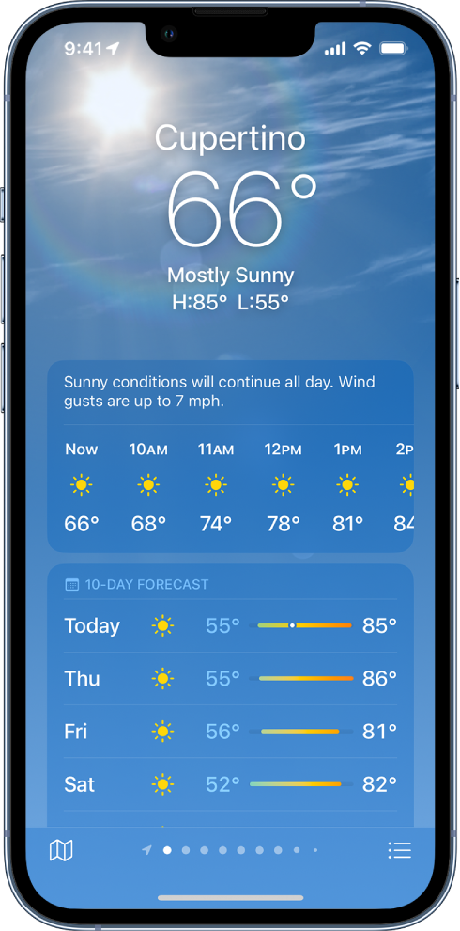

API (Application Programming Interface)
APIs are mechanisms that enable two software components to communicate with each other using a set of definitions and protocols.
For example, the weather bureau’s software system contains daily weather data.
The weather app on your phone “talks” to this system via APIs and shows you daily weather updates on your phone.
Api Call
Data

Slide 4
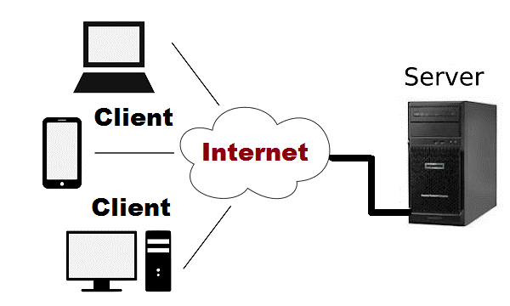
API (Application Programming Interface)
In the context of APIs, the word Application refers to any software with a distinct function.
Interface can be thought of as a contract of service between two applications.
This contract defines how the two communicate with each other using requests and responses.
API architecture is usually explained in terms of client and server.
The application sending the request is called the client, and the application sending the response is called the server.
So in the weather example, the bureau’s weather database is the server, and the mobile app is the client.

Slide 5
API (Application Programming Interface)
There are four different ways that APIs can work depending on when and why they were created.
SOAP APIs
These APIs use Simple Object Access Protocol.
Client and server exchange messages using XML.
This is a less flexible API that was more popular in the past.
RPC APIs
These APIs are called Remote Procedure Calls.
The client completes a function (or procedure) on the server, and the server sends the output back to the client.
Websocket APIs
Websocket API is another modern web API development that uses JSON objects to pass data.
A WebSocket API supports two-way communication between client apps and the server.
The server can send callback messages to connected clients, making it more efficient than REST API.

Slide 6
API (Application Programming Interface)
REST APIs
These are the most popular and flexible APIs found on the web today.
The client sends requests to the server as data.
The server uses this client input to start internal functions and returns output data back to the client.
REST stands for Representational State Transfer.
REST defines a set of functions like GET, PUT, DELETE, etc. that clients can use to access server data.
Clients and servers exchange data using HTTP.
The main feature of REST API is statelessness.
Statelessness means that servers do not save client data between requests.
Client requests to the server are similar to URLs you type in your browser to visit a website.
The response from the server is plain data, without the typical graphical rendering of a web page.

Slide 7
Restfull vs Restless
Restless | Restful
It is not based on the principles of REST. | It is based on the principles of REST architecture and is integrable with other computer systems on the network.
It does not uses REST principles. | It uses REST principles.
It uses SOAP services. | It uses REST services.
It supports only XML format. | It supports JSON, HTML, etc format.
These services uses service interface to show business logic. | These services uses service interface to show business logic.
It is less usable and flexible for the users. | It is more usable and flexible for the users.
More secure as it designs it’s own security layer. | Less secure as it uses the security layers to communication protocols.
It uses a small bandwidth. | It uses a large bandwidth.

Slide 8
Api URL
An API URL Path is an address that allows you to access an API and its various features.
An API URL Path is as simple as using any URL in your web browser.
If you’re typing www.darshan.ac.in into your browser’s address bar, you’re basically making a request to your browser to show you the content of our website.
In the context of APIs, basically the same thing is happening.
There are 2 parts to any API URL:
Base URL
Endpoint
The Base URL is kind of like the base address for the specific API that you’re using.
Until you choose a specific Endpoint, though, the Base URL isn’t going to do much.
The Endpoint is a specific point of entry in an API.
You attach these to the end of your Base URL and get results depending on which Endpoint you choose.

Slide 9
Api URL
All API paths are relative to this base URL
In above url https://perstore.swagger.io/v2 is base url & /pets/findByStatus is end points & status=available is query parameter.

Slide 10
JSON
JSON stands for JavaScript Object Notation.
JSON is a lightweight format for storing and transporting data.
JSON is often used when data is sent from a server to a web page.
JSON is self-describing and easy to understand.
JSON data is written as name/value pairs, just like JavaScript object properties.
A name/value pair consists of a field name (in double quotes), followed by a colon, followed by a value:
JSON response is made up of JSON Objects and Arrays.
JSON objects are written inside curly braces { }.
JSON arrays are written inside square brackets [ ].
Syntax
1
"firstName":"John"

Slide 11
JSON Object
JSON object literals are surrounded by curly braces {}.
JSON object literals contains key/value pairs.
Keys and values are separated by a colon : .
Keys must be strings, and values must be a valid JSON data type:
string
number
object
array
boolean
null
Each key/value pair is separated by a comma , .
Syntax
1
{"name":"John", "age":30, "car":null}

Slide 12
JSON Array
Arrays in JSON are almost the same as arrays in JavaScript.
In JSON, array values must be of type string, number, object, array, boolean or null.
A JSON array contains zero, one, or more ordered elements, separated by a comma.
The JSON array is surrounded by square brackets [ ].
A JSON array is zero terminated, the first index of the array is zero (0). Therefore, the last index of the array is length - 1.
Example
1
2
3
4
5
6
7
8
9
10
11
[ ] //Empty JSON array
[ 0, 1, 2, 3, 4, 5]
[ “StringValue”, 10, 20.13, true, null ]
[
{
“Name” : “Nested Object”
},
[ 10, 20, true, 40, “Nested Array” ]
]

Slide 13
Working with REST APIs
Everything we see in today’s world is just data.
There are a lot of ways we show data in our app, such as:
Static data
From a file
From a database or public APIs
The most common method is to show data from a database or public APIs.
Even loading data from a database involves using APIs.
We can integrate APIs, fetch data from a public API.
There are a few steps that we can follow to easily integrate an API into our Flutter app.
Step 1: Get the API URL and endpoints.
Step 2: Add relevant packages into the app (http, dio, chopper, etc.).
Step 3: Create a constant file that stores URLs and endpoints.
Step 4: Create a file that handles the API call, and write specific methods to fetch and parse data.

Slide 14
http package
A composable, Future-based library for making HTTP requests.
This package contains a set of high-level functions and classes that make it easy to consume HTTP resources.
It's multi-platform, and supports mobile, desktop, and the browser.
They allow you to make individual HTTP requests with minimal hassle.
Example
1
2
3
4
5
6
import 'package:http/http.dart' as http;
var url = Uri.https('example.com', 'whatsit/create');
var response = await http.post(url, body: {'name': 'doodle', 'color': 'blue'});
print('Response status: ${response.statusCode}');
print('Response body: ${response.body}');

Slide 15
http package
When we are making multiple requests to the same server, can keep open a persistent connection by using a Client rather than making one-off requests.
Make sure to close the client when it’s done.
Example
1
2
3
4
5
6
7
8
9
10
11
var client = http.Client();
try {
var response = await client.post(
Uri.https('example.com', 'whatsit/create'),
body: {'name': 'doodle', 'color': 'blue'});
var decodedResponse = jsonDecode(utf8.decode(response.bodyBytes)) as Map;
var uri = Uri.parse(decodedResponse['uri'] as String);
print(await client.get(uri));
} finally {
client.close();
}

Slide 16
Retrying requests
package:http/retry.dart provides a class RetryClient to wrap an underlying http.Client which transparently retries failing requests.
By default, this retries any request whose response has status code 503 Temporary Failure up to three retries.
It waits 500ms before the first retry, and increases the delay by 1.5x each time.
All of this can be customized using the RetryClient() constructor.
Example
1
2
3
4
5
6
7
8
9
10
11
import 'package:http/http.dart' as http;
import 'package:http/retry.dart';
Future<void> main() async {
final client = RetryClient(http.Client());
try {
print(await client.read(Uri.http('example.org', '')));
} finally {
client.close();
}
}

Slide 17
http GET method
HTTP GET requests are used to retrieve data from a server.
This code sends an HTTP GET request to the URL https://jsonplaceholder.typicode.com/posts, API for testing purposes.
If the response status code is 200, which indicates success, the response body is decoded from JSON and returned as a list of dynamic objects.
Otherwise, an exception is thrown.
Example
1
2
3
4
5
6
7
8
9
10
Future<List<dynamic>> fetchData() async { final response = await http.get(Uri.parse('https://jsonplaceholder.typicode.com/posts')); if (response.statusCode == 200) { return jsonDecode(response.body); } else { throw Exception('Failed to load data'); } }

Slide 18
http POST method
HTTP POST requests are used to create new data on a server.
This code sends an HTTP POST request to the same URL as before, but with a different payload in the body.
The body is a JSON-encoded map with three fields: title, body, and userId.
If the response status code is not 201, which indicates success, an exception is thrown.
Example
1
2
3
4
5
6
7
8
9
10
Future<void> createData() async { final response = await http.post(Uri.parse('https://jsonplaceholder.typicode.com/posts'), headers: <String, String>{'Content-Type': 'application/json; charset=UTF-8',}, body: jsonEncode(<String, dynamic>{ 'title': 'Flutter HTTP CRUD', })); if (response.statusCode != 201) { throw Exception('Failed to create data'); } }

Slide 19
http PUT method
HTTP PUT requests are used to update existing data on a server.
The URL includes the ID of the post to be updated, and the body is a JSON-encoded map with the same fields as in the HTTP POST.
If the response status code is not 200, an exception is thrown.
Example
1
2
3
4
5
6
7
8
9
10
Future<void> createData(int id) async { final response = await http.post(Uri.parse('https://jsonplaceholder.typicode.com/posts/$id'), headers: <String, String>{'Content-Type': 'application/json; charset=UTF-8',}, body: jsonEncode(<String, dynamic>{ 'title': 'Flutter HTTP CRUD', })); if (response.statusCode != 200) { throw Exception('Failed to create data'); } }

Slide 20
http DELETE method
HTTP DELETE requests are used to delete data on a server.
The URL includes the ID of the post to be deleted.
If the response status code is not 200, an exception is thrown.
Example
1
2
3
4
5
6
7
8
Future<void> deleteData(int id) async { final response = await http.delete(Uri.parse('https://jsonplaceholder.typicode.com/posts/$id')); if (response.statusCode != 200) { throw Exception('Failed to delete data'); } }

Slide 21
http
Example
Example
1
2
3
4
5
6
7
8
9
10
11
12
13
14
15
16
17
18
19
20
21
22
import 'dart:convert'; import 'package:flutter/material.dart'; import 'package:http/http.dart' as http; void main() { runApp(MyApp()); } class MyApp extends StatelessWidget { @override Widget build(BuildContext context) { return MaterialApp( title: 'Flutter HTTP CRUD', theme: ThemeData( primarySwatch: Colors.blue, ), home: MyHomePage(title: 'Flutter HTTP CRUD'), ); } }
23
24
25
26
27
28
29
30
class _MyHomePageState extends State<MyHomePage> { List<dynamic> _data = []; @override void initState() { super.initState(); _fetchData(); }

Slide 22
http
Example
Example
31
32
33
34
35
36
37
38
39
40
41
42
43
44
45
46
47
48
49
50
51
52
@override Widget build(BuildContext context) { return Scaffold( appBar: AppBar( title: Text(widget.title), ), body: ListView.builder( itemCount: _data.length, itemBuilder: (BuildContext context, int index) { final data = _data[index]; return ListTile( title: Text(data['title']), subtitle: Text(data['body']), trailing: Row( mainAxisSize: MainAxisSize.min, children: [ IconButton(
icon: Icon(Icons.edit), onPressed: () => _updateData(data['id']), ),
53
54
55
56
57
58
59
60
61
62
63
64
65
66
67
68
69
70
IconButton( icon: Icon(Icons.delete), onPressed: () => _deleteData(data['id']), ), ], ), ); }, ), floatingActionButton: FloatingActionButton( onPressed: _createData, tooltip: 'Create', child: Icon(Icons.add), ), ); }

Slide 23
Thank You

