Slide 1
A Parallel Jacobi-Embedded Gauss-Seidel Method
Presented by:- Nirav Pansuriya (101214045)

Slide 2
Content
Jacobian Method
Gauss Seidel Method
PJG Method
Experimental setup
Dynamic Parallelism
Parallel Implementation of Iterative methods
Results

Slide 3
Methods to solve linear equations
Two methods to solve system of linear equations
Direct Method (Gaussian elimination)
Expensive in terms of computational resources and time
Require time to solve equations increase exponentially with number of linear equations
Iterative Method (Jacobian Method, Gauss Seidel Method)
Most common method to solve large system of linear equations with the help of computers
Less expensive in terms of computational recourses

Slide 4







Linear System

Slide 5

Jacobian Method
Step 1:- Initialize x with random values
Step 2:- for i <- range(1, totalEquations)
solve $x_{i}$ and store in $xNew_{i}$
Step 3:- copy values of xNew to x
Step 4:- Repeat step 2 and 3 until convergence

Slide 6

Gauss Seidel Method
Step 1:- Initialize x with random values
Step 2:- for i <- range(1, totalEquations)
solve $x_{i}$ and update $x_i$
Step 4:- Repeat step 2 until convergence

Slide 7
Jacobian Method
Easy to implement algorithm in parallel system
Very hard to archive convergence for the large system
Gauss Seidel Method
Hard to implement in parallel system
Very easy to archive convergence even in large system

Slide 8
Questions
We have seen two methods, Jacobian and Gauss Seidel.
1.) Which method is easy to implement in parallel system? Why?
2.) Which method is very fast to get convergence? Why?

Slide 9
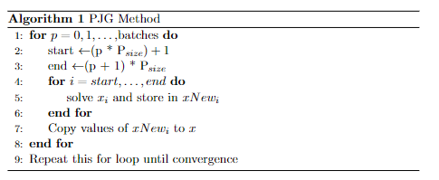
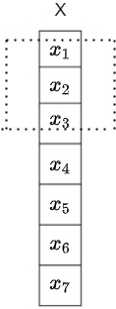
PJG Method

Slide 10
PJG Method
Combination of Jacobian and Gauss Seidel method
Archive high parallelisation and convergence

Slide 11
Experiment Setup
Language:- C++ with CUDA
GPU:- NVIDEA T4
2560 CUDA CORES
16 GB Global Memory

Slide 12
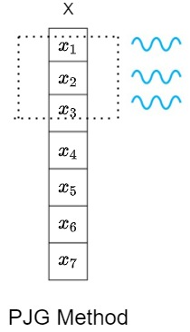
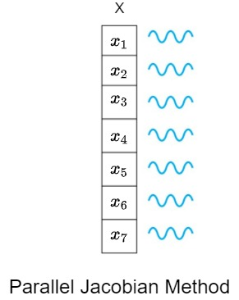
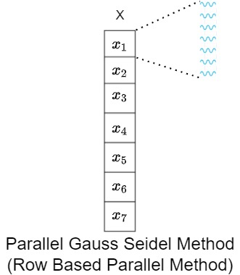
Parallel Implementation

Slide 13
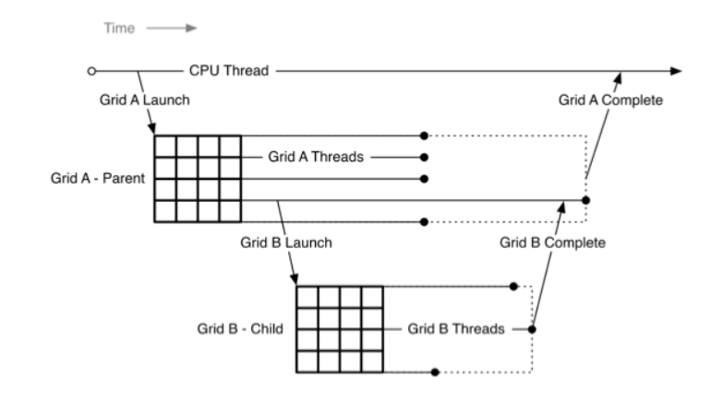
Dynamic Parallelism
Issues
Very Expensive
Degrade Performance
Synchronization is complex

Slide 14
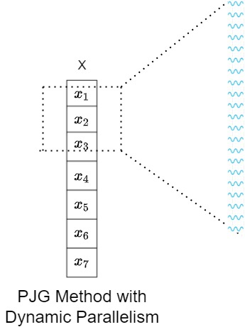
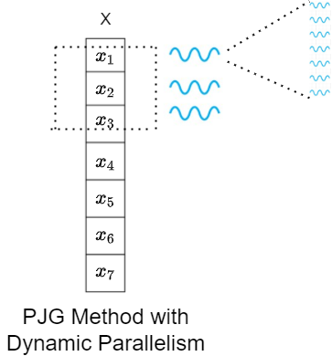
Dynamic Parallelism

Slide 15
Results
Iterations:- until convergence
Equations:- 50
Block Size:- 10
Method | Time (seconds) | Iterations
Jacobian | 0.0125762 | 478
Jacobian (Parallel) | 0.0268081 | 478
GS | 0.0001888 | 7
Row Based Parallel | 0.00842755 | 7
PJG (Sequential) | 0.000267712 | 9
PJG (Parallel) | 0.00077216 | 9
PJG (Parallel with DP) | 0.00100070906 | 9

Slide 16
Results
Iterations:- until convergence
Equations:- 1000
Block Size:- 35
Method | Time (seconds) | Iterations
Jacobian | 99.802 | 10000 (no convergence)
Jacobian (Parallel) | 5.69737 | 10000 (no convergence)
GS | 0.0992823 | 10
Row Based Parallel | 0.0930212 | 10
PJG (Sequential) | 0.267712 | 10
PJG (Parallel) | 0.056479 | 10
PJG (Parallel with DP) | 0.039485 | 10

Slide 17
Results
Iterations:- 1000
Equations:- 1000
Block Size:- 35
Method | Time (seconds)
Jacobian | 5.562
Jacobian (Parallel) | 0.270
GS | 5.518
Row Based Parallel | 3.389
PJG (Sequential) | 5.549
PJG (Parallel) | 0.770
PJG (Parallel with DP) | 0.587

Slide 18
Questions?

Slide 19
Thank you!

