Slide 1

PennTechnoGrads
dhasudyiusadyiewdsa
GIT session 2017
-Nirav Shah

Slide 2
Agenda
Version Control (Need, Types, Comparison)
Git
Git Basics
Branching
Workflows
Working Session
Installing Git
Cloning a repository
Feature Development
Make changes
Commit
Pull Request
Merge/Release

Slide 3

Version Control
Version control is a system that records changes to a file or set of files over time so that you can recall specific versions later.

Slide 4

Local VCS
Version Control

Slide 5
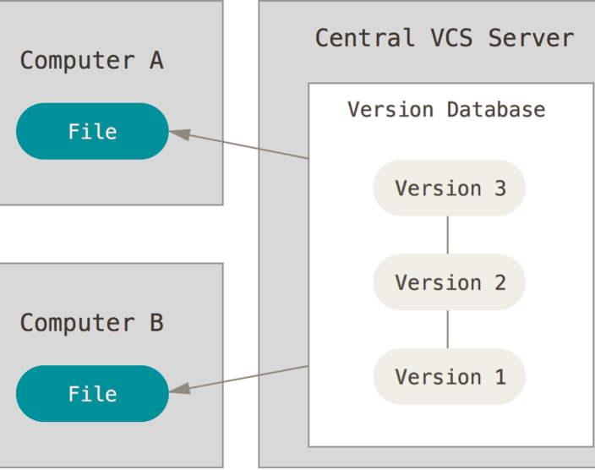
Centralized VCS

Slide 6
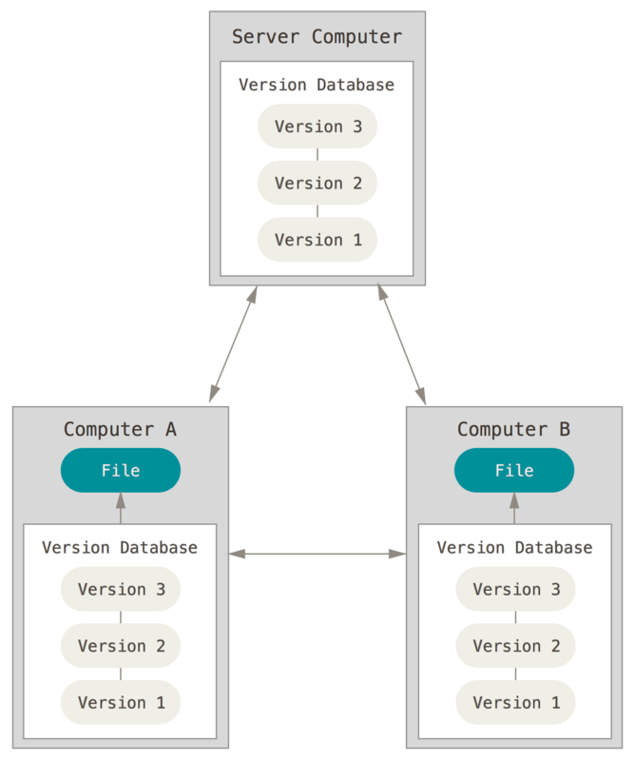
Distributed VCS
Version Control

Slide 7
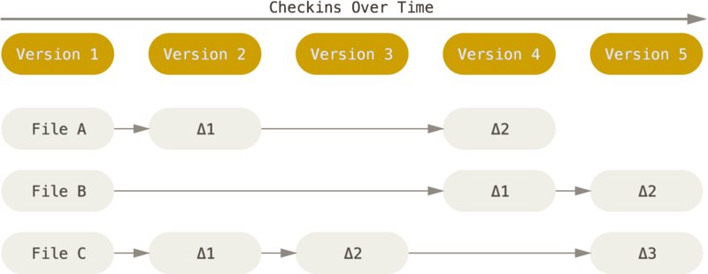
Git Basics
Other VCS

Slide 8
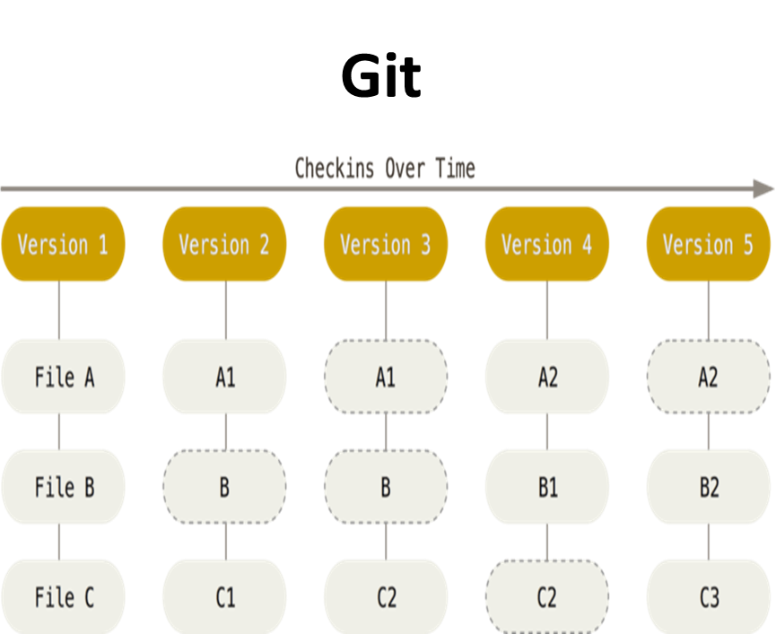
Git Basics

Slide 9
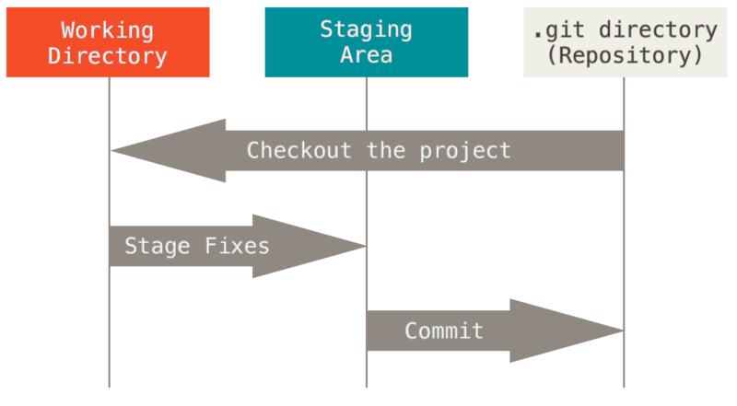
Git Basics
3 STATES
3 States

Slide 10
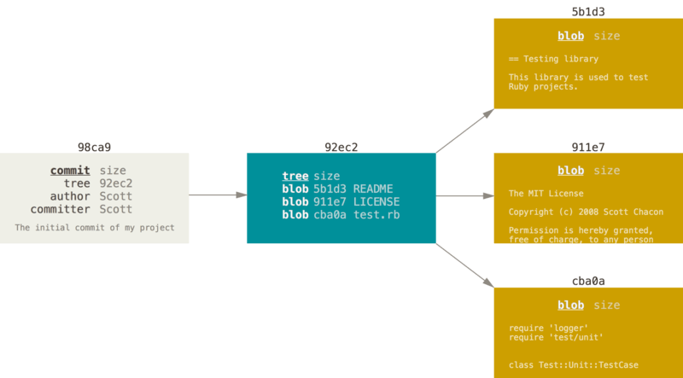
Git Basics
The blob and Tree

Slide 11
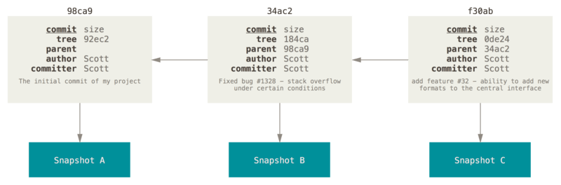
Branching
Commits and Parents

Slide 12
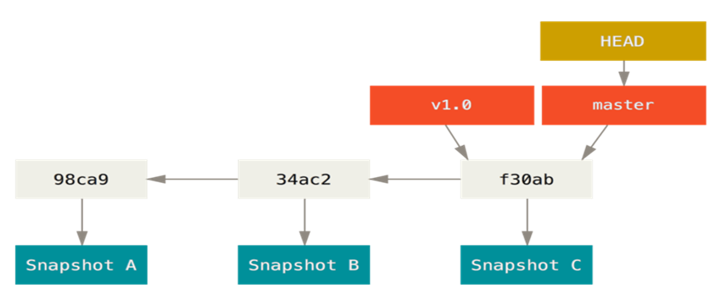
Branching
The Head

Slide 13
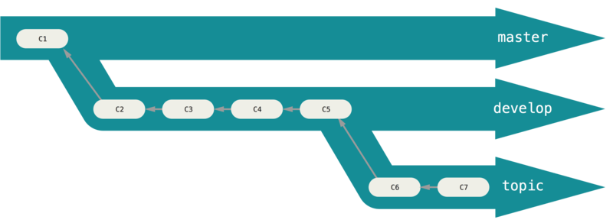
Workflows
Long Running Branches

Slide 14
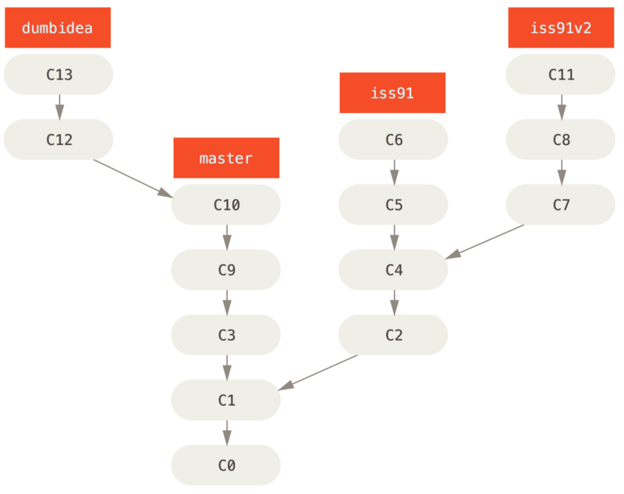
Workflows
Topic Branches

Slide 15
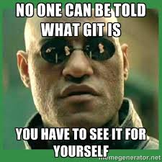
Working Session

Slide 16
Working Session
Git config
Git clone
Git fetch
Git pull
Git diff
Git commit
Git push
Git Commands

Slide 17
Questions?

