Slide 1
PennTechnoGrads
GIT session 2017
-Nirav Shah

Slide 2
Agenda
Version Control (Need, Types, Comparison)
Git
Git Basics
Branching
Workflows
Committing changes to repository
Working Session
Installing Git
Cloning a repository
Feature Development
Pull Request
Merge/Release

Slide 3

Version Control
Version control is a system that records changes to a file or set of files over time so that you can recall specific versions later.

Slide 4

Local VCS

Slide 5
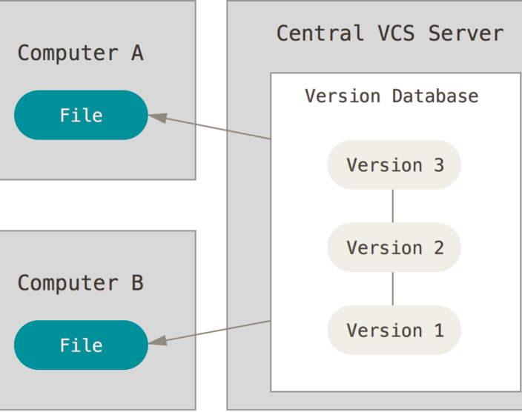
Centralized VCS

Slide 6
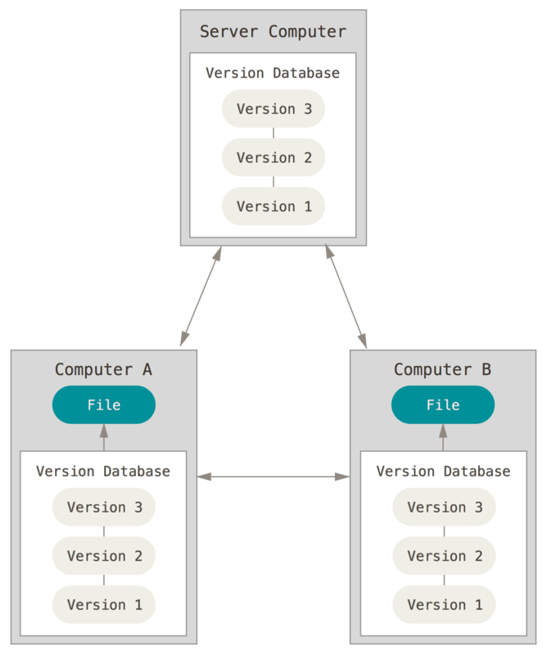
Distributed VCS

Slide 7
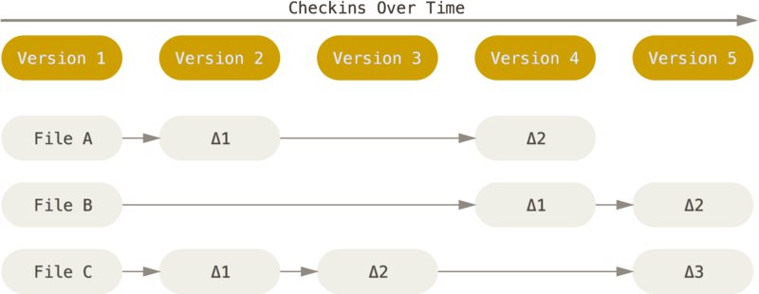
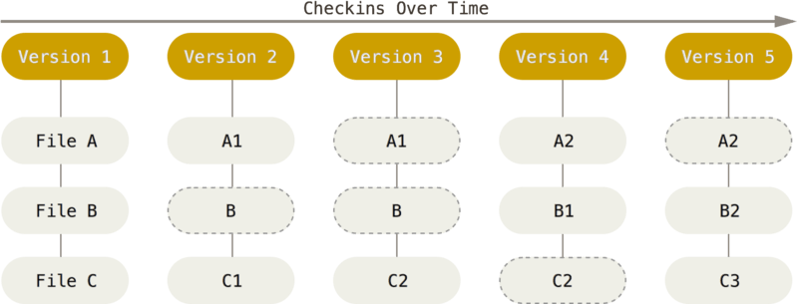
Git Basics
Other VCS
Git

Slide 8
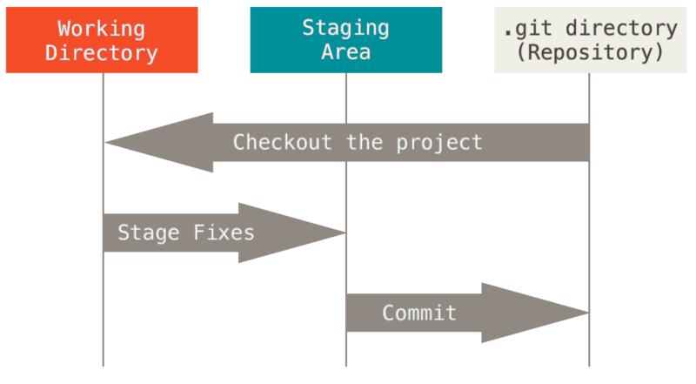
3 STATES

Slide 9
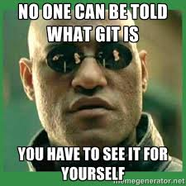
Working Session

