Slide 1

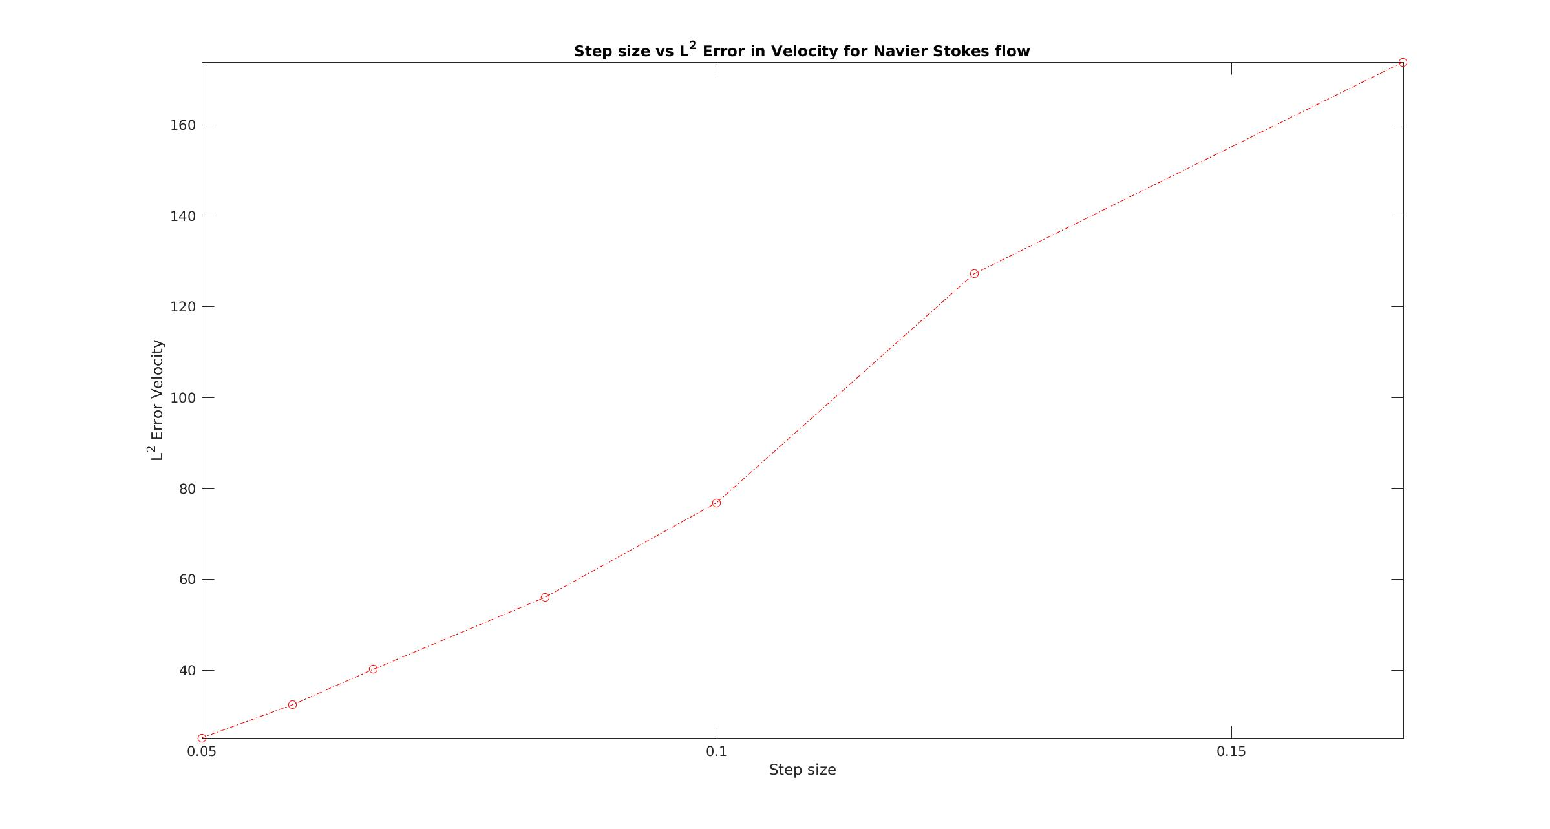
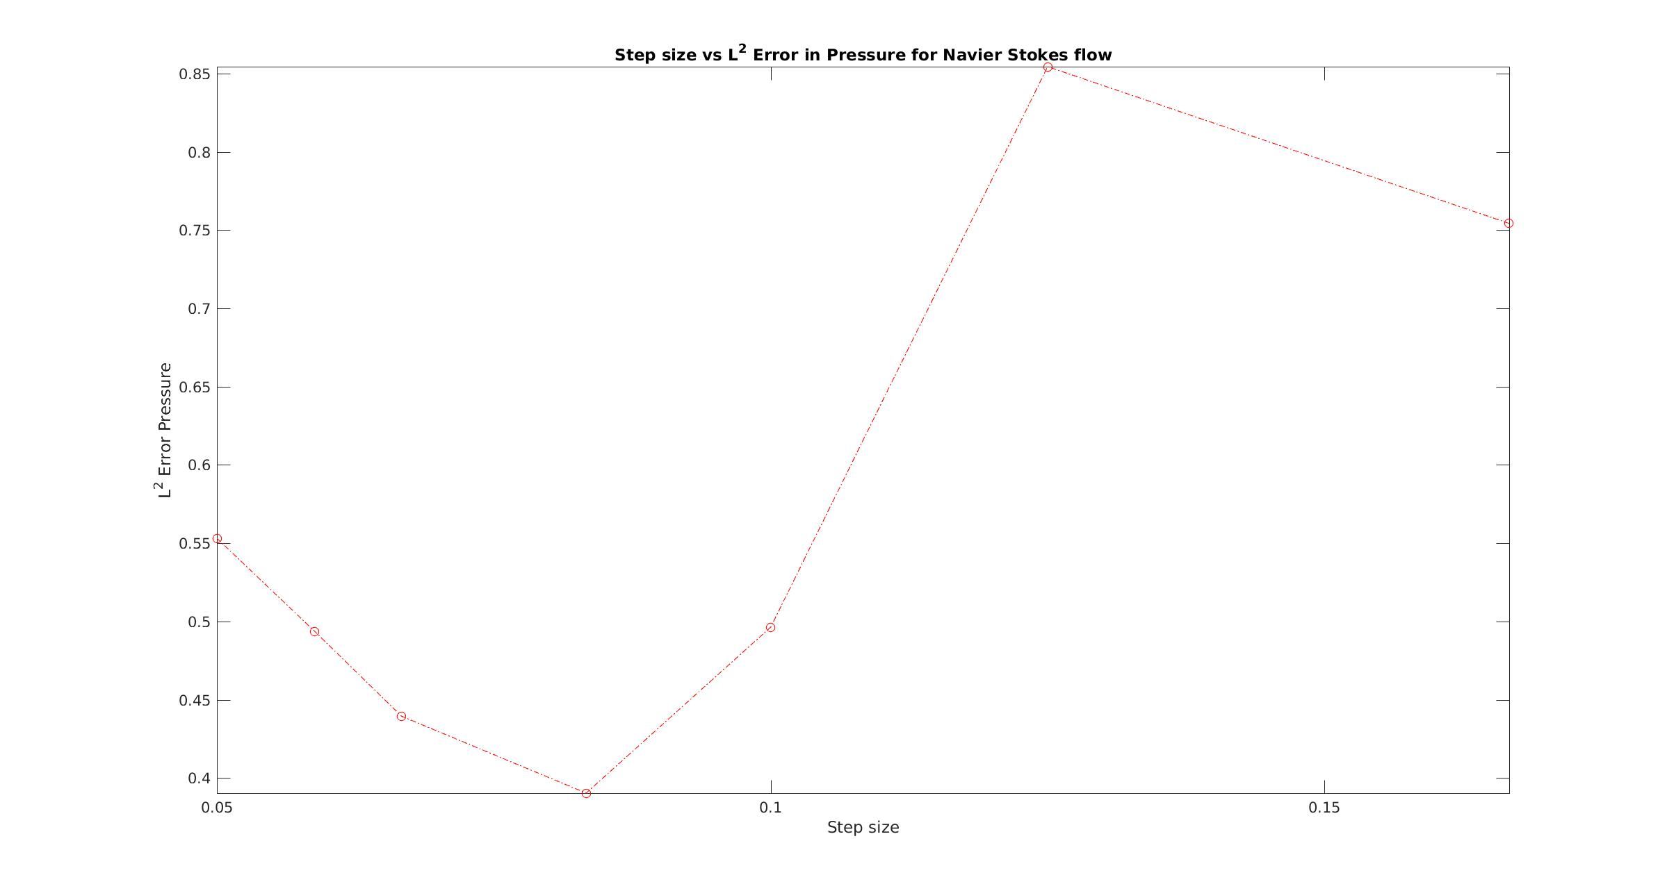
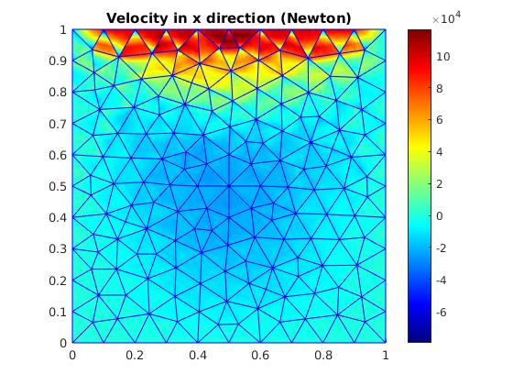
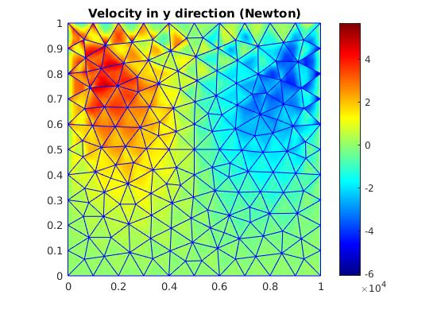
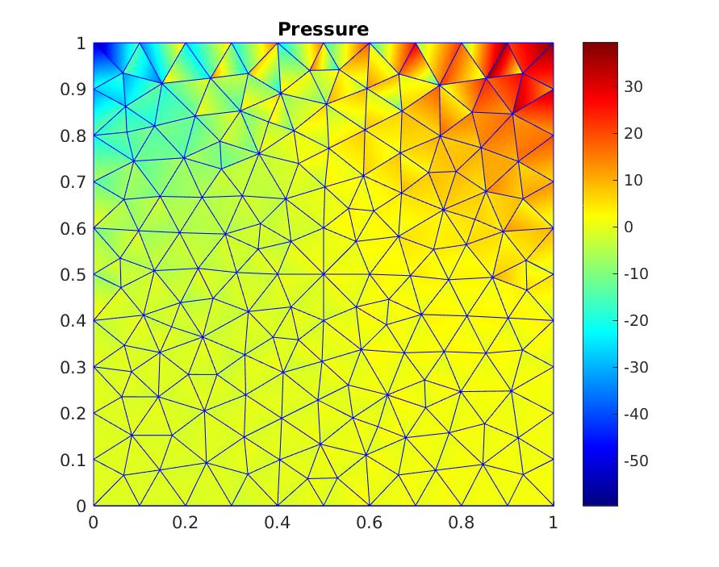
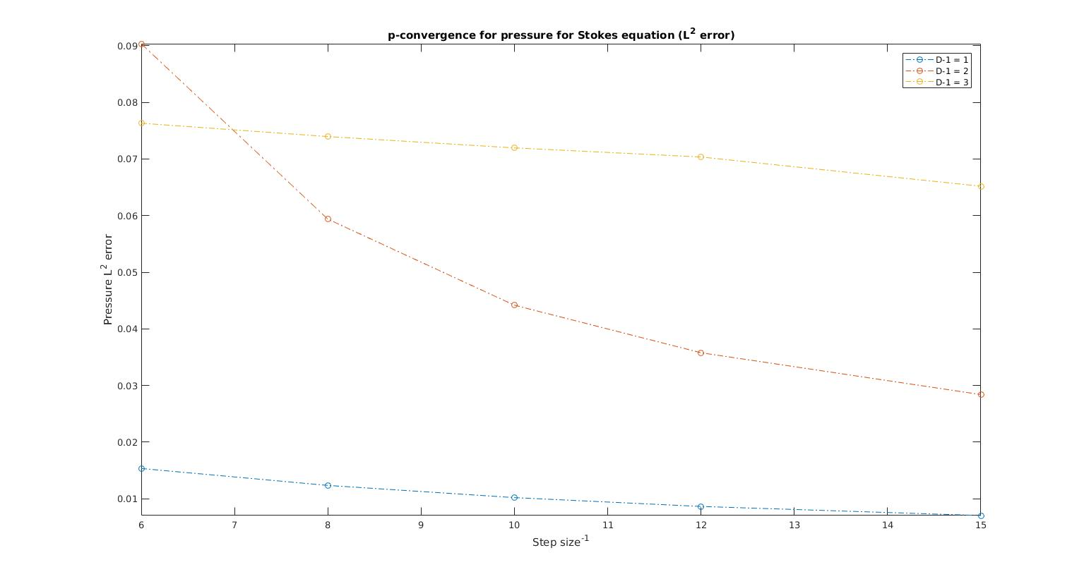
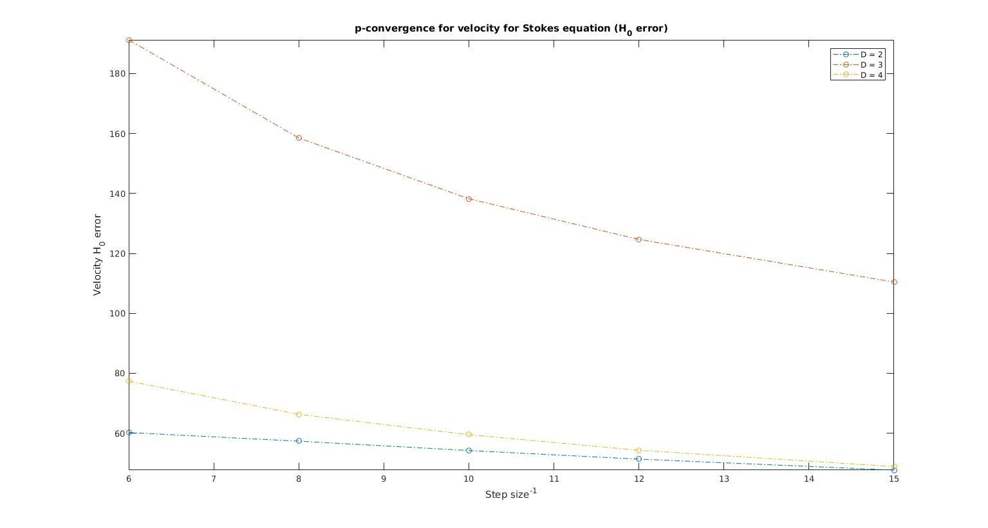
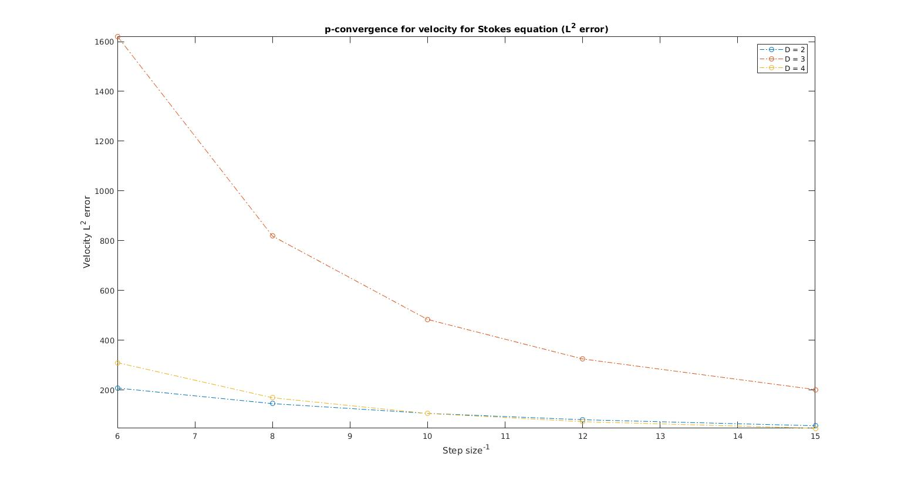
Discontinuous Galerkin Method for Direct Numerical Simulation of the Navier Stokes Equation
Supervisor : Prof. Dr. Bernard Haasdonk, Institute of Applied Analysis and Numerical Simulation, University of Stuttgart
t
The Navier Stokes equation is the core of the Computational Fluid Dynamics or CFD. We use theinterior penalty discontinuous Galerkin method to numerically solve the incompressible steady state Navier Stokes equation. We use the Taylor Hood element for Velocity and Pressure basis function. We employ Newton method for non linearity and use Stokes equation as initial guess for Newton method.
Nirav
Vasant
Shah
India
h-Convergence test for the Navier Stokes equation
Lid driven cavity flow (Benchmark CFD problem)
p-cpnvergence test for the Stokes equation

