Slide 1
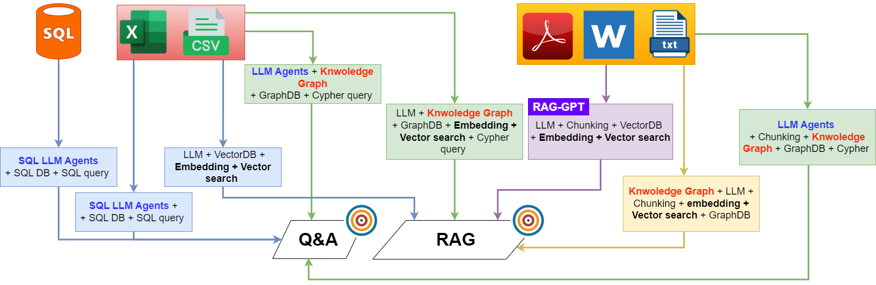


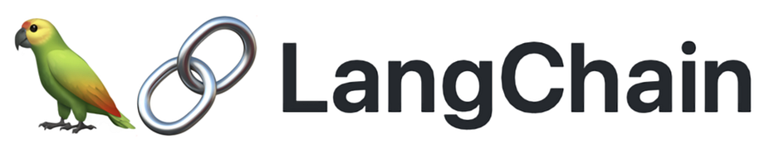

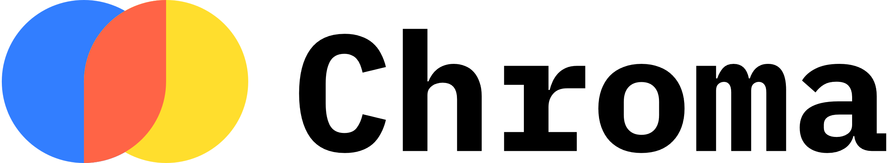


Objectives:
RAG: Text Embedding + Vector Search
Q&A: LLM Agent querying the database (SQL, Cypher, etc.)

Slide 2


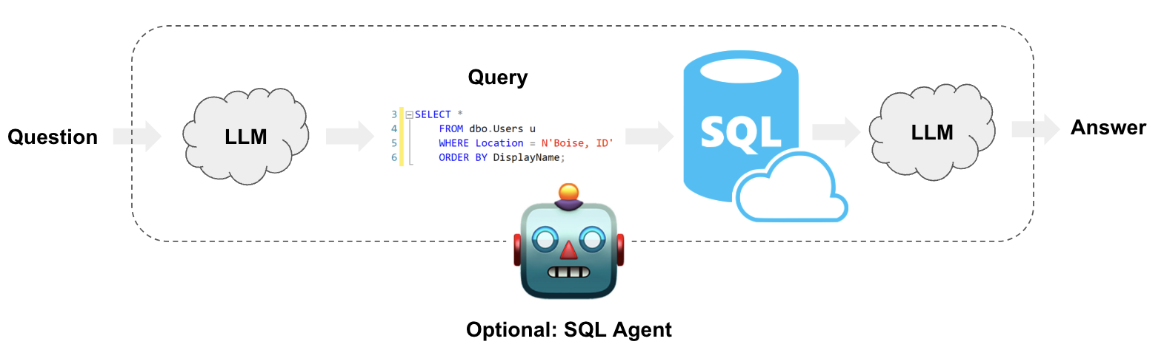
RAG with Vector DB:
Question
Embedding
Vector search
Retrieval
LLM
Answer
Q&A with SQL DB:
Reference: https://python.langchain.com/docs/use_cases/sql/

Slide 3
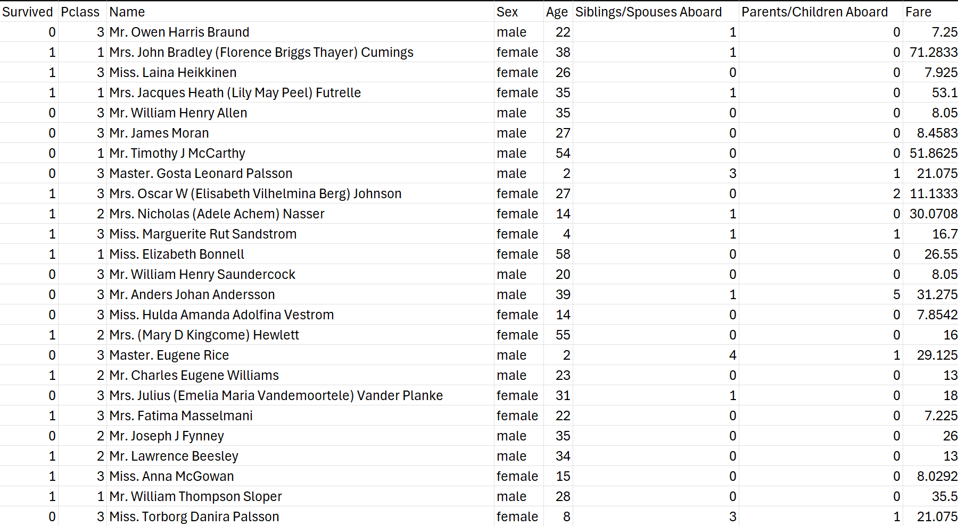
RAG on Tabular Data
Treat each row as one chunk of the vectorDB
Str(
Survived: 0
Pclass: 3
Name: Mr. Owen …
…
)
Perform vector search on the embeddings of one specific column
Ex: Column name“description”: values (str)

Slide 4
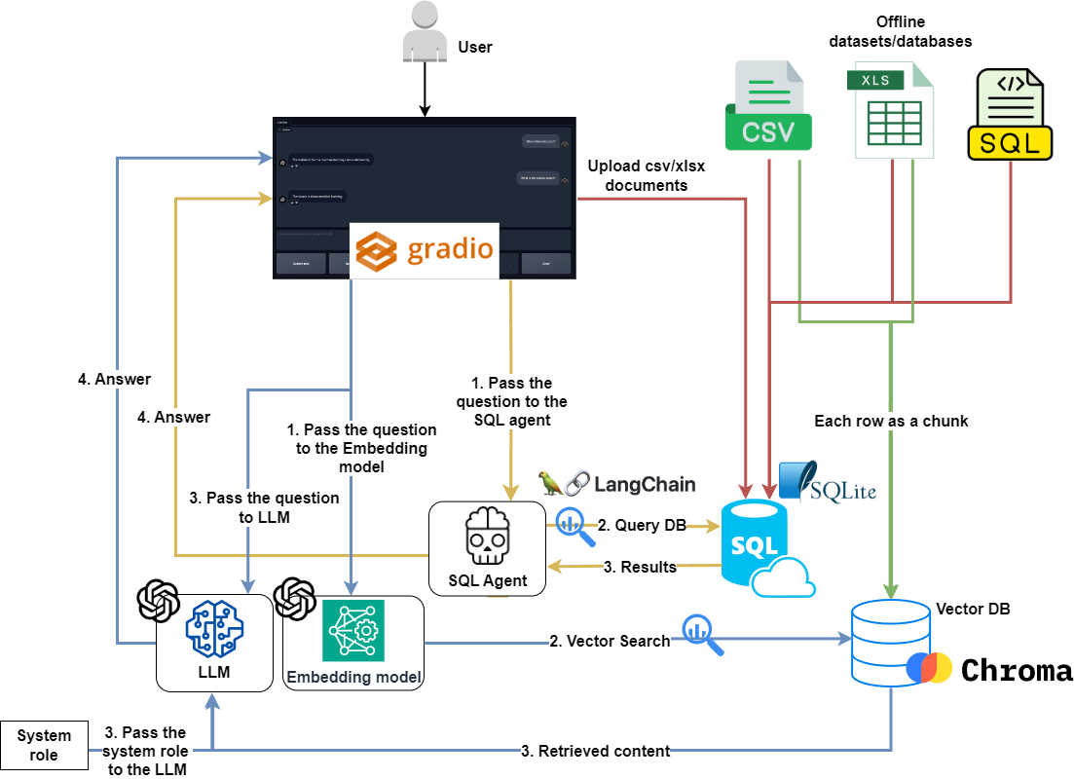
Q&A-and-RAG-with-SQL-and-TabularData
Red: Data preparation pipeline for SQL DB. (Q&A)
Green: Data preparation pipeline for VectorDB. (RAG)
Yellow: Chat pipeline for interacting with the SQL agent and SQL database. (Q&A)
Blue: Chat pipeline for interacting with the Embedding model, LLM, and VectorDB. (RAG)

Slide 5
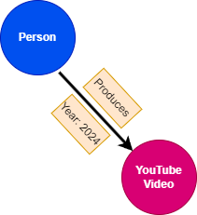
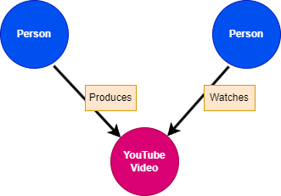
Knowledge Graph: Fundamentals
Knowledge graph: A database that stores information in nodes and relationships
Node properties: key (e.g: name) + value (e.g: Farzad)
Nodes can have labels that groups them together.
Relationships have direction, type, and properties
Name:
Farzad
Name:
Mike
Relationships contains
two nodes
Period:
Weekly
Year:
2024
Topic:
AI projects
(Person)-[Produces]→(YouTube Video)
(Person)-[Produces]→(YouTube Video)←[Watches]-(Person)

Slide 6
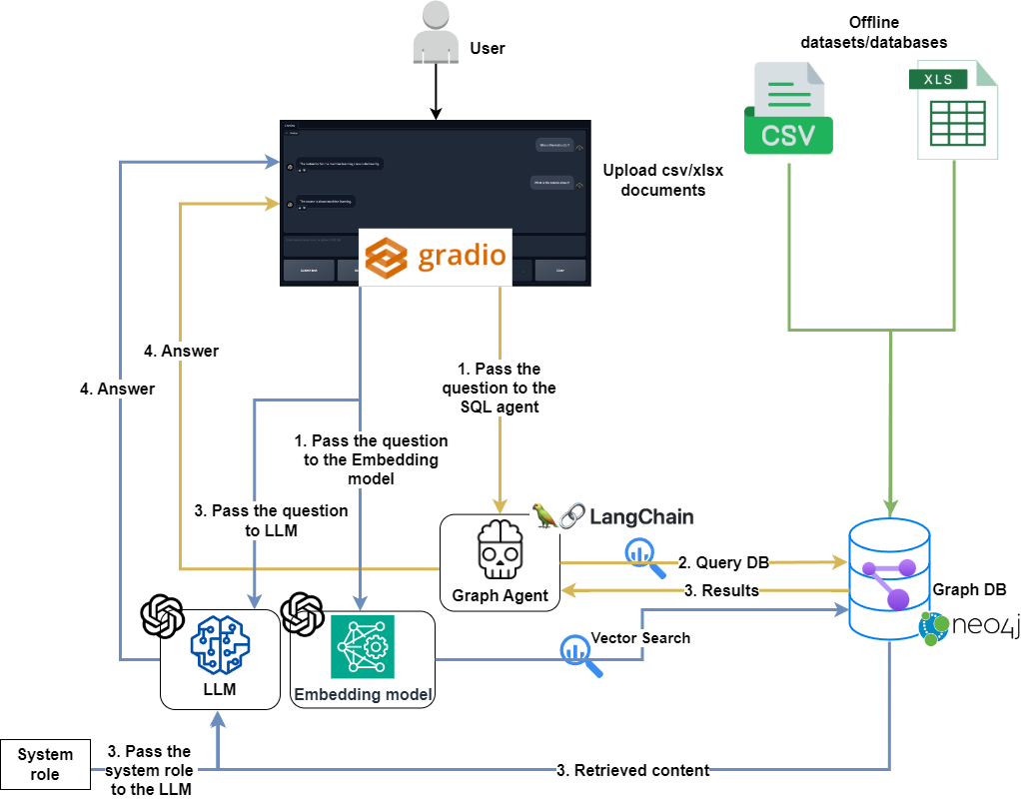
KnowledgeGraph-Q&A-and-RAG-with-TabularData
Green: Data preparation pipeline for GraphDB. (Q&A and RAG)
Yellow: Chat pipeline for interacting with the graph agent and GraphDB. (Q&A)
Blue: Chat pipeline for interacting with the Embedding model, LLM, and GraphDB. (RAG)

Slide 7
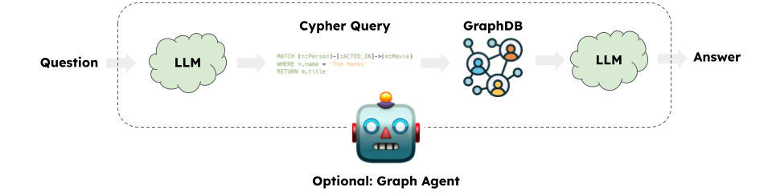
Q&A on Graph DB using Graph Agent
RAG with Vector DB
Q&A with SQL DB
Question
Embedding
Vector search
Retrieval
LLM
Answer
Knowledge Graph Agent: Q&A
https://python.langchain.com/docs/use_cases/graph/quickstart/

Slide 8
RAG on Tabular Data
Treat each row as one chunk of the vectorDB
Str(
Survived: 0
Pclass: 3
Name: Mr. Owen …
…
)
Perform vector search on the embeddings of one specific column
Ex: Column name“description”: values (str)

Slide 9
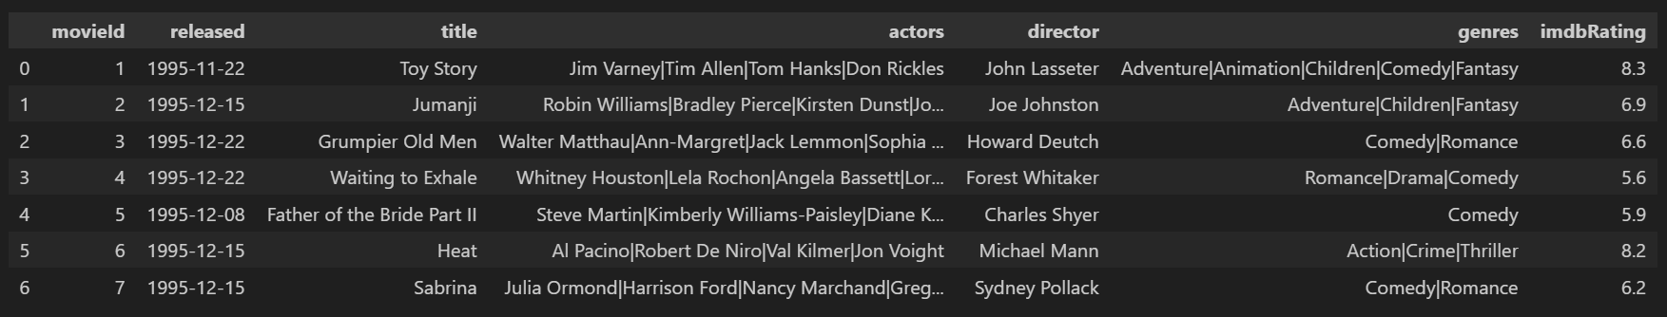
Part 1: Knowledge Graph for Movie Dataset
Dataset
Knowledge graph
Nodes and their properties:
Movie {imdbRating: FLOAT, id: STRING, released: DATE, title: STRING},
Person {name: STRING},
Genre {name: STRING}
Location {name: STRING}
SimilarMovie {name: STRING}
Property
name
Person
Genre
Property
name
[:DIRECTED]
Relationship properties:
(:Movie)-[:IN_GENRE]->(:Genre)
(:Person)-[:DIRECTED]->(:Movie)
(:Person)-[:ACTED_IN]->(:Movie)
(:Movie)-[:WAS_TAKEN_IN]->(:Movie)
(:Person)-[:IS_SIMILAR_TO]->(:Movie)
[:IN_GENRE]
[:ACTED_IN]
Movie
[:IS_SIMILAR_TO]
Properties
id
released
tagline
title
imdbRating
[:WAS_TAKEN_IN]
Property
name
Similar
Movie
Location
Property
name

Slide 10
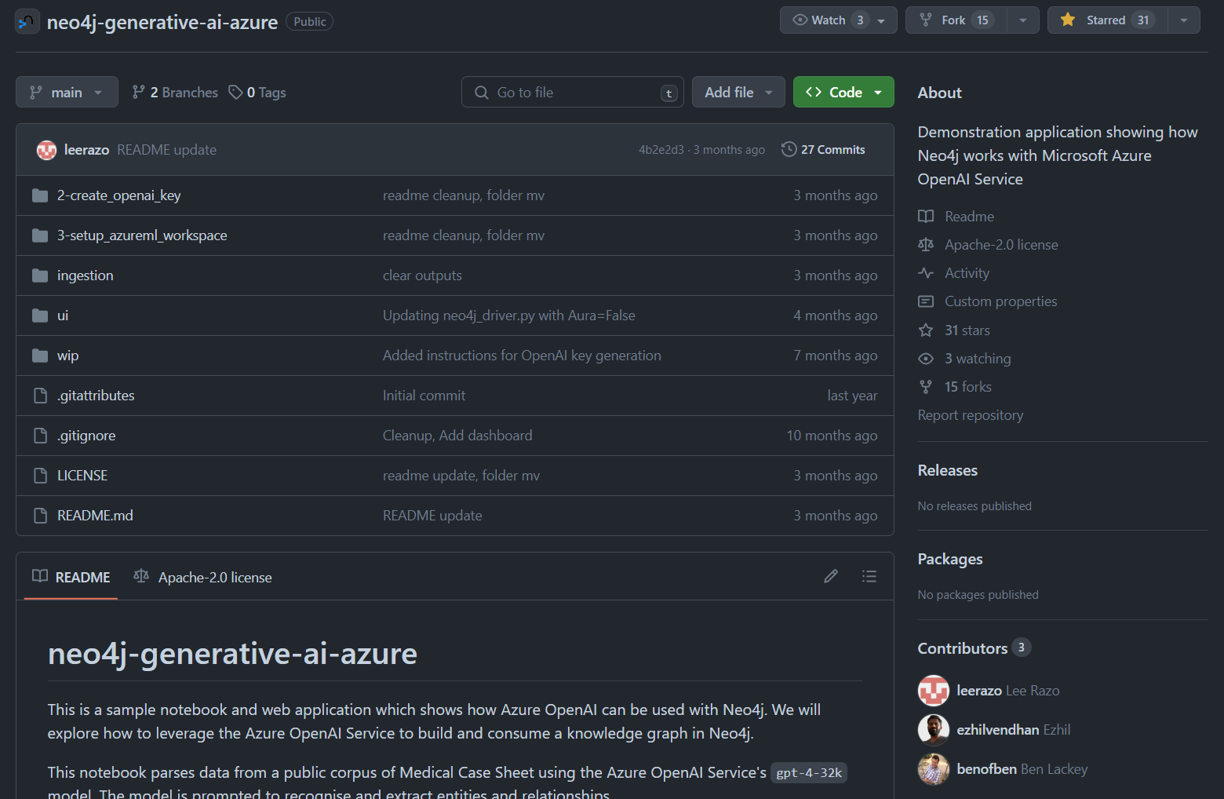
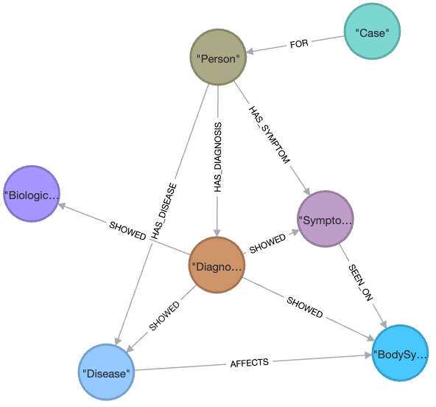
Part 2: Medical Chatbot Using Unstructured Data
What you will learn:
How to prompt an LLM to construct the knowledge graph.
How to create knowledge graph from unstructured text.

Slide 11
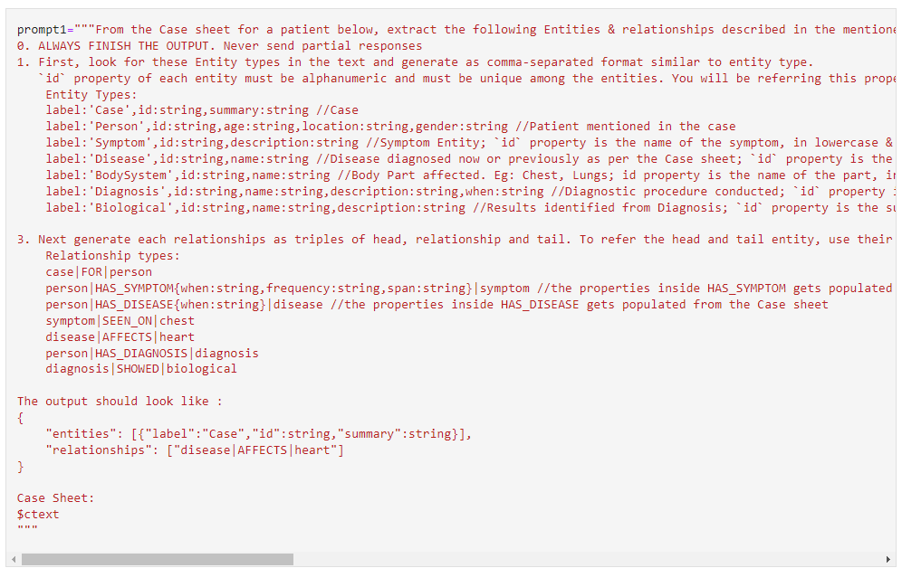
Prompt
GPT 4 + Neo4j (cypher)

Slide 12
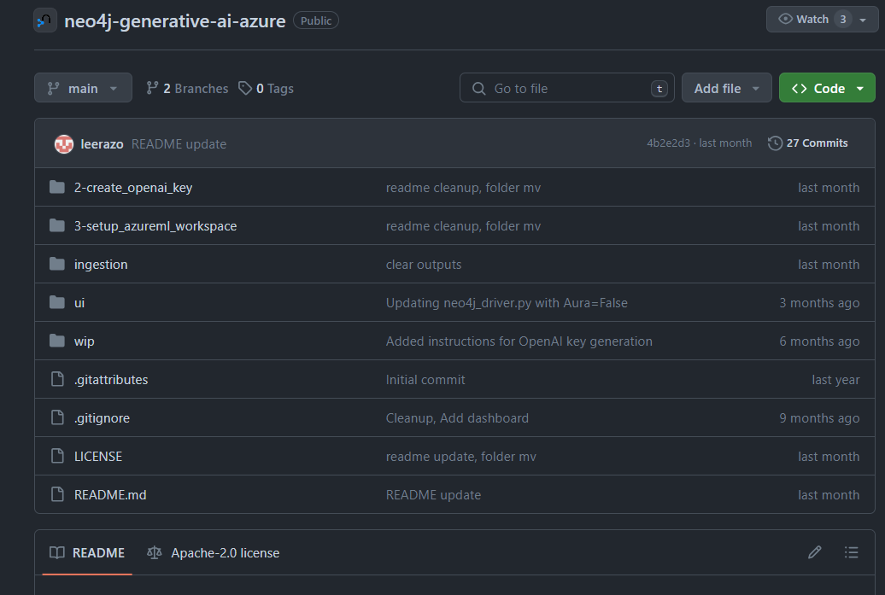
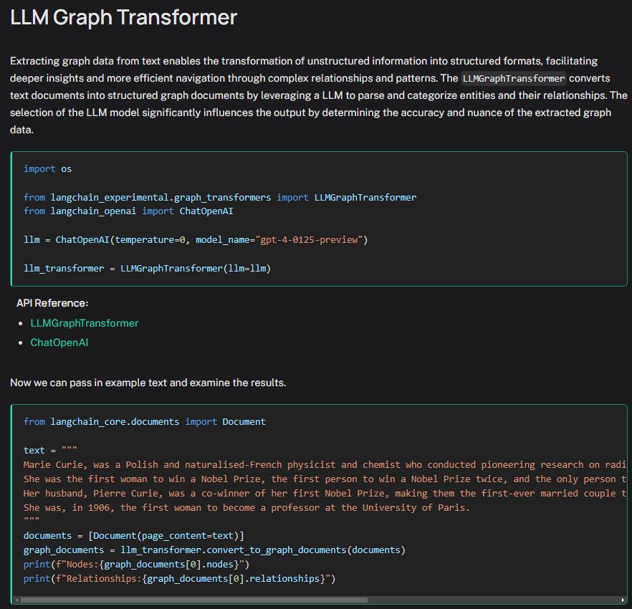
Resources: LLMs for constructing Knowledge Graph
https://github.com/neo4j-partners/neo4j-generative-ai-azure
https://python.langchain.com/docs/use_cases/graph/constructing/

