Slide 1
Kubernetes

Slide 2
Container Orchestration
ProductService
ProductService
Fault-tolerance
On-demand scalability
Performance
CouponService
CouponService
Auto Discovery
Public Access
Auto Update and
RollBack
DB Server
DB Server

Slide 3

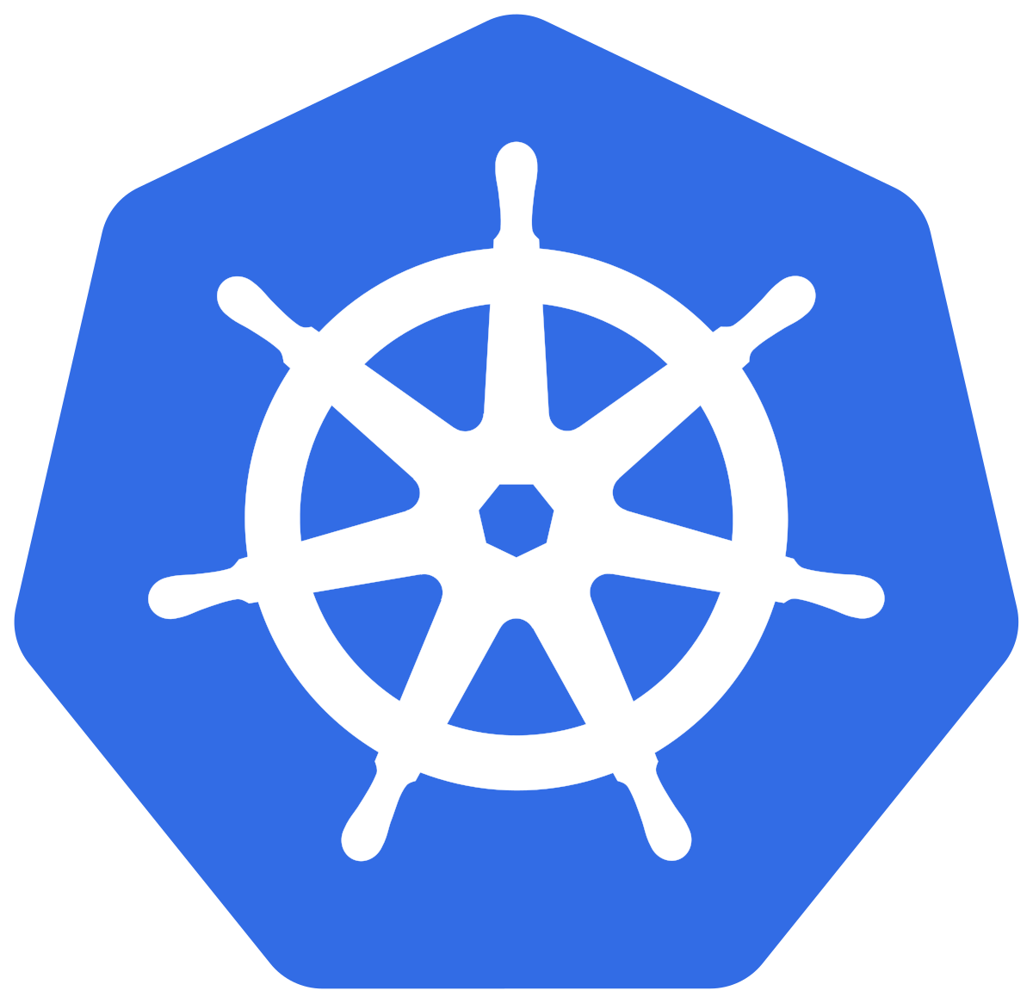
ProductService
CouponService
DB Server
ProductService
ProductService
Helmsman
CouponService
CouponService
Ship Pilot
DB Server
DB Server
Prod
ProductService
CouponService
DB Server
K8s
CI/CD
Cloud Native Computing Foundation
ProductService
CouponService
DB Server
Google Kubernetes Engine
AWS Elastic Container Service
Test
Azure Kubernetes Service

Slide 4
Namespace
Deployment
Docker
ReplicaSet
POD
POD
POD
Pod
Service

Slide 5
Master
Worker
Api Server
kubelet
proxy
Scheduler
Control
Manager
Docker
etcd
Worker
kubelet
proxy
kubectl
Docker

Slide 6
Phases
POD
Pending
Running
Container
Succeeded
Failed
Unknown

Slide 7
POD
Network
Security
DB Server
CouponService
ProductService
DB Server
CouponService
ProductService
Configuration
Volumes

Slide 8
Environment Variables
POD
POD
POD
Executing Commands
Product
Service
Product
Service
Product
Service
POD
POD
DB Server
DB Server
Service
POD
POD
POD
Coupon
Service
Coupon
Service
Coupon
Service
Liveness and Readiness

Slide 9
productservice
POD
POD
POD
Product
Service
Product
Service
Product
Service
POD
POD
DB Server
DB Server
POD
POD
POD
Coupon
Service
Coupon
Service
Coupon
Service
mysqlservice
couponservice

Slide 10
Single-Node Installation
Master
Worker
Api Server
kubelet
proxy
Scheduler
Control
Manager
Docker
kubectl
Minikube
Docker Desktop

Slide 11
On-Premise Bare Metal or VMs
Cloud Installation
Hosted Solutions on Cloud
Google Kubernetes Engine (GKE)
Azure Kubernetes Service (AKS)
OpenShift Dedicated
On Premise Private Cloud

Slide 12
Apps
Master
Worker
Api Server
Load
Balancer
kubelet
proxy
Scheduler
Control
Manager
Docker
etcd
Worker
kubelet
proxy
kubectl
Single-Master and Multi-Worker
Docker
Multi-Master and Multi-Worker

Slide 13
Only Cluster
Client/Tester
Outside
Maps to a entity
Service
PodA
PodB
PodC
172.33.22.1
172.33.22.10
172.33.22.18

Slide 14
ClusterIP
PodD
172.33.22.30
10.20.162.144
Cluster IP
Service
IP Tables
IPV4
PodA
PodB
PodC
172.33.22.1
172.33.22.10
172.33.22.18

Slide 15
NodePort
Client/Tester
NodePort
Service
30000 to 32767
10.20.162.144
Cluster IP
PodA
PodB
PodC
172.33.22.1
172.33.22.10
172.33.22.18

Slide 16
LoadBalancer
Client
AWS ELB
NodePort
NodePort
32333
32333
ClusterIP
ClusterIP
PodA
PodB
PodC
172.33.22.1
172.33.22.10
172.33.22.18

Slide 17
External Name
Ingress
8080
80

Slide 18
kubectl
command
resource
<options>
create
pod
get
replicaset
describe
service
delete

Slide 19
Coupon
Service
coupon-app
MySql
docker-mysql
Product
Service
product-app

Slide 20
DB Deployment
Create Deployment
Create ConfigMap
Mount Volume

Slide 21
Volumes
Container
Container
Container
/etc/config
/etc/config
/etc/config
Pod
Pod
/config/data
/config/data

Slide 22
emptyDir
nfs
Config Map and secret
hostPath

Slide 23
httpd
Image Versions
POD
httpd
maxUnavailable
Deployment
maxSurge
POD
Recreate
httpd
POD
RollingUpdate

Slide 24
PersistentVolume
PersistentVolumeClaim
Container
Container
Cluster
/etc/config
/etc/config
\
Persistent Volume
/data
Pod
Persistent
Volume
Claim
Volume

Slide 25
Access Modes
ReadWriteOnce
ReadOnlyMany
ReadWriteMany

Slide 26
Create Persistent Volume
Create Persistent Volume Claim
Mount the Volume Claim

Slide 27
Labels and Selectors

Slide 28
Coupon Deployment
DB Deployment
app: cs
Product Deployment
app: db
app: ps
Product
Service
MySql
app: db
Product
Service
app: ps
app: ps
Coupon
Service
MySql
Coupon
Service
app: cs
Coupon
Service
app: cs
app: db
app: cs

Slide 29
=
!=
in
notin
exists

