Slide 1




SMART KOPARGOAN HACKATHON
Problem Statement ID – SHK007
Problem Statement Title - AI smart farm operations & Resource Coordination platform
Theme - Smart Agriculture & Rural Digital Transformation
PS Category - Software
Team ID - PAR5ZV
Team Name - Team KrishiX
sanjivani.edu.in skh.sanjivaniuniversity.co
2

Slide 2

IDEA TITLE
PROPOSED SOLUTION
KEY USP's
Generates a personalized crop-wise farming schedule with timely reminders.
Instantly matches verified labour and machinery based on real-time availability, pricing, and ratings.
Enables nearby farmers to share machinery, reducing transportation costs and increasing utilization.
OTP verification, Smart Trust Score, & secure digital payments ensure transparency & reliability.
Manage bookings, live tracking, earnings, analytics, and resources from a single platform.
Multilingual Support for better accessibility.
Real-Time Notifications & Reminders for timely farm operations.
Scalable & Future-Ready Platform with support for weather, crop advisory, and government services.
An AI-powered Smart Farm Operations Platform that connects Farmers, Labourers, and Machinery Owners in a single digital ecosystem..
an search, compare, and instantly book verified labour
and machinery based on real-time availability, pricing, and ratings.
AI Farm Operations Planner generates a personalized crop-wise schedule and sends timely reminders for every farming activity.
Smart Cooperative Booking enables nearby farmers to share machinery, reducing transportation costs, fuel consumption, and waiting time.
Live GPS tracking, OTP verification, secure digital payments, and Smart Trust Score ensure transparency, safety, and reliability.
A centralized dashboard allows users to manage bookings, monitor resources, track earnings, and view analytics in one place.
The platform helps ensure timely farm operations, better resource utilization, lower farming costs, and increased productivity.
The platform also promotes digital transformation in agriculture by simplifying resource management through a single, user-friendly application.
It strengthens collaboration between farmers, labourers, and machinery owners, creating a more connected and efficient farming ecosystem.
input
Process
OUTPUT
farmer Requirements
AI-analysis & planning
farm operation schedule
labour & Machinery
Smart Matching
Labour & Machinery booking
Weather & soil info
Cooperative Optimization
Live Tracking & Updates
Marhet Price
Secure booking & Payment
Cost Saving & Productivity
sanjivani.edu.in skh.sanjivaniuniversity.co
2

Slide 3





TECHNICAL APPROACH
Login / Register
(Farmer / Labourer / Machinery Owner)
Technology Stack
Farmers
Post Requirements
View Dashboard
Check Schedule
Labourers
Create Profile
Update Availability
View Bookings
Machinery Owners
Add Machinery Details
Update Availability
View Bookings
Admin
Manage Users
Verify Profiles
Monitor Platform
Front End
Requirement
Select Work Type
Date & Location
Other Details
AI Based Matching
Find Nearby Labour
Find Machinery
Compare Price & Ratings
Choose & Book
Select Best Option
Confirm Booking
Get Confirmation
Secure Payment
Pay Online
Safe & Secure
Get Receipt
Live Tracking
Track Labour / Machinery
Live Location
Backend
Database & File Storage
Data Inputs
Weather Information
Soil Information
Crop Information
AI Planning
Crop Wise Plan
Activity Schedule
Timely Reminders
Outputs / Benefits
Timely Operations
Cost Saving
Higher Productivity
Payments
Alerts
Booking Alerts
Reminders
Weather Alerts
Operation Management
Manage Bookings
Work Completion
Feedback & Ratings
Reports & Analytics
Earnings Report
Booking History
Performance Report
Maps and Geolocation
sanjivani.edu.in skh.sanjivaniuniversity.co
2

Slide 4
FEASIBILITY AND VIABILITY
Challenges | Our Solution
Labour shortage | AI matches nearby verified labourers instantly
Machinery unavailability | Real-time machinery booking with live availability
High transportation cost | Smart Cooperative Booking reduces travel cost
AI-Powered Farm Planning
Cloud & Mobile
Platform
Feasibility
Scalable & Easy to Deploy
Smart Resource
Matching
Viability
Problem Solving
- Helps farmers easily find labour and machinery when they need them.
Operational Efficiency
- Reduces waiting time, travel costs, and fuel usage.
Productivity Impact
- Increases farm productivity with AI-based planning.
Economic Impact
- Creates more income opportunities for labourers and machinery owners.
Business Model
- Earns revenue through booking fees and premium services.
rust & payment issues | OTP verification, ratings & Smart Trust Score
Lack of transparency | Centralized dashboard with tracking & analytics
Limited digital adoption | Simple multilingual interface with voice assistance
sanjivani.edu.in skh.sanjivaniuniversity.co
2

Slide 5
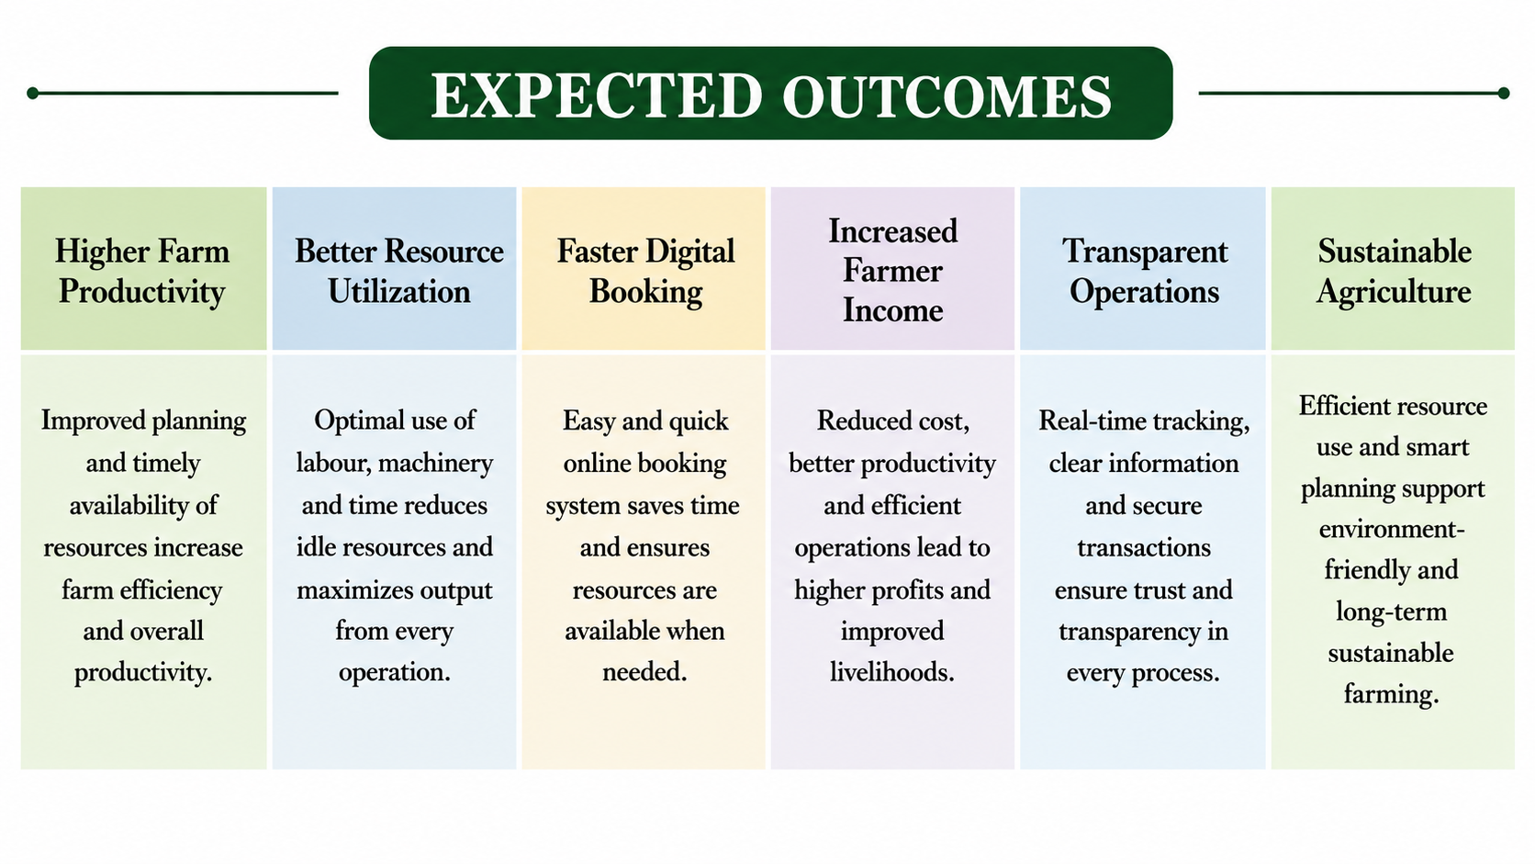
IMPACT AND BENEFITS
BENIFITS
IMPACT
Improves farm productivity through AI-based planning and timely operations.
Reduces labour shortages by connecting farmers with verified labourers instantly.
Optimizes machinery utilization using Smart Cooperative Booking.
Promotes digital farming with online booking, tracking, and secure payments.
Builds trust and transparency through OTP verification, ratings, and Smart Trust Score.
Supports sustainable agriculture by reducing fuel usage and resource wastage.
Strengthens rural economy by creating employment and increasing farmers' income.
Increases crop productivity through intelligent planning and timely execution.
AI-based farm planning and timely reminders
Easy labour & machinery booking with real-time tracking
More booking opportunities and steady income
Better machinery utilization with less idle time
Secure payments and transparent transaction
Efficient sharing of local resources
Sustainable and collaborative farming ecosystem
Transforms traditional farming into an AI-based smart farming ecosystem
Enhances farmer’s income by reducing operational costs and increasing efficiency.
EXPECTED OUTCOMES
sanjivani.edu.in skh.sanjivaniuniversity.co
2

Slide 6
RESEARCH AND REFERENCES
RESEARCH INSIGHTS
Indian Council of Agricultural Research (ICAR)
https://icar.org.in
Ministry of Agriculture & Farmers Welfare
https://agricoop.gov.in
Studied the challenges faced by farmers, labourers, and machinery owners in rural Maharashtra.
Identified major issues such as labour shortages, machinery underutilization, and delayed farm operations.
Explored AI-based farm planning, cooperative resource sharing, and digital booking systems as practical solutions.
Reviewed national initiatives promoting Digital Agriculture and rural digital transformation.
These findings formed the foundation of the Smart Kopargaon Platform.
REFERENCES
Department of Agriculture, Maharashtra
https://krishi.maharashtra.gov.in
e-NAM – National Agriculture Market
https://enam.gov.in
Food and Agriculture Organization (FAO)
https://www.fao.org
FUTURE SCOPE
Add AI weather forecasts and smart crop advice to help farmers make better farming decisions.
Use drones and smart sensors to monitor crops, check field conditions, and improve farming efficiency.
sanjivani.edu.in skh.sanjivaniuniversity.co
2

