Slide 1
Innovation & Entrepreneurship
Sessions 4 & 5:
Satish Medapati

Slide 2
Innovation Examples
Tech : Internet, Mobile etc.
Product : Electric cars, Planes
Process : Lean, Kaizen, CICD
Finance :, Sub prime, VC
Cultural : Live -in, Entrepreneurship
Legal : Class Action Lawsuits, Patents
Eco System: Silicon Valley, Bangalore
Sports:

Slide 3
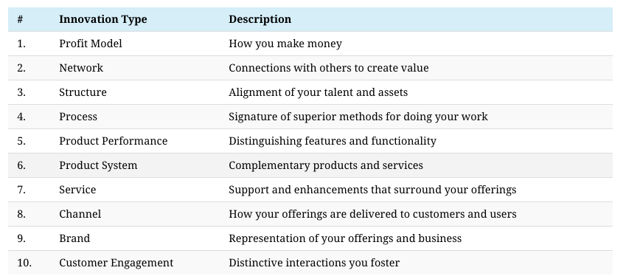
Ten Types of Innovation (Doblin/Deloitte)

Slide 4
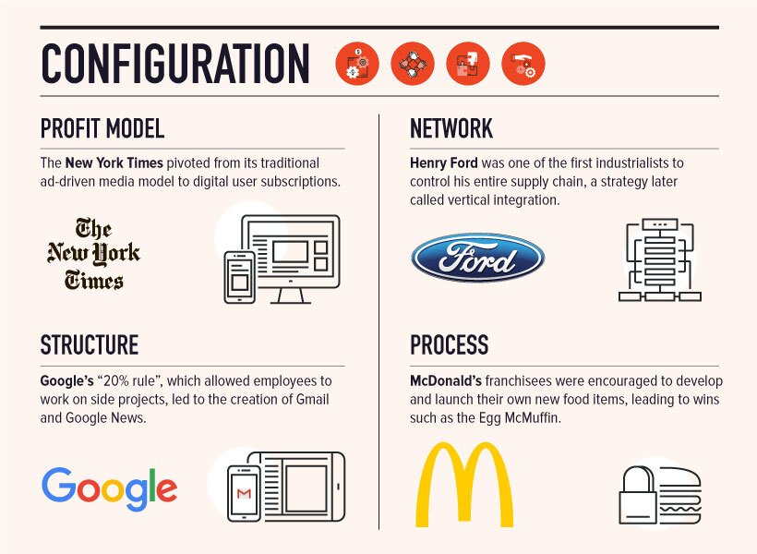
First Four (4) - Configuration
According to Doblin, the first four types of innovation center around the configuration of the company, and all the work that happens “behind the scenes”.
Non -Customer - Facing ?
Downstream Effect
Notes:
https://www.visualcapitalist.com/10-types-of-innovation-the-art-of-discovering-a-breakthrough-product/

Slide 5
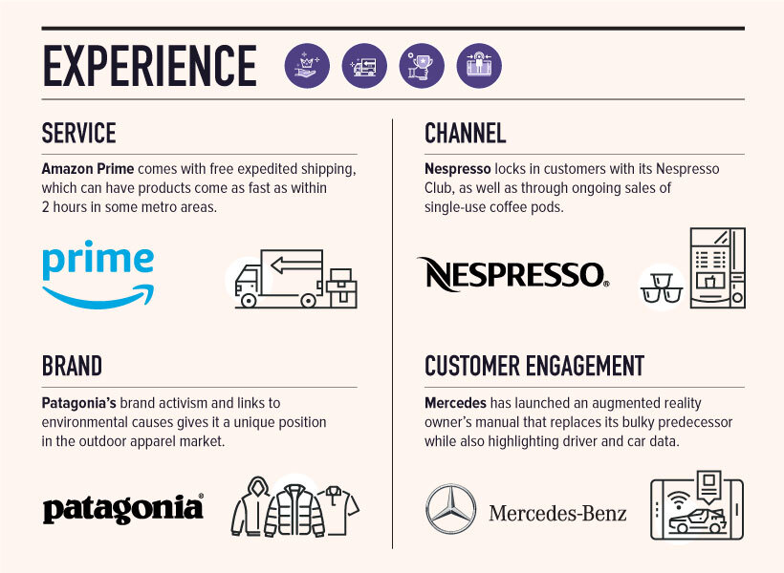
Innovation Types #7-10: “Experience”
Customer -facing
Practical evaluation in customer’s hands (risk)
Early internet days, online shipping was precarious - Amazon Prime and free expedited shipping for all members has been a game-changer
Executing on such a promise was no small task, but today there are 150 million users of Prime worldwide,

Slide 6
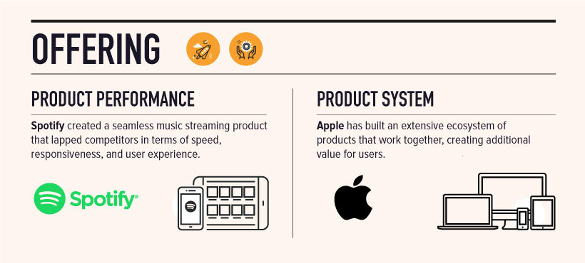
Innovation Types #5-6: “Offering”
Product performance improvement is obvious but difficult type of innovation unless it’s added by a deeply ingrained company culture towards technical innovation
Combine multiple areas of innovation together

Slide 8
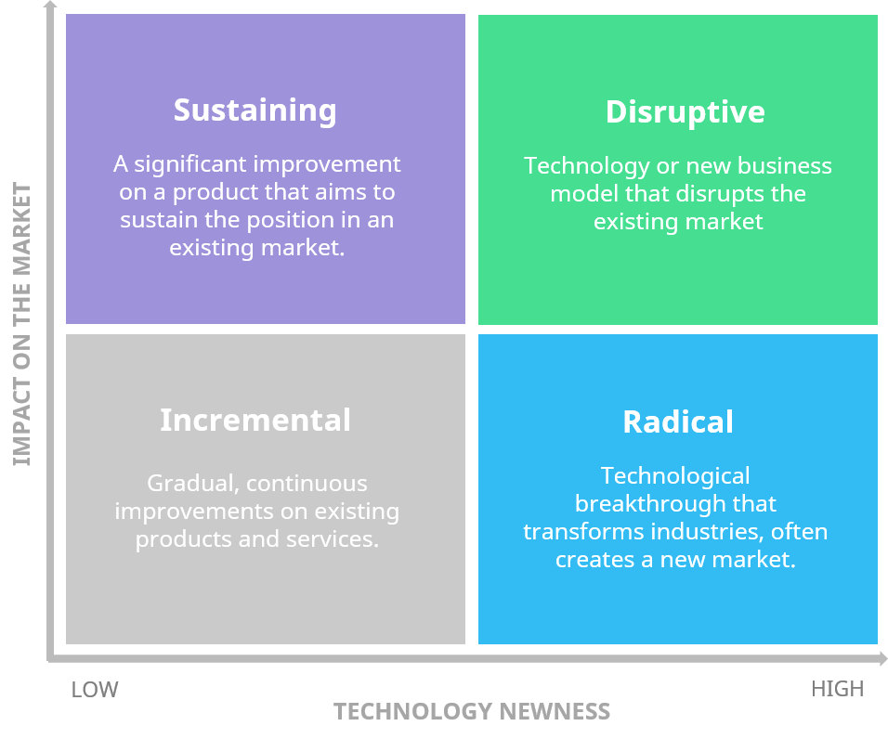
Innovation Matrix Framework
Incremental innovation is focused on iteration and modification of existing technologies or processes, usually to improve efficiency or costs, or reduce use of materials.
Disruptive innovation is still based on the existing technology, but changes how things are done and what is achieved as a result.
Radical innovation marks a break with previous technologies, processes, ideas and ways of doing things.

Slide 9
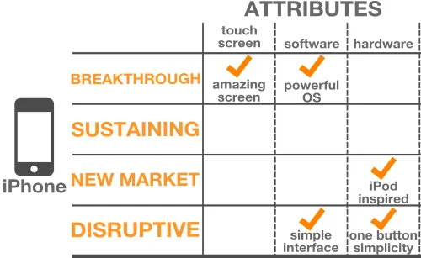
Examples of Innovation in iphone
What applies to iphone 12 ?
Can you map the same to a new version of phone you like ?
Notes:
https://www.ignitionframework.com/the-four-types-of-innovation-and-the-strategic-choices-each-one-represents/
https://openviewpartners.com/blog/11-disruptive-innovation-examples-and-why-uber-and-tesla-dont-make-the-cut/#lightbulbs

Slide 10
Technology Assessment of Innovation

Slide 11
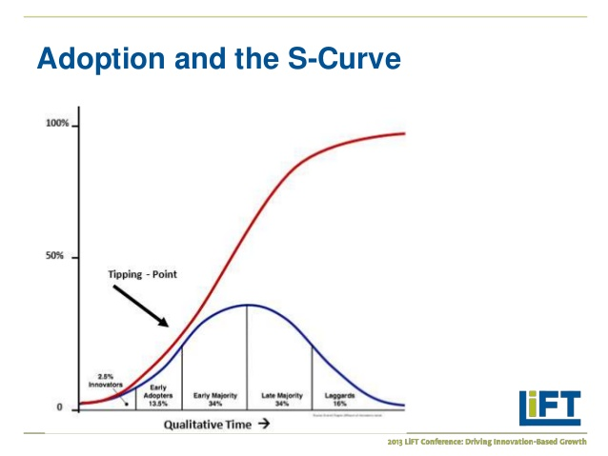
S-Curve - What is it ?
S-Curve is a measure of the speed of adoption of an innovation
First used in 1903 by Gabriel Tarde who first plotted the S-shaped diffusion curve
Diffusion of innovations is a theory that seeks to explain how, why, and at what rate new ideas and technology spread (Everett Rogers, 1962, Communication Studies Prof.)

Slide 12
S-Curve - Four (4) Components
Scale. In this phase, the product or industry has established its design or business model. In addition, the product or industry has proven to fulfill the needs of the market and is now gaining customer adoption. This phase is placed in the middle of the S-shape because it is characterized by hypergrowth, mass production and increasing market demand.
Incubate. This phase describes products or an industry that is completely new and innovative. Organizations in this phase are in fierce competition to establish a dominant position in the market before the market becomes too established. In order to assure top-billing, organizations spend a lot of their time and effort researching and developing their products so that they are the best offered. This stage is located at the bottom of the S-shape as there is only a small amount of growth
Discontinuity. As prior products or older industries reach their peak, there is opportunity for new ideas to take shape, which is where innovation occurs. This stage is considered to be “disruptive” as opportunities arise for new product appeal, new market segments or new technologies to work with. This stage is located at the bottom of the second S (which is higher than the first S to reflect upward growth), and essentially restarts the four steps.
Maturity. A product or industry in this phase has reached the plateau of market acceptance. The product is well-established and widely used. Because of industry growth and the number of competitors, organizations usually spend time and money on improving their products or reducing their cost. Very incremental changes are made when it comes to innovation. As such, this stage is located in the peak of the S-curve as there is very little growth during this time.

Slide 13
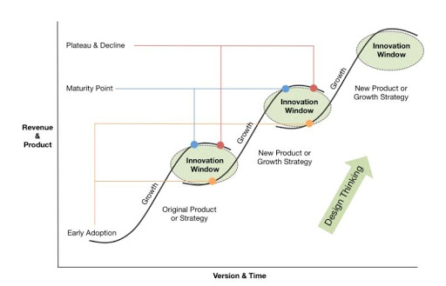
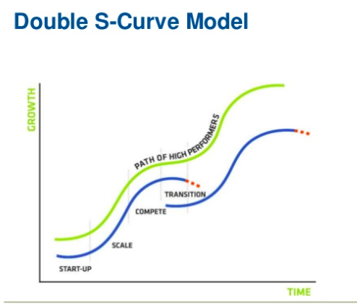
S-Curve - Growing the Curve
How do we move the S curve
Double S-Curve concept are more perception of high performing innovating companies
101014649058

Slide 14
S-Curve - Growth Trajectory
4 Types of S-Curves
It is helpful to consider the numerous S-curves that can explain how a product or industry is changing over time:
Level of Invention – Breakthrough inventions lead to the appearance of new industries. Typically, a high-level solution solves a contradiction which delivers a new or potentially more ideal way of delivering an existing function. For example, the solid state transistor led to the semiconductor industry and manufacture of integrated circuits.
Number of Inventions – As an industry evolves over time, the number of inventions within it gradually rises until the decline stage.
Performance – As an industry evolves over time, the perceived performance of the products within it gradually rises. In the decline stage, the perceived performance declines relative to competing offerings.
Profit – As an industry evolves over time, the profits generated by it gradually rise until the decline stage.

Slide 15
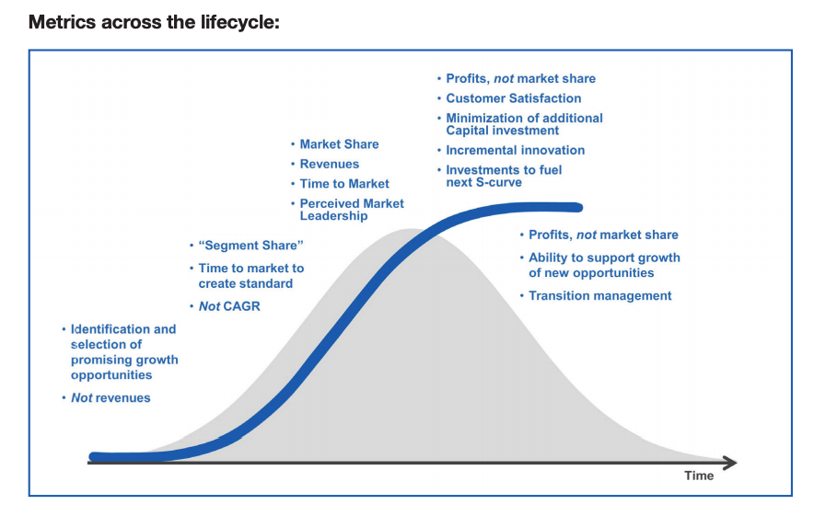
Metrics - Across the Curve
Which metrics to track across which stages of life cycle are evident here
Pick up triggers of growth or decline at each bend and track metrics to understand how and where to move the next innovation forward.
Which stage are you in?
How many innovation projects ?
Team, Skills, Culture, Planning etc.
10146405

Slide 16
Market Assessment of Innovation

Slide 17
DISRUPTIVE INNOVATION THEORY: WHAT IT IS & 4 KEY CONCEPTS
What is disruptive innovation ?
Uber, Lyft , Tesla ?
What does “disruptive innovation” actually mean, and how can today’s businesses—both the disruptors and the disrupted—form an understanding that will allow them to spot potential opportunities and threats?

Slide 18
DISRUPTIVE INNOVATION THEORY: WHAT IT IS & 4 KEY CONCEPTS
According to Christensen(who coined the term in 1990s), disruptive innovation is the process in which a smaller company, usually with fewer resources, is able to challenge an established business (often called an “incumbent”) by entering at the bottom of the market and continuing to move up-market. This process usually happens over a number of steps:
Incumbent businesses innovate and develop their products or services in order to appeal to their most demanding and/or profitable customers, ignoring the needs of those downmarket.
Entrants target this ignored market segment and gain traction by meeting their needs at a reduced cost compared to what is offered by the incumbent.
Incumbents don’t respond to the new entrant, continuing to focus on their more profitable segments.
Entrants eventually move upmarket by offering solutions that appeal to the incumbent’s “mainstream” customers.
Once the new entrant has begun to attract the incumbent business’s mainstream customers en masse, disruption has occurred.

Slide 19
HOW TO UNDERSTAND DISRUPTIVE INNOVATION THEORY
1. Not All Innovation Is Disruption: It is "what happens when the incumbents are so focused on pleasing their most profitable customers that they neglect or misjudge the needs of their other segments."
2. Disruption Can Be Low-End or New-Market
Low-end disruption refers to businesses that come in at the bottom of the market and serve customers in a way that is "good enough." These are generally the lower profit markets for the incumbent and thus, when these new businesses enter, the incumbents move further "upstream." In other words, they put their focus on where the greater profit margins are.
New-market disruption refers to businesses that compete against non-consumption in lower margin sectors of an industry. Similar to low-end disruption, the products offered are generally seen as "good enough," and the emerging business is profitable at these lower prices.
3. Disruptive Innovation Is a Process, Rather Than a Product or Service
Source: HBR article

Slide 20
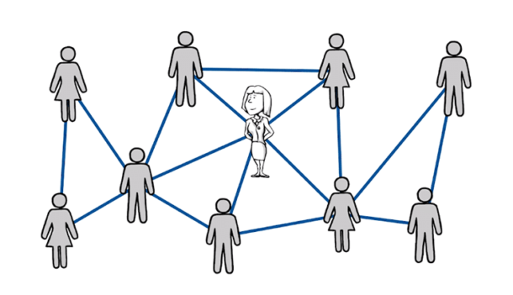
How to identify Target Segment?
Demographics
Research Customer, Product, Service, Competition
Understand your customers - interview, focus groups, survey
Competition Analysis (to be continued in next slide)
Product Value Analysis
10146405

Slide 21
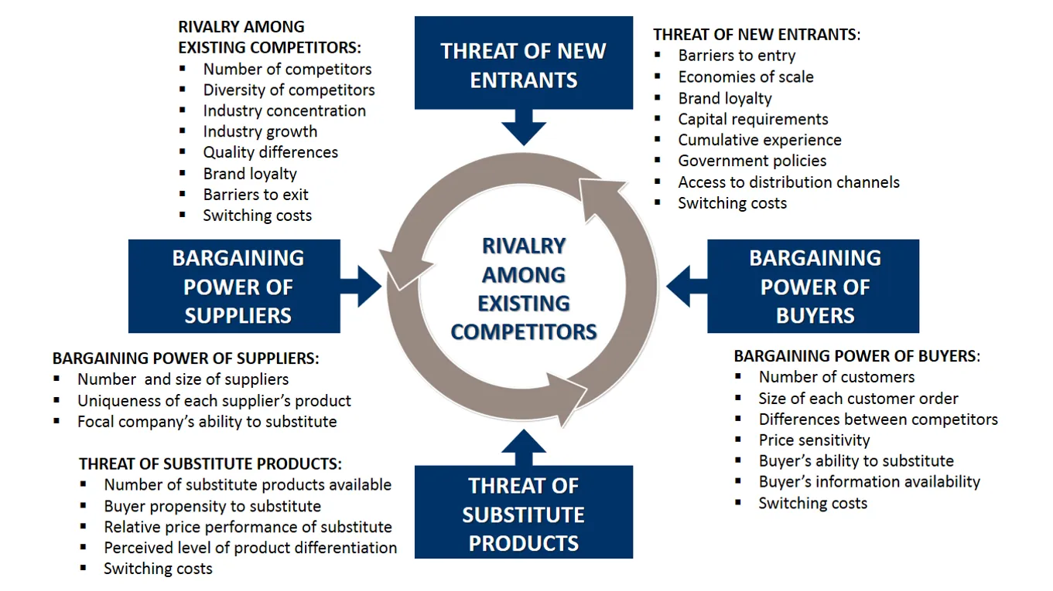

Slide 22
Now go Innovate !

