Slide 1
Digital Marketing for Product Start Ups

Slide 2

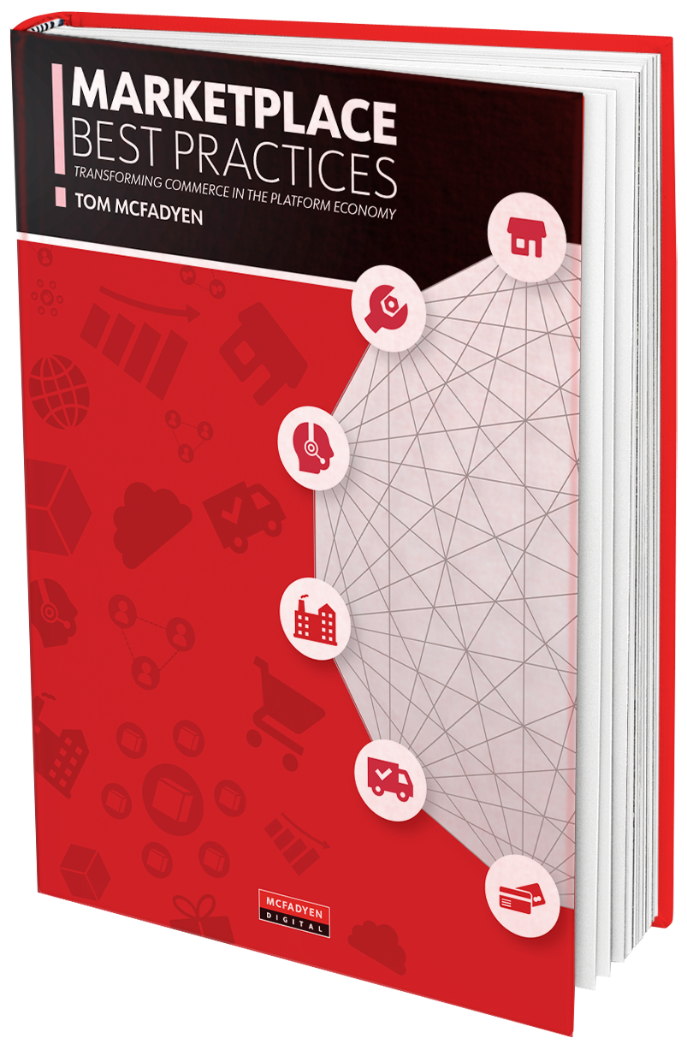






About Stephen George
Over 20 Years of experience in digital marketing across B2B, B2C & Tech Startups
Currently serving as Director of Content & Digital at McFadyen Digital
Author of Books & Industry Leading Whitepapers
MARKETPLACE BEST PRACTICES
A new book about transforming commerce in the platform economy with the online marketplace model

Slide 3
What we will cover in this session
Why Do Products Fail
How Do you not Fail
Agile Marketing
Agile vs Conventional Marketing
Introduction to Growth Marketing
Growth Marketing Skills
Growth Marketing Tactics
Temperament for Growth Marketing
How do you go about it
Digital Marketing Tactics

Slide 4

Percentage of products launches that fail range from anywhere between 75-90%.
Your product attempted to fill a need that did not exist yet or
You failed to educate the market on the need for an innovative product.
Poor reading of market and consumer trends.
Product price could be a factor, or it could be a matter of bad timing,
Competitor coming to market at the same time with a better product

Slide 5
So How Do You Not Fail
use an iterative launch framework that helps to define and refine what works for your company and your audience, and builds a predictable, repeatable process as you go

Slide 6
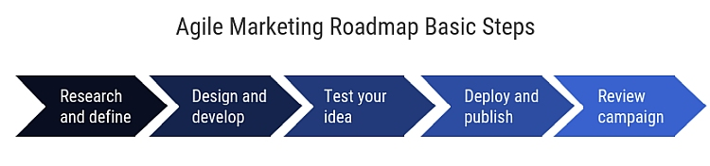
Let’s Define Agile Marketing
Agile in marketing doesn’t differ much from its use in software development. It encompasses the process of designing, developing, deploying, and testing creative campaigns continuously.

Slide 7
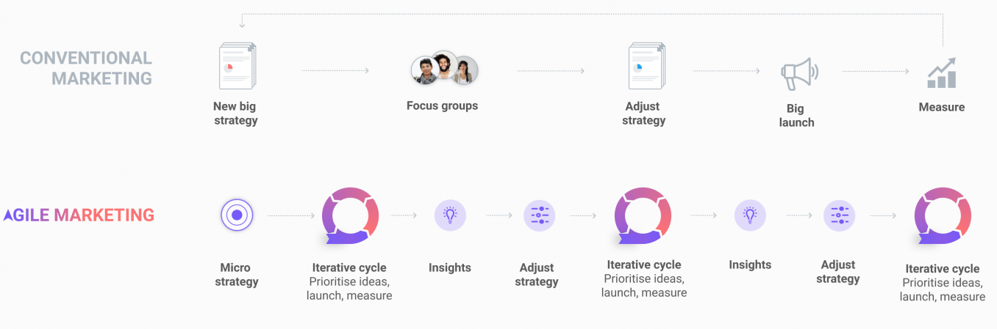
Agile Vs Conventional Marketing

Slide 8
While Agile Marketing is Great IT IS NOT
Not exactly like a Agile Software Development
An excuse not to Plan
Not meant to sacrifice planning & stability for the sake of speed
A way to force teams to accept changes constantly

Slide 9
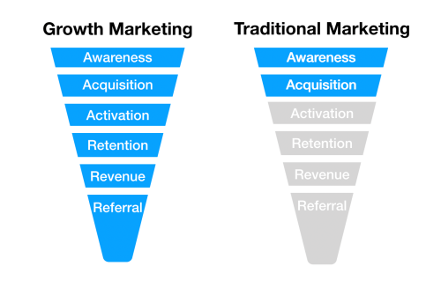
What is Growth Marketing
Growth marketing is about (you guessed it!) growth. Specifically, growing whatever a business deems the key metrics in its funnel. That might mean click-through rate, monthly active users or revenue — growth marketers don’t confine themselves to top-of-funnel metrics.

Slide 10
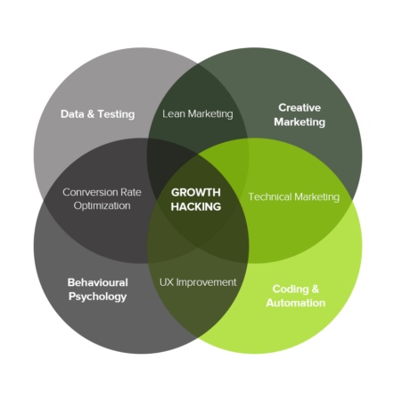
Who is Growth Marketer
Similar to “marketing managers” of the past, growth marketers know enough about paid search, paid social, CRO, user experience, email marketing, content marketing, and SEO.
They’re more focused on strategy than execution, though; you will likely need someone more specialized to 10x the plans a growth marketer puts in place.
ALSO CALLED Growth marketing managers/ Demand generation marketers/ Performance marketers/ Digital marketing managers

Slide 11
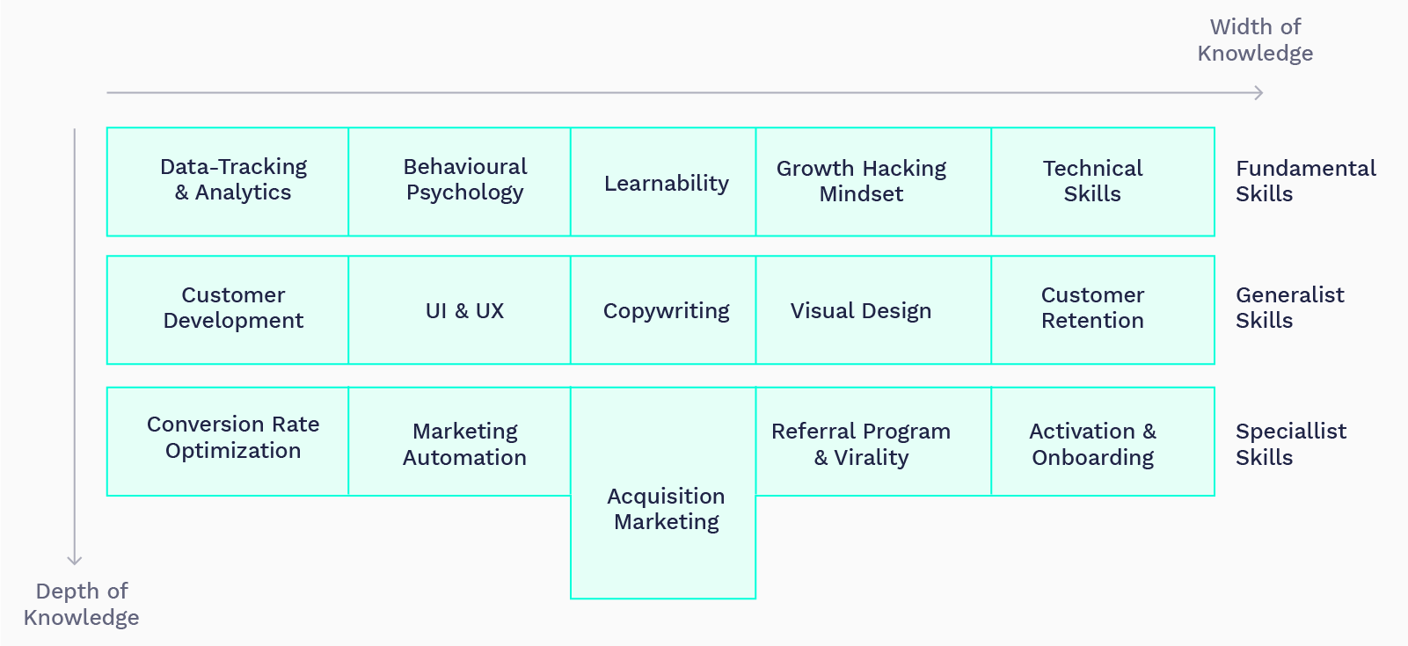
Growth Marketing Skills 2021

Slide 12
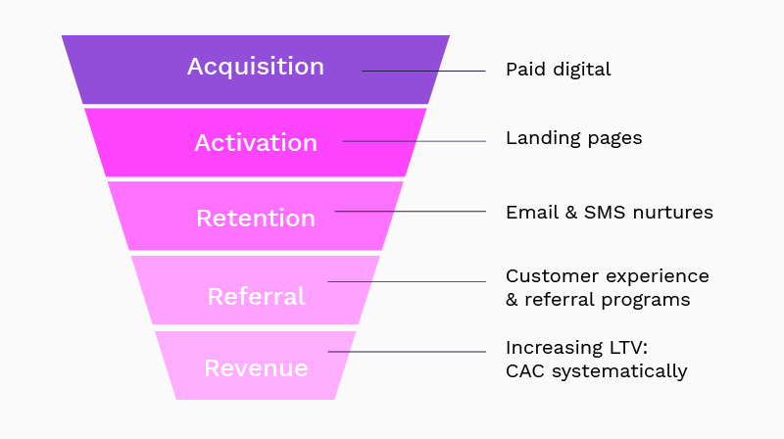
Growth Marketing Tactics – Funnel Optimization

Slide 13
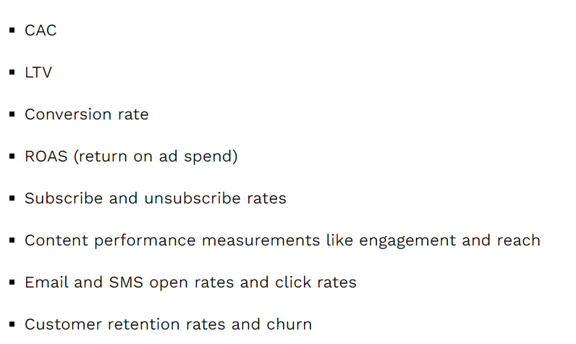
Temperament for Growth Marketing
Opinionated about creative.
Data Driven
Open to any channel
Customer Obsessed
Engineer at heart
Impatient
Innovative

Slide 14
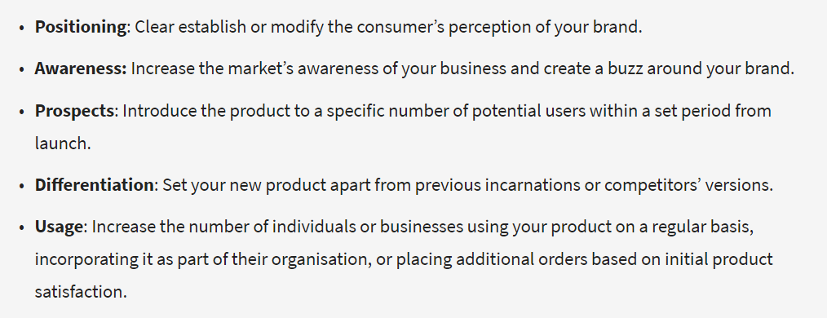
How to you go about it
Better Product – Is a GIVEN
Have a Strong Positioning and Messaging Framework
Define Launch Goals
Create Initial Target Audience
Map Your Customer Journey
Aim for High Quality Customer Experience
Focus on Your Ideal Customer
Evaluate Your Measurement Criteria
Measure & Keep Optimizing

Slide 15
Digital Marketing Tactics
Search Engine Optimization (SEO)
Pay-Per-Click (PPC) Marketing
Webinar Production
Content Marketing (Blogging & Article Writing)
Downloadable Content Offerings (eBooks, Whitepapers, Webinars)
Email Marketing
Social Media Marketing
Video Production
Website Design A/B Testing
Link Building/Earning
Marketing Automation
Lead Nurturing
Public Relations (PR)

