Slide 1

Team 1
Window evaluation strategies in Flink using the RocksDB state backend
Nirbhay Malhotra
Yuesi Liu
Rhythm Somaiya
Aman Ahmed
Bhargav Ram Reddy Pattiputtur

Slide 2

Project Goals
In this project, we intend to design and implement two alternative window operators in Flink using the Record buffer and Slicing strategies.
In our approach, we have opted to include one commutative operator and one holistic operator.
Our objective is to design efficient operators so that they provide low latency and high throughput.
Project Objective
The motivation behind this project is to explore and develop alternative window operators in Apache Flink in order to improve its performance and scalability for handling large volumes of streaming data.
Design and implement two alternative window operators in Flink using the record buffer and slicing strategies.
Optimize the representation of the state of these operators as key-value pairs in RocksDB.
Evaluate the performance and scalability of the new operators compared to Flink's default implementation, with respect to window length, the ratio of length to slide, and using different window evaluation functions.
Analyze the results of the evaluation and identify any trade-offs or limitations of the new operators.
Project Motivation
1

Slide 3
Main Achievements
01
02
03
The Tumbling Window we designed with the respective trigger is much more efficient than the default one provided by the Flink as our implementation has lower latency and higher throughput.
The Sliding Window we implemented has lower latency than the one provided by Flink.
We were able to incorporate parallelism with our Tumbling Window and Sliding Window approaches to see the difference in performance.
2

Slide 4
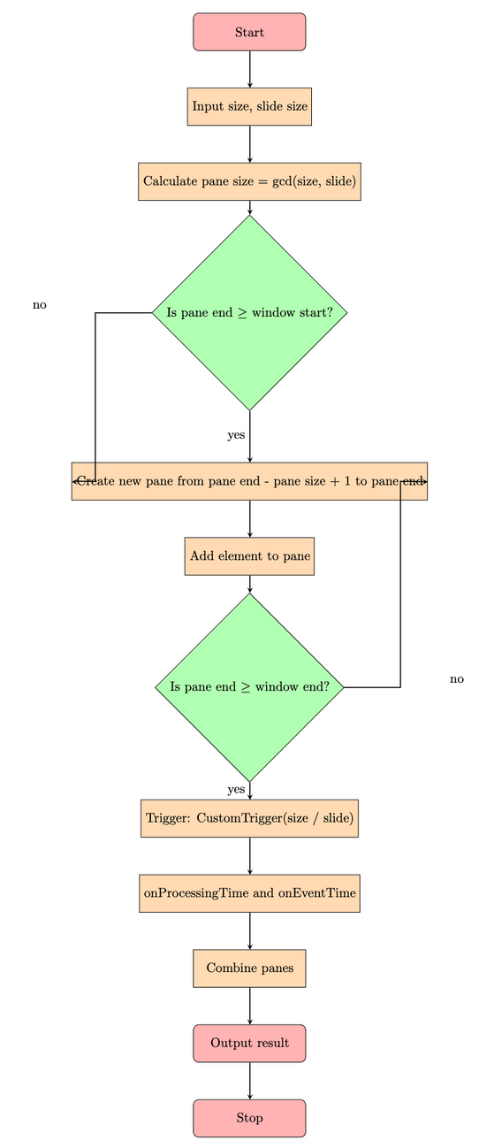
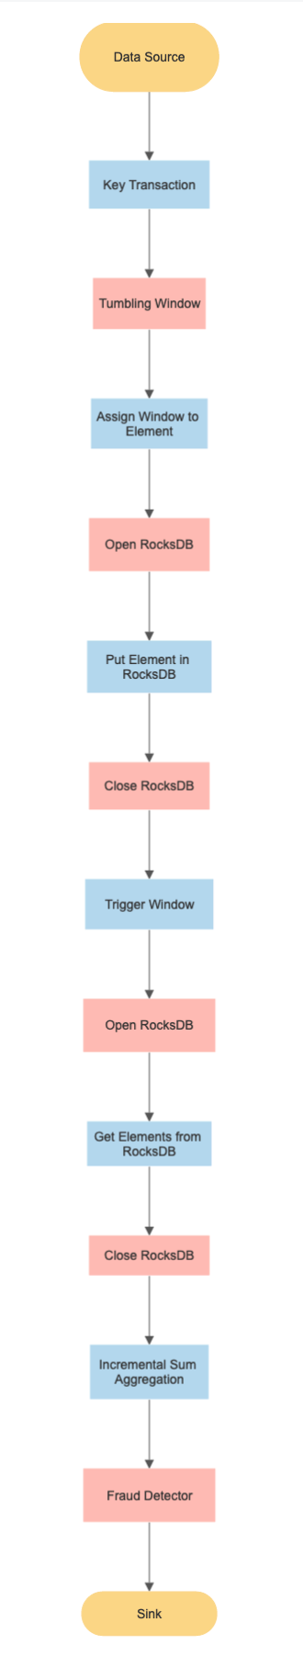
Sliding Window Approach
Tumbling Window Approach
3

Slide 5
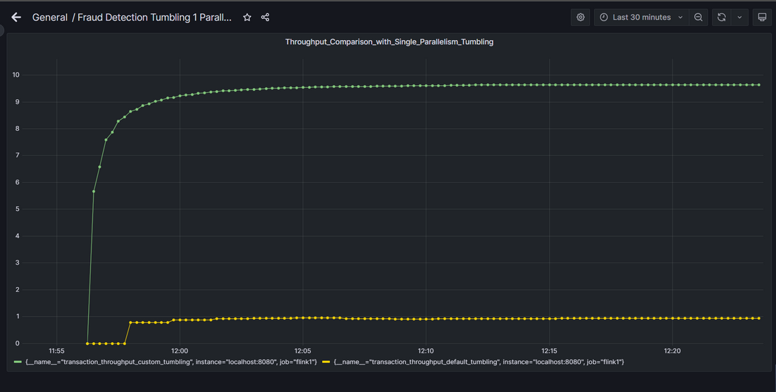
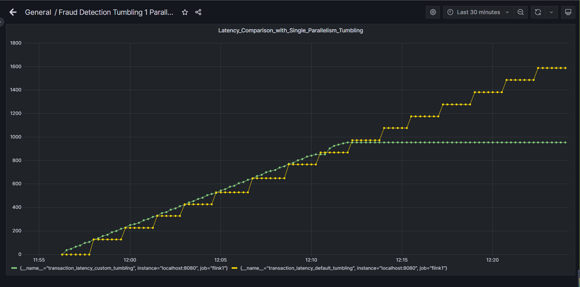
Experimental Results
Flink's Tumbling Window approach vs Custom Tumbling Window approach Throughput
Flink's Tumbling Window approach vs Custom Tumbling Window approach Latency
Our implementation of the Tumbling Window with incremental sum aggregation has better throughput than Flink's default Tumbling Window implementation with incremental sum aggregation.
Our implementation of the Tumbling Window with incremental sum aggregation has lower latency than Flink's default Tumbling Window implementation with incremental sum aggregation.
4

Slide 6
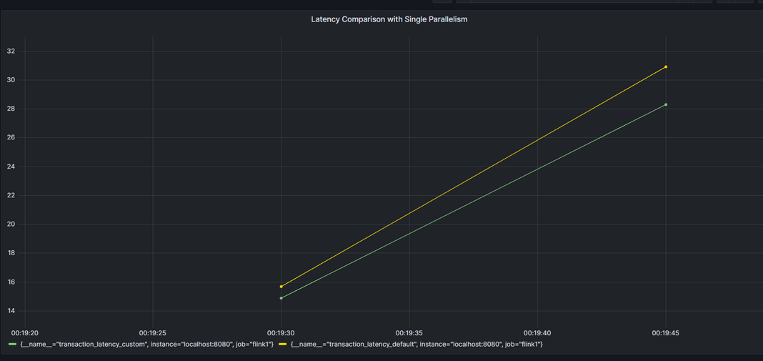
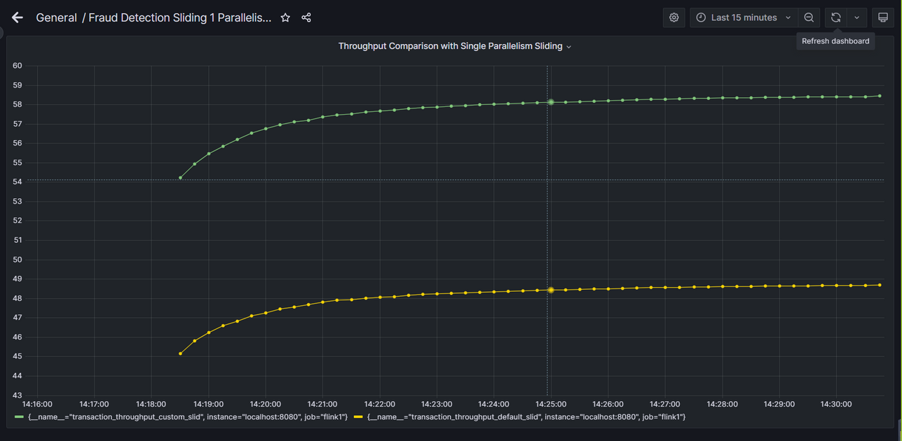
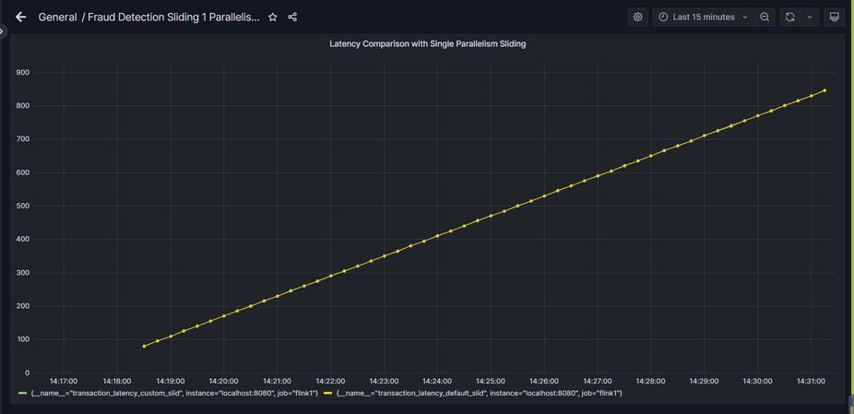
Experimental Results
Flink's Sliding Window approach vs Custom Sliding Window approach Latency
Flink's Sliding Window approach vs Custom Sliding Window approach Throughput
Our Implementation of the Sliding Window with incremental mean aggregation and slicing strategy has better throughput than Flink's default Sliding window implementation with incremental mean aggregation and slicing strategy.
Our Implementation of the Sliding Window with incremental mean aggregation and slicing strategy has lower latency than Flink's default Sliding Window implementation with incremental mean aggregation and slicing strategy.
5

Slide 7
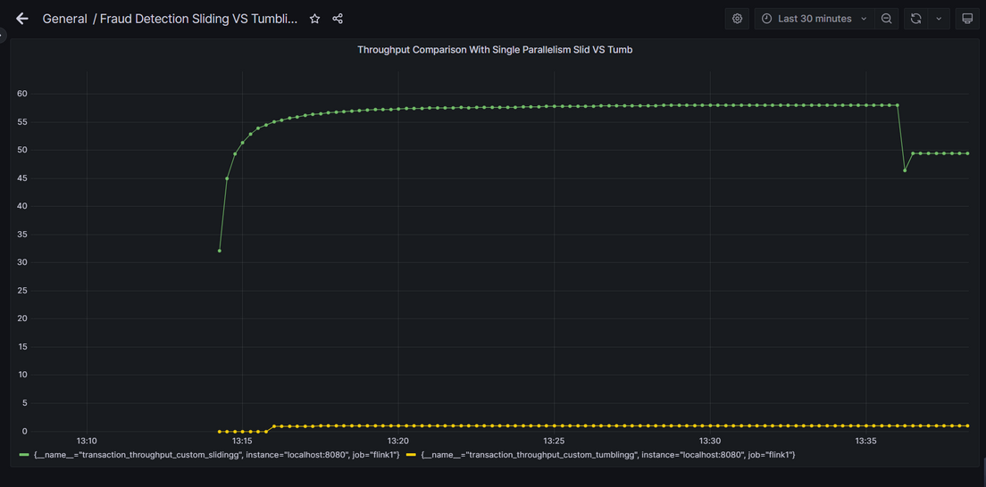
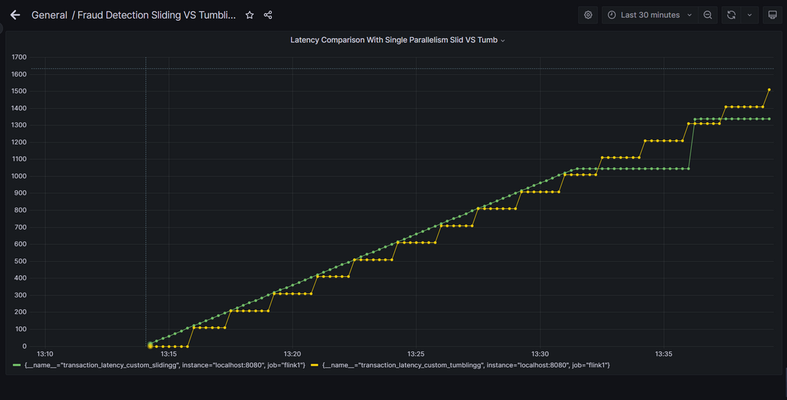
Experimental Results
Custom Sliding Window approach with incremental mean aggregation and slicing strategy vs Custom Tumbling Window approach with incremental Sum Aggregation and record Buffer Strategy
Throughput
Custom Sliding Window approach with incremental mean aggregation and slicing strategy vs Custom Tumbling Window approach with incremental Sum Aggregation and record Buffer Strategy
Latency
We can observe that the Sliding Window approach with incremental mean aggregation and slicing strategy has higher throughput than the Tumbling Window approach with incremental Sum Aggregation and record buffer strategy.
We can observe that the Sliding Window approach with incremental mean aggregation and slicing strategy has lower latency than the Tumbling Window approach with incremental Sum Aggregation and record buffer strategy.
6

Slide 8
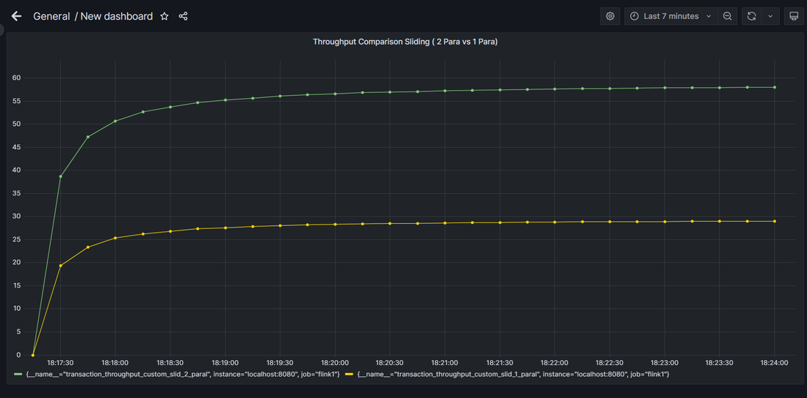
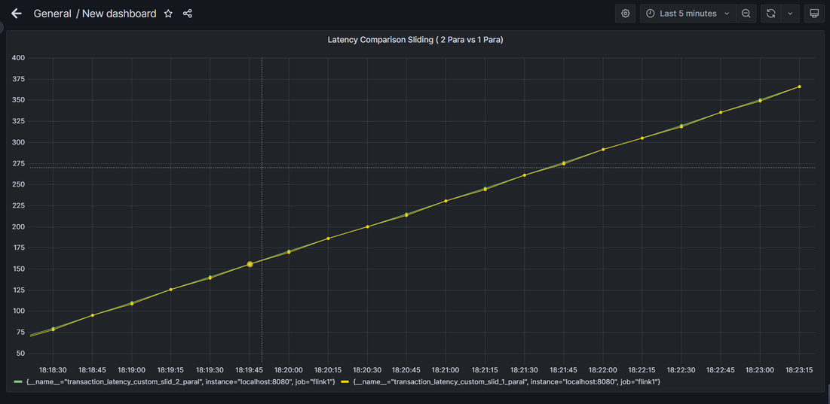
Experimental Results
Custom Sliding Window approach with parallelism - 1 vs Custom Sliding Window approach with parallelism - 2
Throughput
Custom Sliding Window approach with parallelism - 1 vs Custom Sliding Window approach with parallelism - 2
Latency
We can observe that the Sliding window with parallelism 2 with slicing strategy and incremental mean aggregation has higher throughput than the Sliding window with parallelism 1 with slicing strategy and incremental mean aggregation.
We can observe that the Sliding window with parallelism 2 with slicing strategy and incremental mean aggregation has around the same latency as the Sliding window with parallelism 1 with slicing strategy and incremental mean aggregation.
7

Slide 9
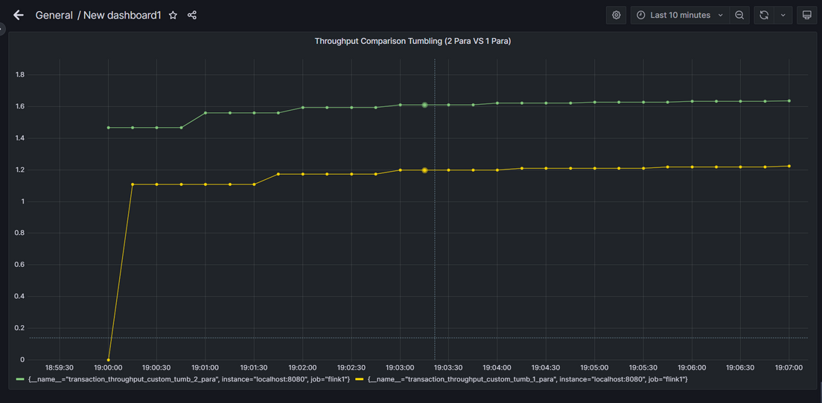
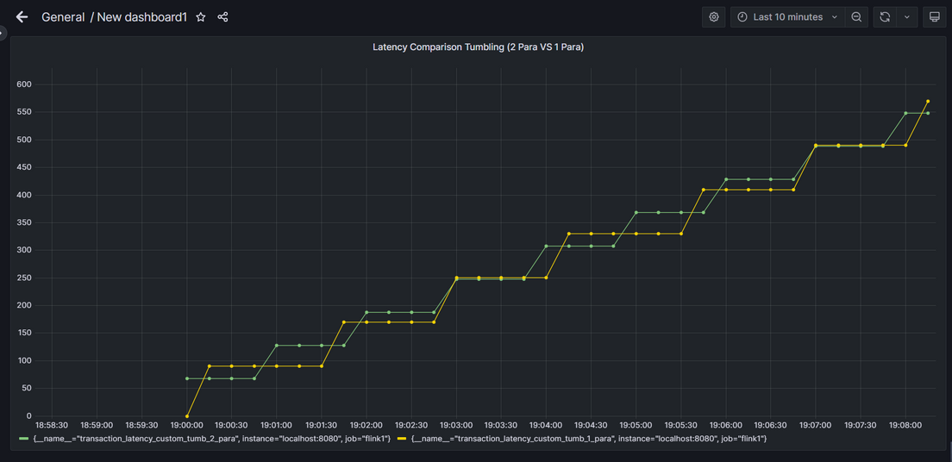
Experimental Results
Custom Tumbling Window approach with parallelism - 1 vs Custom Tumbling Window approach with parallelism - 2
Throughput
Custom Tumbling Window approach with parallelism - 1 vs Custom Tumbling Window approach with parallelism - 2
Latency
We can observe that the Tumbling window with parallelism 2 with record buffer strategy and incremental sum aggregation has higher throughput than the Tumbling window with parallelism 1 with record buffer strategy and incremental sum aggregation.
We can observe that the Tumbling window with parallelism 2 with record buffer strategy and incremental sum aggregation has lower latency than the Tumbling window with parallelism 1 with record buffer strategy and incremental sum aggregation.
8

Slide 10
Experience and Challenges
Built custom window assigner classes extending Flink's capabilities. This allowed us to implement the Sliding, Tumbling, and other window strategies.
It was interesting to integrate Tumbling Windows with RocksDB as the record buffer for performing incremental sum aggregation following the record buffer strategy.
It was fascinating to implement different levels of parallelism for the Tumbling Window approach by incorporating different RocksDB Instances to be accessed by the processes.
Engaging to implement Sliding Windows with slicing strategy with different levels of parallelism.
Experience
Setting up RocksDB as the state backend was a technical challenge that required careful configuration and tuning. Especially for M1/M2 Macs, RocksDB couldn't load its native library into the Apache Flink Cluster, so using a VM was the only solution.
It was difficult to include combined panes for getting the incremental aggregation as a result of the aggregated transaction.
Incorporating Grafana and Prometheus with Apache Flink to monitor the performance of our project was another challenge. Using Fraud Detector and involving latency and throughput for the pipeline was difficult.
Managing RocksDB instances to work with higher parallelism for the Tumbling window with incremental sum aggregation.
Less documentation for setting up parallelism for operators, jobs, and also for enabling state backend with parallelism.
Challenges
9

Slide 11
THANK YOU!

