Slide 1


QuickBite Crisis Analysis & Recovery Insights
Domain: Food Delivery & Consumer Analytics
Function: Crisis Recovery & Business Strategy
CODEBASICS RESUME PROJECT CHALLENGE #18
Presented by: Nirbhay Kumar

Slide 2
PROBLEM STATEMENT
QuickBite Express, a Bengaluru-based food-delivery startup, faced a major crisis in June 2025 due to a viral food-safety incident and a week-long delivery outage during the monsoon season.
This crisis led to:
A sharp decline in daily orders
A significant drop in customer satisfaction ratings
Many partner restaurants shifting to competitors
Customer acquisition cost (CAC) increasing nearly 3
A large portion of active and loyal customers becoming inactive
To recover, QuickBite upgraded its food-safety protocols, improved delivery infrastructure, and allocated a major recovery budget.

Slide 3
OVERVIEW
This analysis evaluates the impact of the June 2025 crisis on QuickBite’s business performance, covering customers, orders, delivery operations, restaurant partners, and overall sentiment. By comparing pre-crisis vs crisis periods, the study uncovers how demand, revenue, customer engagement, and service quality were affected.
The dashboard and insights aim to:
Identify where the biggest losses occurred (cities, cuisines, restaurants)
Understand how customer behavior shifted during the crisis
Diagnose delivery inefficiencies and SLA breakdowns
Analyse review sentiment to detect major pain points
Highlight key drivers of churn and loyalty
Provide strategic recommendations for recovery and trust rebuilding
Overall, this analysis helps QuickBite’s leadership make data-backed decisions to stabilize operations, regain customer confidence, and rebuild growth.

Slide 4

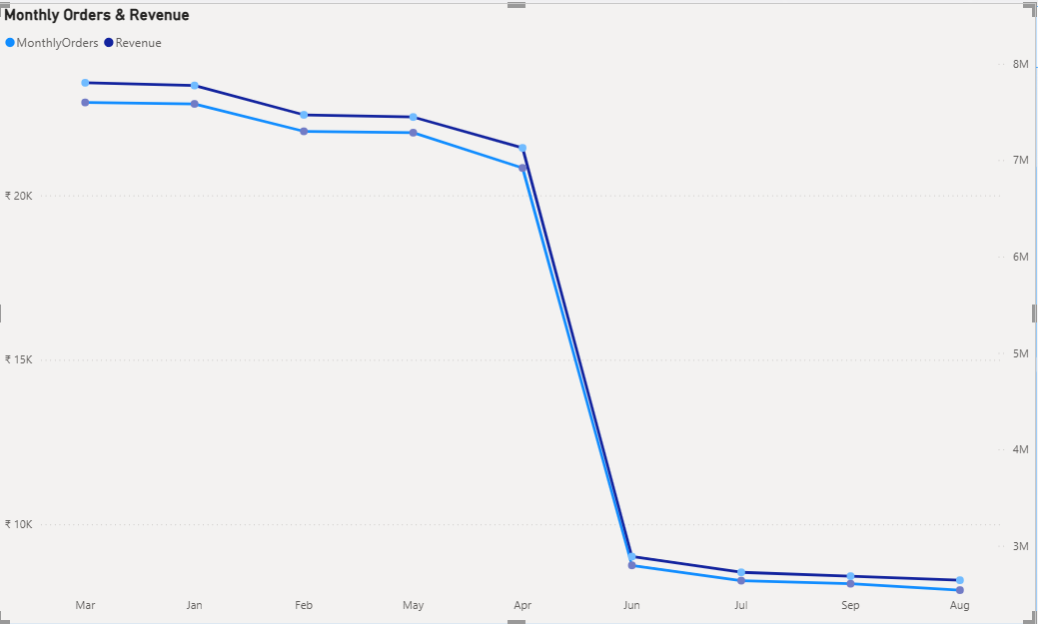
PRIMARY ANALYSIS
1. Monthly Orders: Compare total orders across pre-crisis (Jan–May 2025) vs crisis (Jun–Sep 2025). How severe is the decline?
Orders fell drastically from 110K pre-crisis to 33K during the crisis, reflecting a 70% overall decline in demand.
QuickBite experienced a sharp demand collapse after June 2025, with monthly orders and revenue dropping by nearly 70% — falling from stable 20K+ orders to below 8K during the crisis months.

Slide 5
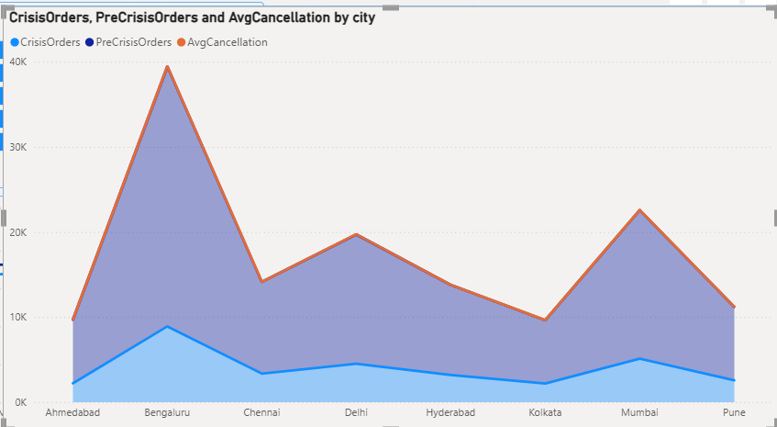
PRIMARY ANALYSIS
2. Which top 5 city groups experienced the highest percentage decline in orders during the crisis period compared to the pre-crisis period?
Bengaluru, Mumbai, and Delhi recorded the highest drop in orders during the crisis, with sharp declines in both demand and customer activity. These metro cities also showed elevated cancellation rates, indicating stronger crisis sensitivity compared to other regions

Slide 6
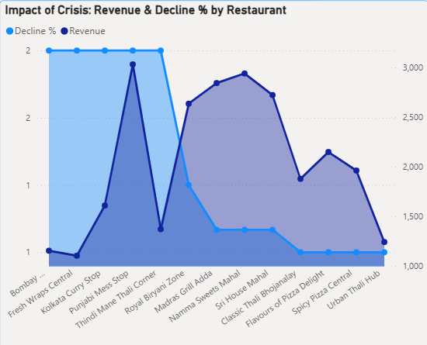
PRIMARY ANALYSIS
3. Among restaurants with at least 50 pre-crisis orders, which top 10 high-volume restaurants experienced the largest percentage decline in order counts during the crisis period?
Punjabi Mess Stop and Kolkata Curry Stop were the most impacted high-volume restaurants, showing the steepest decline in orders during the crisis.

Slide 7
PRIMARY ANALYSIS
4. Cancellation Analysis: What is the cancellation rate trend pre-crisis vs crisis, and which cities are most affected?
Bengaluru, Mumbai, and Delhi recorded the highest cancellation rates during the crisis due to delivery outages.

Slide 8
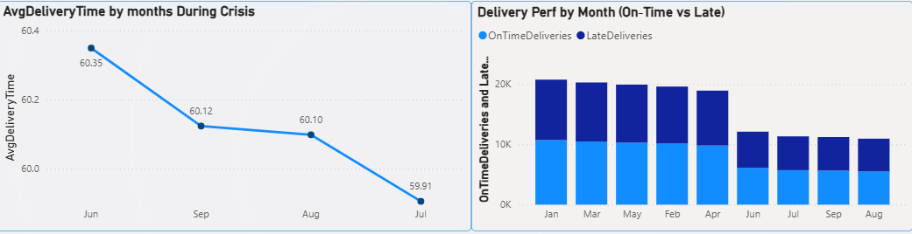
PRIMARY ANALYSIS
5. Delivery SLA: Measure average delivery time across phases. Did SLA compliance worsen significantly in the crisis period?
SLA performance worsened during the crisis: average delivery time crossed 60 minutes, while on-time deliveries fell sharply across months.

Slide 9
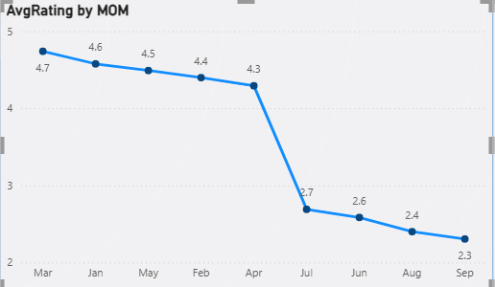
PRIMARY ANALYSIS
6. Ratings Fluctuation: Track average customer rating month-by-month. Which months saw the sharpest drop?
The sharpest decline in customer ratings occurred between April and June, dropping from 4.3 to 2.7.

Slide 10
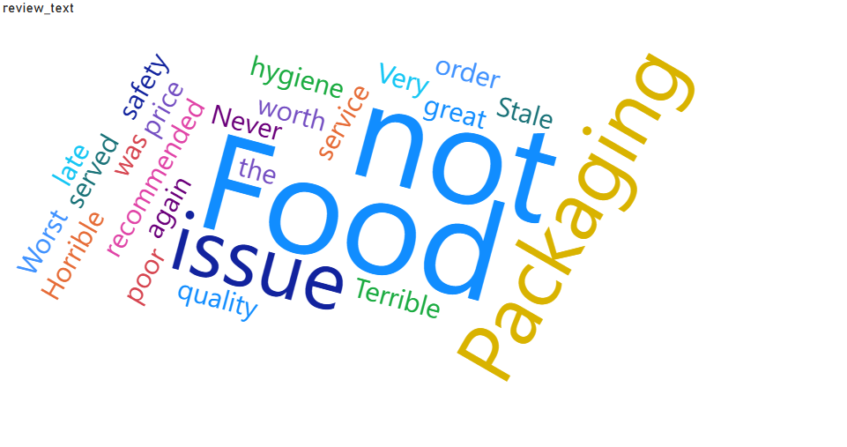
PRIMARY ANALYSIS
7. Sentiment Insights: During the crisis period, identify the most frequently occurring negative keywords in customer review texts. (Hint: Use a Word Cloud visual in Power BI to visualize the findings.)
Top negative keywords—‘not good’, ‘packaging’, ‘food issue’, and ‘late’—show that delays and safety concerns were the major crisis pain points.

Slide 11

PRIMARY ANALYSIS
8. Revenue Impact: Estimate revenue loss from pre-crisis vs crisis (based on subtotal, discount, and delivery fee).
QuickBite’s revenue dropped from ₹37.39M in the pre-crisis period, resulting in a revenue loss of ₹26.53M — a steep 70.96% decline driven by reduced orders and operational disruption.

Slide 12
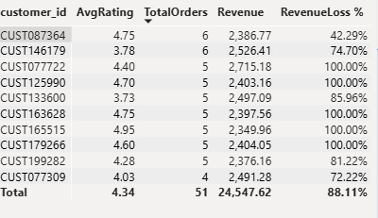
PRIMARY ANALYSIS
9. Loyalty Impact: Among customers who placed five or more orders before the crisis, determine how many stopped ordering during the crisis, and out of those, how many had an average rating above 4.5?
High-value customers (5+ orders) showed major churn, including many top-rated customers (4.5+), highlighting a severe loyalty issue.

Slide 13
PRIMARY ANALYSIS
10. Customer Lifetime Decline: Which high-value customers (top 5% by total spend before the crisis) showed the largest drop in order frequency and ratings during the crisis? What common patterns (e.g., location, cuisine preference, delivery delays) do they share?
Top spenders with high ratings displayed sharp churn, highlighting a major lifetime value drop.

Slide 14
SECONDARY ANALYSIS
1. How does QuickBite’s crisis impact compare to competitor trends (Swiggy, Zomato) during the same period?
QuickBite faced a significantly sharper decline in orders (~69%) during the crisis compared to typical industry patterns. Competitors like Swiggy and Zomato usually experience moderate monsoon-related slowdowns of only ~20–30%.
The unusually steep drop at QuickBite was driven by the food-safety incident and the week-long delivery outage, making the crisis largely QuickBite-specific rather than industry-wide.
Recovery efforts must therefore prioritize rebuilding customer trust, strengthening operational reliability, and improving competitive positioning.

Slide 15
SECONDARY ANALYSIS
2. What external factors (e.g., ad prices, seasonal effects) may have contributed to CAC tripling?
Customer acquisition cost (CAC) tripled during the crisis, signaling a much higher effort required to attract and retain customers.
Key contributing factors:
Rising digital advertising costs, which increased overall marketing expenditure.
Seasonal delivery challenges during monsoon, reducing conversion rates.
Heavier reliance on incentives such as discounts and cashback to drive orders.
This highlights the need for more efficient, targeted marketing strategies to optimize spending and rebuild the customer base.

Slide 16
SECONDARY ANALYSIS
3. Which strategies (cashbacks, partnerships, food safety audits) could be most effective to rebuild trust?
Strengthen food safety protocols through regular audits and strict quality checks to rebuild customer trust.
Launch targeted cashback and discount campaigns to re-engage lapsed users and high-value customers.
Develop strategic partnerships with reliable restaurants to enhance menu variety and ensure consistent service quality.
Maintain transparent communication with customers regarding safety improvements and operational upgrades.
Adopt a combined recovery strategy focused on operational excellence, meaningful customer incentives, and strong restaurant partnerships.

Slide 17
Key Takeaways
Demand & revenue dropped ~70% post-crisis
Bengaluru, Delhi, Chennai most impacted
Basic meals stayed, premium meals collapsed
Delivery outages caused sharp negative sentiment spike
High-value customers showed heavy churn
Recovery requires: Safety, SLA improvement, incentives, partnerships

Slide 18
SECONDARY ANALYSIS
4. Which types of restaurants (cloud kitchens vs dine-in, small vs large brands) are most likely to churn?
Cloud kitchens and small independent restaurant brands show a higher likelihood of churn during a crisis. In contrast, large and established dine-in restaurants tend to remain due to stronger brand presence and a stable customer base.
Key drivers of restaurant churn:
Operational inefficiencies
Frequent delivery delays
Consistently low order volumes
Recovery efforts should prioritize high-risk restaurants to preserve platform variety and sustain customer satisfaction.

Slide 19
SECONDARY ANALYSIS
5. Which lapsed customers (churned post-crisis) show the highest probability of returning with the right incentives?
High-value lapsed customers have the strongest likelihood of returning when offered targeted incentives. Customers with a pre-crisis order frequency of ≥5 or average ratings ≥4.5 show the highest re-engagement potential.
Effective incentive strategies include:
Personalized cashback or discount offers
Exclusive loyalty rewards
Targeted communication highlighting service improvements
Focusing recovery efforts on these high-potential segments can maximize revenue impact and rebuild engagement efficiently.

Slide 20
Extra Details
1. Priority Cities: Which Tier-1/Tier-2 cities show the highest risk of long-term demand loss?
Priority Cities at Risk of Long-Term Demand Loss
High-Risk Cities (Severe Demand Drop):
Bengaluru – largest order decline and highest cancellation rates
Delhi – heavy drop in crisis orders
Chennai – significant decline and rising cancellations
Moderate-Risk Cities:
Hyderabad, Pune – noticeable but manageable drops
Low-Risk City:
Ahmedabad – stable performance, smallest decline

Slide 21
Extra Details
2. Behavior Shifts: Did customers shift from high-value orders to low-value “survival orders” during crisis?
Customer Behavior Shift During the Crisis
Yes — customers shifted from high-value meals to low-value “survival orders.”
Revenue dropped faster than order count → average spend per order fell.
Premium cuisines (Pizza, Biryani, Desserts) saw major decline.
Basic meals (North Indian, South Indian) held relatively stable.

Slide 22
Extra Details
3. Feedback Trends: Do spikes in negative reviews align with the delivery outage period?
Negative Review Trend During Crisis Period
Strong spike in negative reviews during outage months (Jun–Sep).
Average rating fell sharply from 4.3 → 2.3.
Common complaints:
Late delivery
Poor packaging
Cold food
Hygiene issues

Slide 23
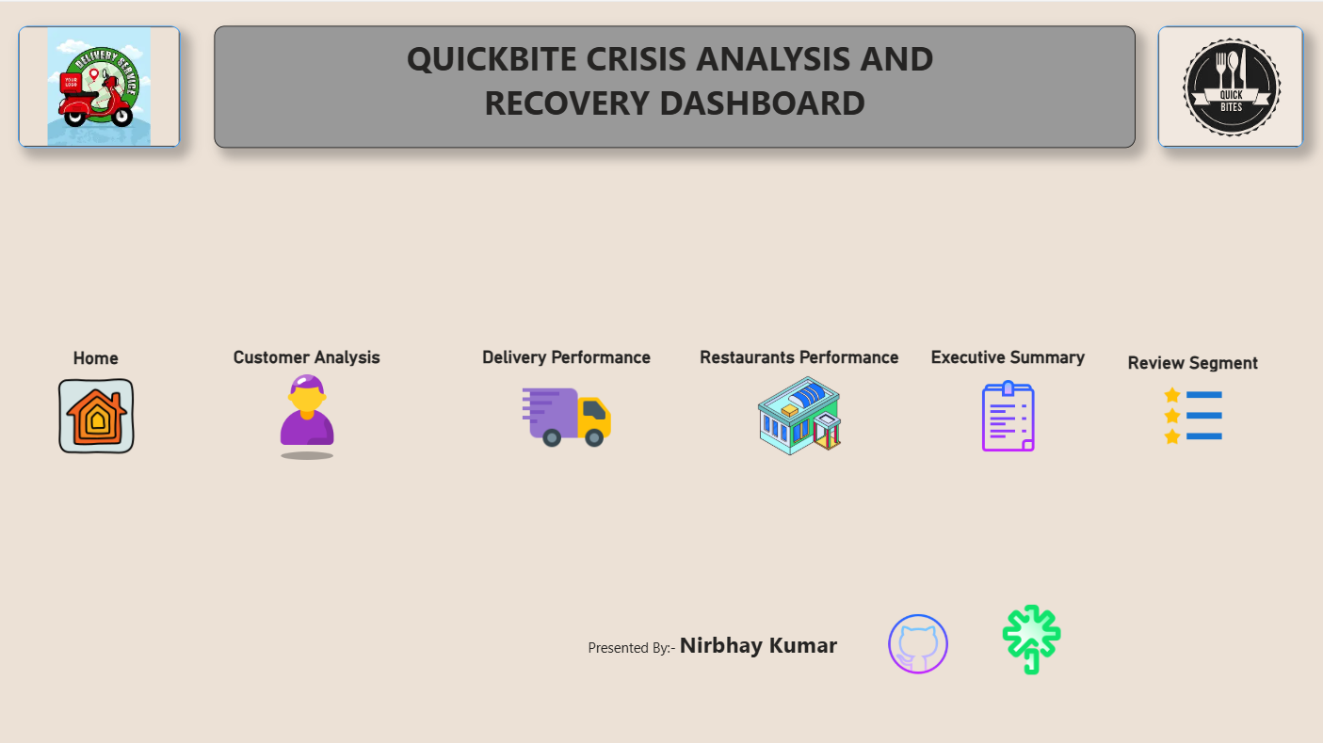

Slide 24
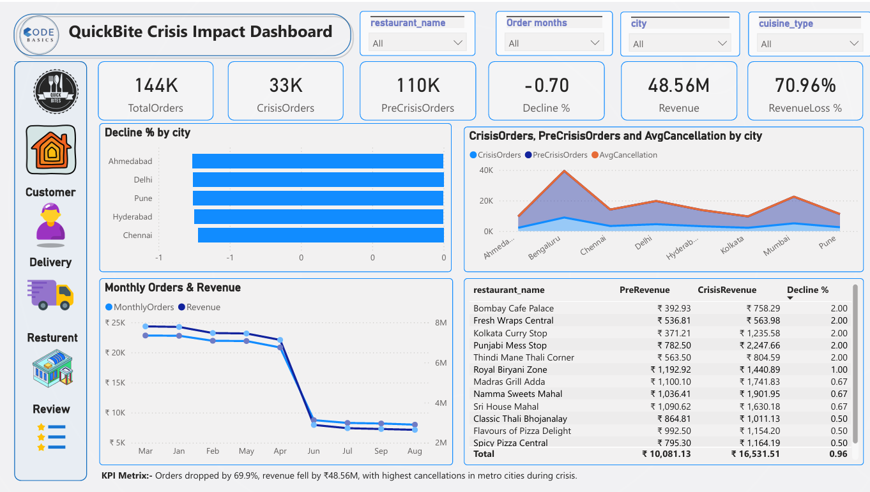

Slide 25
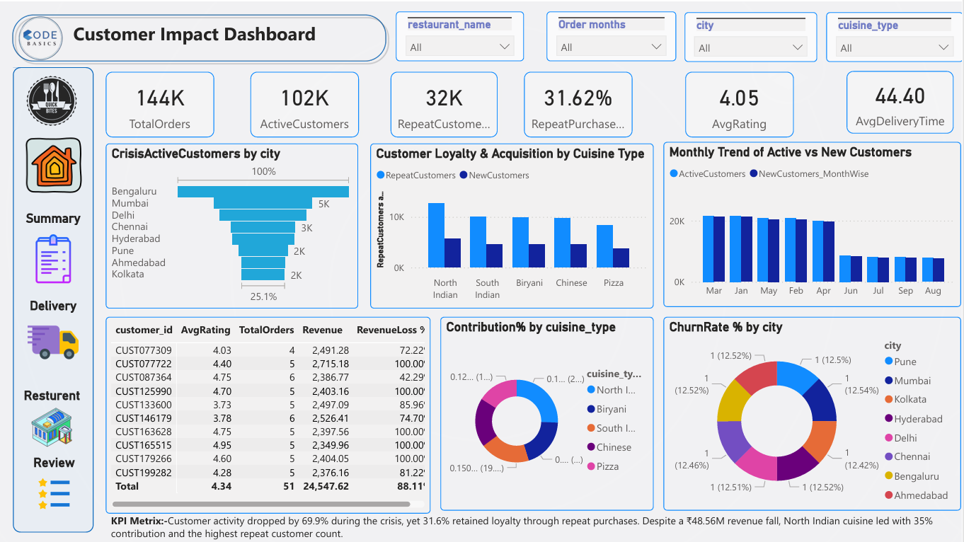

Slide 26
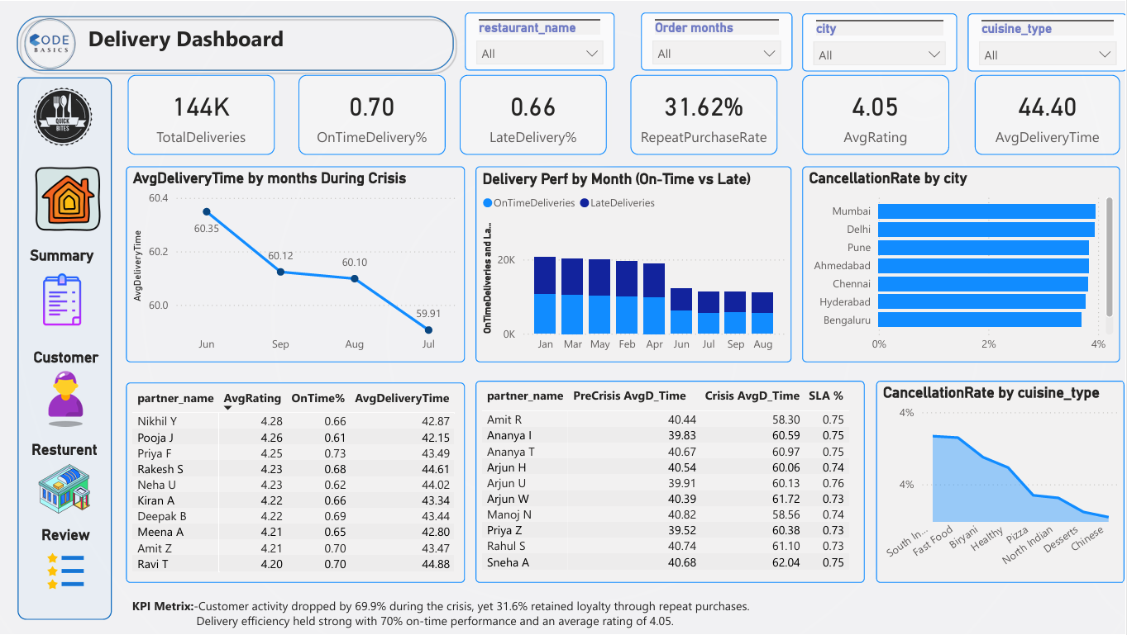

Slide 27
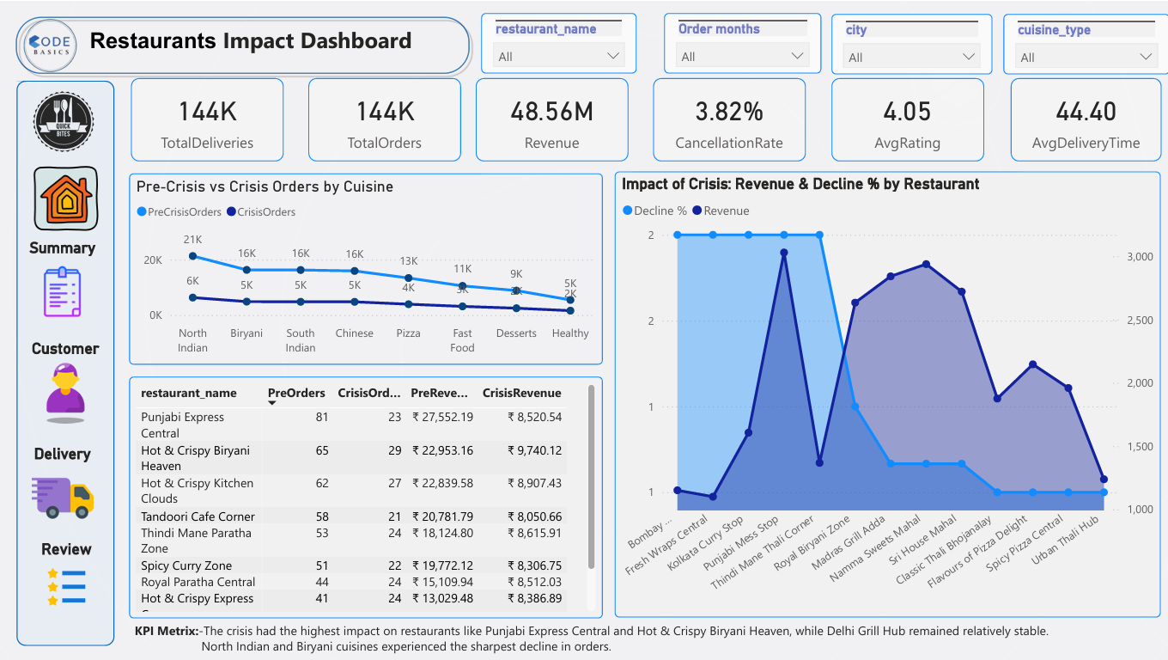

Slide 28
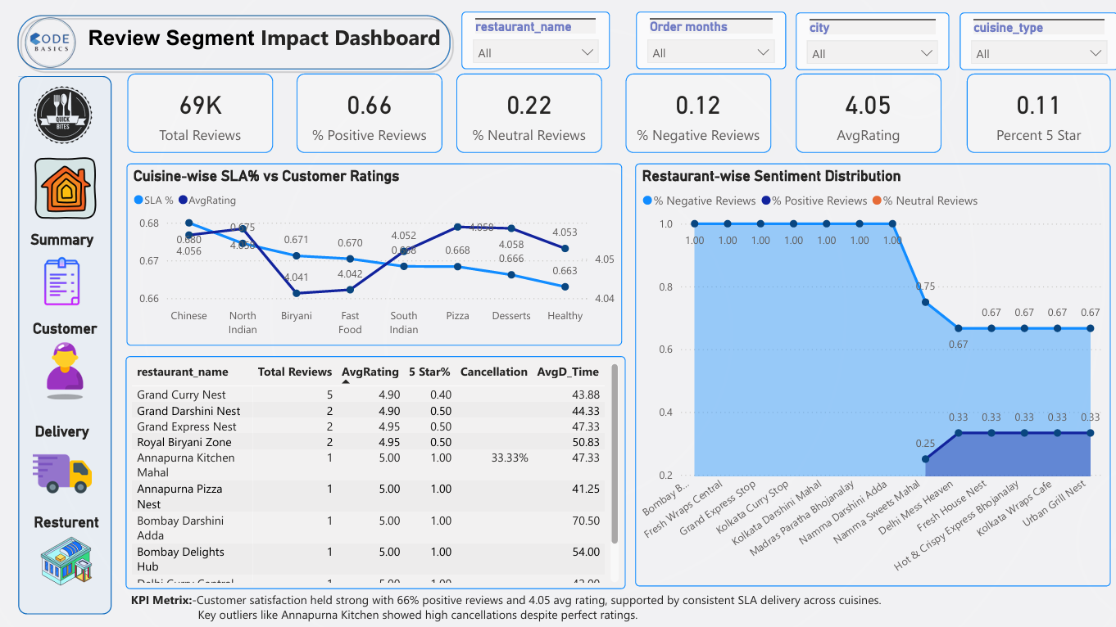

Slide 29
THANK YOU

