Slide 1


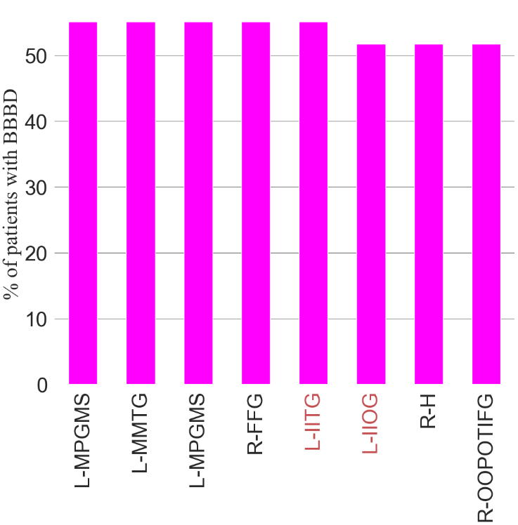
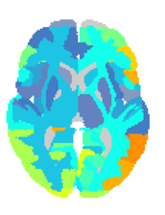

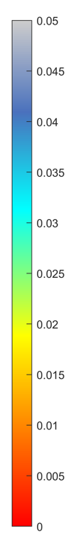
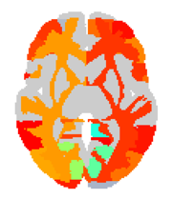
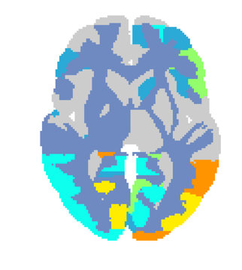
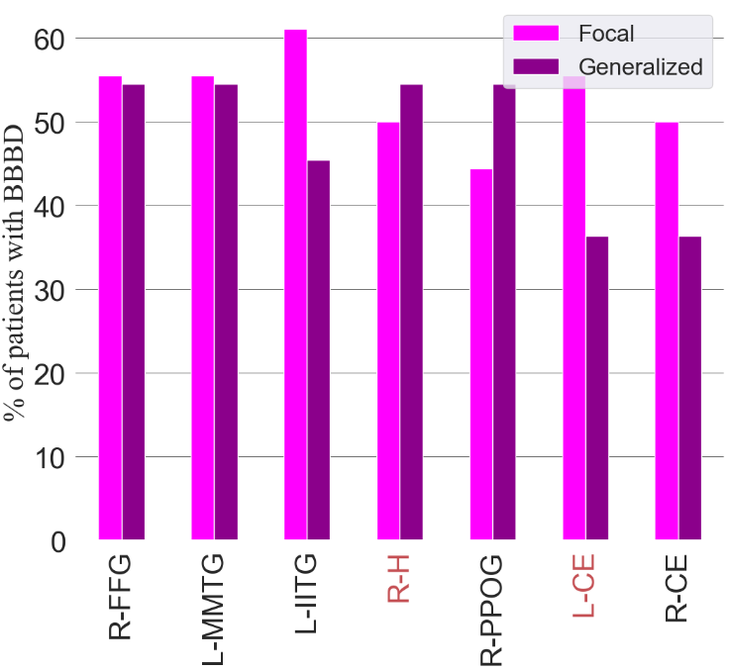
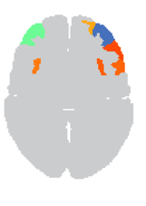
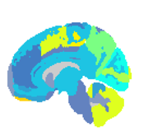
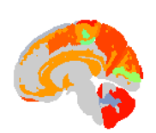

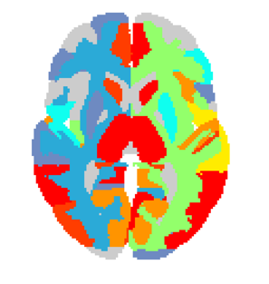
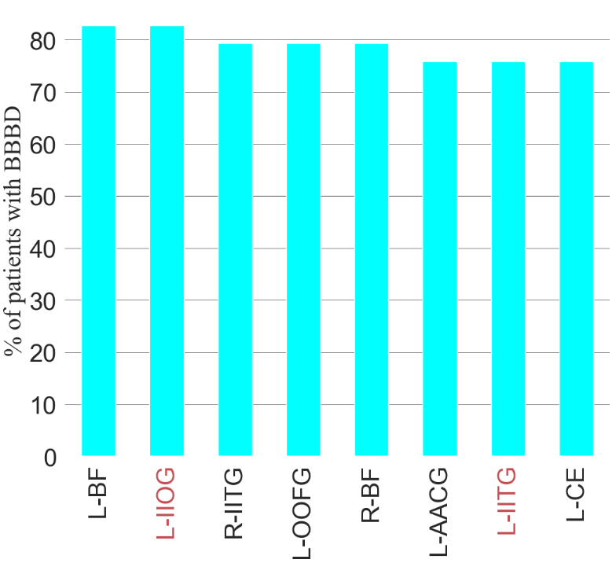

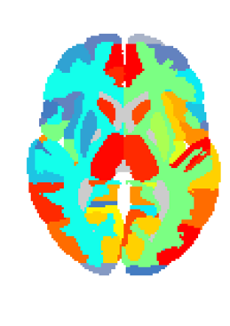
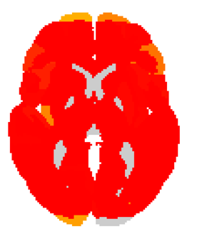
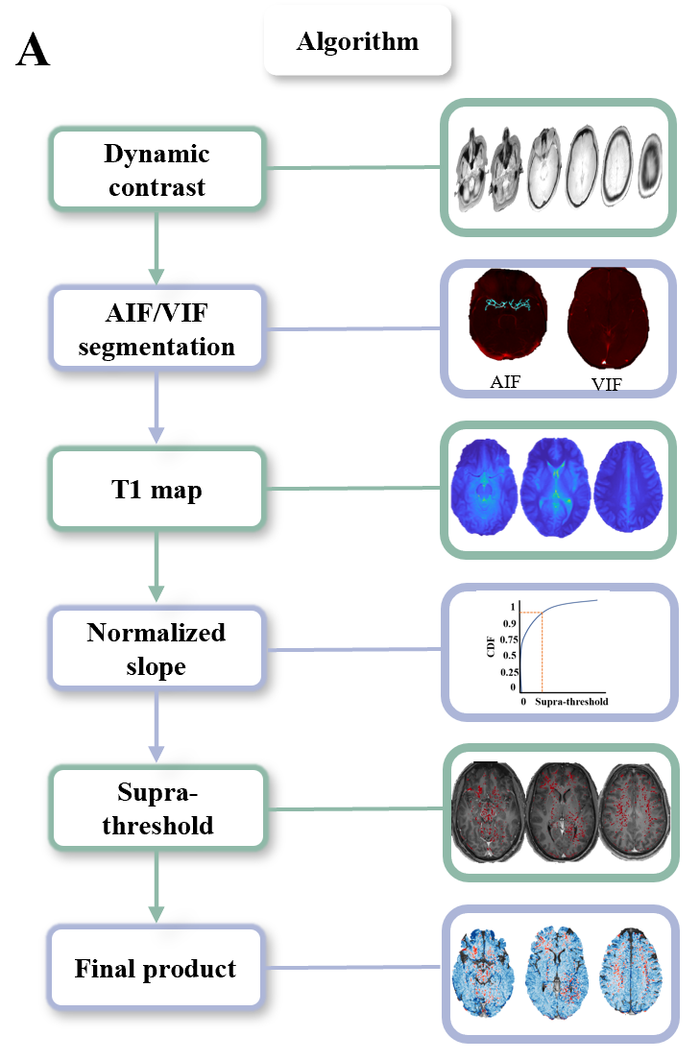

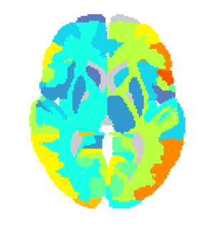
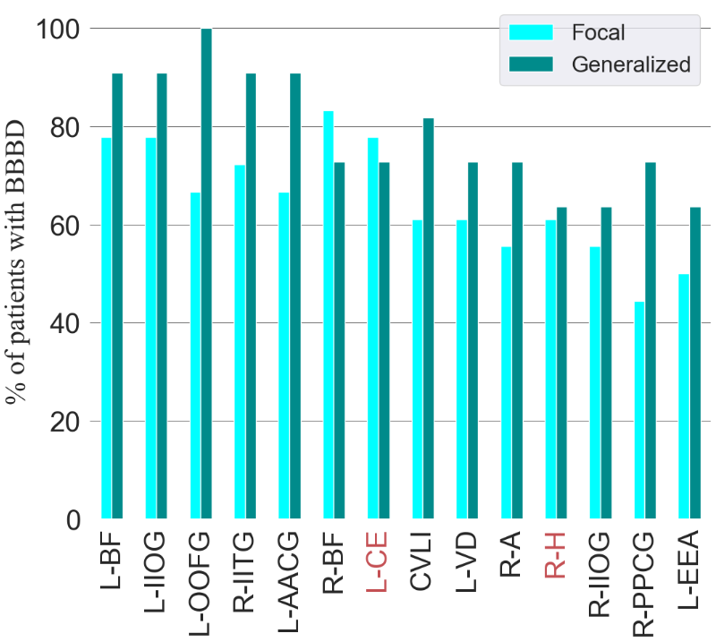
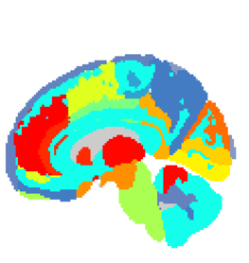
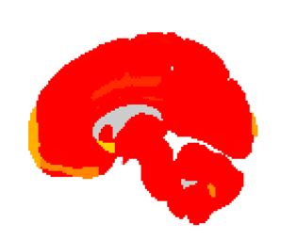
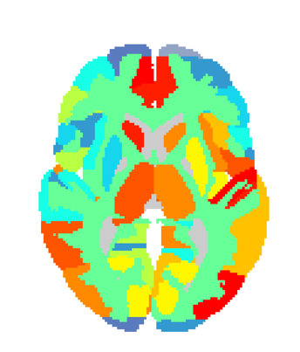

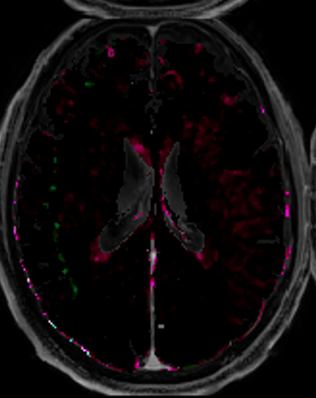

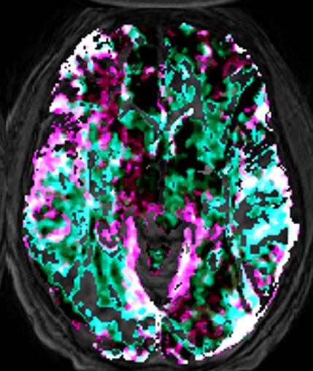
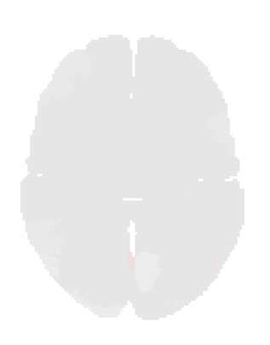

Imaging Blood Brain Barrier Dysfunction in Drug Resistance Epilepsy: A Multi-Center Feasibility Study
Nir Cafri1,2, Daniel Zarhin2, Sheida Mirlo3, Gal Ben-Arie2, Lyna Kamintsky3, Yonatan Serlin3,4, Laith Alhadid3, Ilan Goldberg2, Mark Maclean5, Ben Whatley4, Felix Beninger2 and Alon Friedman1,3.
1The Departments of Physiology & Cell Biology and Cognitive & Brain Sciences, Professor Vladimir Zelman Inter-Disciplinary Center of Brain Sciences, Ben-Gurion University of the Negev, Beer-Sheva, Israel. 2Department of Neurology, Rabin Medical Center, Beilinson Hospital and Tel-Aviv University, Israel 3Department of Medical Neuroscience, Dalhousie University, Halifax, Canada, 4 Division of Neurology, and 5Neurosurgery, Nova Scotia Health Authorities, Dalhousie University, Halifax, Canada
Introduction :
Epilepsy, a neurological disorder characterized by an increased risk of spontaneous seizures, Focal epilepsy is characterized by seizures that start in one part of the brain, while generalized epilepsy is characterized by seizures that start in both sides of the brain at the same time[1]. BBB dysfunction (BBBD) is common in many brain disorders and has been shown to have a critical role in epileptogenesis. Dynamic contrast-enhanced MRI (DCE-MRI) has become the most common approach to quantify the extent and localization of BBBD in human patients. Several models including the compartment fast model (~0-6 min after contrast injection)[2]. And the Veksler linear model has been shown to allow the detection of a slow (~6-20) BBB leakage [3].
FIGURE 2: Regional analysis
FIGURE 3: Focal vs Generalized
FIGURE 4: Frontal focal epilepsy
A Fast
E Fast
C Fast
A Generalized
C Fast
A Fast
Fast
Patients with BBBD, % all
P-value
B Slow
B Slow
D Slow
F Slow
P-value
Slow
FIGURE 1: Epilepsy vs controls
A Method
B
B Focal
D Slow
Patients with BBBD, % all
Fast
MRI
C
(A) Percent of epileptic patients with BBBD of each region in fast model. (B) Significant regions of epileptic patients compared to controls in fast model. (C) Percent of epileptic patients with BBBD of each region in slow model. . (D) Significant regions of epileptic patients compared to controls in slow model. (E) Regions with most % of patients with BBBD in fast model (p value < 0.0001). (F) Regions with most % of patients with BBBD in slow model (p value < 1e-06). Areas in red are highly significant in both models. Regions legend; L-AACG: Left ACgG anterior cingulate gyrus, L-BF: Left Basal Forebrain, L-CE: Left Cerebellum Exterior, L-IIOG: Left IOG inferior occipital gyrus, L-IITG: Left ITG inferior temporal gyrus, L-MPGMS: Left MPrG precentral gyrus medial segment, L-MMTG: Left MTG middle temporal gyrus, L-OOFG: Left OFuG occipital fusiform gyrus, R-BF: Right Basal Forebrain, R-FFG: Right FuG fusiform gyrus, R-H: Right Hippocampus, R-IITG: Right ITG inferior temporal gyrus, R-OOPOTIFG: Right OrIFG orbital part of the inferior frontal gyrus
Slow
C Controls
F Epilepsy
0 slow 0.1
(A) Percent of focal epileptic patients with fast BBBD in each region. (B) Percent of generalized epileptic patients with fast BBBD in each region.(C) Regions with most % of patients with BBBD in fast model (p value < .01). (D) Regions with most % of patients with BBBD in slow model (p value < .0005). Areas in red are highly significant in both models. Regions legend; CVLI: Cerebellar Vermal Lobules I-V, L-AACG: Left ACgG anterior cingulate gyrus, L-BF: Left Basal Forebrain, L-CE: Left Cerebellum Exterior, L-EEA: Left Ent entorhinal area, L-IIOG: Left IOG inferior occipital gyrus, L-IITG: Left ITG inferior temporal gyrus, L-MMTG: Left MTG middle temporal gyrus, L-OOFG: Left OFuG occipital fusiform gyrus, L-VD: Left Ventral DC, R-A: Right Amygdala, R-BF: Right Basal Forebrain, R-CE: Right Cerebellum Exterior, R-FFG: Right FuG fusiform gyrus, R-H: Right Hippocampus, R-IIOG: Right IOG inferior occipital gyrus, R-IITG: Right ITG inferior temporal gyrus, R-PPCG: Right PCgG posterior cingulate gyrus, R-PPOG: Right POrG posterior orbital gyrus
0 fast 0.1
Conclusions: 1. BBBD can serve as a reliable biomarker for epilepsy in human patients. 2. Specific regions such as Left IOG (Inferior Occipital Gyrus) exhibits significant involvement in epilepsy. 3. The Slow model effectively simulates epilepsy characteristics more than the fast model. 4. Frontal focal epilepsy demonstrates higher sensitivity to BBBD compared to temporal focal epilepsy.
D
STD above controls
G
Fast
Fast
(A) BBBD analysis method. (B) Epileptic patients’ BBBD% and percent of areas above 2SD from the top 5% of controls statistics compared to controls. (C) Example of controls without BBBD, with fast BBBD and slow BBBD. (D) Examples of controls fast regional maps. (F) Examples of patients with epilepsy without BBBD, with fast BBBD and slow BBBD and both fast and slow BBBD. (G) Examples of patients with epilepsy fast regional maps.
References
[1] Lopes, Marinho A., et al. "The role of excitability and network structure in the emergence of focal and generalized seizures." Frontiers in neurology 11 (2020). [2] Tofts, Paul S., et al. "Estimating kinetic parameters from dynamic contrast‐enhanced T1‐weighted MRI of a diffusable tracer: standardized quantities and symbols." Journal of Magnetic Resonance Imaging: An Official Journal of the International Society for Magnetic Resonance in Medicine 10.3 (1999) [3] Veksler, Ronel, Ilan Shelef, and Alon Friedman. "Blood–brain barrier imaging in human neuropathologies." Archives of medical research 45.8 (2014)
(A) P value of frontal regions in frontal epileptic patients compared to rest of patients with epilepsy in fast. (B) in slow.
(C) 2 way ANOVA frontal regions comparison.

