Slide 1


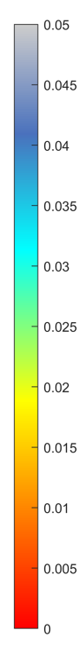
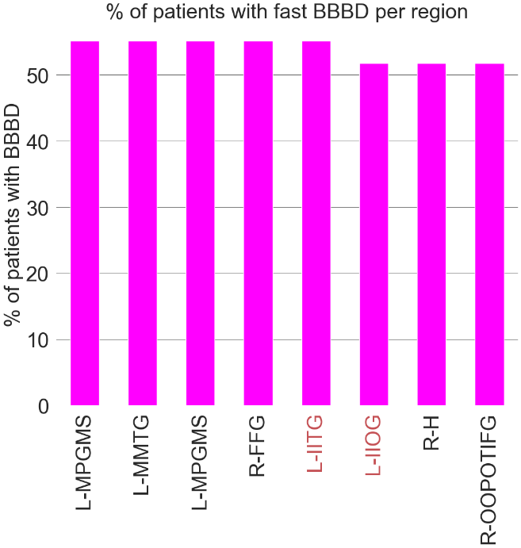
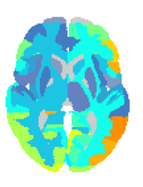
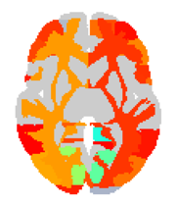
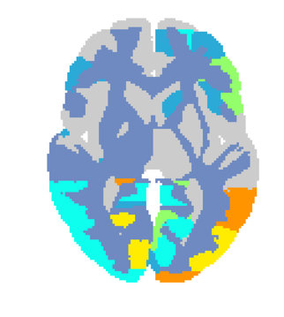
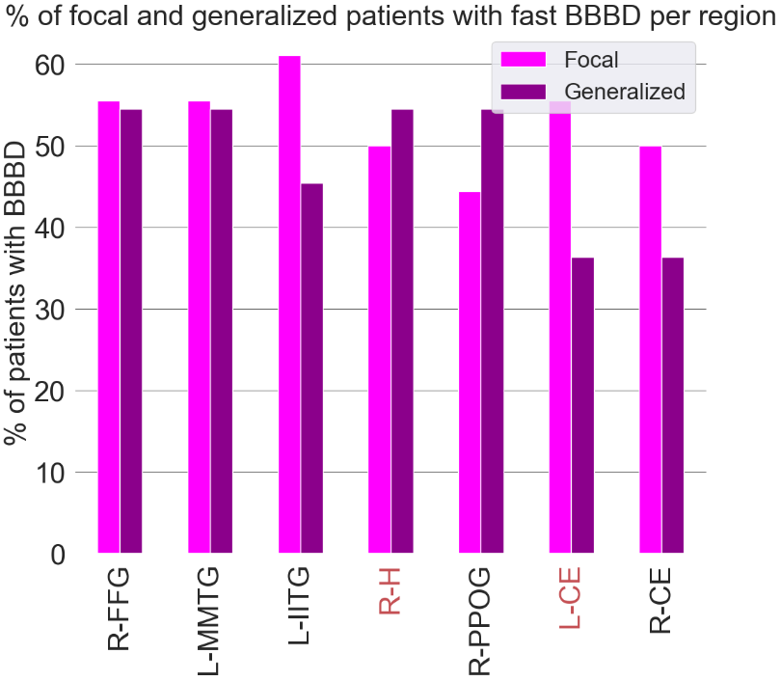
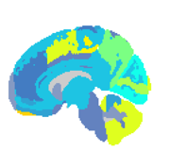
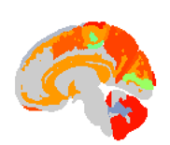
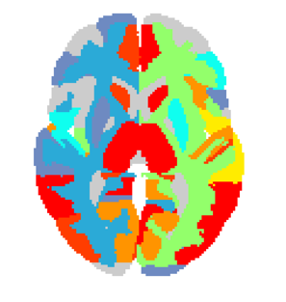
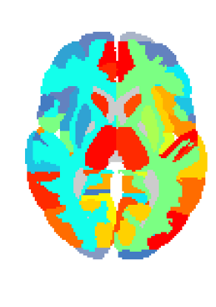
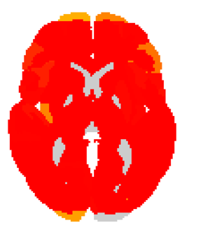
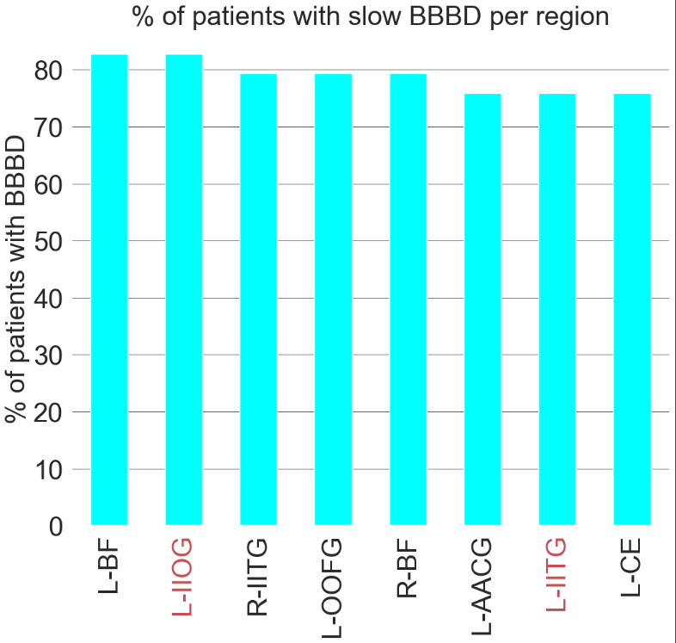
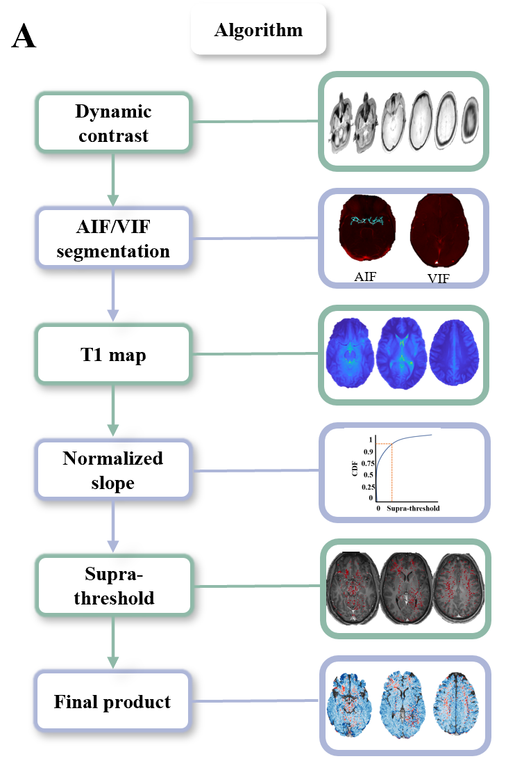
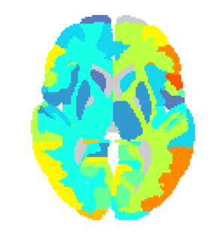
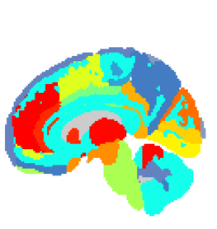
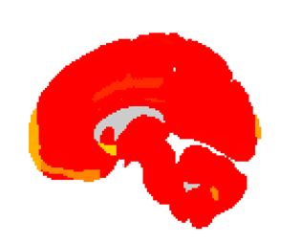
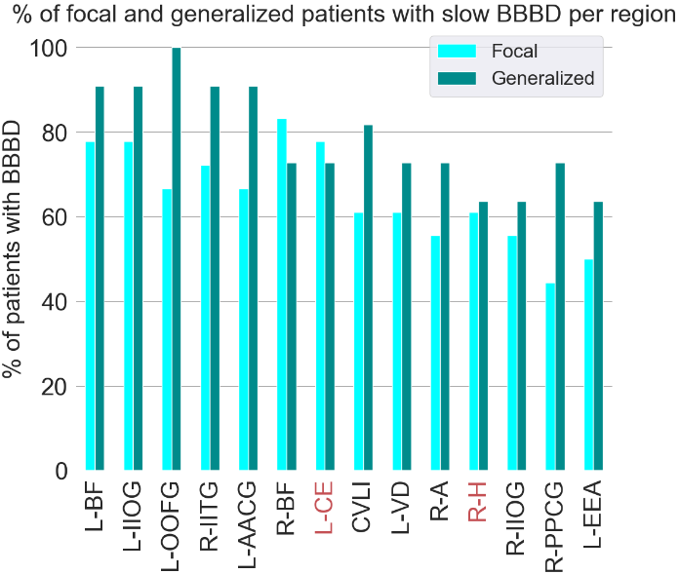
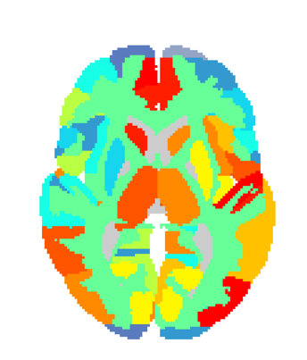
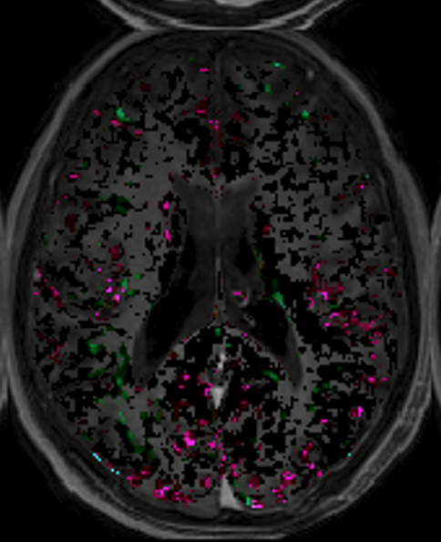
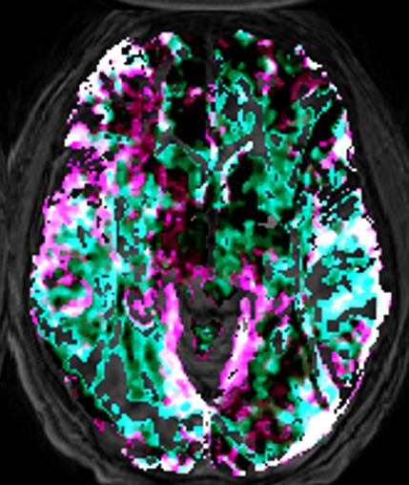
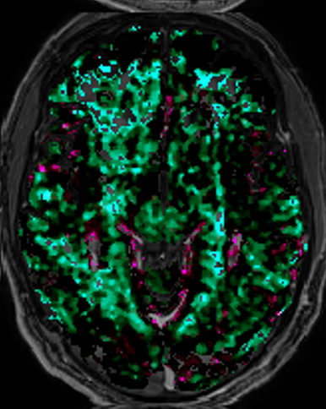
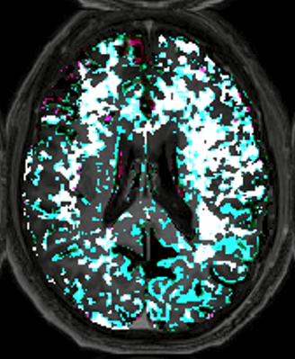

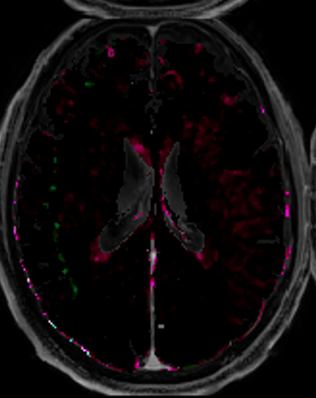

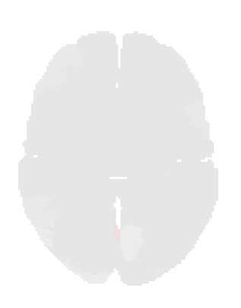


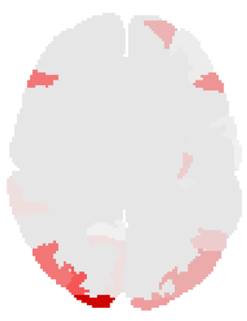

Imaging Blood Brain Barrier Dysfunction in Drug Resistance Epilepsy: A Multi-Center Feasibility Study
Nir Cafri1,2 Daniel Zarhin2 Sheida Mirlo3 Lyna Kamintsky3 Yonatan Serlin3,4 Laith Alhadid3 Ilan Goldberg2 Mark Maclean5 Ben Whatley4 Felix Beninger2 and Alon Friedman1,3.
1The Departments of Physiology & Cell Biology and Cognitive & Brain Sciences, Professor Vladimir Zelman Inter-Disciplinary Center of Brain Sciences, Ben-Gurion University of the Negev, Beer-Sheva, Israel. 2Department of Neurology, Rabin Medical Center, Beilinson Hospital and Tel-Aviv University, Israel 3Department of Medical Neuroscience, Dalhousie University, Halifax, Canada, 4 Division of Neurology, and 5Neurosurgery, Nova Scotia Health Authorities, Dalhousie University, Halifax, Canada
Introduction :
Epilepsy, a neurological disorder characterized by an increased risk of spontaneous seizures, While there are effective medicines to treat seizures, up to one third are refractory to anti-convulsant drugs. The blood-brain barrier (BBB) maintains the brain in a narrow homeostatic range essential for normal neural function (Ton et al., 2017). BBB dysfunction (BBBD) is common in many brain disorders and has been shown to have a critical role in epileptogenesis. Dynamic contrast-enhanced MRI (DCE-MRI) has become the most common approach to quantify the extent and localization of BBBD in human patients. Several models including the compartment fast model (Tofts et al., 1999) which assumes irreversible trappinwere described in the literature (Chassidim et al., 2013),g of the contrast agent And the Veksler linear model has been shown to allow the detection of a slow (measured ~6-20 min after contrast injection) BBB leakage (Veksler et al., 2020).
FIGURE 2: Regional analysis
FIGURE 3: Focal vs Generalized
A Fast
E Fast
D Fast
C Fast
A Generalized
C
Fast
Patients with BBBD, % all
B Slow
P-value
FIGURE 1: Epilepsy vs controls
D Slow
F Slow
Slow
A Method
B
B Focal
Patients with BBBD, % all
E Slow
MRI
Fast
F Epilepsy
Figure 2 . (A) Percent of epileptic patients with BBBD of each region in fast model. (B) Significant regions of epileptic patients compared to controls in fast model. (C) Percent of epileptic patients with BBBD of each region in slow model. . (D) Significant regions of epileptic patients compared to controls in slow model. (E) Regions with most % of patients with BBBD in fast model (p value < 0.0001). (F) Regions with most % of patients with BBBD in slow model (p value < 1e-06). Areas in red are highly significant in both models. Regions legend; L-AACG: Left ACgG anterior cingulate gyrus, L-BF: Left Basal Forebrain, L-CE: Left Cerebellum Exterior, L-IIOG: Left IOG inferior occipital gyrus, L-IITG: Left ITG inferior temporal gyrus, L-MPGMS: Left MPrG precentral gyrus medial segment, L-MMTG: Left MTG middle temporal gyrus, L-OOFG: Left OFuG occipital fusiform gyrus, R-BF: Right Basal Forebrain, R-FFG: Right FuG fusiform gyrus, R-H: Right Hippocampus, R-IITG: Right ITG inferior temporal gyrus, R-OOPOTIFG: Right OrIFG orbital part of the inferior frontal gyrus
C Controls
1 2 3 4
Slow
1
0 slow 0.1
G
0 fast 0.1
Figure 3 Similar BBBD behavior of slow and fast models. (A) Percent of focal epileptic patients with fast BBBD in each region. (B) Percent of generalized epileptic patients with fast BBBD in each region. (C) Statistics of focal and generalized epileptic patients. (D) Regions with most % of patients with BBBD in fast model (p value < .01). (E) Regions with most % of patients with BBBD in slow model (p value < .0005). Areas in red are highly significant in both models. Regions legend; CVLI: Cerebellar Vermal Lobules I-V, L-AACG: Left ACgG anterior cingulate gyrus, L-BF: Left Basal Forebrain, L-CE: Left Cerebellum Exterior, L-EEA: Left Ent entorhinal area, L-IIOG: Left IOG inferior occipital gyrus, L-IITG: Left ITG inferior temporal gyrus, L-MMTG: Left MTG middle temporal gyrus, L-OOFG: Left OFuG occipital fusiform gyrus, L-VD: Left Ventral DC, R-A: Right Amygdala, R-BF: Right Basal Forebrain, R-CE: Right Cerebellum Exterior, R-FFG: Right FuG fusiform gyrus, R-H: Right Hippocampus, R-IIOG: Right IOG inferior occipital gyrus, R-IITG: Right ITG inferior temporal gyrus, R-PPCG: Right PCgG posterior cingulate gyrus, R-PPOG: Right POrG posterior orbital gyrus
D
STD above controls
Fast
Fast
(A) BBBD analysis method. (B) Epileptic patients’ BBBD% and percent of areas above 2SD from the top 5% of controls statistics compared to controls. (C) Examples of controls without BBBD, with fast BBBD and slow BBBD. (D) Examples of controls fast regional maps. (F) Examples of patients with epilepsy without BBBD, with fast BBBD and slow BBBD and both fast and slow BBBD. (G) Examples of patients with epilepsy fast regional maps.
References
[1] Milikovsky, D. Z. et al. Paroxysmal slow cortical activity in Alzheimer’s disease and epilepsy is associated with blood-brain barrier dysfunction. Sci. Transl. Med. 11, (2019)
[2] Senatorov, V. V. et al. Blood-brain barrier dysfunction in aging induces hyperactivation of TGFβ signaling and chronic yet reversible neural dysfunction. Sci. Transl. Med. 11, (2019)
[3] Guy Bar-Klein, Svetlana Lublinsky, Lyn Kamintsky, Iris Noyman, Ronel Veksler, Hotjensa Dalipaj, Vladimir V. Senatorov Jr., Evyatar Swissa, Dror Rosenbach, Netta Elazary, Dan Z. Milikovsky, Nadav Milk, Michael Kassirer, Yossi Rosman, Yonatan Serlin, Arik Eisenkraft, Yoash Chassidim, Yisrael Parmet, Daniela Kaufer, and Alon Friedman (2017) Imaging blood–brain barrier dysfunction as a biomarker for epileptogenesis, BRAIN: 140; 1692–1705, doi:10.1093/brain/awx073

