Slide 1
Article Classification
Nir Tal

Slide 2


Slide 3
Project analysis slide 4
Introduction
Frontiers for Young Minds
Online & open-access science journal for kids (8 to 15 years old)
Kid-friendly articles on core concepts and recent discoveries
Articles written by academic scientists and reviewed by kids and their science mentors

Slide 4


Project analysis slide 4
The Problem
Article Classification (Topic Analysis)
Articles already organized in 6 sections:
How to classify new articles into sections?

Slide 5
Project analysis slide 4
The Data
Section Webpage

Slide 6
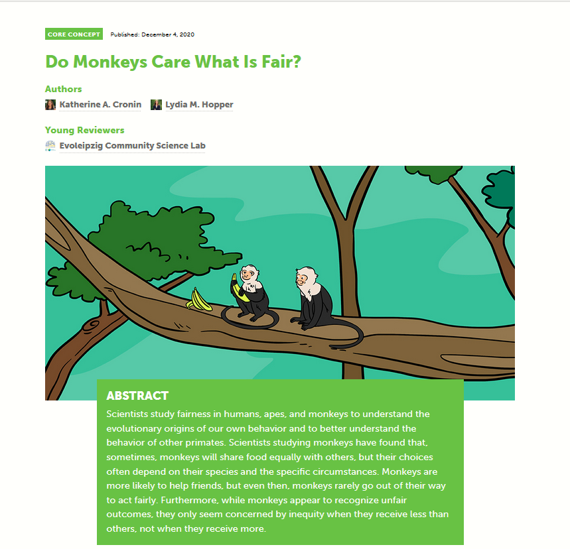
Project analysis slide 4
The Data
Article Structure

Slide 7
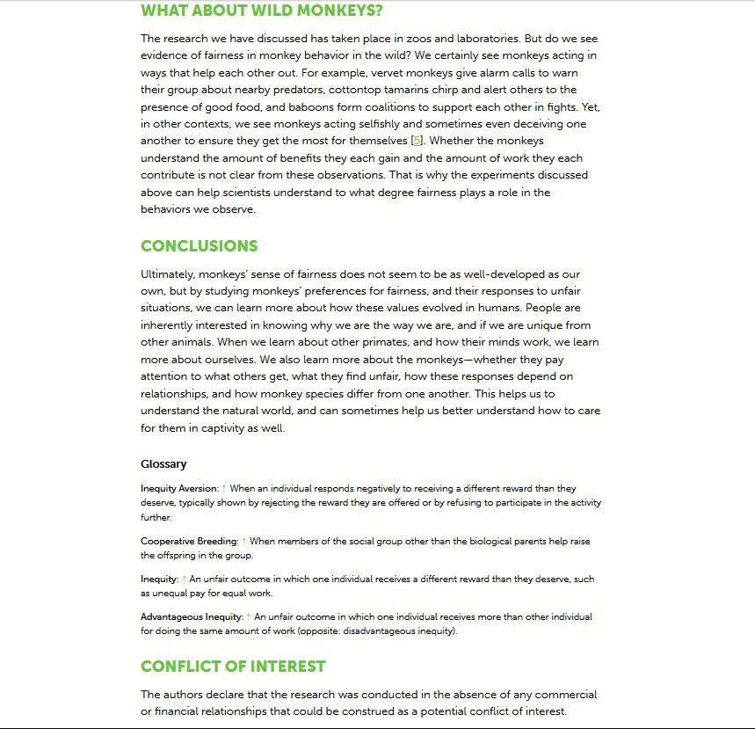
Project analysis slide 4
The Data
Article Structure - Continued

Slide 8
Project analysis slide 4
The Data
Web Scraping
Retrieving article links from each section
Opening links and finding html elements: title, abstract, paragraphs
Extracting text and writing to txt files: one paragraph per line

Slide 9
Project analysis slide 4
The Data
Text Standardization
Parsing paragraphs to sentences
Splitting sentences to words (tokenization)
Removing stop words (NLTK)
Recombining tokens to a single string
Writing strings to txt files: one file per article

Slide 10
Project analysis slide 4
The Data
Text Dataset Preparation
Data splitting into 3 directories: train, validation, and test
Eeach directory contains 4 sub-directories, i.e., 4 classes:
  Biodiversity
  Earth-and-its-resources
  Human-health
  Neuroscience-and-psychology
TensorFlow/Keras text_dataset_from_directory():
  Samples are string tensors
  Targets are float tensors, multi-hot encoding 4 classes
  For example, the Biodiversity class is encoded by [1, 0, 0, 0]
  Batch size is 32
  Train/Val/Test dataset samples: 489/139/74 (70%/20%/10%)

Slide 11
Project analysis slide 4
The Models
Bag-of-Words Models: Unigram Model
Dataset processing with Keras TextVectorization layer:
  Single words (unigrams) with multi-hot encoding
  Max tokens are 20,000
  Building the vocabulary using the Train dataset
Building the model:
  Inputs layer: 20,000 dimensions
  Dense layer: 24 dimensions, ReLU activation
  Outputs (dense) layer: 4 dimensions, SoftMax activation
  Loss: categorical crossentropy
  Optimizer: rmsprop
  Metrics: accuracy

Slide 12
Project analysis slide 4
The Models
Bag-of-Words Models: Unigram Model
Training the model (4 epochs):
  Train_loss: 0.0153
  Train_accuracy: 1.0000
  Val_loss: 0.4315
  Val_accuracy: 0.8417
Testing the model:
  Test_loss: 0.3449
  Test_accuracy: 0.8243

Slide 13
Project analysis slide 4
The Models
Bag-of-Words Models: Bigram Model
Dataset processing with Keras TextVectorization layer:
  Bigrams with multi-hot encoding
  Max tokens are 20,000
  Building the vocabulary using the Train dataset
Building the model:
  Inputs layer: 20,000 dimensions
  Dense layer: 24 dimensions, ReLU activation
  Outputs (dense) layer: 4 dimensions, SoftMax activation
  Loss: categorical crossentropy
  Optimizer: rmsprop
  Metrics: accuracy

Slide 14
Project analysis slide 4
The Models
Bag-of-Words Models: Bigram Model
Training the model (4 epochs):
  Train_loss: 0.0093
  Train_accuracy: 1.0000
  Val_loss: 0.3859
  Val_accuracy: 0.8633
Testing the model:
  Test_loss: 0.3359
  Test_accuracy: 0.8514

Slide 15
Project analysis slide 4
The Models
Bag-of-Words Models: TF-IDF Model
Dataset processing with Keras TextVectorization layer:
  Bigrams with TF-IDF encoding
  Max tokens are 20,000
  Building the vocabulary using the Train dataset
Building the model:
  Inputs layer: 20,000 dimensions
  Dense layer: 24 dimensions, ReLU activation
  Outputs (dense) layer: 4 dimensions, SoftMax activation
  Loss: categorical crossentropy
  Optimizer: rmsprop
  Metrics: accuracy

Slide 16
Project analysis slide 4
The Models
Bag-of-Words Models: TF-IDF Model
Training the model (4 epochs):
  Train_loss: 0.0182
  Train_accuracy: 1.0000
  Val_loss: 0.5636
  Val_accuracy: 0.7842
Testing the model:
  Test_loss: 0.5021
  Test_accuracy: 0.8510

Slide 17
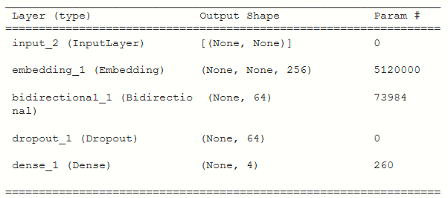
Project analysis slide 4
The Models
Sequence Models: Bidirectional LSTM Model #1
Dataset processing with Keras TextVectorization layer:
  Words with integer indexing: each sample (article) is represented as a sequence of integer indices
  Max tokens are 20,000
  Max article length is 1,000 tokens
Building the model: learning word embeddings

Slide 18
Project analysis slide 4
The Models
Sequence Models: Bidirectional LSTM Model #1
Training the model (8 epochs):
  Train_loss: 0. 3876
  Train_accuracy: 0.9530
  Val_loss: 0.9109
  Val_accuracy: 0.6835
Testing the model:
  Test_loss: 0.8738
  Test_accuracy: 0.6892

Slide 19
Project analysis slide 4
The Models
Sequence Models: Bidirectional LSTM Model #2
Dataset processing with Keras TextVectorization layer:
  Words with integer indexing: each sample (article) is represented as a sequence of integer indices
  Max tokens are 20,000
  Max article length is 1,000 tokens
Building the model: learning word embeddings & masked zeros

Slide 20
Project analysis slide 4
The Models
Sequence Models: Bidirectional LSTM Model #2
Training the model (8 epochs):
  Train_loss: 0.1972
  Train_accuracy: 0.9775
  Val_loss: 0.7821
  Val_accuracy: 0.7770
Testing the model:
  Test_loss: 0.6210
  Test_accuracy: 0.7838

Slide 21
Project analysis slide 4
Summary
Conclusions
For this small dataset, bag-of-words models perform better than sequence models, and in particular the bigram model
Because the dataset is small, overfitting is very fast. Hence we needed to reduce the vocabulary size and dense layer dimensions

Slide 23
Thank You

