Slide 1


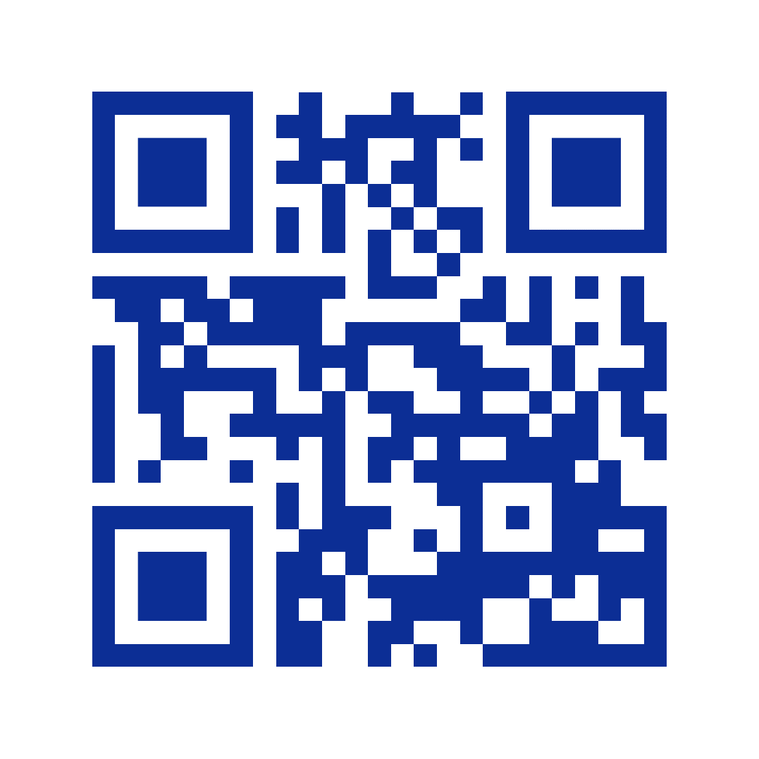


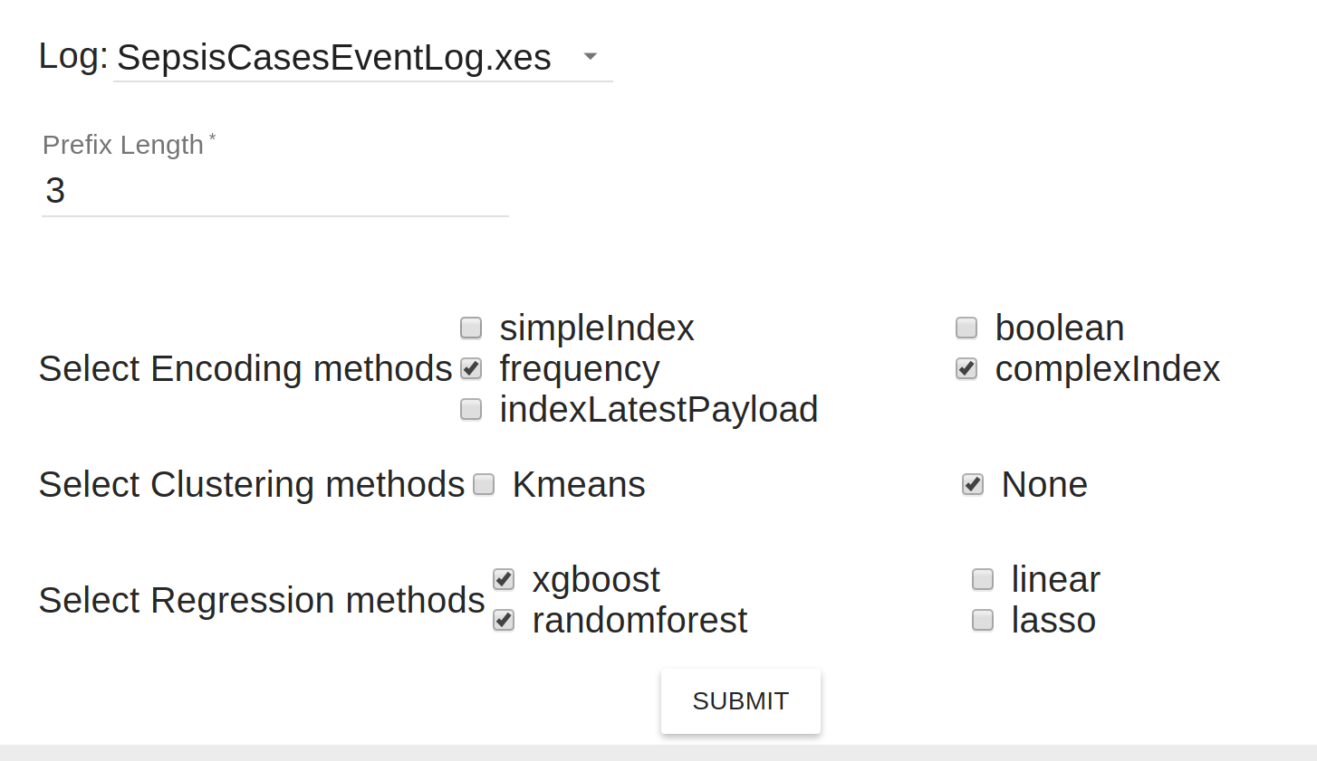
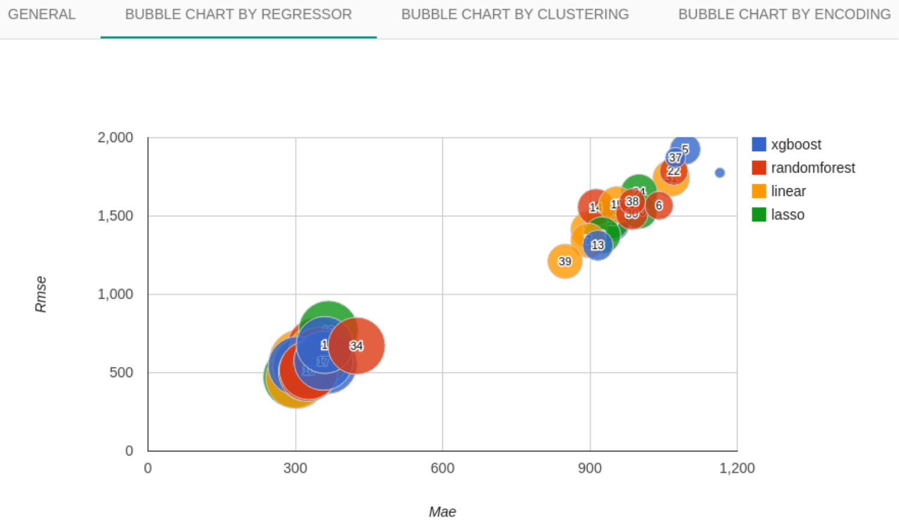
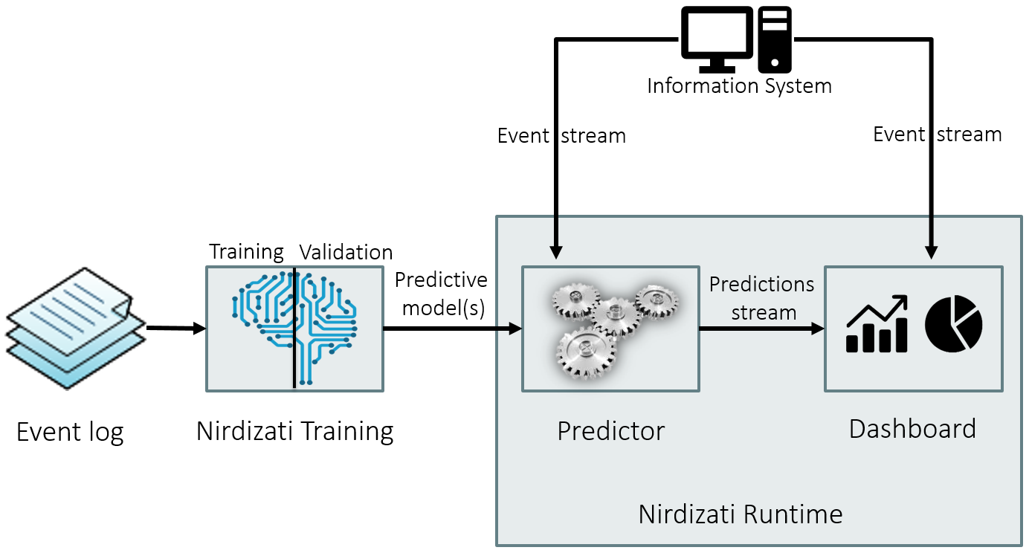
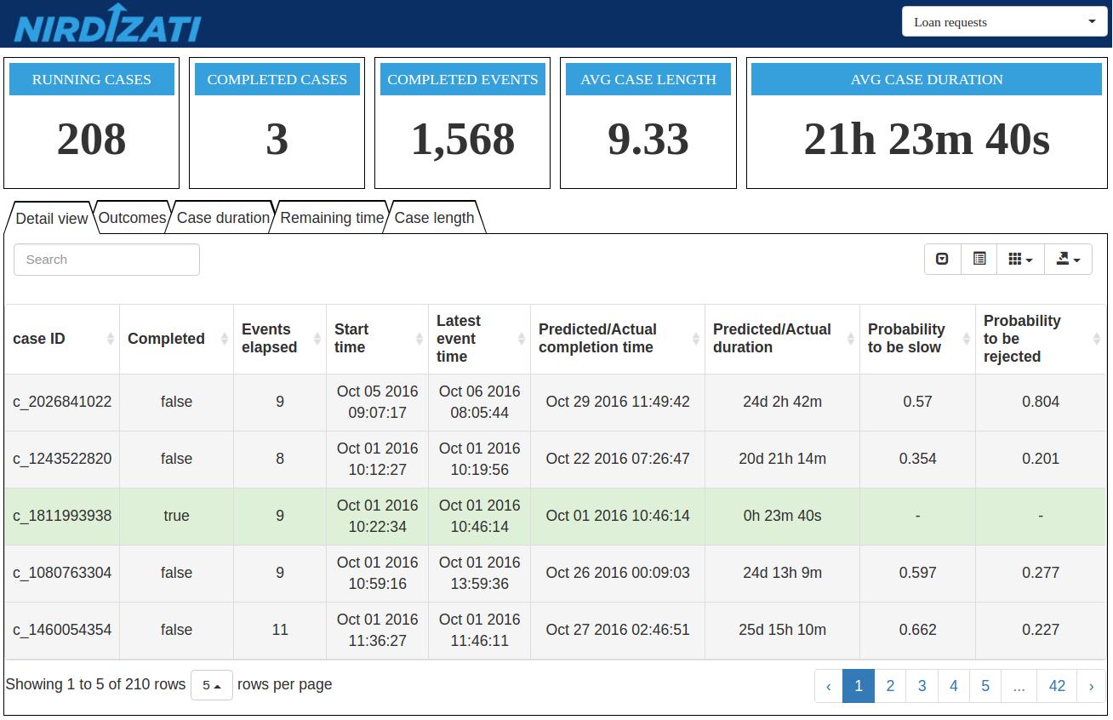
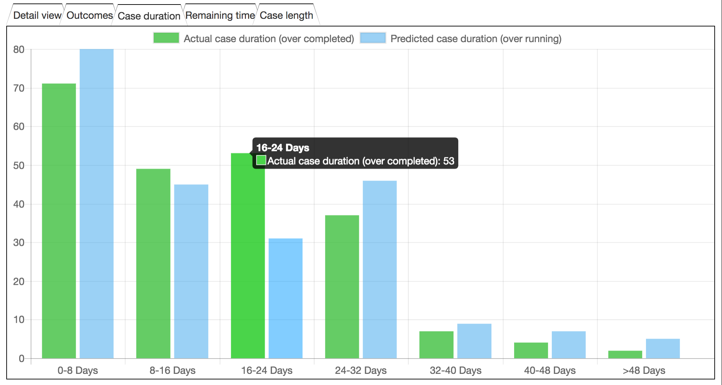
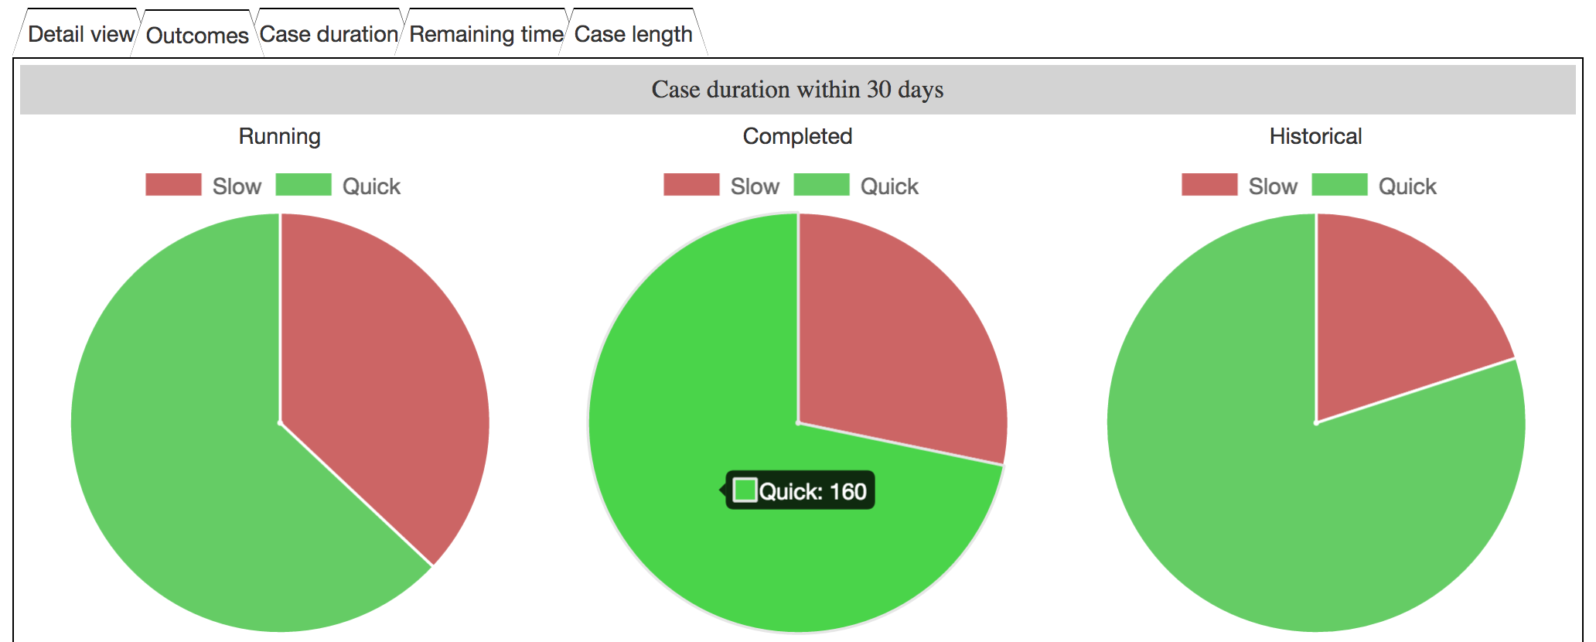
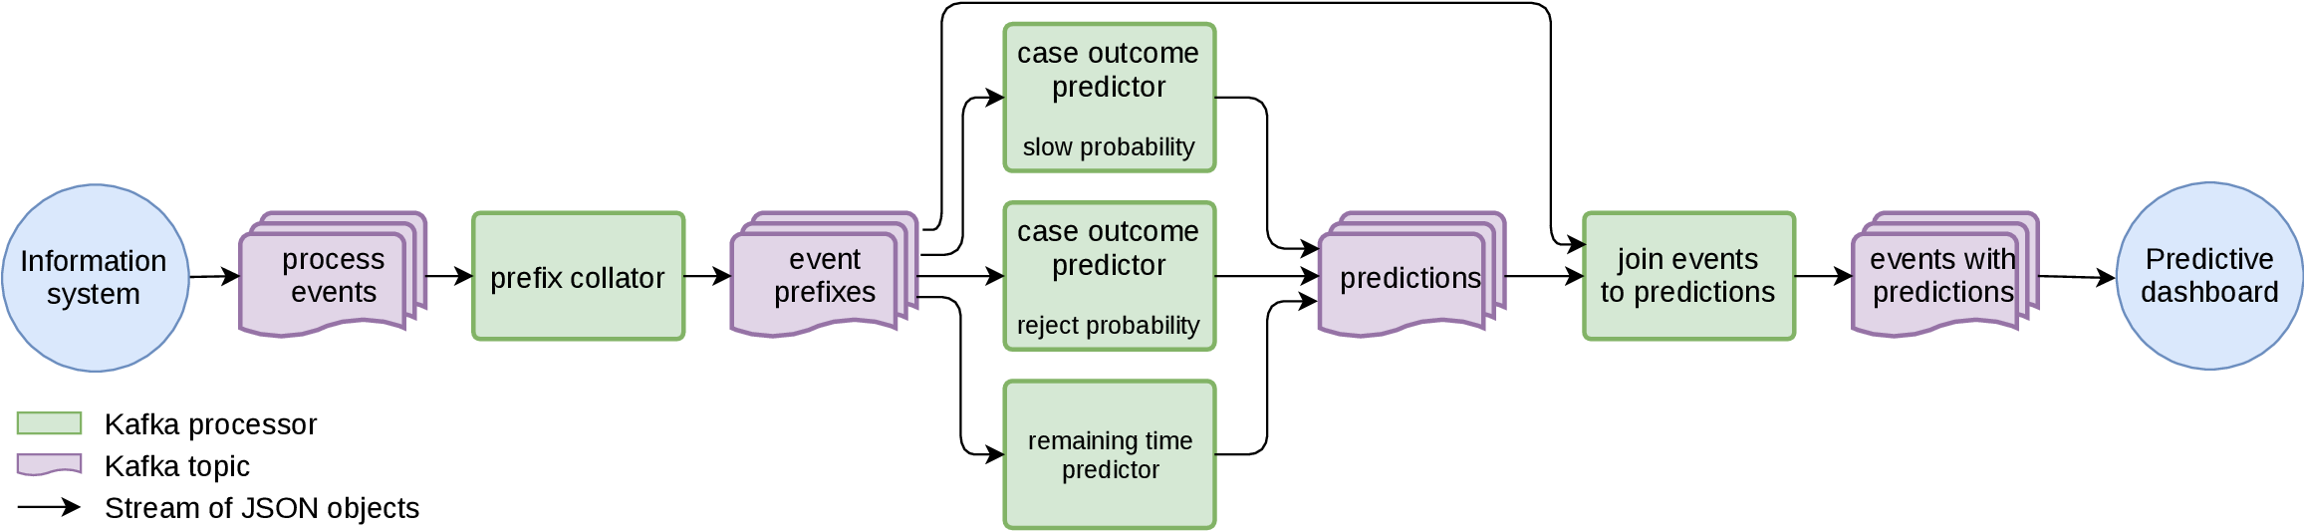
Open source predictive process monitoring dashboard
Predict process outcome (“Is this loan offer going to be rejected?”)
Predict process performance (“Will this claim take longer than 5 days to be handled?”)
Predict future events (“What activity is likely to be executed next? And after that?”)
Training component
High-level overview
Runtime component
Dataflow diagram of the Runtime component
Web: http://nirdizati.org
Code: https://github.com/nirdizati
Runtime: http://dashboard.nirdizati.org
Training: http://training.nirdizati.org
Notes:
Missing:
Introduction
Problem statement
Solution
Link to landing/demo, repo
Background
Use cases ? (at least which type of predictions)

