Slide 1

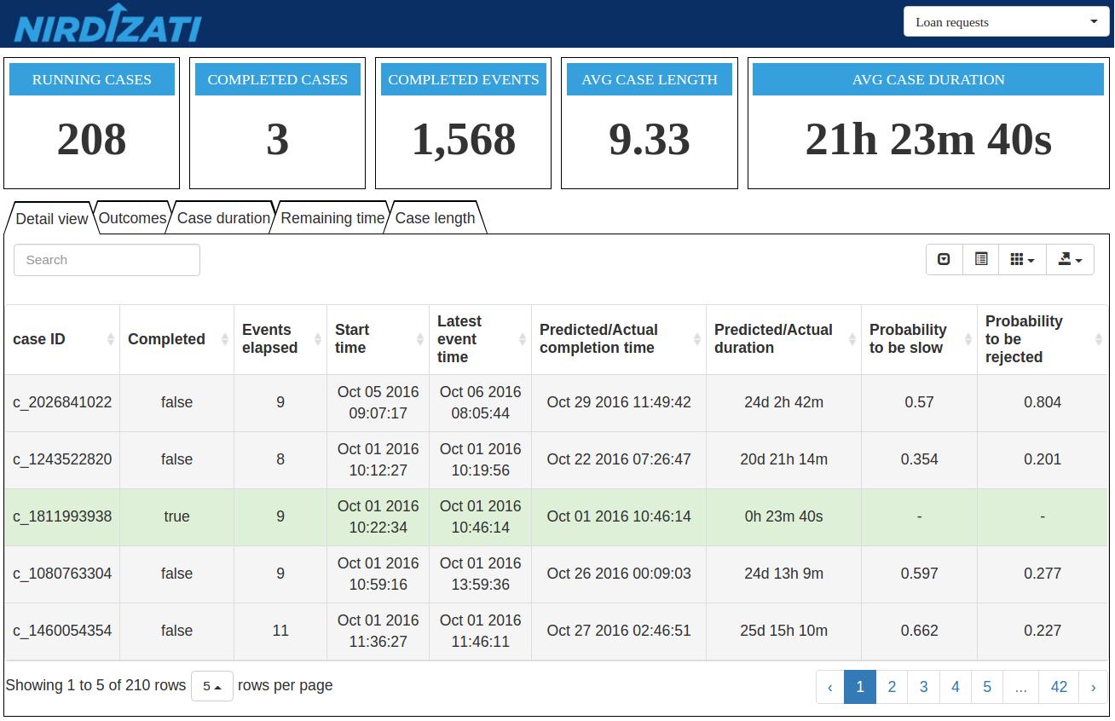
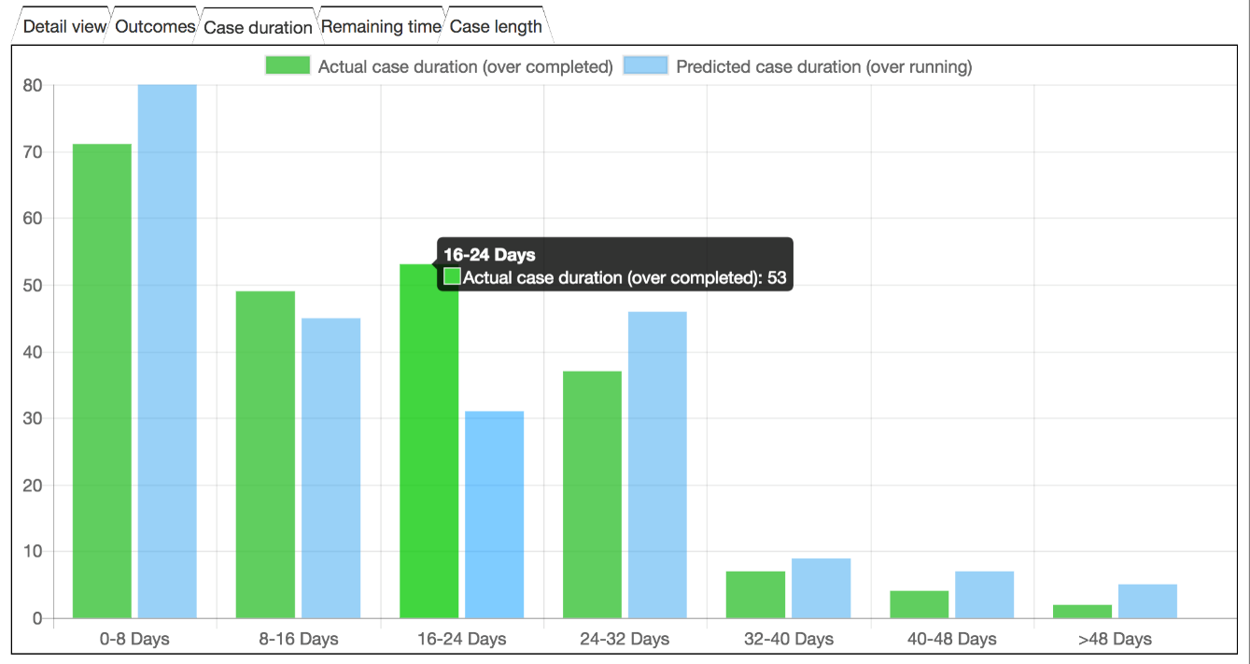
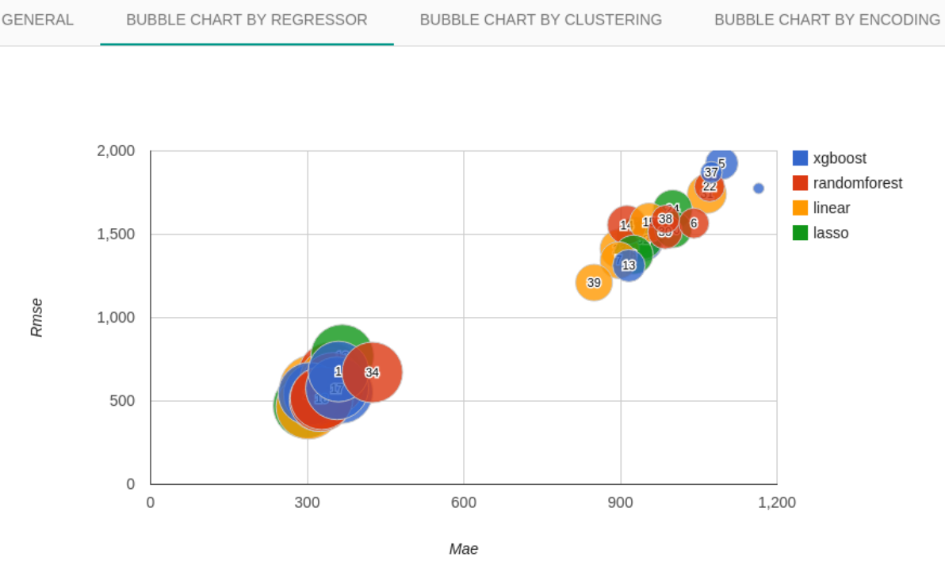



Open source predictive process monitoring dashboard
Predict process outcome (“Is this loan offer going to be rejected?”)
Predict process performance (“Will this claim take longer than 5 days to be handled?”)
Predict future events (“What activity is likely to be executed next? And after that?”)

Slide 2
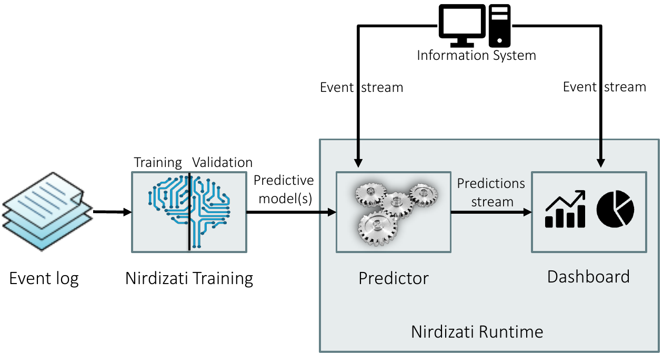
Nirdizati: open-source predictive process monitoring dashboard (nirdizati.com)
Predict process outcome (e.g. “Is this loan offer going to be rejected?”)
Predict process performance (e.g. “Will this claim take longer than 5 days to be handled?”)
Predict future events (e.g. “What activity is likely to be executed next? And after that?”)

