Slide 1
Fundamentals of Python
Data Structures
Heaps

Slide 2
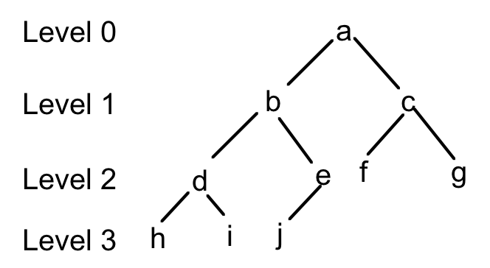
Complete Binary Tree
A binary tree is complete if each of its levels, with the possible exception of the last level, has a complete complement of nodes
Fundamentals of Python: Data Structures

Slide 3
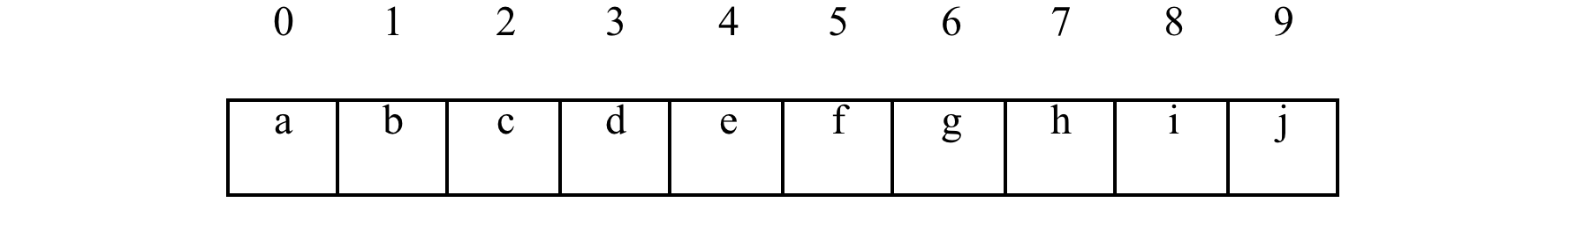
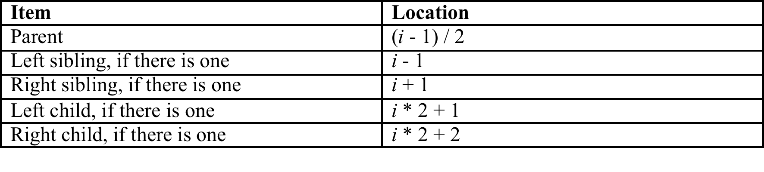
Array Representation
A complete binary tree lends itself to an array representation
Fundamentals of Python: Data Structures

Slide 4
Primary Use: Heaps
A heap is a complete binary tree in which items are generally less than those one level below and greater than those one level above
A heap provides logarithmic access to items that are in a natural order
Heaps are used to implement priority queues and the O(nlogn) heap sort
Fundamentals of Python: Data Structures

Slide 5
Examples
3
2
4
7
3
4
6
8
5
6
7
8
Fundamentals of Python: Data Structures

Slide 6
The Heap Interface
heap.isEmpty()
heap.add(item)
heap.pop()
heap.peek()
item in heap
len(heap)
str(tree)
iter(heap)
Fundamentals of Python: Data Structures

Slide 7
Using a Heap
heap = ArrayHeap()
heap.add("D")
heap.add("B")
heap.add("A")
heap.add("C")
heap.add("F")
heap.add("E")
heap.add("G")
print(heap)
print("F" in heap)
for item in heap:
print(item, end = " ")
while not heap.isEmpty():
print(heap.pop())
||G
|B
||E
A
||F
|C
||D
True
A B C D E F G
Fundamentals of Python: Data Structures

Slide 8
Using a Heap
heap = ArrayHeap(range(1, 8))
print("\n\nHeap with 1..7:")
print(heap)
print("for loop: ")
for item in heap:
print(item, end=" ")
Heap with 1..7:
||7
|3
||6
1
||5
|2
||4
for loop:
1 2 3 4 5 6 7
Fundamentals of Python: Data Structures

Slide 9
The ArrayHeap Class
class ArrayHeap(AbstractCollection):
def __init__(self, sourceCollection = None):
self._heap = list()
AbstractCollection.__init__(self, sourceCollection)
# Heap methods go here
Fundamentals of Python: Data Structures

Slide 10
Adding an Item to a Heap
Insert the new item at the bottom of the heap (the position after the current last item in the array)
Walk the new item up the heap, swapping it with the current parent, until the current parent is less than the new item
Fundamentals of Python: Data Structures

Slide 11
The add Method
class ArrayHeap(AbstractCollection):
def __init__(self, sourceCollection = None):
self._heap = list()
AbstractCollection.__init__(self, sourceCollection)
def add(self, item):
self._size += 1
self._heap.append(item)
curPos = len(self._heap) - 1
while curPos > 0:
parent = (curPos - 1) // 2
parentItem = self._heap[parent]
if parentItem <= item:
break
else:
self._heap[curPos] = self._heap[parent]
self._heap[parent] = item
curPos = parent
Fundamentals of Python: Data Structures

Slide 12
Popping an Item from a Heap
Removes and returns the root item
Replace the first item with the one at the bottom (last in the array)
Walk that item down the heap until it reaches its proper place
Fundamentals of Python: Data Structures

Slide 13
The pop Method
def pop(self):
self._size -= 1
topItem = self._heap[0]
bottomItem = self._heap.pop(len(self._heap) - 1)
if len(self._heap) == 0:
return bottomItem
self._heap[0] = bottomItem
lastIndex = len(self._heap) - 1
curPos = 0
while True:
leftChild = 2 * curPos + 1
rightChild = 2 * curPos + 2
if leftChild > lastIndex:
break
if rightChild > lastIndex:
maxChild = leftChild;
else:
leftItem = self._heap[leftChild]
rightItem = self._heap[rightChild]
if leftItem < rightItem:
maxChild = leftChild
else:
maxChild = rightChild
maxItem = self._heap[maxChild]
if bottomItem <= maxItem:
break
else:
self._heap[curPos] = self._heap[maxChild]
self._heap[maxChild] = bottomItem
curPos = maxChild
return topItem
Fundamentals of Python: Data Structures

Slide 14
Runtime Complexity Analysis
Insertion divides position by 2 each time items are swapped: logarithmic in worst case
Removal multiplies position by 2 each time items are swapped: logarithmic in worst case
Fundamentals of Python: Data Structures

Slide 15
Heap Sort
Copy the elements in the list to a heap
For each position in the list, pop an element from the heap and assign it to that position
Fundamentals of Python: Data Structures

Slide 16
Heap Sort Implementation
from heap import ArrayHeap
def heapSort(self, lyst):
heap = ArrayHeap(lyst)
for i in range(len(lyst)):
lyst[i] = heap.pop()
Fundamentals of Python: Data Structures

Slide 17
Heap Sort Analysis
from heap import ArrayHeap
def heapSort(self, lyst):
heap = ArrayHeap(lyst)
for i in range(len(lyst)):
lyst[i] = heap.pop()
N insertions when the heap is built from the list
Each insertion is O(log₂N)
N removals when the elements are transferred back to the list
Each removal is O(log₂N)
Total running time (all cases): O(Nlog₂N) Total memory: ?
Fundamentals of Python: Data Structures

Slide 18
A Better Version?
from heap import ArrayHeap
def heapSort(self, lyst):
heap = ArrayHeap()
while not lyst.isEmpty():
heap.add(lyst.pop())
while not heap.isEmpty():
lyst.add(heap.pop())
Fundamentals of Python: Data Structures

Slide 19
For Next Time:
O(n) Sorting with Bucket Sort
Fundamentals of Python: Data Structures

