Slide 1

DEPARTMENT OF INFORMATION SCIENCE & ENGINEERING
Mini Project-I
22ISE48
Air Quality Monitoring System using IoT and Data Visualization
Presentation by,
NAME :R Nirenjan Kumar, Ranjit Prasad AJ
USN :1NH23IS126, 1NH23IS131
Under the Guidance of ,
Guide Name : Dr. Kalaivani
Designation : Associate Professor

Slide 2
Agenda
Introduction
Problem Definition
Literature Survey
Objectives
Proposed system
Design modules
Implementation
Demonstration
Conclusion

Slide 3
Introduction
Air Pollution Challenge:
Air pollution poses a significant risk to public health and the environment, and requires precise and scalable monitoring systems.
Limitations of Traditional Monitoring:
Fixed stations are expensive, stationary, and inflexible in monitoring large or heterogeneous areas.
Proposed Solution:
A mobile, IoT-enabled air quality monitoring system based on sensors to identify methane (CH₄) and carbon monoxide (CO) in real-time.
Core Features:
Comprises a four-wheeled robot car, MQ-5 & MQ-7 gas sensors, Arduino microcontroller, and a mobile application with live data visualization.
Key Benefits & Use Cases:
Provides mobility, real-time data, and cost-effectiveness for urban surveillance, industrial areas, and environmental studies.

Slide 4
Problem Definition
Limited Spatial Awareness:
Existing monitoring systems cannot dynamically monitor pollutant concentration at multiple locations, resulting in data inconsistencies in highly dynamic urban and industrial settings.
No User Interaction & Flexibility:
Most existing solutions do not provide real-time user control or remote reconfiguration, and hence on-demand or occasion-specific monitoring is virtually impossible.
Delayed and Isolated Data Access:
Air quality information is frequently delayed, confined to localized systems, or hard to comprehend, which makes it less than useful for immediate public health responses and environmental activities.

Slide 5
Literature Survey
Sl No | Authors | Methodology | Advantages | Disadvantages
1 | Yu-Ren Zeng, Yue Shan Chang, You Hao Fang Dept. of CSIE, National Taipei University, New Taipei City, Taiwan | The system uses a big data platform with an ETL (Extract-Transform-Load) framework to collect, process, and visualize air quality data. Computing nodes handle data collection and forecasting for the next 1 to 8 hours using machine learning and deep learning. Storage nodes manage data retrieval and preprocessing. A RESTful API delivers data to a web interface, where real-time and forecasted air quality information is displayed using Google Maps API and D3.js for interactive visualization.. | This approach provides both real-time and forecasted air quality insights, supports large-scale data processing, and improves prediction accuracy with machine learning. The use of interactive, map-based visualization enhances user engagement, while browser-based access via RESTful APIs makes the system easily accessible and user-friendly. | The system requires significant computing resources and technical expertise. Its complexity and dependence on high-quality data can impact performance and accuracy. Additionally, ETL and processing layers may introduce slight delays, making it less ideal for applications requiring instant responses.
2 | K. S. Umadevi & D. Geraldine Bessie Amali School of Computer Science and Engineering, Vellore, India | This work integrates data visualization with Internet of Things (IoT) technology to simplify the process of understanding and analyzing real-time, big data. The approach involves selecting the most appropriate visual representations to make complex data from various IoT sensors comprehensible. IBM’s analytics solutions are used to gather data from diverse sources, including web and social media, which are then processed and visualized through analytic engines to provide actionable insights and support real-time decision-making. | Data visualization enables the identification of patterns, trends, and correlations in complex data, making it easier to understand and take fast, result-oriented actions. The use of IBM’s solutions allows for efficient data collection, storage, analysis, and reporting, providing users with real-time insights and actionable analytics. | The complexity of integrating diverse IoT data and sensors can pose challenges in ensuring consistency and accuracy. Additionally, while visualization aids in comprehension, it requires specialized tools and expertise to implement effectively, which can limit its accessibility for non-technical users

Slide 6
Literature Survey
Sl No | Authors | Methodology | Advantages | Disadvantages
3 | Nayan Das, Asaduzzaman Department of Computer Science and Engineering (CSE), Chittagong University of Engineering and Technology (CUET), Chittagong, Bangladesh | This system uses IoT sensors to collect real-time data on smoke, CO, particulate matter, temperature, and humidity. The data is displayed through a front-end interface for live monitoring. Machine learning models are applied to historical data to predict future air quality. Various algorithms are tested for accuracy, and correlations between AQI and weather conditions are analyzed. | The system enables continuous, real-time air quality monitoring and provides early warnings through predictive analysis. IoT automation reduces manual effort, while correlation analysis helps understand how weather impacts pollution. | Sensor accuracy may vary due to environmental factors. The system relies on internet and power connectivity, involves high setup costs, and requires regular updates to the machine learning models for accurate predictions.
4 | Haziq Zamri, Zatul Amilah Shaffiei, Nor Aziah Daud & Nor Diana Ahmad Faculty of Computer and Mathematical Sciences, Universiti Teknologi MARA (UiTM), 40450, Shah Alam, Selangor, Malaysia | The study uses the CRISP-DM model to guide the data analytics process. Air pollution data is collected, analyzed, and visualized through a dashboard called AirAwareMalaysia. Prediction techniques help identify low air quality areas, and an interactive web interface is designed for users to explore the data by clicking on specific features. | The system increases public awareness of air pollution, provides easy-to-understand visualizations, and allows early detection of poor air quality through predictive analysis. The interactive dashboard improves user engagement and supports informed decision-making. | The accuracy of the system depends on the quality of the collected data. Maintaining and updating the dashboard may require technical expertise, and users must have internet access to use the platform effectively.

Slide 7
Literature Survey
Sl No | Authors | Methodology | Advantages | Disadvantages
5 | Ajitesh Kumar, Mona Kumari, Harsh Gupta CEA Deaprtment, GLA University, Mathura, India | The study presents a mobile IoT-enabled air quality monitoring system that measures real-time environmental data, specifically focusing on Carbon Monoxide, Smoke, and PM levels. The system analyzes this data to assess air contamination in local areas and triggers alerts via a built-in buzzer when pollution levels rise. It uses AQI standards and is designed for small-scale, easy deployment. | The system provides real-time alerts, helping users respond quickly to poor air quality. Its compact and mobile design makes it suitable for homes and small spaces. It is also user-friendly and easy to operate, promoting wider adoption. | It may have limited coverage and scalability for larger areas. Sensor accuracy can vary, and it relies on consistent power and maintenance. The buzzer alert system may not provide detailed information compared to full dashboards.
6 | Paul D. Rosero-Montalvo & Vivian F. López-Batista, Diego H. Peluffo-Ordóñez & Leandro L. Lorente-Leyva Universidad de Salamanca, Salamanca, Spain & Universidad Técnica del Norte, Ibarra, Ecuador | This study implements thirteen IoT devices in Ibarra city to collect real-time urban pollution data. The data is processed using Prototype Selection and Data Balance algorithms, which are compared for performance with the k-Nearest Neighbour (k-NN) classifier. This approach ensures an optimized training set for accurate pollution classification. The results are displayed through a visualization platform with over 90% accuracy. | The system provides accurate, real-time pollution monitoring with high classification performance. The use of multiple IoT devices improves data reliability, while the visualization platform enhances user understanding of pollution levels in urban areas. | The system setup may be complex and resource-intensive due to the number of devices and algorithm tuning. It may also require technical expertise for maintenance and further updates to maintain performance across varying conditions.

Slide 8
Literature Survey
Sl No | Authors | Methodology | Advantages | Disadvantages
7 | Gagan Parmar, Sagar Lakhani, Manju K. Chattopadhyay School of Electronics, Devi Ahilya University, Indore, India | This prototype system uses low-cost air quality monitoring nodes equipped with semiconductor gas sensors and Wi-Fi modules to detect gases like CO, CO₂, SO₂, and NO₂. The sensor data is transmitted to a Raspberry Pi, which acts as a base station. A web server hosted on Raspberry Pi 3 displays the real-time data using a MEAN stack (MongoDB, Express.js, Angular, and Node.js) for visualization. | The system is cost-effective and suitable for widespread deployment. It allows real-time monitoring and data sharing via a web platform. The use of Raspberry Pi and MEAN stack makes it flexible, scalable, and user-accessible. | Sensor accuracy may be limited due to the use of low-cost components. The system requires reliable power and network connectivity. Performance may degrade in harsh environmental conditions or without regular calibration and maintenance.
8 | M. Saifeddine Hadj Sassi, Lamia Chaari Fourati Digital Research Center of Sfax (CRNS) Laboratory of Signals, systeMs, aRtificial Intelligence, and neTworkS (SM@RTS), Sfax University, Tunisia | The proposed system combines IoT devices for real-time air quality monitoring with deep learning techniques, specifically Recurrent Neural Networks (RNN) and Long Short-Term Memory (LSTM), to analyze time-series air quality data. Augmented Reality (AR) is integrated for enhanced data visualization, allowing users to intuitively interact with and interpret AQ information for better decision-making. | The system leverages advanced AI for accurate prediction of air quality trends and supports early warning against pollution risks. AR visualization enhances user engagement and simplifies complex data interpretation. It also helps highlight the link between poor air quality and health risks, especially in pandemic contexts. | Deep learning models require significant computational resources and high-quality training data. The use of AR and IoT may increase system complexity and cost. Additionally, reliable internet and hardware are necessary for seamless performance and real-time updates.

Slide 9
Literature Survey
Sl No | Authors | Methodology | Advantages | Disadvantages
9 | R. Kingsy Grace, Karthika Aishvarya S., B. Monisha, A. Kaarthik Department of Computer Science and Engineering, Sri Ramakrishna Engineering College, Coimbatore, India | The proposed system uses real-time sensor data to analyze and visualize air quality by measuring six critical pollutants: ozone (O₃), Particulate Matter (PM2.5), carbon monoxide (CO), nitrogen dioxide (NO₂), and sulfur dioxide (SO₂). Fuzzy C-Means clustering is applied to process the data, providing a more accurate analysis of air pollution. The results are compared with other algorithms in the literature, showing superior accuracy with Fuzzy C-Means. | The system provides real-time air quality monitoring, offering valuable insights into pollutant levels. Fuzzy C-Means clustering enhances accuracy and effectiveness compared to other algorithms. This system can help raise awareness of air pollution’s health risks and guide preventive actions. | The accuracy of the system depends on the quality of sensor data and environmental conditions. The complexity of Fuzzy C-Means clustering may require more processing power, and maintaining the system can be resource-intensive. The system's performance may also be influenced by sensor calibration and data variability.
10 | Carlo Alberto Rosati, Andrea Cervo, Cesare Fantuzzi DISMI, UNIMORE, Reggio Emilia, Italy | This project integrates Building Information Modeling (BIM) with IoT sensor networks to monitor air quality parameters in real-time. The system uses distributed IoT sensors, employing open-source software and MQTT communication protocols to update and manage air quality data. A web-based dashboard is developed to visualize both real-time and historical data. The BIM system is enhanced with sensor data to bridge the gap between digital models and actual conditions in construction automation. | The integration of IoT sensors with BIM allows for real-time monitoring and updating, improving synchronization between the digital model and the physical structure. It provides scalable solutions for air quality monitoring and enhances decision-making with live data. Open-source software and protocols reduce costs and promote flexibility. | Managing large datasets may become complex as the system scales, requiring efficient data processing and storage solutions. The system’s reliance on continuous sensor data and stable communication networks may introduce risks related to data loss or inaccuracies. Additionally, frequent updates to the digital model may still require manual input to maintain synchronization.

Slide 10
Objectives
Develop a Mobile Air Quality Monitoring System: Build a sensor-equipped robotic vehicle using MQ-5 and MQ-7 sensors to measure methane and carbon monoxide in real-time.
Implement Wireless Control and Data Transmission: Use Bluetooth or Wi-Fi to remotely control the vehicle and transmit sensor data to a mobile application.
Provide Real-Time Data Visualization: Design a user-friendly mobile dashboard to display live gas readings, trends, and vehicle status for effective air quality assessment.

Slide 11
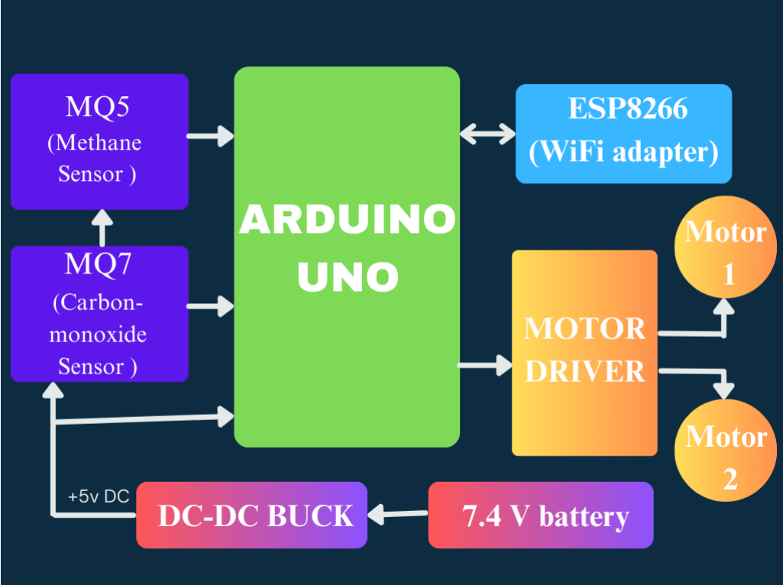
Design Modules

Slide 12
Algorithm
1.Start
2.Initialize hardware components:
Define motor pins (motor1_A, motor1_B, motor2_A, motor2_B)
Define gas sensor input pins (A0 for Methane, A1 for CO)
Initialize Serial and SoftwareSerial communication
Connect to Blynk using Wi-Fi credentials and authorization token
3.Set Blynk Timer:
Every 1 second, call send_parameters() to read and send sensor data
4.Inside loop():
Continuously run Blynk and the timer
Check the values of control flags (f, b, l, r)
If f is HIGH → call forward()
If b is HIGH → call backward()
If r is HIGH → call right()
If all are LOW → call halt()
5.Motor Movement Functions:
forward(): Set motor directions to move forward
backward(): Set motor directions to move backward
right(): Set motor directions to turn right
halt(): Stop all motors
6.Read Gas Sensor Data in send_parameters():
Read analog values from Methane and CO sensors
Apply basic calibration offset (ch4 - 130, co - 30)
Send these values to Blynk app on virtual pins V2 (CH₄) and V4 (CO)
7.Respond to Blynk Control:
When values on virtual pins V0–V3 change (from the app), update direction control variables (f, b, l, r)
8.Repeat Loop
9.End

Slide 13
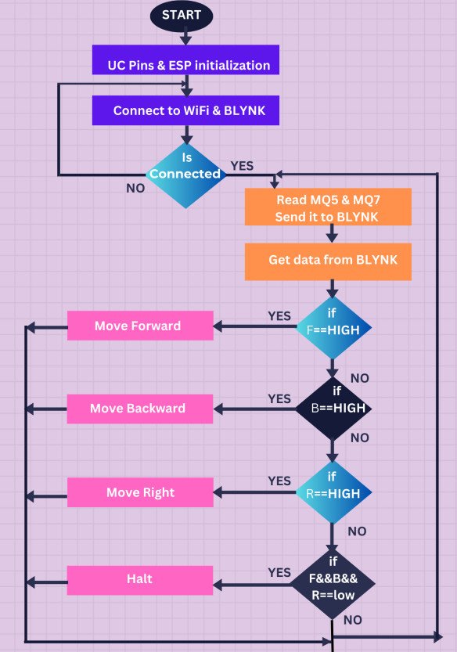
Flow Chart

Slide 14
Demonstration
Setup Function
void setup()
{
pinMode(motor1_A,OUTPUT);
pinMode(motor1_B, OUTPUT);
pinMode(motor2_A, OUTPUT);
pinMode(motor2_B, OUTPUT);
Serial.begin(9600);
EspSerial.begin(9600);
delay(100);
Blynk.begin(auth, wifi, ssid, pass);
timer.setInterval(1000L,
send_parameters);
}
Motor Control Functions
void forward()
{
digitalWrite(motor1_A, LOW); digitalWrite(motor1_B, HIGH);
digitalWrite(motor2_A, LOW); digitalWrite(motor2_B, HIGH);
}
void backward()
{
digitalWrite(motor1_A, HIGH); digitalWrite(motor1_B, LOW);
digitalWrite(motor2_A, HIGH); digitalWrite(motor2_B, LOW);
}
void right()
{
digitalWrite(motor1_A, HIGH); digitalWrite(motor1_B, LOW);
digitalWrite(motor2_A, LOW); digitalWrite(motor2_B, HIGH);
}
void left()
{
digitalWrite(motor1_A, LOW); digitalWrite(motor1_B, HIGH);
digitalWrite(motor2_A, HIGH); digitalWrite(motor2_B, LOW);
}
void halt()
{
digitalWrite(motor1_A, LOW); digitalWrite(motor1_B, LOW);
digitalWrite(motor2_A, LOW); digitalWrite(motor2_B, LOW);
}
Send Sensor Data to Blynk
void send_parameters()
{
ch4 = analogRead(methane) - 130;
co = analogRead(carbon_mono) - 30;
Blynk.virtualWrite(V2, ch4);
Blynk.virtualWrite(V4, co);
}

Slide 15
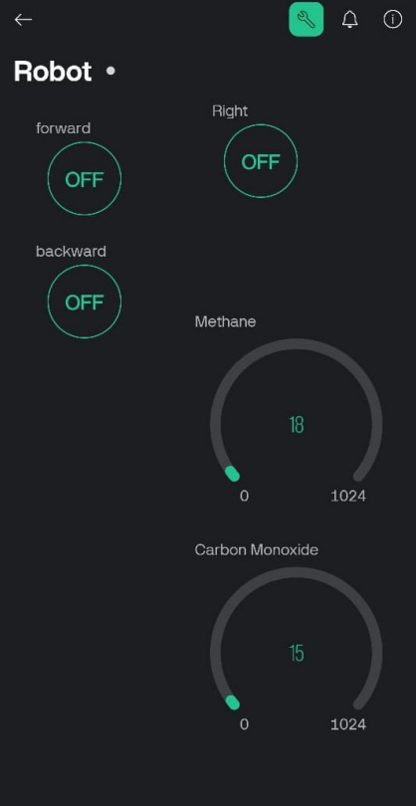
Experimental results
Graph

Slide 16
Conclusion
Real-time Gas Detection The system effectively detects CH₄ and CO levels in real-time using reliable gas sensors.
Mobile Monitoring Advantage A mobile robot allows flexible air quality monitoring across different locations and terrains.
Wireless Local Control Users can control the robot and view sensor data through a custom mobile app without internet/cloud dependency.
Cost-Effective & Scalable Solution Built with affordable components, making it easy to replicate for broader monitoring coverage.

Slide 17
References
[1] Zeng, Yu-Ren, Yue Shan Chang, and You Hao Fang. "Data visualization for air quality analysis on bigdata platform." 2019 international conference on system science and engineering (ICSSE). IEEE, 2019.
[2] Umadevi, K. S., and D. Geraldine Bessie Amali. "Data Visualization and Analysis for Air Quality Monitoring Using IBM Watson IoT Platform." Data Visualization: Trends and Challenges Toward Multidisciplinary Perception (2020): 15-32.
[3] Das, Nayan. "An IoT-based System for Air Pollution Data Analysis and Visualization." 2021 5th International Conference on Electrical Engineering and Information Communication Technology (ICEEICT). IEEE, 2021.

Slide 18
References
[4] Zamri, Haziq, et al. "AirAwareMalaysia: Data Visualization and Air Quality Awareness on Air Pollution in Selangor Using Big Data Analytics." International Conference on Soft Computing and Data Mining. Cham: Springer International Publishing, 2022.
[5] Kumar, Ajitesh, Mona Kumari, and Harsh Gupta. "Design and analysis of iot based air quality monitoring system." 2020 International Conference on Power Electronics & IoT Applications in Renewable Energy and its Control (PARC). IEEE, 2020.
[6] Rosero-Montalvo, Paul D., et al. "Urban pollution environmental monitoring system using iot devices and data visualization: a case study." Hybrid Artificial Intelligent Systems: 14th International Conference, HAIS 2019, León, Spain, September 4–6, 2019, Proceedings 14. Springer International Publishing, 2019.
[7] Parmar, Gagan, Sagar Lakhani, and Manju K. Chattopadhyay. "An IoT based low cost air pollution monitoring system." 2017 International Conference on Recent Innovations in Signal processing and Embedded Systems (RISE). IEEE, 2017.

Slide 19
References
[8] Sassi, M. Saifeddine Hadj, and Lamia Chaari Fourati. "Deep learning and augmented reality for IoT-based air quality monitoring and prediction system." 2021 International Symposium on Networks, Computers and Communications (ISNCC). IEEE, 2021.
[9] Grace, R. Kingsy, B. Monisha, and A. Kaarthik. "Analysis and visualization of air quality using real time pollutant data." 2020 6th International Conference on Advanced Computing and Communication Systems (ICACCS). IEEE, 2020.
[10] Rosati, Carlo Alberto, Andrea Cervo, and Cesare Fantuzzi. "Air quality monitoring in a BIM model by means of a IoT sensors network." 2020 Fourth International Conference on I-SMAC (IoT in Social, Mobile, Analytics and Cloud)(I-SMAC). IEEE, 2020.

Slide 20
Thank you
Queries ?

