Slide 1
IA-3 SKILL-BASED EVALUATION (25 MARKS)
Real-Time Multi-Crop Plant Leaf Disease Detection
Deep Residual Learning (ResNet-50) Transfer Learning with Automated Foliage Guard
Course: Deep Learning (23DC2040) | B.Tech. AI & Data Science | Semester V

Slide 2
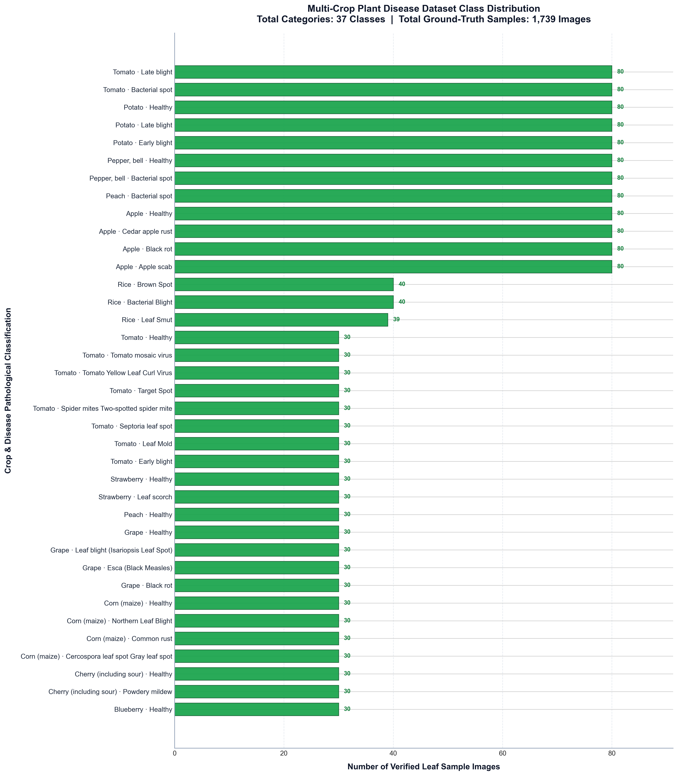
Problem Identification & Multi-Crop Dataset Distribution
Dataset Synthesis & Coverage
Total Classes: 37 Verified Agricultural Pathologies & Healthy Categories
Crops Covered (11): Apple, Blueberry, Cherry, Corn, Grape, Peach, Pepper, Potato, Rice, Strawberry, Tomato
Ground-Truth Sources: PlantVillage & Rice Leaf Disease benchmark repositories
Stratified Split: 70% Training (1,217 imgs) / 15% Validation (250 imgs) / 15% Test (272 imgs)
Pre-processing: Standardized RGB 224x224 with ResNet-50 zero-centering & TTA

