Slide 1

High-Order Paths in LDA and CTM
William M. Pottenger, Ph.D., Paul B. Kantor, Ph. D.
Kashyap Kolipaka, Shenzhi Li and Nir Grinberg
Rutgers University

Slide 2


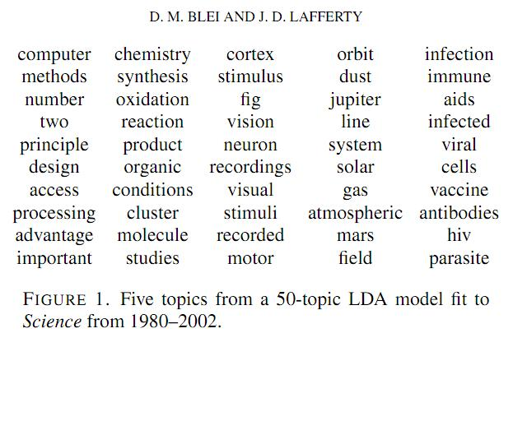






What is LDA all about?

Slide 3
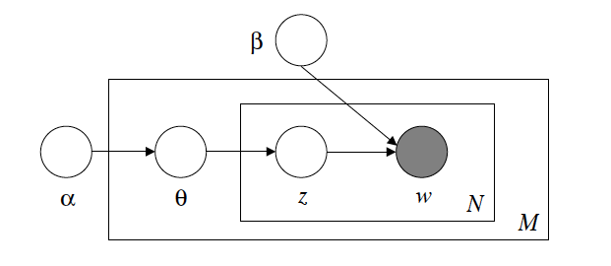
Graphical Model for LDA

Slide 4
Latent Dirichlet Allocation (LDA)
Suppose T is the number of topics to be discovered and W is the size of the dictionary of words.
α is a Dirichlet parameter vector of length T and β is a T x W matrix, where each row of the matrix is a Dirichlet parameter vector of length W.
Following is the generative process to use the shown graphical model to generate a corpus of documents using the Dirichlet Model.
Choose θ ~ Dirichlet(α).
For each of the N words w_{n}:
(a) Choose a topic z_{n} ~ Multinomial(θ).
(b) Choose a word w_{n} from p(w_{n} |z_{n};β), a multinomial probability conditioned on the topic z_{n}

Slide 5

Inference in LDA
There are two primary methods:
Variational Methods:
Exact inference in graphical models is intractable.
Gibbs Sampling:
The Dirichlet distribution is a conjugate prior of the multinomial distribution. Because of this property:
Roughly, the formula says that the probability that word i is assigned topic j is proportional to the number of times the term at i is assigned to the topic j.

Slide 6
High-Order Paths
1st order term co-occurrence: {A,B}, {B,C},{C,D}
2nd order term co-occurrence: {A,C}, {B,D}
A
B
B
C
C
D
D1
D2
D3
A
B
C
D

Slide 7
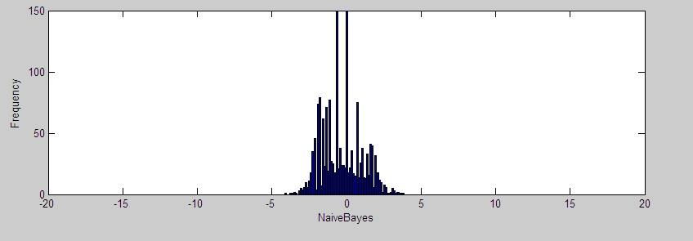
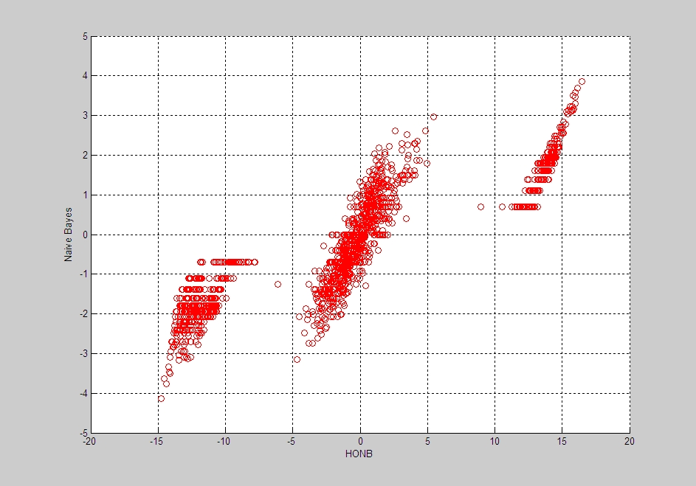
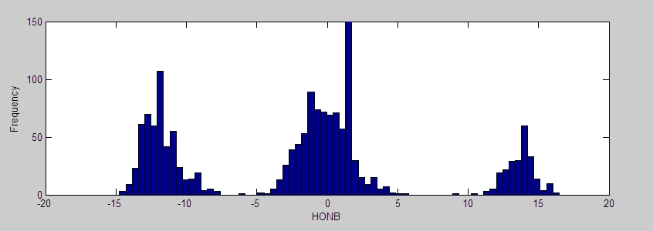
Higher-Order Learning
Log Probability Ratios Between Two Classes for Higher-Order vs. Traditional Naïve Bayes for 20 Newsgroups ‘Computers’ Dataset
Important discriminators for class #1
Log probability ratio distribution for Higher Order Naïve Bayes
Important discriminators for class #2
Log probability ratio distribution for Naïve Bayes

Slide 8
Higher Order LDA (HO-LDA)
Previous studies established the usefulness of the higher order transform for algorithms like Naïve-Bayes, SVM, LSI.
We used the same intuition to replace term frequencies by higher order term frequencies in topics:

Slide 9
Experimental Setup
Experiments on synthetic and real world datasets with dictionary size ~ 50 terms and corpus size ~ 100 documents.
Path counting
The input to this algorithm is a set of documents, each word being labeled with a topic index in [1, T].
Partition documents into topics => d₁, d₂, …., d_{T}
Now each topic has a set of “partial” documents.
We count higher-order paths in partial document for each one of the topics.
Exactly the same as in HONB.
Metric for evaluation
KL-Divergance:

Slide 10
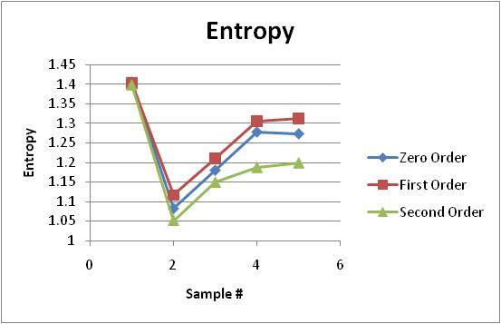
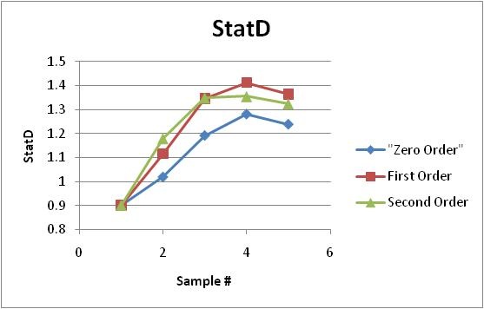
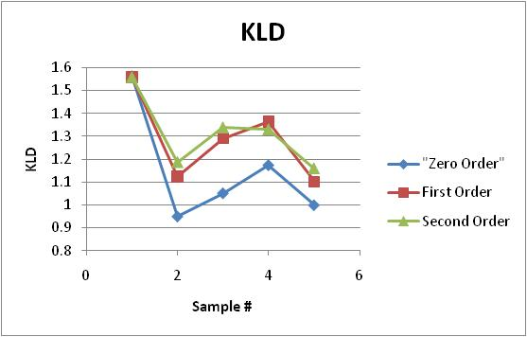
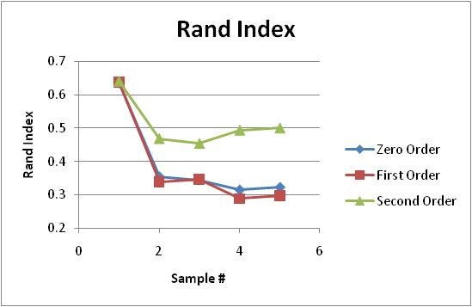
Preliminary Results (Synth)

Slide 11
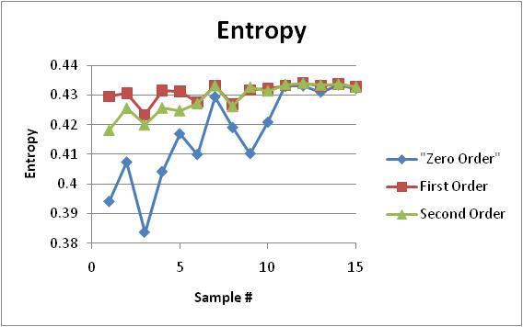
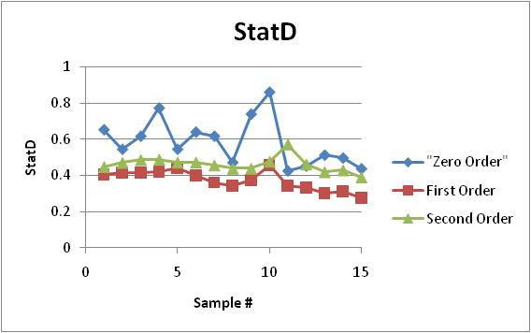
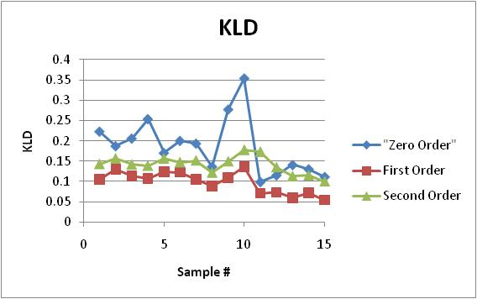
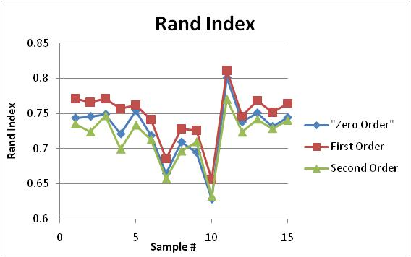
Preliminary Results (20 NG)

Slide 12
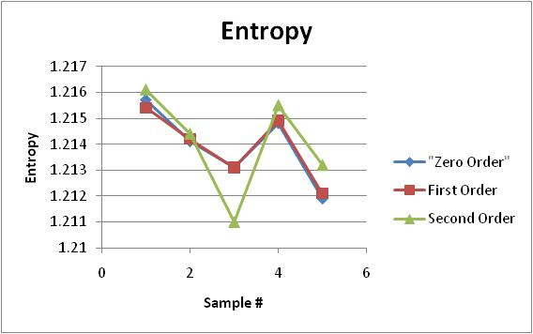
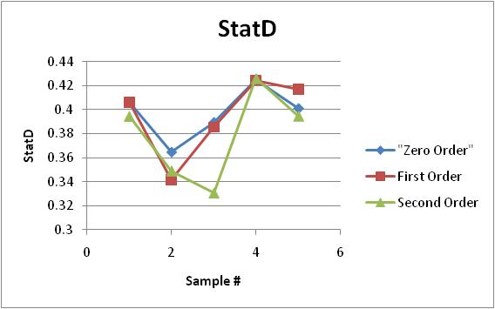
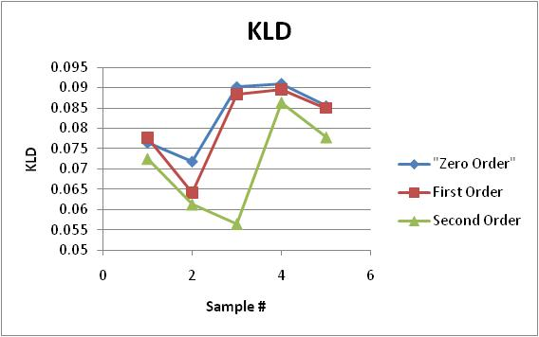
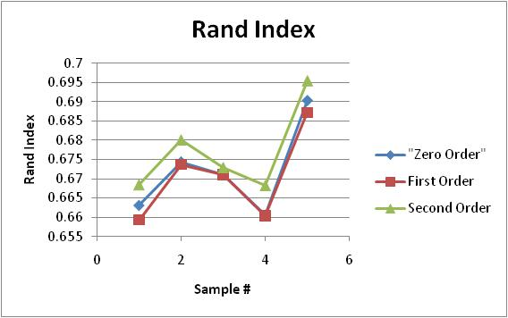
Preliminary Results (Cora)

Slide 13
Conclusions
For all datasets results suggest that HO-LDA outperforms LDA or perform equally as good.
Future research will attempt to substantiate this claim on additional benchmark and real world data.

Slide 14
Correlated Topic Model
Despite the convenience of the Dirichlet distribution, the distribution of its components are assumed to be independent.
Unlikely assumption in real corpuses:
For example, a document about quantum computing is more likely to contain references to quantum physics rather than references to the WWII.
CTM captures this:
Changing priors for topics from Dirichlet to Logistic-Normal Distribution.

Slide 15
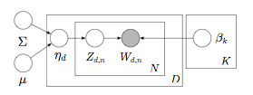
Graphical Model for CTM
only differs in the parameters for logistic-normal distribution, μ,Σ.
However we lost the simplifying conjugacy property
=> use variational methods

Slide 16
Correlation Transform
Take advantage of the topic correlation information
Let M = (m_{i,j}) be the TxT topic-covariance matrix.
M’ = exp{m_{i,j}}
normalized across rows to get stochastic matrix
Apply the transform the vectors and measure distance
KLD(M’a, M’b)

Slide 17
IC3 Data
The Internet Crime Complaint Center (IC3)
partnership between the FBI and the National White Collar Crime Center (NW3C) to deal with internet crime.
Contains reported incidents in 2008, each consists of the incident and witness description as free text.
Pre-processing:
concatenated the two text fields.
applied standard Information Retrieval techniques: stop words removal, stemming, frequency based threshold.
resulted ~ 1000 incidents with ~ 4500 terms dictionary.

Slide 18
Topic Models and Modus Operandi
Topic distribution can be representative of the modus operandi described in the incident document.
Then, modus operandi matching can be done using KL-Divergence similarity metric for distributions:

Slide 19
Results
Here is a sample:
Incident Ids | KLD Score | Documents | Word lists | Comments
I0809221032176501, I0809202119575841 | 4.0e-4 | Nigeria Scam-1, Nigeria Scam-2 | Nigeria List-1, Nigeria List-2 | Nigeria Scam
I0809220707030322, I0809220915581552 | 2.3e-4 | Porn-1, Porn-2 | Porn list-1, Porn list-2 | Pornography
I0809212047136972, I0809201507229792 | 1.4e-3 | Capital One-1, Captial One-2 | Capital One list-1, Capital One list-2 | Attempt to steal login and password

Slide 20
Results (Cont.)
We examined top 100 pairs in terms of similarity.
Results can be classified into 3 major groups:
duplicated incidents (ranked highest)
variants of the Nigerian scam (most numerous)
incidents with pornographic content (not so numerous)

Slide 21
Conclusions and Future Work
Higher Order transform in HO-LDA looks promising when substituted for (zero-order) term counts in LDA
CTM is more powerful representation of topics
Readily applied to resolution of sophisticated entities approximating modus operandi of internet identify theft
Future Work
Remains to be seen if Higher Order transform can be leveraged in HO-CTM

Slide 22
Q&A Thank you!

