Slide 1
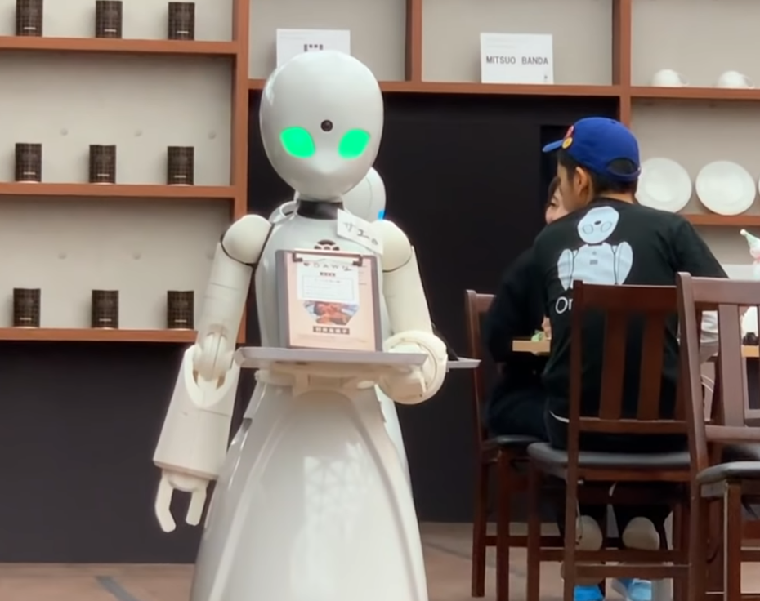
Robot-Run Cafe In Los Angeles
By Nir Galili
Rev v2
https://bgr.com/science/robot-cafe-tokyo-disabled-staff/

Slide 2
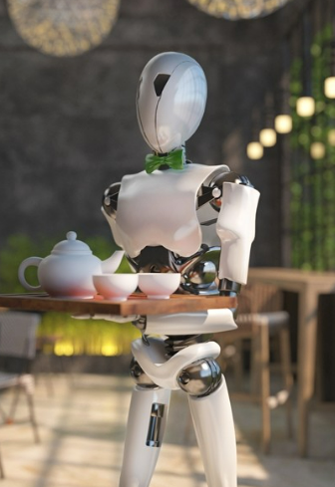
General conclusions
More than 75% of establishments are restaurants
62% of the establishments are not part of a chain
In chains we will most likely find a large number of seats
Restaurants has the greatest number of seats
The two most crowded streets by number of establishments are Sunset and Wilshire with 404 and 398 establishments respectively.
On the most popular streets bars and restaurants have the largest number of seats
https://www.fun-japan.jp/en/articles/11481

Slide 3
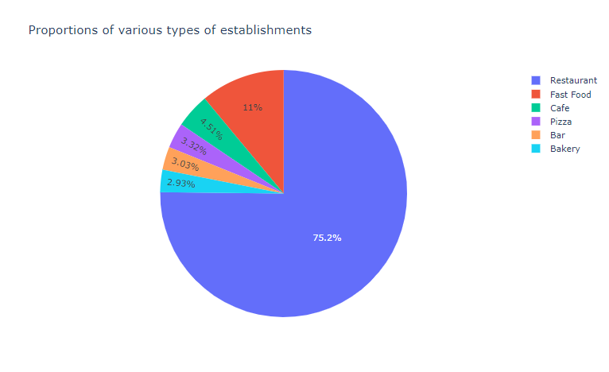
Type of establishments
The most common establishment is simply restaurant

Slide 4
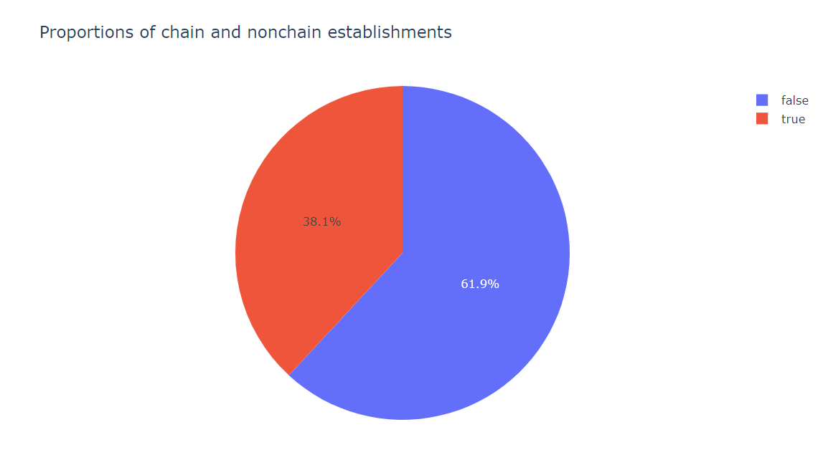
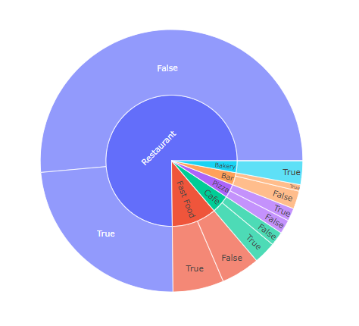
The proportions of chain and nonchain
Non chains more common
Unlike the rest, bakeries are always part of a chain

Slide 5
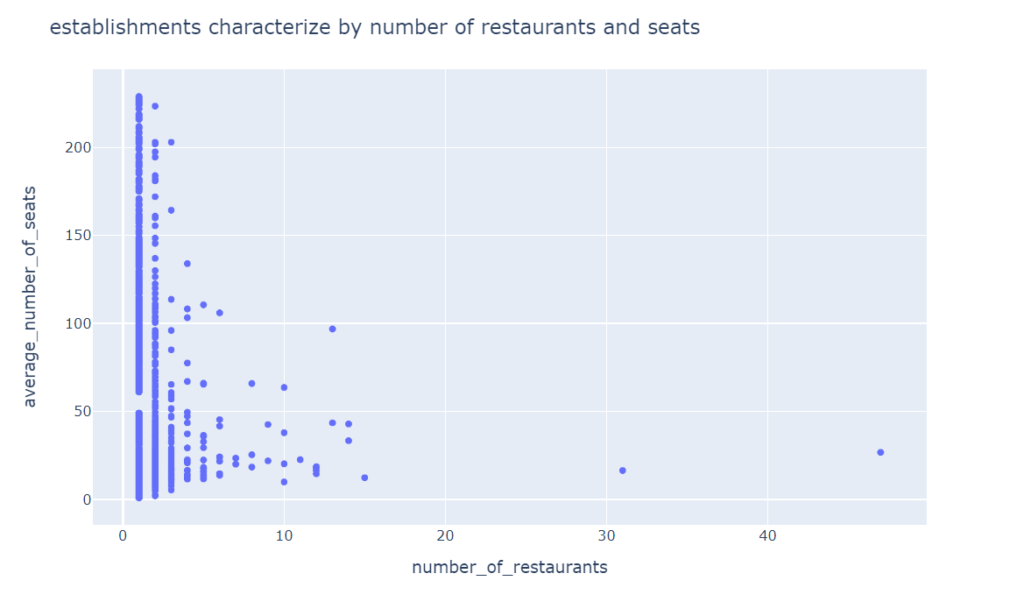
What characterizes chains?
Chains characterize by few establishments with a lot of seats rather than many establishments with a small number of seats

Slide 6
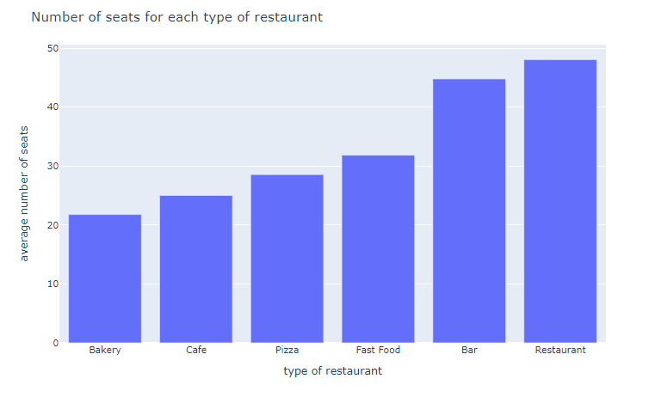
Number of seats
On average, restaurants has the highest number of seats
The second establishment with highest number of seats is bars

Slide 7
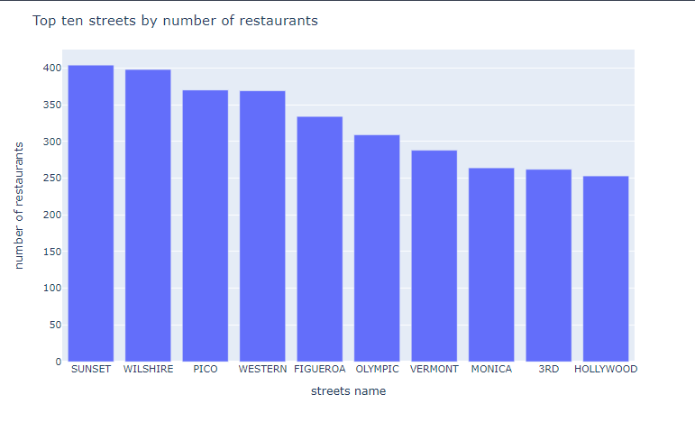
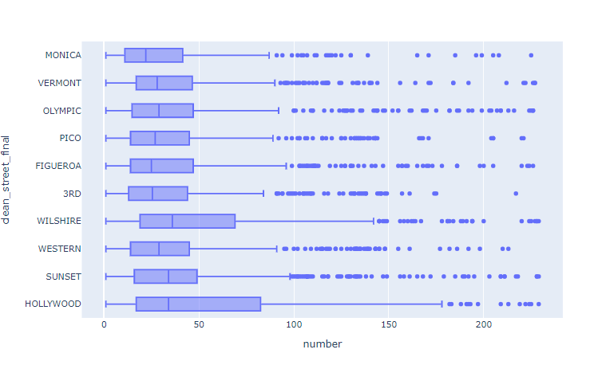
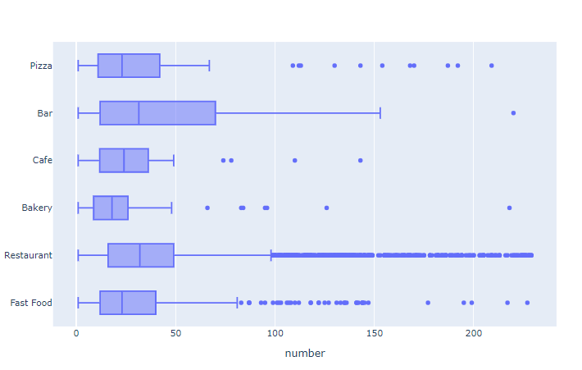
Top 10 streets for restaurants
On the lead Sunset with 404 establishments and Wilshire with 398 establishments.
Restaurants and bars have the largest number of seats. On bars as apposed to restaurants except of one location all the places are close by number of seats.
On Wilshire and Hollywood there is the largest difference between the first quartile and the 4th (IQR)

Slide 8
Overall conclusions
We don't have a measurement of success to the places we see on the data. We can only tell few characteristics like location, number of seats, part of a branch and type of restaurant. We will start from a premise that the more common a particular type it is the more likely it is to be successful and otherwise there would have been few of it. So we will recommend to open a restaurant from type restaurant. Put between 45 to 50 seats. Set the place in one of the 10 most crowded streets. Since the majority of restaurant from type restaurant are not part of chain we will recommend not to develop in this direction.

Slide 9
End

