Slide 1
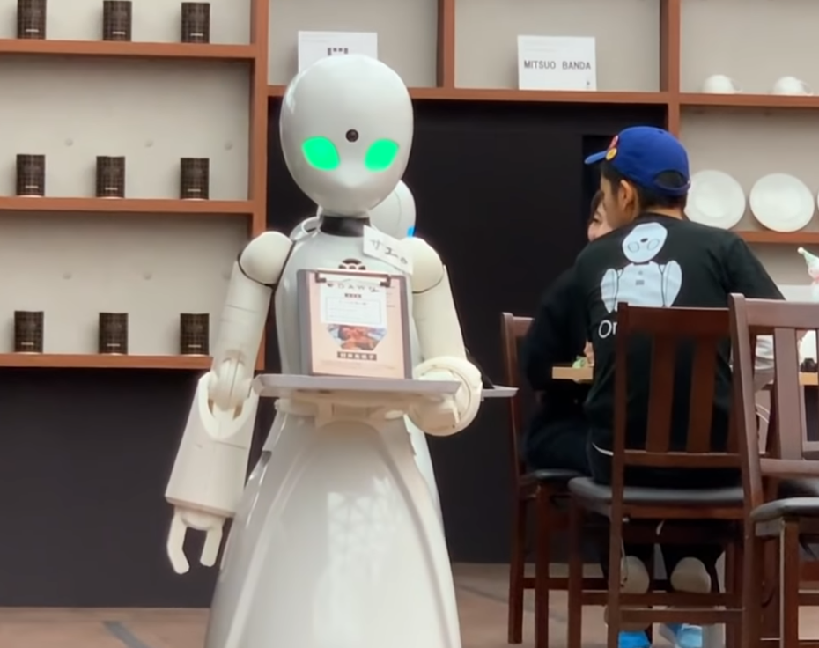
Robot-Run Cafe In Los Angeles
By Nir Galili
Rev v1
https://bgr.com/science/robot-cafe-tokyo-disabled-staff/

Slide 2
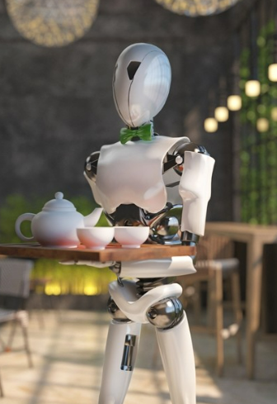
General conclusions
More than 75% of establishments are restaurants
62% of the establishments are not part of a chain
In chains we will most likely find a large number of seats
Restaurants has the greatest number of seats
The two most crowded streets by number of establishments are 6333 3RD and 10250 MONICA with 63 restaurants each
On the most popular streets most of the places have the smallest number of seats
https://www.fun-japan.jp/en/articles/11481

Slide 3
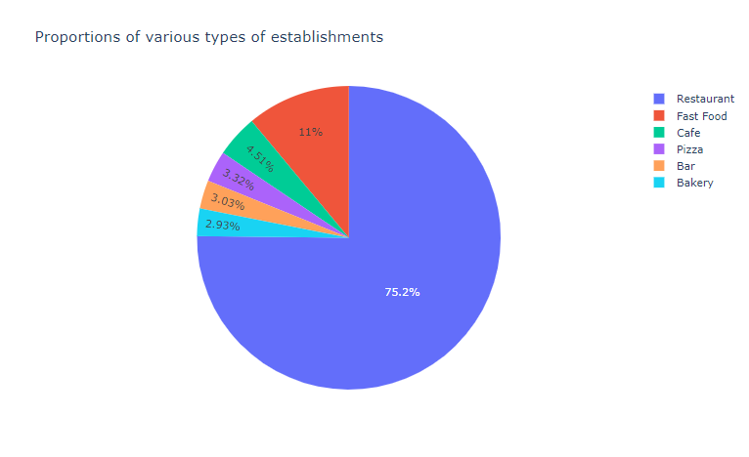
Type of establishments
The most common establishment is simply restaurant

Slide 4
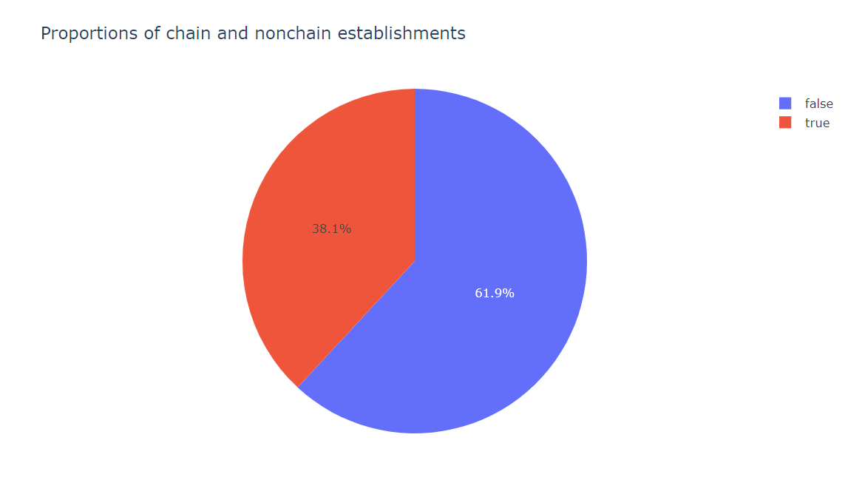
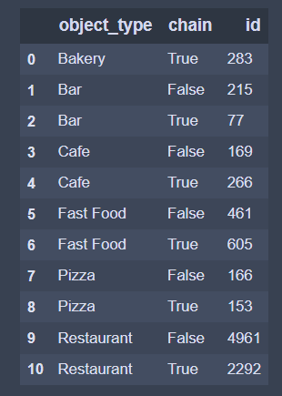
The proportions of chain and nonchain
Non chains more common
Unlike the rest, bakeries are always part of a chain

Slide 5
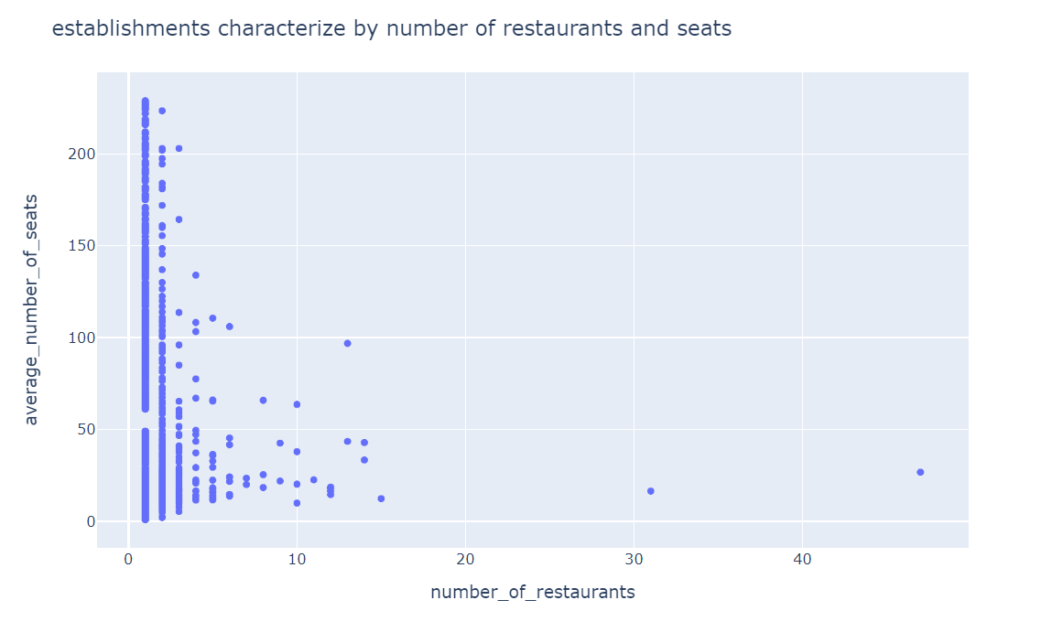
What characterizes chains?
Chains characterize by few establishments with a lot of seats rather than many establishments with a small number of seats

Slide 6
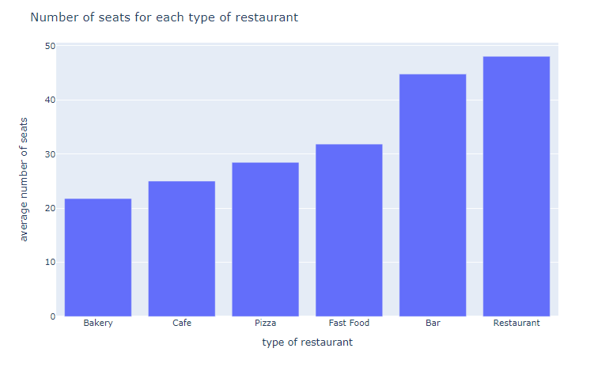
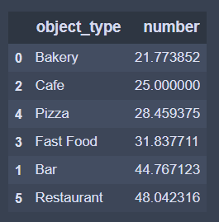
Number of seats
On average, restaurants has the highest number of seats
The second establishment with highest number of seats is bars

Slide 7
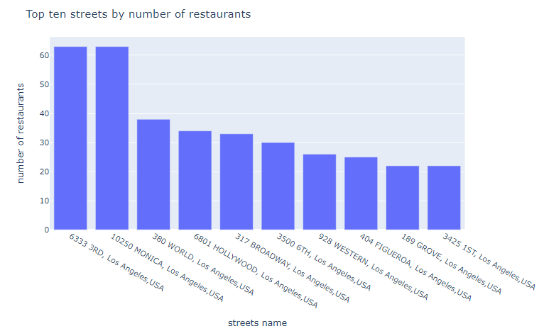
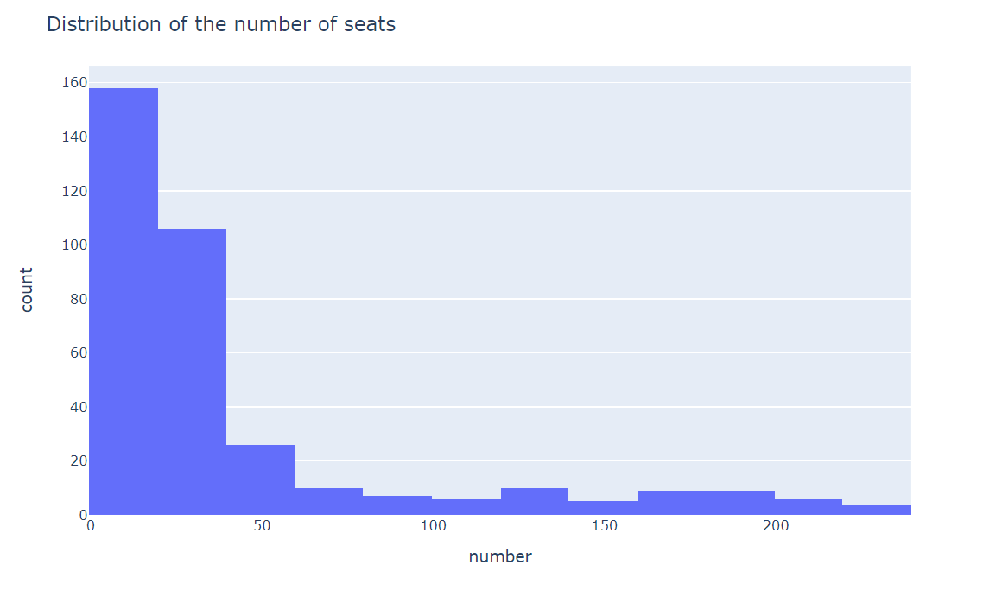
Top 10 streets for restaurants
On the lead 6333 3RD and 10250 MONICA with 63 restaurants
When we observe the establishments from the top 10 streets we see that the majority of places have small number of seats. Small places are trendy

Slide 8
End

