Slide 1

MongoDB

Slide 2
MongoDB
document oriented NoSQL databse
Json based
Dynamic structure & content
No multi document transactions

Slide 3
Json
Json are JavaScript based Object
Json are key/value pairs
Keys are simple strings
Values can be any legit language type (string, array, number etc)

Slide 4
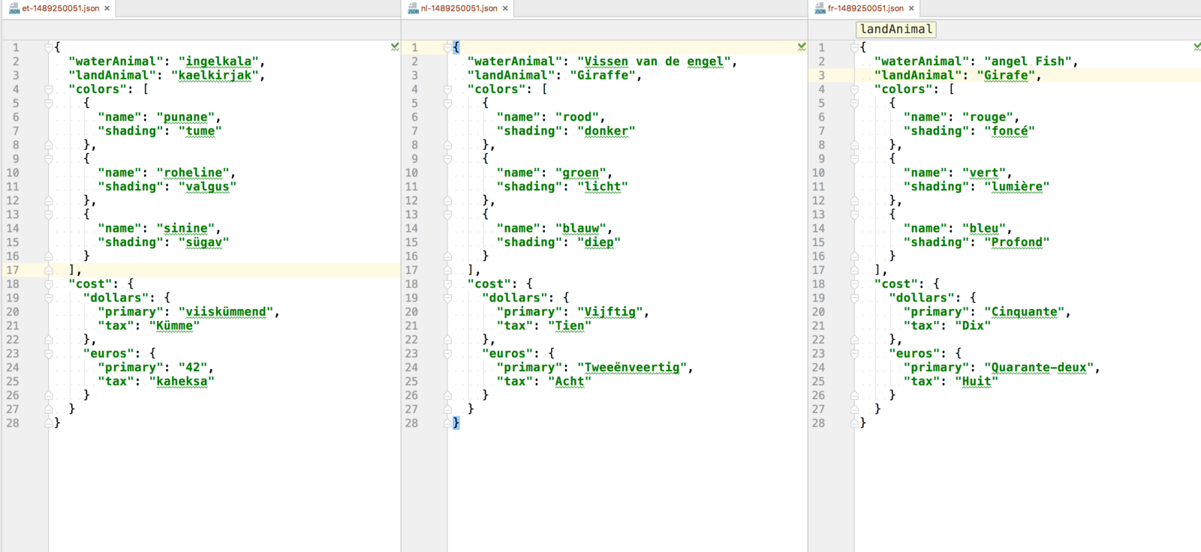
Json

Slide 5
Schema
Schema maps to a MongoDB collection and defines the shape of the documents within that collection.
var userSchema = new Schema({
name: String,
type: String
});

Slide 6
Schema (Types)
String
Number
Date
BufferString
Number
Date
Buffer
Boolean
Mixed
ObjectId
Array
Decimal128
Map

Slide 7
Schema (Middleware)
validate
save
remove
init

Slide 8
Schema (additional information)
required
enum
min/max
unique
validate
And more

Slide 9
Model
Models are fancy constructors compiled from Schema definitions.
An instance of a model is called a document.
Models are responsible for creating and reading documents from the underlying MongoDB database
var Users = mongoose.model(“User”, schema);

Slide 10
CRUD
Create
Read
Update
Delete

Slide 11
CRUD
Create
Insert
Save
Create
insertOne
insertMany
bulkWrite

Slide 12
CRUD
Read (find)
Model.find()
Model.findOne()
Model.findById()
Model.findByIdAndDelete()
Model.findByIdAndRemove()
Model.findByIdAndUpdate()
Model.findOneAndDelete()
Model.findOneAndRemove()
Model.findOneAndUpdate()

Slide 13
CRUD
Update
Model.updateMany()
Model.updateOne()
upsert boolean
Optional. If set to true, creates a new document when no document matches the query criteria.
The default value is false, which does not insert a new document when no match is found.

Slide 14
CRUD
Delete
Model.deleteMany()
Model.deleteOne()

