Slide 1

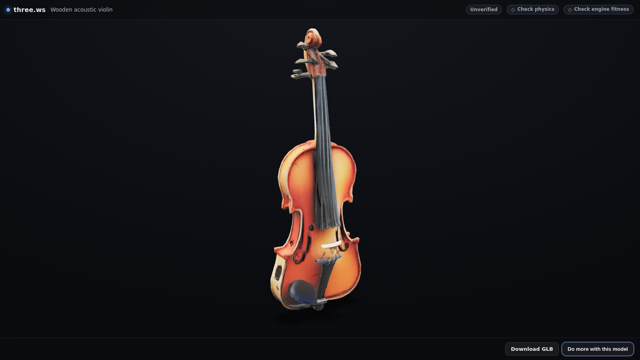

A sentence or a photo in. A rigged 3D agent that speaks, out.
Open-source (Apache-2.0) 3D agents for the web, Microsoft 365 and every MCP client.
three.ws and Microsoft have announced a partnership, and three.ws is live on Microsoft Marketplace.
A wooden violin generated from one sentence, in the three.ws viewer
three.ws
Notes:
three.ws in one line: an open-source platform that turns a sentence or a photo into a rigged 3D agent that speaks, and ships it with one HTML tag. Say the partnership exactly as the slide does. Numbers in this deck were measured 12 November 2026; sources are in docs/partners/microsoft/sources.md.

Slide 2
THE PROBLEM
3D and agents are slow, separate, specialist work
3D content needs specialists
Agents have no presence
Every surface is a new integration
Modelling, texturing and rigging a character is skilled manual work in desktop tools, so most product teams never ship 3D at all.
Assistants answer in a text box. There is no face, voice or body a customer recognises, and nothing to put on a page, in a meeting or in a store.
The web, Teams, Copilot, Power Platform and a company intranet each need their own packaging, sign-in and card formats before a single user sees anything.
three.ws closes all three gaps with one pipeline: the same agent, generated in minutes, runs on a web page, in Teams, in Copilot Studio and in Power Platform.
three.ws
Notes:
Three gaps, all qualitative on purpose: we do not quote market sizes we have not measured.

Slide 3
THE PRODUCT
One pipeline from a sentence to a speaking agent
1 Generate
2 Rig
3 Give it a voice
4 Ship it
Text, photo or sketch to a textured 3D model (GLB) on our own GPU fleet.
A humanoid skeleton and skin weights, so the model can pose and animate.
Persona, memory and skills, with speech and lip-sync in the browser.
One HTML tag, MCP servers and SDKs put the agent anywhere.
The whole install
<script type="module" src="https://unpkg.com/three.ws"></script>
<agent-3d
body="https://three.ws/avatars/realistic-female.glb"
brain="free"
instructions="You are Maya, a friendly guide to this site."
></agent-3d>
three.ws
Notes:
Walk left to right. The snippet is the real embed from docs/embedding.md: a bare GLB body plus brain="free" gives a talking agent with no key and no backend.

Slide 4
MICROSOFT SURFACES
Microsoft surfaces: live today, and built for what comes next
LIVE IN PRODUCTION
BUILT, AWAITING PUBLICATION
Microsoft Marketplace
App for Teams and Microsoft 365
Publisher listing live. Same platform as three.ws; nothing forks for the channel.
Bot, two tabs, search extension, agent connector. Manifest v1.30, checks pass.
MCP server for Copilot Studio and Foundry
TRELLIS (Microsoft Research, MIT)
Streamable HTTP, 16 tools; certification package drafted.
Self-hosted image-to-3D on NVIDIA L4 GPUs: 35,531 jobs since 8 July 2026.
Power Platform connector
Five actions, OAuth with PKCE, four flow templates.
ONNX Runtime Web
Microsoft 365 Copilot connector
Wake word, voice activity and transcription in the visitor's browser.
Agents, models and avatars indexed into the tenant through Microsoft Graph.
Marketplace SaaS offer
Adaptive Cards 1.6
Entra sign-in, SaaS Fulfillment v2, hourly metered billing.
One agent card layout for chat hosts and the Windows widgets board.
Microsoft Store and Edge Add-ons
The web app as MSIX, and the browser extension.
three.ws
Notes:
Left column runs in production for real users. Right column is in the open-source repository, passes its automated checks, and waits on a publication step in Partner Center or a store. Nothing on the right is described as approved or listed.

Slide 5
HOW IT FITS TOGETHER
Architecture on Microsoft technology
WHERE PEOPLE MEET THE AGENT
THREE.WS PLATFORM (GOOGLE CLOUD RUN)
GPU WORKERS
Any web page or intranet
API and agent runtime
TRELLIS on NVIDIA L4
<agent-3d> web component
Persona, memory, skills, speech and lip-sync
Microsoft Research, MIT. Image to textured GLB, one job per GPU
Teams and Microsoft 365
MCP server, 16 tools
Bot, tabs and search on Adaptive Cards
Free, no account and no key
TRELLIS.2 worker
Copilot Studio and Foundry
Marketplace SaaS fulfilment
Deployed and tested; not yet serving the image-to-3D lane
Through the MCP server
Entra sign-in, Fulfillment v2, metering
Power Automate and Power Apps
Adaptive Cards renderer
Blue edge: Microsoft technology
Power Platform connector
Agent card 1.6, progress card 1.5
IN THE VISITOR'S BROWSER: ONNX Runtime Web
Silero VAD, openWakeWord, Moonshine Base (English) and Whisper Base (other languages), all on the WebAssembly execution provider. Audio stays on the device.
three.ws
Notes:
Blue edges mark Microsoft technology. The platform runs on Google Cloud Run; TRELLIS runs on our own NVIDIA L4 GPUs. Speech never leaves the browser: ONNX Runtime Web runs the VAD, the wake word and the transcription models locally.

Slide 6
PRODUCTION DATA, 12 NOVEMBER 2026
Traction, measured
54,356
29,443
4,936
3D models generated on three.ws
models finished by TRELLIS on our GPUs since 8 July 2026
agents created
655
16
276
live embeds on other sites
tools on the free MCP server
GitHub stars and 78 forks, Apache-2.0
TRELLIS tier, last 30 days | Jobs finished | Median wall time | Median GLB
Draft | 1,404 | 132 s | 1.51 MB
Standard | 1,956 | 234 s | 6.06 MB
High | 275 | 602 s | 17.21 MB
three.ws
Notes:
Every figure is read from production or a public API on 12 November 2026; sources.md gives the query or endpoint for each. TRELLIS medians are wall time from job accepted to GLB finished, last 30 days, completed jobs only.

Slide 7
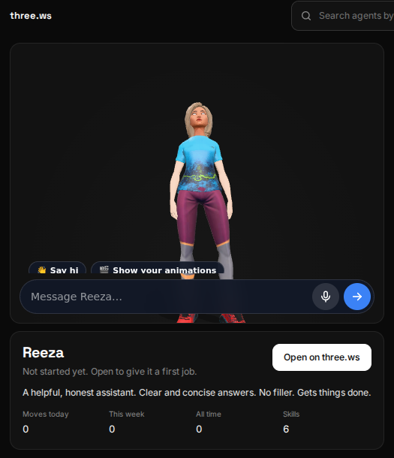
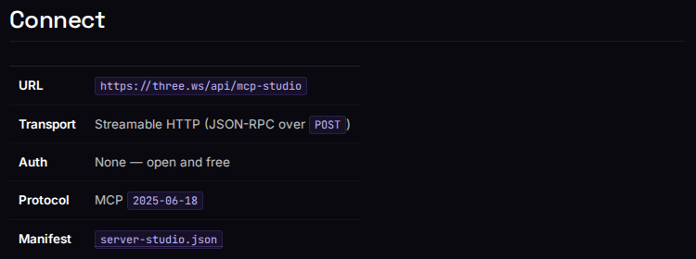
WHAT PEOPLE SEE
In Teams, and in any MCP client
Free MCP server: no account, no key
Tested, not just drawn
97 automated tests cover the Teams bot, the generation flow and cards, the agent card, the meeting stage view and the package builder. The app manifest validates against schema v1.30.
Agent tab, built for Teams: a live 3D agent with chat
three.ws
Notes:
Left: the agent tab built for Teams, captured from the live page at /microsoft/teams-tab. Right: the connection details for the free MCP server, from the live docs. Both are real screenshots, refreshed with scripts/microsoft-pack/capture-screenshots.mjs.

Slide 8
TEMPLATE
Customer story
Customer and team
The challenge
Organisation, industry and the team that owns the experience.
What they needed a 3D agent for, and what they used before.
What they built
The result
The three.ws pieces and the Microsoft surfaces they used: Teams app, Copilot Studio through MCP, Power Platform connector, Marketplace purchase.
Numbers the customer measured and approved: time to first agent, assets produced, usage after launch.
A quote from the customer, in their words and approved by them, closes the story.
three.ws
Notes:
This slide is the frame for the first published customer story. Fill it from programs/case-study-template.md once a customer has approved the wording and every result is a number they measured. Until then, present it as the shape of the story, not as a story.

Slide 9
WHAT COMES NEXT
Roadmap on Microsoft surfaces
1. Marketplace SaaS offer
2. Teams and Microsoft 365 app
3. Copilot Studio and Foundry
Buy three.ws through an existing Microsoft agreement, with Entra sign-in and metered billing.
Bot, tabs, search extension and the agent connector, submitted through Partner Center.
The MCP server submitted to the Copilot connector catalog.
4. Power Platform connector
5. Microsoft 365 Copilot connector
6. Store, Edge and TRELLIS.2
Five actions and four flow templates, submitted for certification.
Agents, models and avatars searchable in the customer's tenant.
MSIX and browser extension listings; TRELLIS.2 serving image-to-3D.
Every step is built and checked in the repository today. What remains is the submission and Microsoft's review.
three.ws
Notes:
Ordered by the owner checklist in docs/microsoft-marketplace-offer-plan.md, because later steps take values from earlier ones. Each step is a submission by three.ws followed by Microsoft's own review, so no dates are promised.

Slide 10
THE ASK
How Microsoft can help people find this
Feature our three Tech Community articles: TRELLIS on production GPUs, a Teams app on Adaptive Cards, and on-device speech with ONNX Runtime Web.
Talk to us
partnerships@three.ws
A Microsoft Reactor slot for the 45-minute live build: an agent in Copilot Studio that generates, rigs and voices a 3D character.
three.ws/docs/microsoft
github.com/nirholas/three.ws
Marketplace Rewards co-marketing once the SaaS offer is transactable.
three.ws and Microsoft have announced a partnership, and three.ws is live on Microsoft Marketplace.
Introductions to the Teams, Copilot Studio and Power Platform ecosystem teams.
three.ws runs on Google Cloud. Microsoft, Microsoft Marketplace, Microsoft 365, Microsoft Teams, Microsoft Entra, Microsoft Graph, Copilot Studio, Microsoft Foundry, Power Platform, Power Automate, Power Apps, Windows, Edge, TRELLIS, ONNX Runtime and Adaptive Cards are trademarks of the Microsoft group of companies. NVIDIA and Google Cloud are trademarks of their owners.
three.ws
Notes:
Each ask maps to a file in docs/partners/microsoft/: the three Tech Community drafts, reactor-session.md, and the program answers in programs/. Close with the contact details; do not describe any program as joined or approved.

