Slide 1
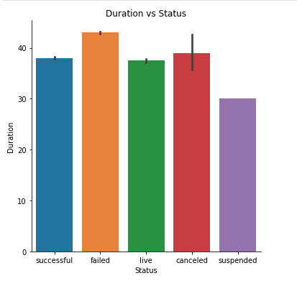
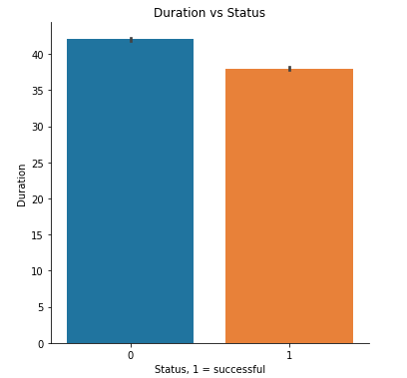
How to Create a Successful Kick-starter Campaign
1. How long should your campaign be?
Let’s take a look at the correlation between the duration of the campaign and its success
Correlation coefficient -0.11
Conclusion: success does not depend from the duration of the campaign

Slide 2
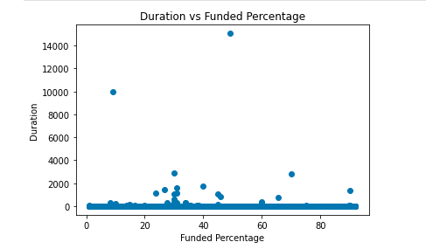
How to Create a Successful Kick-starter Campaign
2. Do longer or shorter projects get more funds?
Correlation coefficient 0.003
Linear regression analysis revealed p-value of 0.5
Conclusion: The length of the project has no correlation with the funded percentage

Slide 3
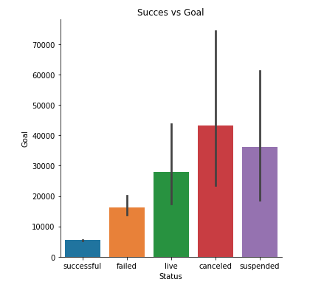
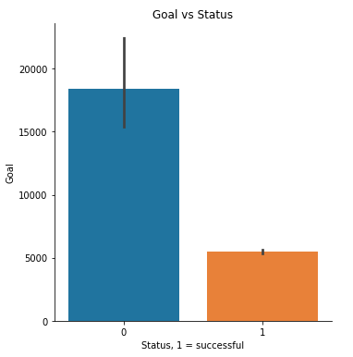
How to Create a Successful Kick-starter Campaign
3. What goals are more successful?
Linear regression p-value is 2.2263410397976805e-13
Which indicates a strong correlation between the amount of funds asked and success
Conclusion: goals with lower projected expenses get to be funded more often

Slide 4
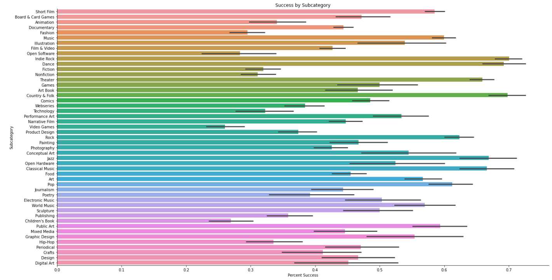
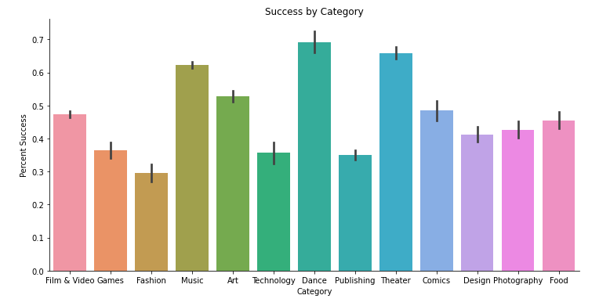
How to Create a Successful Kick-starter Campaign
4.What type of projects would be most successful at getting funded?
Conclusion: the most successful categories are dance, theater and music. The most successful sub-categories are Indie rock, dance and country & folk

Slide 5
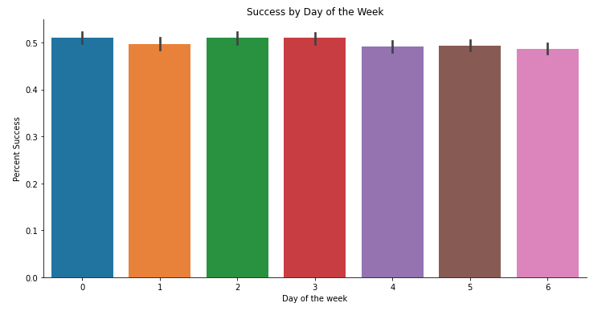
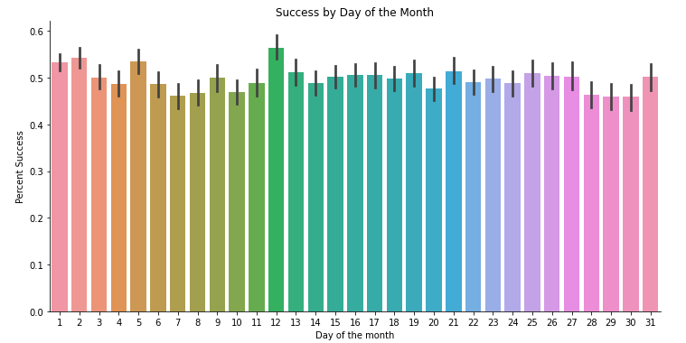
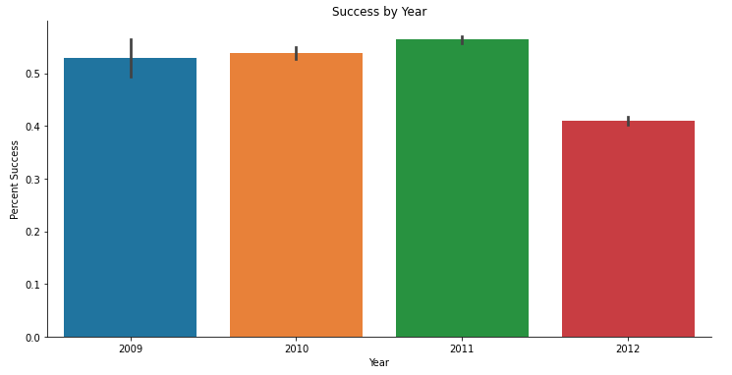
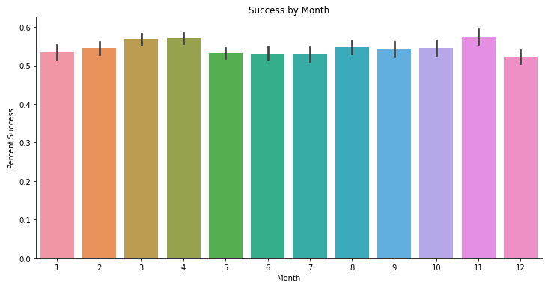
How to Create a Successful Kick-starter Campaign
5. Is there an ideal time to launch a campaign?
Conclusion: you can start at any time of the year
More details and source code at: https://github.com/niri-sky/Data-Science

