Slide 1
Zipf Law and Validation 2 - Analyzing WikiCorpus
Aapo Juutinen, Eetu Ervasti & Niklas Riikonen

Slide 2
Abstract
Zipf’s law states that rank of a word multiplied by its probability (frequency) is approximately a constant. In this project, we aim to validate Zipf’s law on a English Wikipedia corpora containing over 1.5 million articles (exact number of articles: 1 531 203).
Word | Frequency | r | Pr | r x Pr
the | 89815185 | 1 | 7.03 % | 0.0703
of | 45330518 | 2 | 3.55 % | 0.0709
and | 36990190 | 3 | 2.89 % | 0.0868
in | 35021778 | 4 | 2.74 % | 0.1096
to | 25464415 | 5 | 1.99 % | 0.0996
was | 13661416 | 6 | 1.07 % | 0.0641
is | 11111438 | 7 | 0.87 % | 0.0608
for | 10635149 | 8 | 0.83 % | 0.0666
as | 10471522 | 9 | 0.82 % | 0.0737
r × Pr ≈ constant
Notes:
Table: Nine most common words from Wikicorpus with their frequency, rank and probability.

Slide 3
Related Work
Topics investigated:
Zipf’s Law
Validation
Topic modelling (LDA)
Relevant prior work:
Zipf’s word frequency law in natural language: A critical review and future directions, Steven T. Piantadosi

Slide 4
Group member responsibilities
Aapo:
Project leader, tasks 1 and 2, documentation
Eetu:
Task 3, documentation
Niklas:
Task 4, documentation
Group members responsibilities for the remaining tasks had not been decided yet. Ideally all group members will participate to the coding and the report writing process.

Slide 5
Resources
Data Sources
Wikipedia dump file
Consist of English Wikipedia articles
Acquired from Wikimedia Foundation’s xml dumps
Technologies
Python
External Python libraries
Gensim, matplotlib, nltk, numpy, scipy, sklearn

Slide 6
Implementation details
Building text corpus from a Wikipedia dump file using python
Wikipedia dump downloaded from https://dumps.wikimedia.org/enwiki/latest/
Original size reduced from 16.6 to 7.4 GB, over 1.5 million lines of text.
Plotting the 30 most frequent words in the corpus
To validate Zipf’s law, we plotted frequency and rank on a logarithmic scale from the words present in corpus
Rank = The most frequent word’s rank is 1, second most frequent word’s rank is 2 and so on
Further investigation of Zipf’s law by quantifying the goodness of fit using statistical confidence at values of 80%, 85% and 90%
Writing a program that evaluates the search result of the query to each document

Slide 7
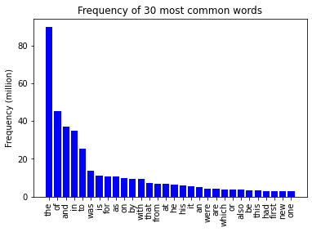
Task 1 Frequency of most common words
Notes:
We used nltk python library’s corpus and FreqDist modules for loading the corpus and calculating frequency of words. All of these words are stopwords.

Slide 8
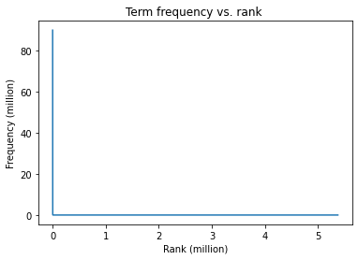
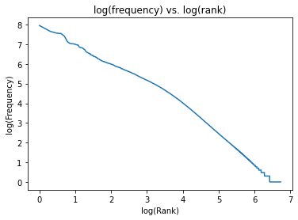
Task 2 Fitting Zipf’s law
Notes:
When we plot word frequency in logarithmic scale, we can see that it follows approximately a linear presentation.

Slide 9
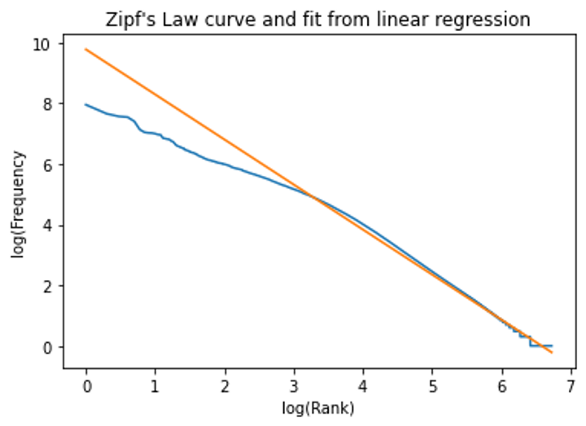
Task 3 Quantifying goodness of fit
Notes:
Task is to quantify the goodness of fit of Zipf’s law.
We fitted regression line on our data, log(freq) ~ log(Rank)

Slide 10
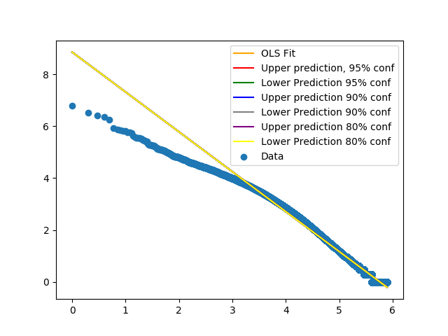
Task 3 Quantifying goodness of fit
Notes:
To further validate the Zipf’s law, we would need to obtain some level of confidence intervals for our fitted line.
We have not yet been able to do so, as seen in the figure below; all of our confidence boundaries are almost exactly equal to the fitted line. We have been working hard to get this right.
Some possible solutions:
There is something wrong in our coding
Our approach is wrong, linear regression is not the way to tackle this problem

Slide 11
Task 4 Making queries
Write down a code that would allow you to query WikiCorpus corpus using two contrasting topics of your choice. For instance, remote learning versus traditional education; peaceful solution versus military solution.
We had a lot of problems with this task, but we now have a piece of code that works.
Our solution is very similar to the code for the task 6 in lab 1.

Slide 12
Task 9 (Plan for) GUI
We want to display our results in a user-friendly manner by generating a graphical user interface.
User should be able to generate and view graphs
Also ability to save and load previous results due to size of datasets
Likely to be develop using Tkinter and matplotlib Python libraries

Slide 13
Challenges and solutions
Size of dataset resulted in slow processing
Using a partial dataset during development
Optimizing structures
Unexpected results in task 3, possible reasons
There is something wrong in our code, need to further investigate this
Our approach is wrong; linear regression is not the way to tackle this problem

Slide 14
Timeline for future tasks
Presentation 22.10
Analyzing results & report
2.11-7.11
26.10-1.11
Implementing tasks 4-9
Deadline 8.11
Notes:
22.10. – 26.10.
Fixing/improving tasks 3 and 4

Slide 15
Questions?

