Slide 1
Zipf Law and Validation 2 - Analyzing WikiCorpus
Aapo Juutinen, Eetu Ervasti & Niklas Riikonen

Slide 2
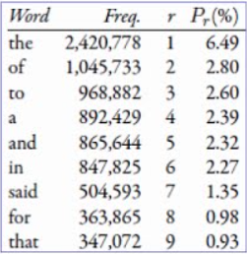
Abstract
Zipf’s law states that rank of a word multiplied by its probability (frequency) is approximately a constant. In this project, we aim to validate Zipf’s law on a English Wikipedia corpora containing over 1.5 million articles.
[montako artikkelia sielä nyt onkaan // jos jokainen rivi on oma artikkelinsa, niin 1531203 kpl].
r × Pr ≈ constant
Image source: [Lisää kuvan lähde tai tee vastaava taulukko omasta datasta]

Slide 3
Related Work
Topics investigated:
Zipf Law
Validation
Topic modelling (LDA)
Relevant prior work:
Zipf’s word frequency law in natural language: A critical review and future directions, Steven T. Piantadosi

Slide 4
Group member responsibilities
Aapo:
Project leader, [Taskit 1-2?, documentation]
Eetu:
Task 3, documentation
Niklas:
Task 4, documentation

Slide 5
Data sources/Technologies/Existing tools [alt.title? Resources?]
Data Sources
Wikipedia dump file
Consist of English Wikipedia articles
Acquired from Wikimedia Foundation’s xml dumps
Technologies
Python
External Python libraries
Gensim, matplotlib, nltk, numpy, scipy, [some other...]
Existing Tools
[Something]

Slide 6
Implementation details
Building text corpus from a Wikipedia dump file using python
Wikipedia dump downloaded from https://dumps.wikimedia.org/enwiki/latest/
Original size reduced from 16.6 to 7.4 GB, over 1.5 million lines of text.
Plotting the 30 most frequent words in the corpus
To validate Zipf’s law, we plotted frequency and rank on a logarithmic scale from the words present in corpus
Rank = The most frequent word’s rank is 1, second most frequent word’s rank is 2 and so on
Further investigation of Zipf’s law by quantifying the goodness of fit using statistical confidence at values of 80%, 85% and 90%

Slide 7
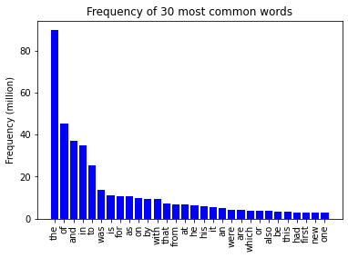
Task 1 Frequency of most common words
Notes:
We used nltk python library’s corpus and FreqDist modules for loading the corpus and calculating frequency of words.

Slide 8
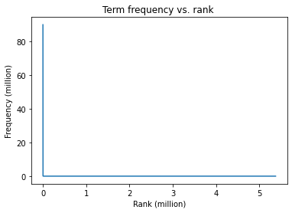
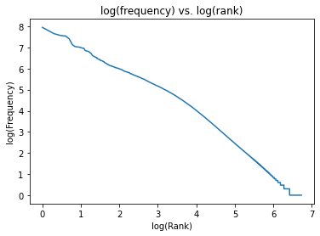
Task 2 Fitting Zipf’s law linearly
Notes:
When we plot word frequency in logarithmic scale, we can see that it follows approximately a linear presentation.

Slide 9
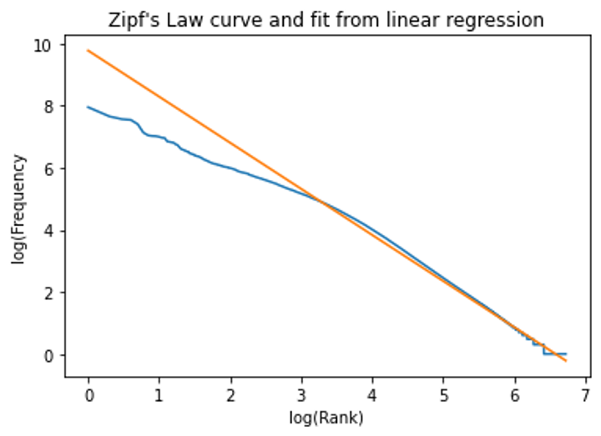
Task 3 Quantifying goodness of fit
Notes:
Task is to quantify the goodness of fit of Zipf’s law.
We fitted regression line on our data, log(freq) ~ log(Rank)

Slide 10
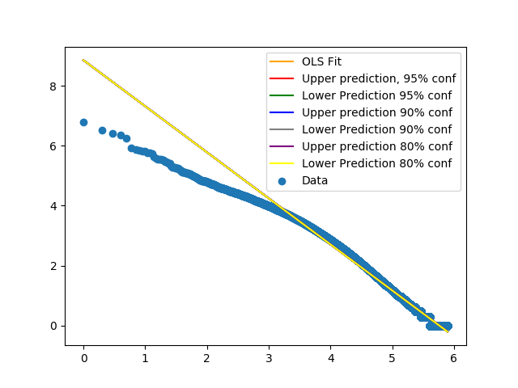
Task 3 Quantifying goodness of fit
Notes:
To further validate the Zipf’s law, we would need to obtain some level of confidence intervals for our fitted line.
We have not yet been able to do so, as seen in the figure below; all of our confidence boundaries are almost exactly equal to the fitted line. We have been working hard to get this right.
Some possible solutions:
There is something wrong in our coding
Our approach is wrong, linear regression is not the way to tackle this problem

Slide 11
Results: Task 4
[Tähän jottain tekstiä tai jättää nelosen ulos presestä]

Slide 12
Challenges and solutions
Size of dataset resulted in slow processing
Using a partial dataset during development
Optimizing structures
Unexpected results in task 3, possible reasons
There is something wrong in our code, need to further investigate this
Our approach is wrong; linear regression is not the way to tackle this problem

Slide 13
Timeline for future tasks [jotenkin näin?]
Presentation 22.10
Analyzing results & report
2.11-7.11
26.10-1.11
Implementing tasks 4-9
Deadline 8.11

