Slide 1
DESCISION ANALYSIS

Slide 2
Introduction
Decision analysis:
Provides framework and methodology
Addresses decision-making in the face of great uncertainty

Slide 3
Decision Making Without Experimentation
Decision maker must choose an alternative
From a set of feasible alternatives
State of nature
Factors in place at the time of the decision that affect the outcome
Payoff table shows payoff for each combination of decision alternative and state of nature

Slide 4
Decision Making Without Experimentation
Analogy with game theory
Decision maker is player 1
Chooses one of the decision alternatives
Nature is player 2
Chooses one of the possible states of nature
Each combination of decision and state of nature results in a payoff
Payoff table should be used to find an optimal alternative for the decision maker
According to an appropriate criterion

Slide 5
Decision Making Without Experimentation
Differences from game theory
Nature is not rational or self-promoting
Decision maker likely has information about relative likelihood of possible states of nature
Probability distribution: prior distribution
Probabilities: prior probabilities

Slide 6
A Prototype Example
Goferbroke Company owns land that may contain oil
Geologist reports 25% chance of oil
Another company offers to purchase land for $90k
Goferbroke option: drill for oil at cost of $100k
Potential gross profit $800k (net $700k)
Potential net loss of $100k if land is dry
Need to decide whether to drill or sell

Slide 7
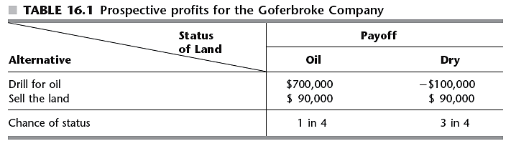
A Prototype Example

Slide 8
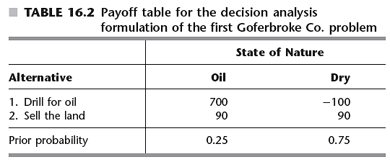
Decision Making Without Experimentation
Formulation of the prototype example
The maximin payoff criterion
Extremely conservative in nature
Assumes nature is a malevolent opponent

Slide 9
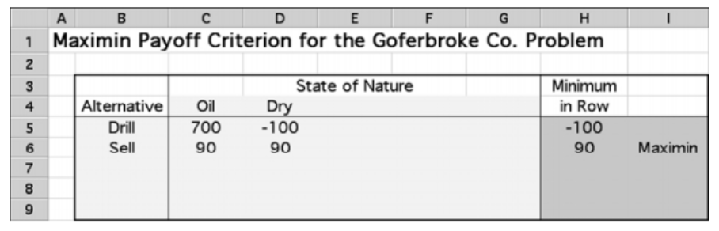
The maximin payoff criterion

Slide 10
Decision Making Without Experimentation
The maximum likelihood criterion
Identify the most likely state of nature
Choose the decision alternative with the maximum payoff for this state of nature
In the example: the decision would be to sell, since the most likely state of nature is dry
Does not permit gambling on a low-probability, big payoff

Slide 11
Decision Making Without Experimentation
Bayes’ decision rule
Commonly used
Using the best available estimates of the probabilities of the states of nature, calculate the payoff value for each decision alternative
Choose the alternative with the maximum expected payoff value
Alternative selected: drill for oil

Slide 12
Decision Making Without Experimentation
Sensitivity analysis with Bayes’ decision rule
Assume prior probability of oil, p, is between 15 and 35 percent
Figure 16.1 shows plot of expected payoff versus p
Crossover point
Point at which decision shifts from one alternative to another

