Slide 1

Healthcare Provider Analytics Repository
From raw patient data to meaningful healthcare intelligence
Presented By
Sai Teja & Nirja Gupta

Slide 2


Introduction
This project focuses on building a centralized healthcare analytics system.
It helps derive insights about patient demographics, healthcare costs, and provider performance.
The solution uses BigQuery with a Medallion Architecture and a Streamlit dashboard for visualization

Slide 3


Objectives
To process and manage healthcare data efficiently using cloud-based architecture.
To create a clean, analytics-ready data model using the Bronze–Silver–Gold pipeline.
To design an interactive dashboard for healthcare insights and decision support.

Slide 4


Dataset Overview
Source: Synthea synthetic health data
File used: patients.csv
Contains demographic and health-related details of patients.
Data stored and queried using Google BigQuery.

Slide 5
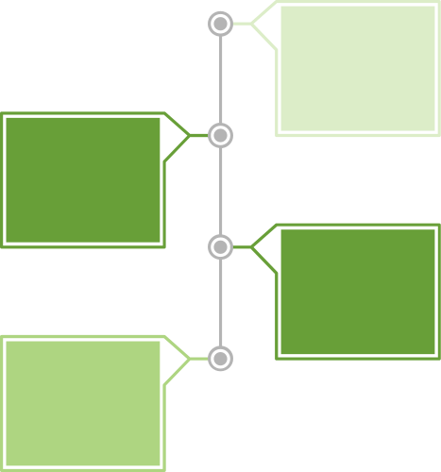

Architecture Overview
Medallion Architecture Layers:
Raw data ingestion from CSV
Bronze:
Data cleaning, standardization, and transformations.
Silver:
Gold
Analytical model with Dimension & Fact tables.

Slide 6
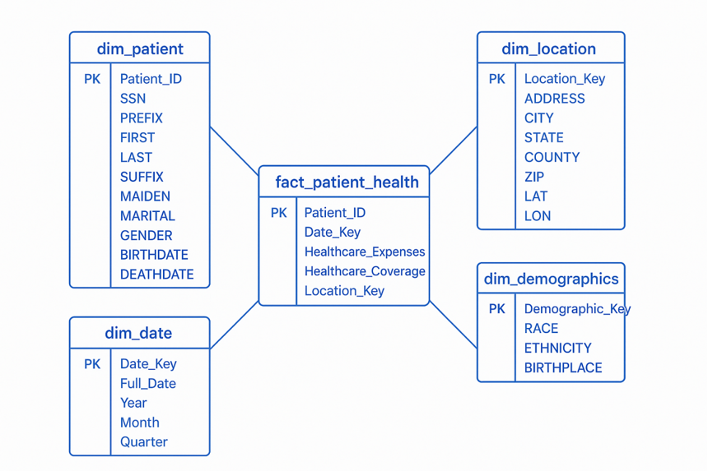

Data Modeling
The data is organized into Dimension and Fact tables for analytical efficiency.

Slide 7
Technology Stack
Google BigQuery: Data warehousing & querying
Python: ETL scripting and transformations
GCP: Cloud environment for scalability
Streamlit: Dashboard creation
VS Code: Development platform

Slide 8
Dashboard Overview
Healthcare Critical Analysis Dashboard
🏠 Home: Key metrics - Provides a quick summary of total patients, gender split, average expenses, and coverage.
👥 Demographics Overview - Shows patient distribution by gender, race, and marital status for population insights.
💰 Financial Insights - Analyzes average healthcare expenses and coverage to identify financial patterns.
🌍 Geographic Distribution - Visualizes patient spread across different regions for location-based analysis.
📈 Data Explorer - Displays correlation heatmaps to reveal relationships between key healthcare metrics.

Slide 9
Key Insights
Gender distribution and total patient count.
Average healthcare expenses and coverage per patient.
Regional trends in healthcare access and spending.
Correlation between demographic attributes and expenses.

Slide 10
Conclusion
The Healthcare Provider Analytics Repository establishes a robust, end-to-end solution for transforming raw data into actionable healthcare intelligence.
​Leveraging a BigQuery-based data pipeline and the Medallion Architecture (Bronze \rightarrow Silver \rightarrow Gold), we successfully integrated and refined disparate patient data without loss of meaning or fidelity.
​The resulting dynamic Streamlit dashboard delivers a comprehensive 360° view via key metrics, demographic distributions, financial analytics, and geographic visuals. This system directly empowers critical decision-making by providing instant, trustworthy insights from a clean, live analytical dataset.

Slide 11



Demonstrates how healthcare data can be effectively managed and analyzed using BigQuery.
Combines data engineering (Medallion) and data visualization (Streamlit) in one ecosystem.
Provides a scalable foundation for future healthcare analytics applications.
Conclusion

