Slide 1
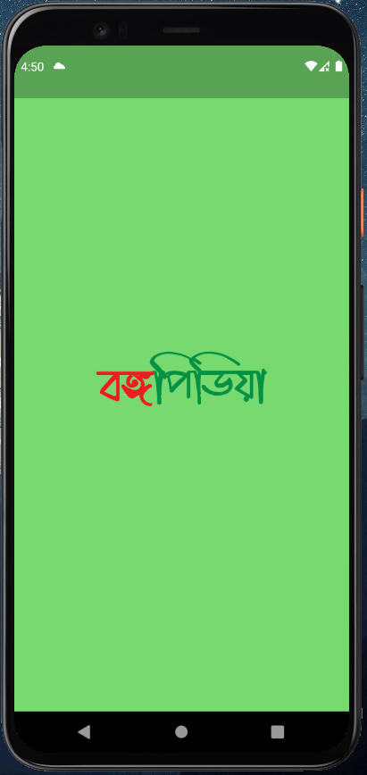
বঙ্গপিডিয়া
An app transporting you mentally to different locations of Bangladesh by offering sites in Virtual Reality

Slide 2
Problem solved :
Foreign or native tourists can use this app to explore tourist places of Bangladesh.
Tourists can experience virtual tours before travelling to that destination for real.
Don’t have to book tickets on the spot. Rather it offers bookings of tickets online.
Booking of hotels can also be done through this app.

Slide 3
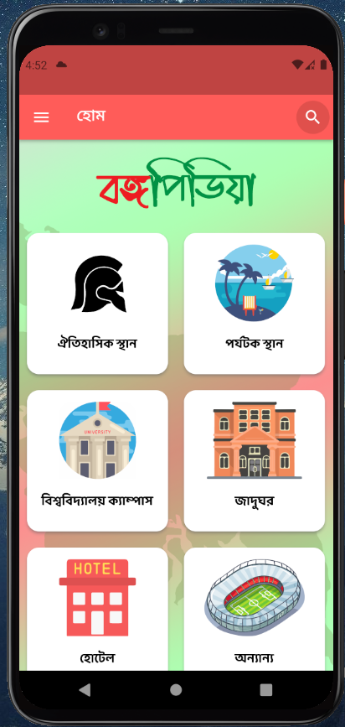
Key Features :
Four destination categories are shown in home page where the users can behold the beauty of tourist places.

Slide 4
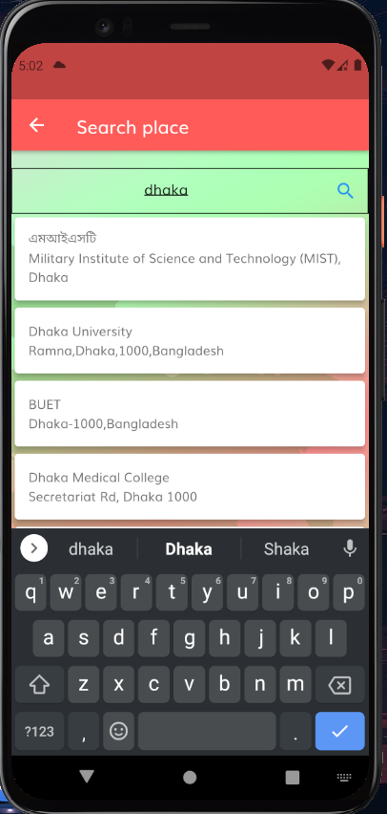
Key Features :
The user can search any location of his interest from the landing page just by typing the name of the place.

Slide 5
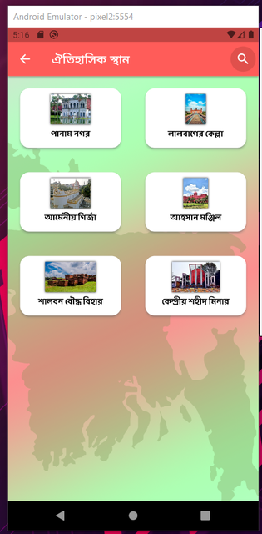
Key Features :
In each category ,search options can be filtered out by division or by district.

Slide 6
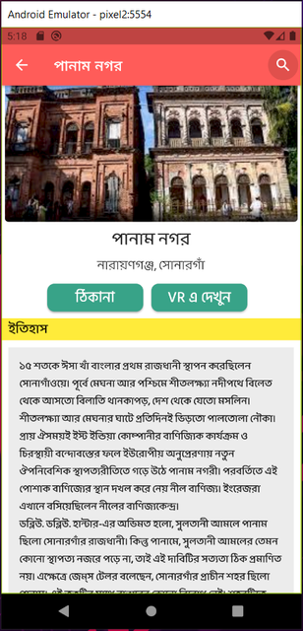
Key Features :
We get vast information about the destinations

Slide 7
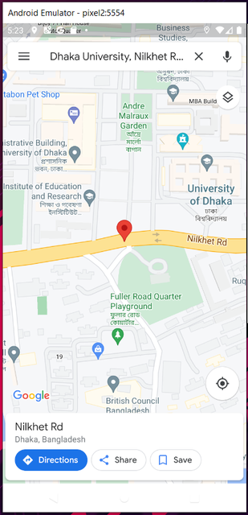
Key Features :
Offers navigation to a destination by using Google Maps

Slide 8
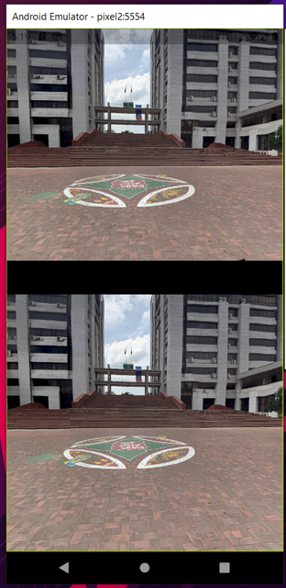
Key Features :
Provides 360 degree of travel experience and a profile of the destination.

Slide 9
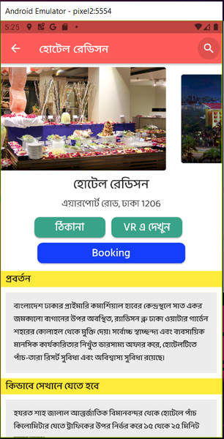
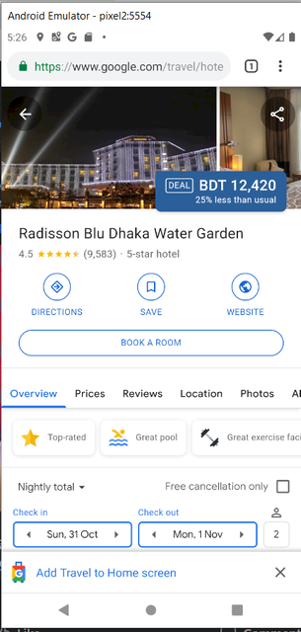
Key Features :
Bookings of hotels and tickets of museums or cricket matches.

Slide 10
Technology Used :
App development : Flutter(Google’s UI toolkit)
Image Processing : Flutter-panorama and Flutter-imageview360
Icon Design : Adobe Illustrator CC
Material UI
Database and storage management : sharedpreferences and SQLite
wiki API (web)

Slide 11
Team Expertise :
Tariquel Islam Tamim
Subah Tasnim Shiary
Tasnim Fariha
Riasat Haque
Nasif Shahriar Mohim

Slide 12
THANK YOU !

