Slide 1
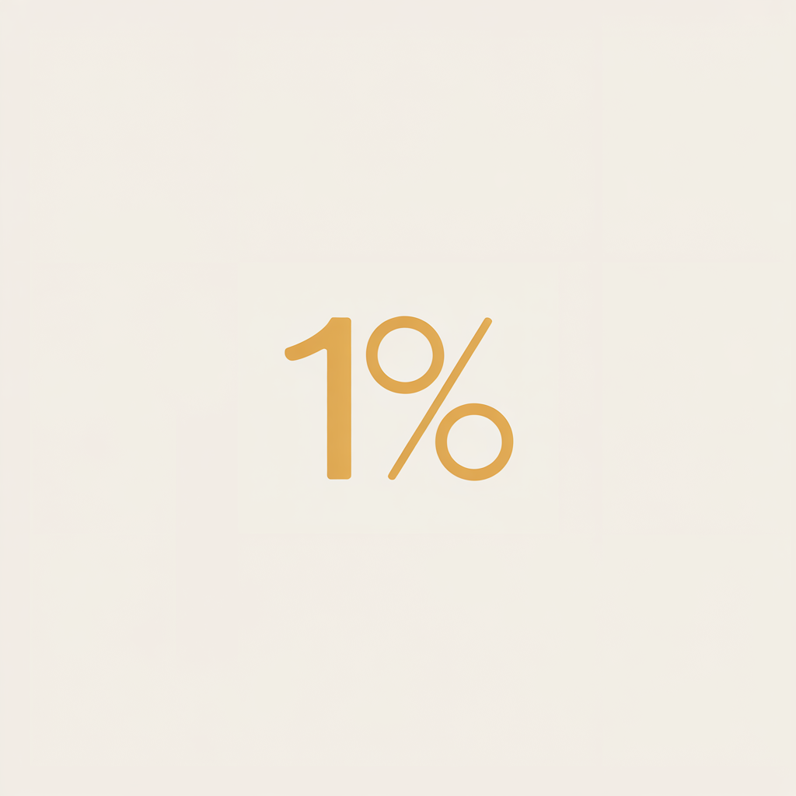
OnePercent
Stay Hungry, Stay Focused

Slide 2
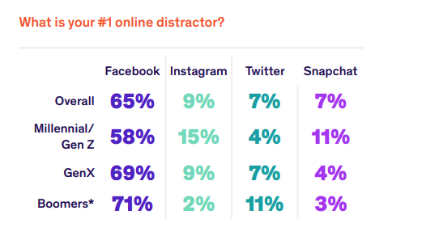
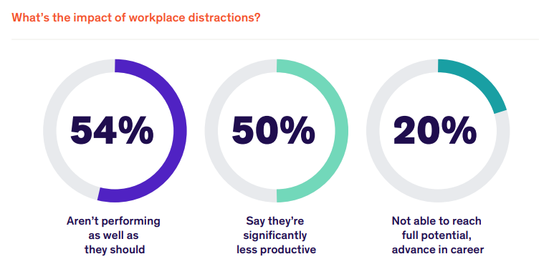
PROBLEM
The Double-Edged Sword of Internet Accessibility
Professionals and students alike rely heavily on online resources to accomplish tasks, access information, and communicate.
60% US Teens view internet as major source of distraction and major problem. Pew Research
workplace distraction report: Udemy

Slide 3




COMPETITIVE LANDSCAPE
All existing solution usage customizable blocklists, pre-scheduling of work hours and daily time limits to restrict internet access and increase productivity.

Slide 4
SOLUTION
Rebuild an app with Generative AI
Leveraging generative AI, We can build a product
we can assesses the relevance of any website to the user's current task.
Intelligently blocks or permits access in real time.
Ensuring professionals and students stay focused while still accessing the resources they need.
First AI enabled assistant for focus Personalized Experience
Unified Safe Search App Lock

Slide 5
MARKET OPPORTUNITY
5.35 billion people accessed the internet in 2024.
Equating to 66.2% of the global population.
97 million people have started using the internet for the first time over the past 12 months,
year-on-year increase of 1.8 percent.
The In-app Advertising Market was valued at USD 168.40 billion in 2023 and is projected to reach USD 561.24 billion by 2032, expanding at a CAGR of 14.4% from 2024 to 2032.
Additionally, In 2023 alone Google's ad revenue amounted to 264.59 billion U.S. dollars.
The reason of google dominance in online advertising space is that they have most precise data about users preference and choices as compared to other apps.

Slide 6
BUSINESS MODEL
Revenue Streams
Online In app AD supported version for all
Subscription for no ad experience
B2B partnership with Educational institutions and Businesses
Financial Landscape
Median revenue per user from apps: $0.31
Revenue per user for AI apps: $0.63
State-of-subscription-apps-2025/
Around 5 million users globally for such services. ~ Perplexity
Productivity apps Market expected to exhibit a CAGR of 9.2% by market size. southeast.newschannelnebraska.com

Slide 7
TEAM
Founding Team
Niraj Kumar

