Slide 1

ZEROTH REVIEW · PROJECT PROPOSAL
23AID303 | QUANTUM COMPUTING & ALGORITHMS
HYBRID VARIATIONAL QUANTUM CLASSIFIER
Medical Image Classification via a Manually Constructed Quantum Ansatz
BATCH A - 17
A.R. NIRMAL CB.AI.U4AID24001
GUNNALA DHEERAJ KUMAR CB.AI.U4AID24017
MEERA S RAJ CB.AI.U4AID24031
VISHNU VARDHAN N CB.AI.U4AID24072
1 / 14

Slide 2
Problem Statement
Quantum computers today are noisy and limited in qubit count (NISQ era), so a pure quantum classifier cannot yet process real-world data like medical images on its own.
Classical deep learning is very good at compressing high-dimensional image data into small feature sets, but cannot access the richer, entangled feature space that quantum circuits can represent.
Most existing hybrid VQC studies either skip medical imaging entirely, or rely on auto-generated quantum circuits from high-level libraries rather than a transparent, manually built circuit making it hard to verify why the quantum layer actually helps.
Question this project addresses:
Can a manually constructed variational quantum circuit, paired with classical feature compression, meaningfully classify medical images (e.g., skin lesions or MRI scans) on today's NISQ-era hardware/simulators?
2

Slide 3
Objectives
1
Classical Feature Extraction: Use PCA or a lightweight CNN to compress medical image data (skin lesion or MRI dataset) down to a 4-to-8 variable feature vector suitable for quantum encoding.
2
Quantum Encoding: Encode the compressed classical features into quantum states using angle embedding (Ry and Rz gates) on a small number of qubits.
3
Manually Constructed Ansatz: Build the variational quantum circuit from scratch using parameterized rotation gates and CNOT entanglement layers — without relying on a high-level auto-generated circuit template — to demonstrate a first-principles understanding of the underlying quantum mechanics
4
Hybrid Training Loop: Implement the classical-quantum optimization loop (e.g., using a classical optimizer such as Adam) to iteratively update the ansatz parameters based on the training loss.
5
Benchmark Against Literature: Compare the manually built ansatz's performance (accuracy, F1-score) against results reported by comparable hybrid VQC studies to evaluate whether a transparent, hand-built circuit is competitive with auto-generated ones.
3

Slide 4
Literature Review
Title | Year | Summary
Variational Quantum Classifier for Binary Classification: Real vs Synthetic Dataset | 2022 | Foundational VQC using amplitude encoding on synthetic, sonar, and diabetes datasets — establishes the core hybrid classification workflow.
Hybrid Quantum Deep Learning and Variational Quantum Classifier-Based Model for Botnet DGA Attack Detection | 2022 | Combines classical deep learning feature extraction with VQC for cybersecurity; shows the hybrid architecture applied outside imaging.
Development of Variational Quantum Deep Neural Networks for Image Recognition | 2022 | Hybrid PCA + VQDNN architecture tested on image datasets — closely mirrors the pipeline structure proposed in this project.
Variational Quantum Circuit Based Demand Response in Building Energy Systems | 2024 | Applies hybrid VQC to a real-world optimization problem, demonstrating the generalizability of VQC beyond classification tasks.
4

Slide 5
Title | Year | Summary
QTN-VQC: An End-to-End Learning Framework for Quantum Neural Networks | 2024 | Uses a trainable quantum tensor network for embedding, replacing manual ansatz design — a useful contrast to the white-box approach.
Fine-Tuned Variational Quantum Classifiers for Cyber Threat Detection | 2024 | Compares different VQC circuit and optimizer configurations; informs this project's methodology and ablation testing.
Variational Quantum Classifier-Based Early Identification and Classification of Chronic Kidney Disease Using Sparse Autoencoder and LASSO Shrinkage | 2025 | Classical feature compression (autoencoder + LASSO) feeding into a VQC for medical diagnosis — strong structural parallel, though on tabular rather than imaging data.
Efficient Blood Cell Classification Using a Hybrid Variational Quantum Circuit–EfficientNet Model on BloodMNIST | 2025 | Closest match: a 6-qubit VQC combined with EfficientNet-B0 on a real medical image dataset — nearly identical hybrid pipeline to what's proposed here.

Slide 6
Gaps Identified from Literature
Most hybrid VQC work has been applied to non-medical domains (cybersecurity, energy systems, generic image benchmarks) rather than clinical imaging.
Where VQC has been applied to medical data, it is typically on tabular/structured data (e.g., chronic kidney disease) rather than image data.
Where VQC has been applied to medical imaging (blood cell classification), the ansatz is built using a high-level, auto-generated circuit template rather than a manually constructed, first-principles design — so the quantum layer's contribution is harder to verify or explain.
Across the literature, comparisons rarely isolate whether a transparently built ansatz performs differently from an auto-generated one on the same task.
6

Slide 7
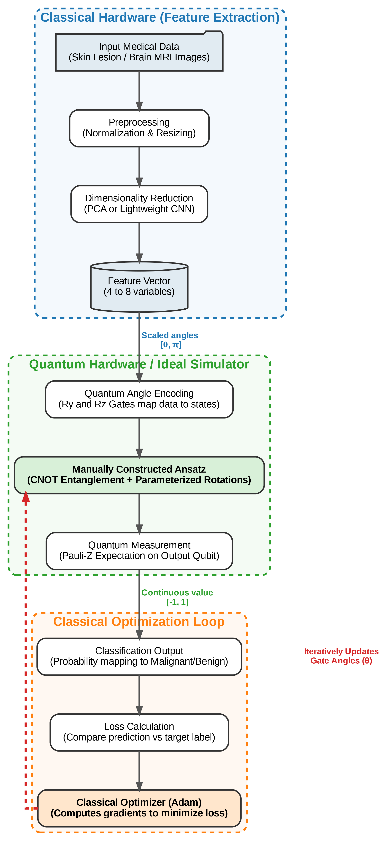
Methodology — Random Bit Sources
7

Slide 8
Experimental Setup
Component | Configuration
Dataset | Downscaled medical imaging dataset (skin lesion subset or brain MRI slices), binary classification target
Classical feature extractor | PCA or lightweight CNN, output reduced to 4–8 features
Quantum encoding | Angle embedding (Ry, Rz gates), one qubit per feature
Ansatz | Manually constructed, 2–3 variational layers, rotation gates + CNOT entanglement
Measurement | Pauli-Z expectation value on output qubit
Classical baseline | Equivalent classical classifier (e.g., SVM or shallow NN) trained on the same compressed features, for comparison
Simulator / hardware | Qiskit Aer (ideal simulator); real IBM Quantum backend where feasible
Optimizer | Adam (classical), updating ansatz parameters via the hybrid training loop
Environment | Standard laptop CPU; no GPU or cluster required at this qubit count

Slide 9
Expected Results & Evaluation Criteria
The ideal-simulator hybrid model is expected to achieve reasonable classification accuracy on the compressed feature set, confirming the ansatz can learn a meaningful decision boundary.
The manually built ansatz is expected to perform comparably to though not necessarily better than the auto-generated circuits used in prior hybrid VQC imaging work, with the key contribution being interpretability rather than raw accuracy.
Real-hardware runs (where accessible) are expected to show reduced accuracy relative to the simulator, due to gate noise and limited qubit coherence this gap itself is a result worth reporting.
Success is evaluated primarily via accuracy and F1-score, compared against: (a) the classical-only baseline, and (b) benchmark figures reported in the closest prior papers (blood cell and kidney disease VQC studies).
Secondary evaluation: how ansatz depth (number of variational layers) trades off against training stability and final accuracy.

Slide 10
Timeline
SECTION 6 — FIVE-WEEK PLAN
Week 1
Prepare and preprocess the medical imaging dataset; implement PCA/CNN feature extraction; validate the compressed feature vectors.
Week 2
Build the manual quantum ansatz (encoding + variational layers + measurement) in Qiskit; test on the ideal simulator with dummy data.
Week 3
Implement the hybrid training loop (classical optimizer + quantum circuit evaluation); train on the full compressed dataset; tune ansatz depth.
Week 4
Run on real IBM Quantum hardware where feasible; compare simulator vs. hardware results; benchmark against the classical baseline and literature figures.
Week 5
Analysis, discussion of findings, final report and presentation preparation.
12

