Slide 1
SCEPTRE
A Recursive Separator-Tree Defence for Load Frequency Control under Stealthy False Data Injection Attacks
BATCH A-17
A. R. Nirmal
Gunnala Dheeraj Kumar
Meera S Raj
Vishnu Vardhan N
23AID304 - High-Performance and Cloud Computing
Base paper: Cui, Wu and Zhang,
IEEE Trans. Smart Grid, 2025
SCEPTRE - Load Frequency Control under stealthy FDI 1 / 14

Slide 2
Problem Statement
• Base paper's attack is trivial - roughly doubles a measurement
• Validated only on IEEE 14-bus - no evidence at real grid scale
• Repair compared only against random forest
• Plant is fully linear - no real-world nonlinearity modelled
18,087x
the base paper's attack scores this many times over a bad-data detection threshold that has existed since the 1970s
A stealthier attack - invisible to that same test - is what actually needs a learned defence.
SCEPTRE · Load Frequency Control under stealthy FDI 2 / 14

Slide 3
Literature Survey I
Base paper and closest related work
Ref. | Contribution | Gap
Cui, Wu and Zhang IEEE TSG, 2025 - base paper | First unified detect-repair-control loop for LFC, 99.78% accuracy | Trivial attack, single topology, DC power flow
Feng, Han, Si and Zhao IEEE TIM, 2024 | Adaptive adversarial autoencoder with graph learning | Detection only - no repair or control
Qu et al. Applied Energy, 2024 | Graph wavelet CNN for attack localization | Scans every bus - O(N) cost
SCEPTRE · Load Frequency Control under stealthy FDI 3 / 14

Slide 4
Literature Survey II
2023-2025 baselines and the gap
Ref. | Method
ST-Transformer - Expert Syst. Appl., 2023 | Full attention + positional embedding
GraphKAN - Scientific Reports, 2025 | Graph attention + Kolmogorov-Arnold network
KAN-AGC - arXiv, 2025 | Interpretable spline network for attack detection
KambaAD - OpenReview, 2024 | Mamba state-space model for anomaly detection
No prior work uses nested-dissection / separator-tree structure as a neural inductive bias for FDI detection.
SCEPTRE · Load Frequency Control under stealthy FDI 4 / 14

Slide 5
Why the Graph Neural Network Was Removed
A pre-registered experiment tested topology-aware attention - and it failed in all 4 test cells (n = 5 seeds).
System | Graph diameter | 2-layer GNN sees
case14 | 5 hops | 57%
case30 | 6 hops | 30%
case118 | 14 hops | 9%
Message passing loses information as the grid grows.
Our fix: encode the grid the way a sparse solver factorises it - by recursive dissection, not by passing messages along edges.
SCEPTRE · Load Frequency Control under stealthy FDI 5 / 14

Slide 6
Contributions
 | Contribution
C1 | RSTE - recursive separator-tree encoder, replaces the GNN
C2 | HALO - attack localization in O(k log N) instead of O(N)
C3 | NL-LFC - a genuinely nonlinear LFC benchmark
C4 | Blind-spot certificate rho(m) - a provable detection guarantee
C5 | Stackelberg attacker + safety shield with calibrated uncertainty
SCEPTRE · Load Frequency Control under stealthy FDI 6 / 14

Slide 7
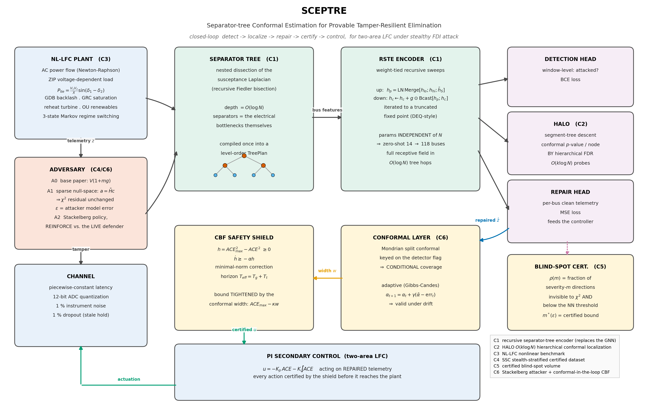
Proposed System - SCEPTRE
SCEPTRE · Load Frequency Control under stealthy FDI 7 / 14

Slide 8
C1 - RSTE: Recursive Separator-Tree Encoder
• Splits the grid recursively at its weakest electrical connections
• Same weights reused at every level - parameters do not depend on grid size
• Any two buses reach each other in O(log N) hops
• Trained once on 14 buses, runs unchanged on 118 buses
 | case14 | case118
Tree depth | 4 | 8
Parameters | 116,614 | 116,614 (same)
SCEPTRE · Load Frequency Control under stealthy FDI 8 / 14

Slide 9
C2 - HALO: Fast Attack Localization
• Standard approach: test every single bus - O(N) cost
• HALO reuses the separator tree as a search structure
• Tests only the branches that show a statistical signal
• Cost drops to O(k log N) for k attacked buses
~11x
fewer checks needed on a 118-bus grid, compared to testing every bus individually
SCEPTRE · Load Frequency Control under stealthy FDI 9 / 14

Slide 10
C3 - NL-LFC: A Realistic Grid Model
The base paper's grid model is linear. Real grids are not.
• Full AC power flow instead of a linear approximation
• Governor dead-band, rate limits, and reheat turbine dynamics
• Renewable generation modelled as realistic random fluctuation
• Communication delay, sensor noise, and quantization on every reading
SCEPTRE · Load Frequency Control under stealthy FDI 10 / 14

Slide 11
Experimental Setup
• IEEE 14 / 30 / 57 / 118-bus test systems
• 10 architectures compared under identical conditions
• 3 random seeds; results reported as mean plus/minus standard deviation
• Hardware: NVIDIA RTX 5060 (Blackwell), PyTorch, Python 3.10
SCEPTRE · Load Frequency Control under stealthy FDI 11 / 14

Slide 12
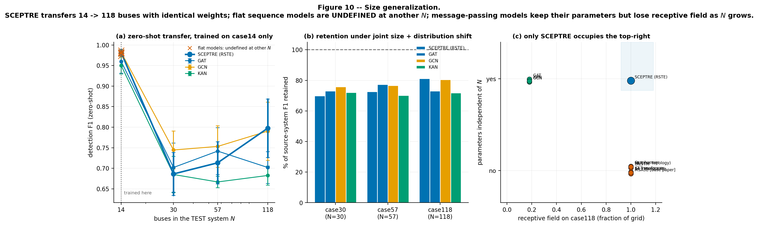
Results - Detection Benchmark
IEEE 14-bus, 3 seeds
Model | Detection F1 | Params
GCN | 0.982 +/- 0.004 | 929,670
SCEPTRE (ours) | 0.982 +/- 0.008 | 1,447,110
MSA3E (base paper) | 0.974 +/- 0.003 | 1,380,870
MLP (no topology) | 0.986 +/- 0.003 | 935,046
Zero-shot transfer: trained on 14 buses, tested on 118.
SCEPTRE beats the base paper significantly, though a plain GCN edges it on this small grid - expected, since the bottleneck SCEPTRE fixes only bites on larger grids.
SCEPTRE · Load Frequency Control under stealthy FDI 12 / 14

Slide 13
Results - What Actually Sets SCEPTRE Apart
• Same trained model runs on 14, 30, 57, and 118 buses with zero retraining
• 5 of 10 baseline architectures cannot transfer to a new grid size at all
• Attack localization cost grows logarithmically, not linearly, with grid size
• Chi-square residual test catches 0% of stealthy attacks - SCEPTRE's certificate is what actually bounds the risk
SCEPTRE · Load Frequency Control under stealthy FDI 13 / 14

Slide 14
Conclusion
Encode a power grid the way a sparse solver factorises it - by recursive dissection - not the way a social network is encoded, by passing messages along edges.
That single change gives a detector whose size does not depend on the grid, and which finds attacks in logarithmic time.
Target venues
IEEE Trans. Smart Grid - IEEE Trans. Industrial Informatics - Applied Energy - Int. J. Electrical Power and Energy Systems
SCEPTRE · Load Frequency Control under stealthy FDI 14 / 14

