Slide 1

Adventure Works Cycles
Project Report - By Group 1
Mr. Jitendra
Ms. Gayatri
Mr. Sahir
Mr. Nirmit
Mr. Mayur
Ms. Kavyasri
Mr. Nirmal

Slide 2
Introduction
The Adventure Works sample datasets are derived from Adventure Works Cycles, a sizable, international manufacturer.
The company produces and distributes bicycles made of metal and composite materials to commercial markets in North America, Europe, and Asia.
With 290 people, its main office is located in Bothell, Washington. However, there are other regional sales teams spread around its customer base.
Adventure Works Cycles purchased a modest Mexican manufacturing facility in the 2000s. It produces a number of essential spare parts for the Adventure Works Cycles product range.
For final product assembly, these subcomponents are sent to the Bothell location. This production facility started serving as the touring bicycle product group's exclusive manufacturer and distributor in 2001.
After a profitable fiscal year, Adventure Works Cycles is hoping to increase its market share by focusing on selling to its most loyal clients, expanding the reach of its products via an outside website, and lowering the cost of production in order to cut its cost of sales.

Slide 3
Sales Insights
Initial sales was less, as time passes, sells along with Production cost increses for year 2011when comapered to 2010. in 2012 compare to 2011 less sales as less production done. here in 2013 highest production done with highest sales.

Slide 4
Profit insights
Average profit % are quite similar from 2010 to 2012 close to 60 %, decreased in from 2013 to 2014 close to 40% ; closed to 20% reduction . sum of profits close to 0 in 2014. profits are reduced as sales are reduced.

Slide 5
Customers insights
United states being most no of custmers , i.e . maximum sales followed by Australia and canada at 3rd place, UK at 4th place france being at last . Maximum revenue from US and least from france.

Slide 6
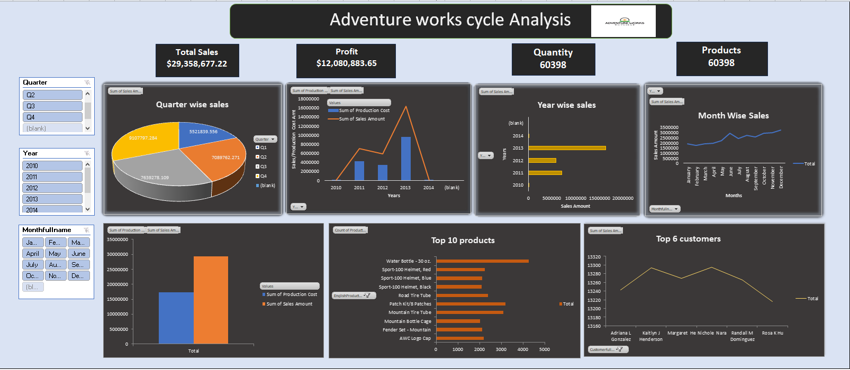
Dashboard using Excel

Slide 7
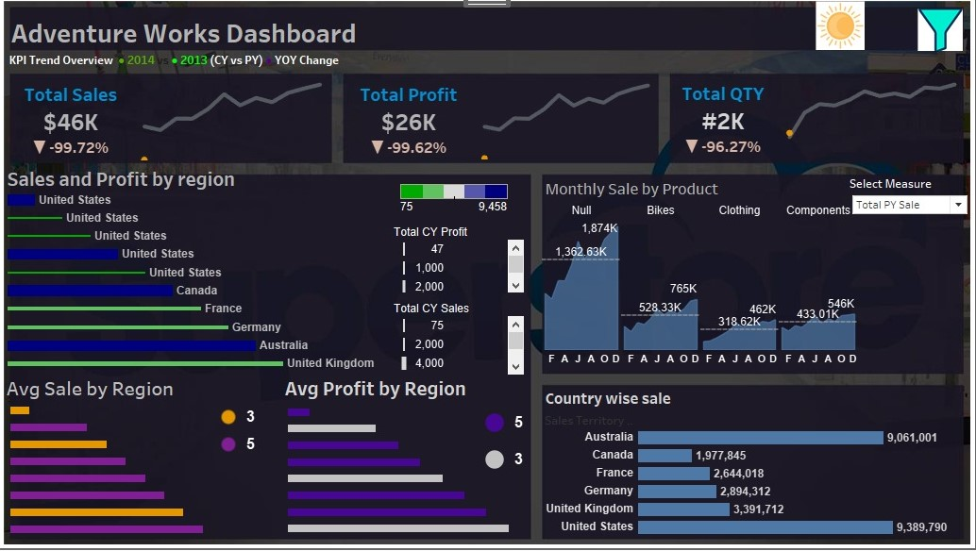
Dashboard using Tableau

Slide 8
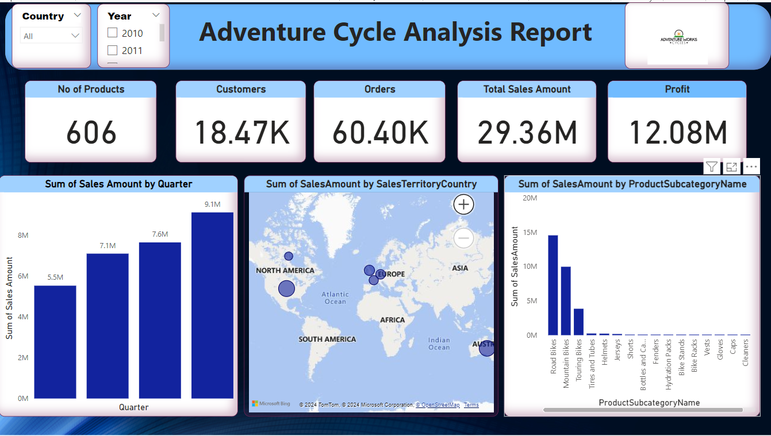
Dashboard using Power-bi

Slide 9
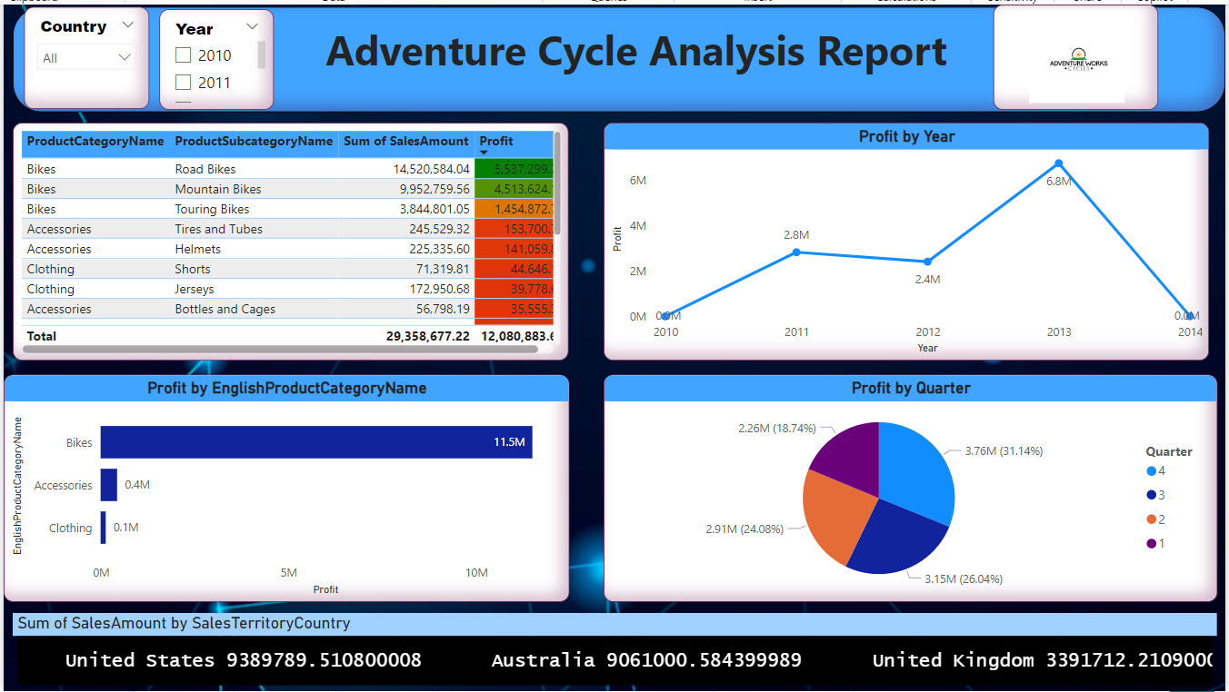

Slide 10
Conclusion
Our Adventure Works Data Analysis journey has provided a deep understanding of the company’s operations and illuminated a path toward data-driven excellence.
By leveraging the power of data, Adventure Works can optimize sales, enhance customer engagement, improve operational efficiency, and strategically expand into new markets.
The recommendations provided serve as a roadmap for the company’s future success.

Slide 11
Thank You

