Slide 1
TestComplete POC

Slide 2
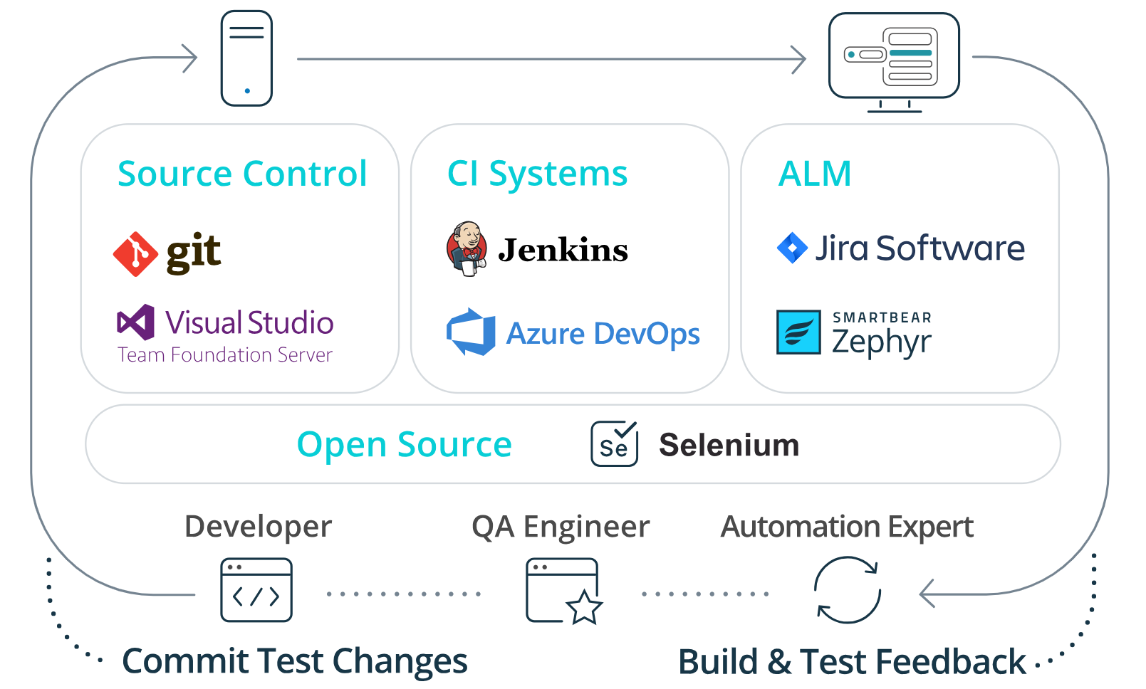
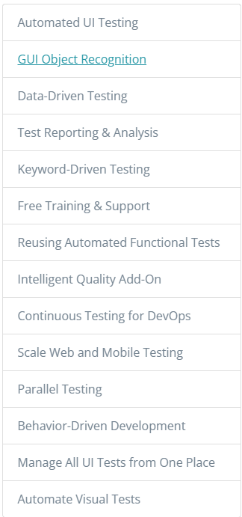
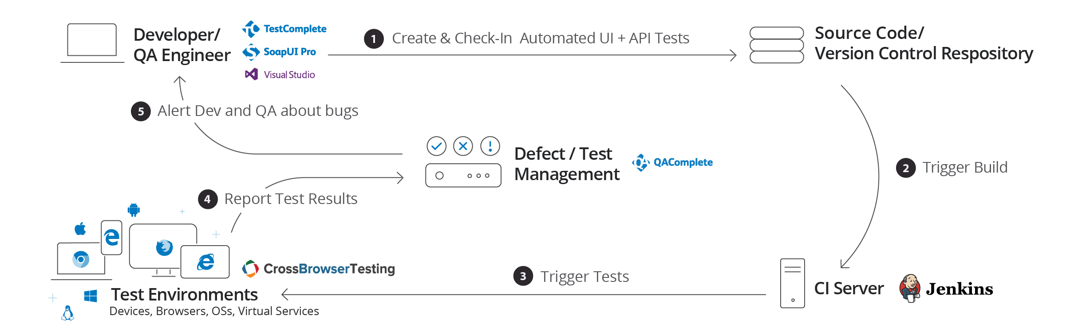
TestComplete Features
https://smartbear.com/product/testcomplete/features/
Integration Capabilities
Continuous Testing

Slide 3
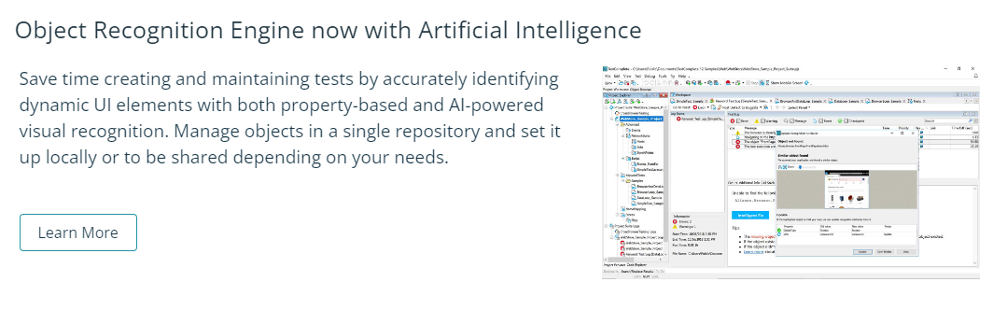
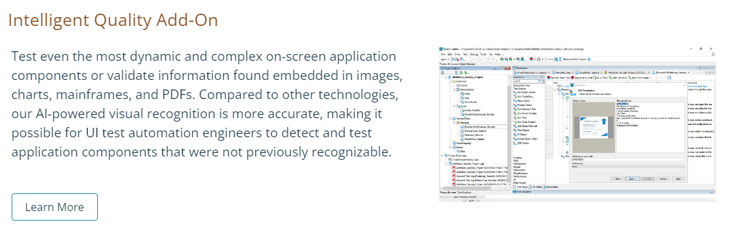
TestComplete Features

Slide 4
TestComplete Object Recognition
GUI Object Recognition Engine now including Artificial Intelligence
Easy UI Testing with Support for Over 500 Controls and 3rd Party Frameworks
Find dynamic UI elements quickly, easily, and accurately with TestComplete. The tool comes with built-in support for over 500 desktop, web, and mobile technologies including Windows, Java, AJAX, WPF, and HTML5 among others, as well as controls and 3rd party frameworks such as React and Angular.
Our powerful object recognition algorithm with artificial intelligence will enable you to identify elements across any technology and will work irrespective of the device screen size, resolution, or language configuration.

Slide 5

TestComplete – UI Technologies covered in Object Recognition
TestComplete allows you to manipulate individual UI objects rather than clicking on screen coordinates. TestComplete recognizes standard Windows, .NET, Java, Web and RIA controls as well as popular third-party UI control libraries.

Slide 6
TestComplete Report Screenshots

Slide 7
TestComplete Detailed Log Screenshots

Slide 8
Demo Recording

