Slide 1

Dr. Derek H. Ogle
The Evolution of a Lecturer

Slide 2
Presentation Goals
Provide a sabbatical completion report.
Describe and reflect on my use of case studies in the Fisheries Science & Management course.

Slide 3
Sabbatical Completion Report
IFAR Book
fishR Webpage

Slide 4
Opportunities from IFAR/fishR
Workshops
AFS national meetings (Portland, Kansas City)
WiDNR trainings
Vermont
Nunavut?

Slide 5
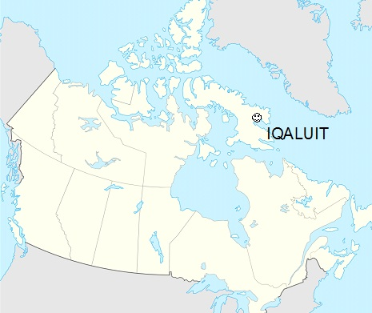
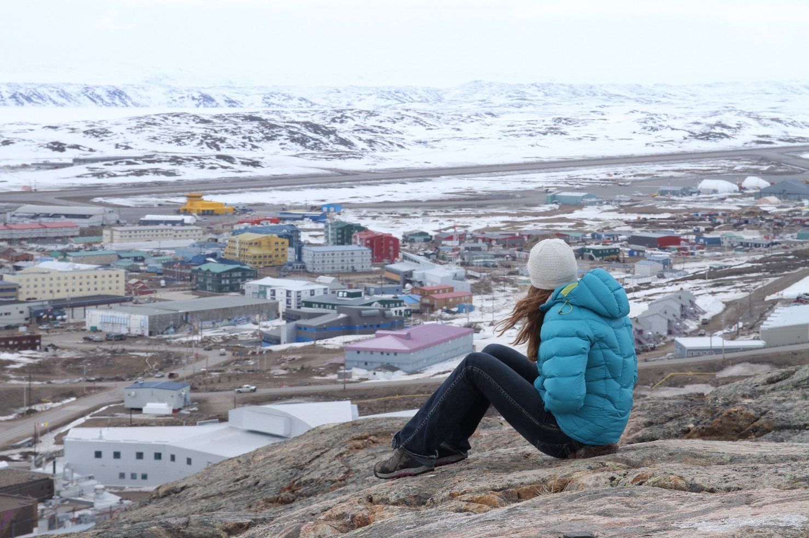

Nunavut?

Slide 6
Opportunities from IFAR/fishR
Workshops
“Cool” Consultations
Atlantic Salmon, Arctic Charr
Brook Trout in high mountain lakes in Idaho
Lake Michigan Whitefish and Cisco
…
Turtles in Turkey
Salamanders in Appalachia
Grizzly Bears

Slide 7
Sabbatical Completion Report
IFAR Book
fishR Webpage
Major changes to Statistical Analysis and Concepts course.

Slide 8
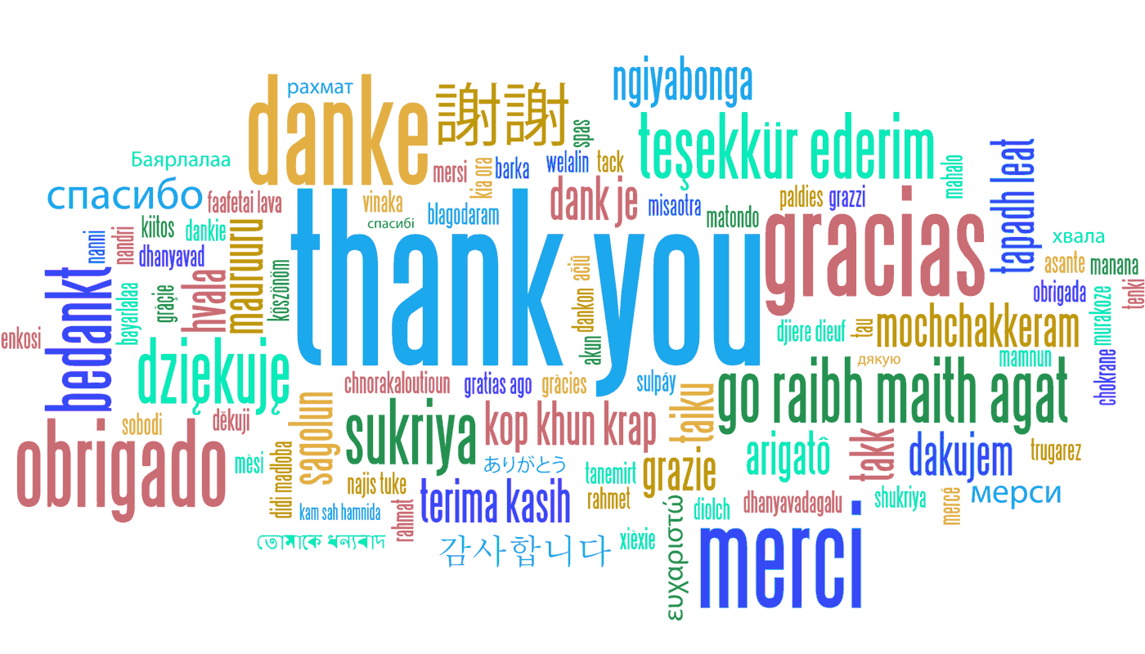
So …

Slide 9
Presentation Goals
Provide a sabbatical completion report.
Describe and reflect on my use of case studies in the Fisheries Science & Management course.

Slide 10
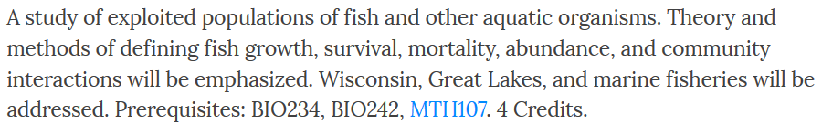
NRS349
Class Description / Learning Outcomes

Slide 11
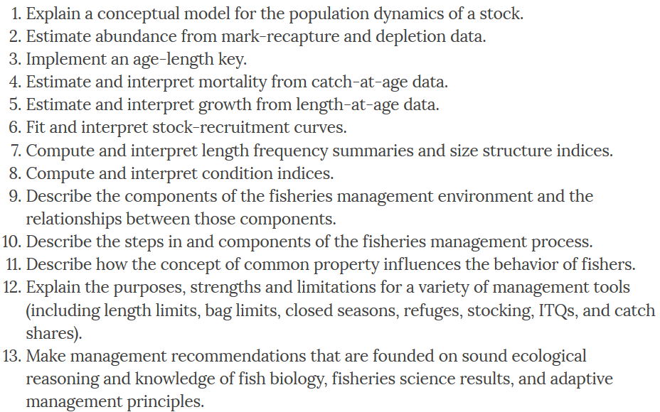
NRS349
Class Description / Learning Outcomes

Slide 12
Case Study Goals
Develop a deeper understanding of analyses.
Mark-Recapture Assumptions
Integrate biological understanding (from other courses) with analytical results.
Whittlesey Creek Size Structure Analysis
Develop understanding from real scenarios/situations.
Largemouth Bass Slot Limit Scenario
Minnesota Bag Limits Scenario

Slide 13
Case Study (Initial) Observations
Overall
Generally effective for learning and engagement
Selection and development is critical
Student preparation is critical
50-minutes is limiting

Slide 14
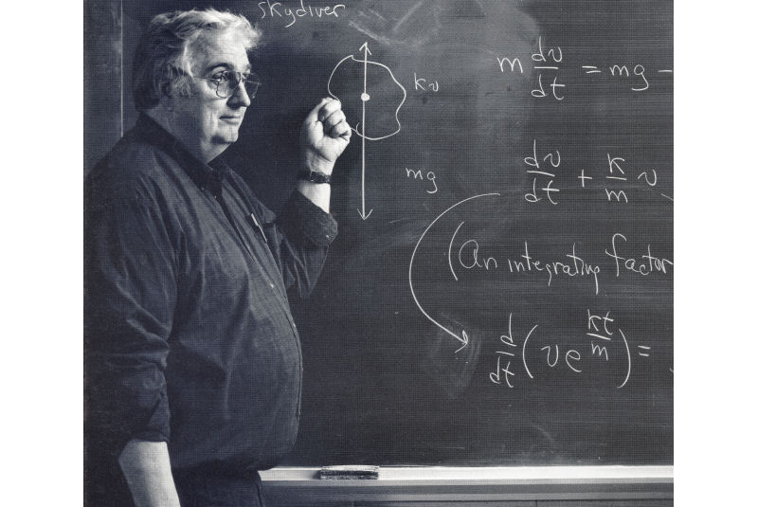

Case Study (Initial) Observations
Overall
Personal
Different skills and mindset are required

Slide 15
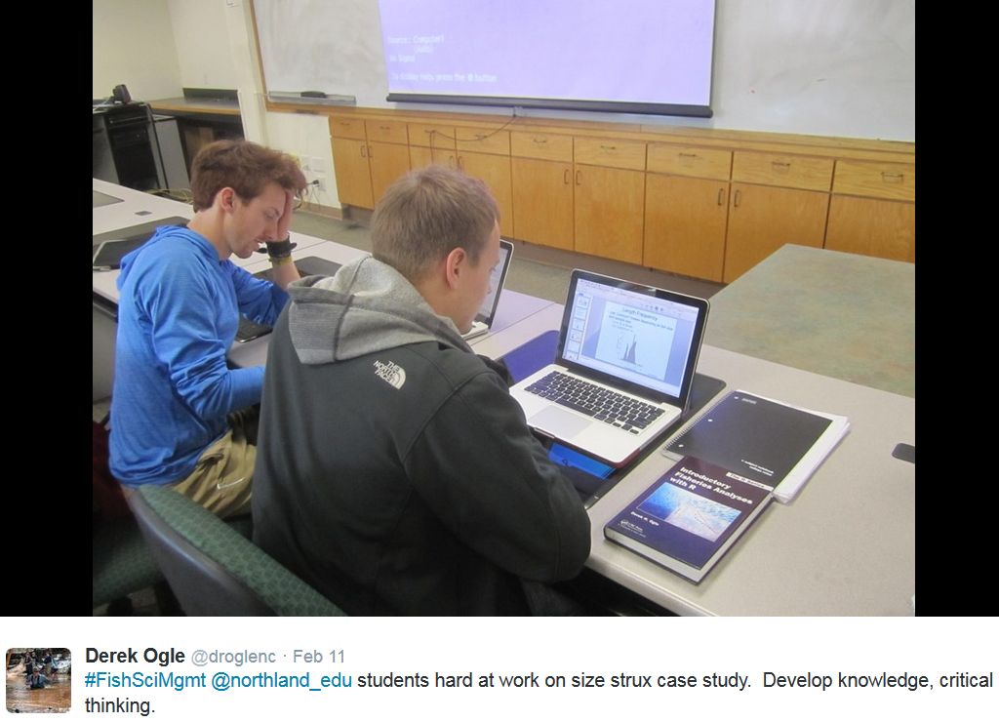

Slide 16
Case Study (Initial) Observations
Overall
Personal
Different skills and mindset are required
Preparation is different
Give up some “control”
Let the students “struggle”
Grading is more difficult

Slide 17
Case Study (Initial) Observations
Overall
Personal
Institutional
Need flexibility
Need support
Consider effects on evaluation

