Slide 1
GREEN LOGISTICS HACKATHON PROJECT
FreshRoute
Smart Food Logistics and Waste Reduction
Deliver Fresh, Waste Less!
Reducing food waste through smarter delivery decisions
FreshRoute · from supply to demand
Notes:
Open with the core promise: FreshRoute helps food move with better timing, better risk awareness, and less avoidable waste. This is a practical green logistics prototype, not a claim of measured impact.

Slide 2

THE PROBLEM
Traffic and weak route planning delay perishable shipments
Improper storage conditions accelerate spoilage
Urgent deliveries compete with routine schedules
Surplus stock can sit near unmet demand
Food can spoil before it reaches the customer
Farm Pickup
Warehouse Transfer
Retail Delivery
Result: avoidable food waste, financial loss, unnecessary travel, and higher emissions.
Notes:
Walk the room through the chain from farm to warehouse to retailer. The risk is cumulative: a late route, poor storage, or a missed demand signal can turn good food into loss before the customer ever sees it.

Slide 3





THE PRODUCT
FreshRoute turns logistics data into better decisions
FreshRoute
Smart Priority Delivery
Nearby Demand Matching
Spoilage-Risk Alerts
Green Route Planning
Automatically prioritize urgent shipments
Real-time warnings for at-risk goods
Find local buyers en route
Optimize for lower emissions
One decision layer connects freshness, movement, and demand.
Notes:
Introduce FreshRoute as a decision layer rather than another disconnected tool. The four capabilities work together: prioritize what matters first, spot risk early, plan movement efficiently, and redirect suitable surplus.

Slide 4
THE WORKFLOW
One workflow connects the decisions
Capture: Enter shipment, destination, deadline, and storage information.
Analyze: Analyze food type, expected shelf life, travel time, and requirements.
Prioritize: Identify spoilage risks and assign delivery priority.
Route & alert: Recommend a route and notify the logistics manager about storage risks.
Match: Match eligible surplus food with nearby demand.
Notes:
Describe this as one continuous loop from intake to action. The prototype does not ask managers to interpret five separate tools. It turns the same shipment record into a priority, a route recommendation, an alert, and a possible surplus match.

Slide 5
WHY IT IS DIFFERENT
FreshRoute coordinates risk, routes, and demand
Decision area | Conventional approach | FreshRoute approach
Scheduling | Schedules deliveries, then reacts to issues. | Prioritizes by risk, deadline, distance, and capacity.
Storage | Problems surface after quality is affected. | Monitors conditions and surfaces configured alerts.
Surplus | Stock can sit near unmet demand. | Links suitable surplus to nearby demand.
Visibility | Operational decisions stay fragmented. | Tracks food waste, distance, fuel, and estimated emissions in one dashboard.
Notes:
Use the comparison row by row. The difference is not simply automation. FreshRoute changes the order of decisions: risk and freshness influence the plan before the route is locked, while surplus and sustainability remain visible afterward.

Slide 6






HYPOTHETICAL · COIMBATORE
Prioritize what can spoil first
Visible Delivery
A supplier has 100 kg of tomatoes and 50 kg of leafy vegetables for different customers.
FreshRoute checks deadlines, travel time, and storage needs; prioritizes urgent shipments and recommends routes; alerts the warehouse manager to configured storage-limit breaches; and finds nearby buyers for suitable surplus stock.
Inventory & Checks
Alerts & Actions
Surplus Matching
Logistics Constraints
Expected outcome: better decisions and potential reduction in avoidable loss and unnecessary travel.
Notes:
Keep the scenario explicitly hypothetical. Explain that the system compares perishability and operational constraints, then recommends priorities and routes. It can also alert the warehouse manager and surface nearby buyers for suitable surplus. These are intended capabilities, not measured results.

Slide 7
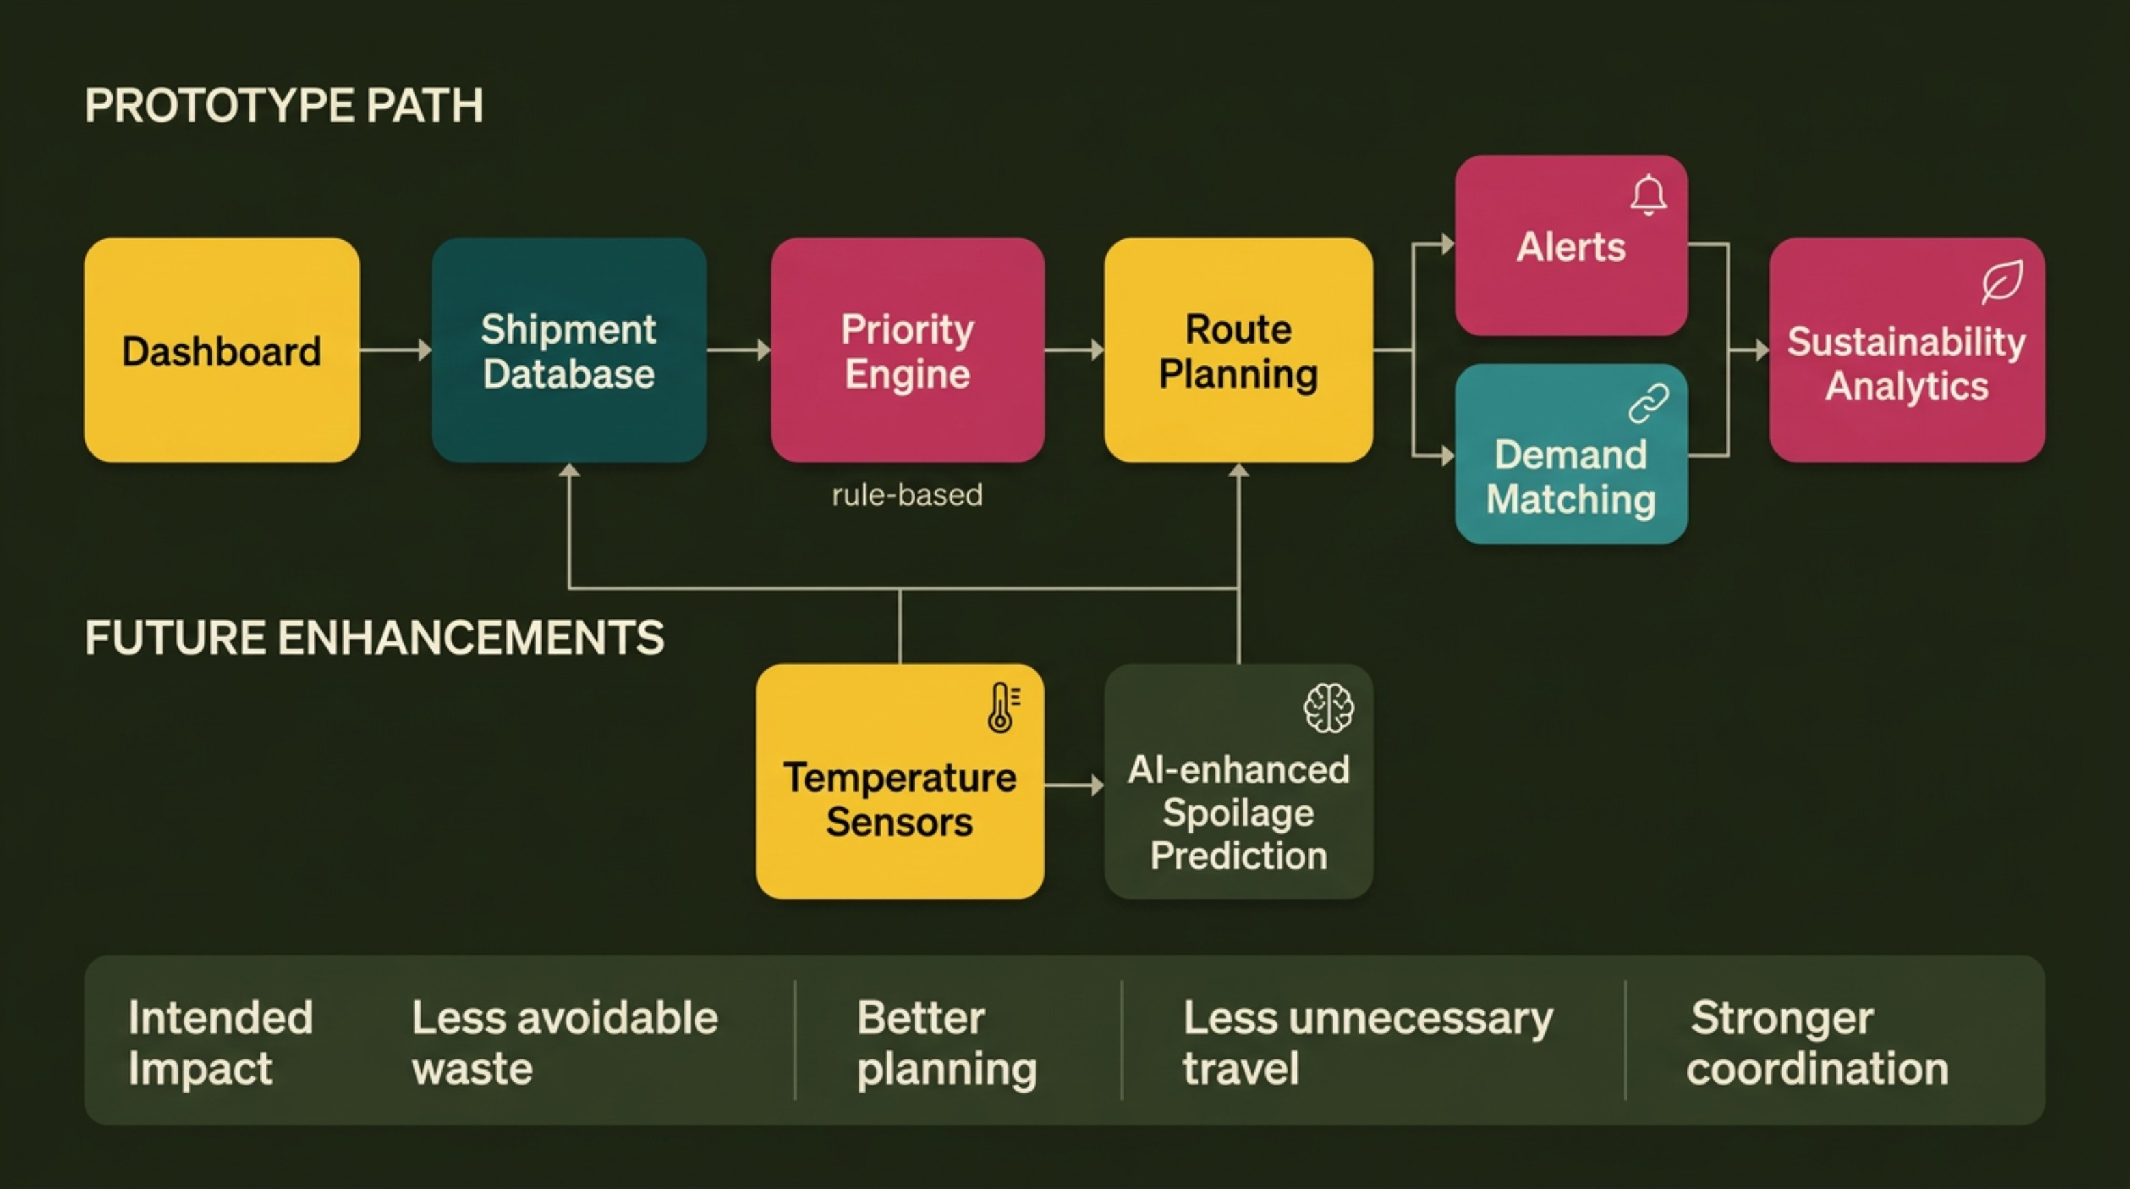
FROM PROTOTYPE TO PLATFORM
A practical prototype with a path to smarter logistics
Prototype stack: React and TypeScript · Supabase · mapping and routing APIs · rule-based prioritization
Notes:
Separate what exists in the hackathon prototype from what comes next. The initial logic is rule-based and practical to test. Future inputs such as temperature sensors and AI-enhanced spoilage prediction can make the risk layer more continuous and precise.

Slide 8
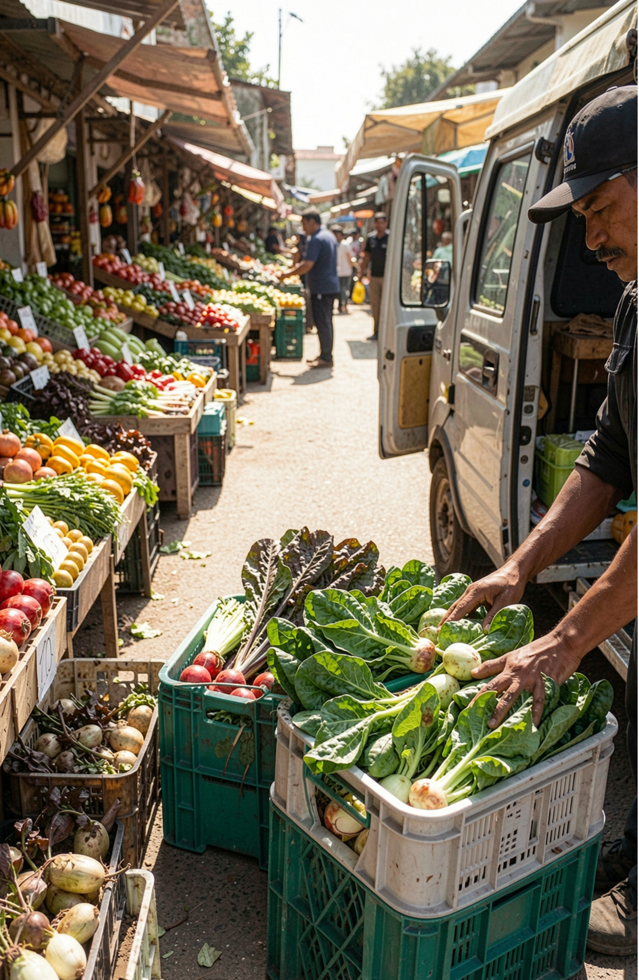
THE GREEN LOGISTICS CASE
Building a greener food supply chain
Problem: spoilage and inefficient perishable-goods logistics.
Solution: prioritization, storage-risk alerts, route planning, and demand matching.
Goal: better logistics decisions with less avoidable food waste.
Future scope: real-time IoT sensors, predictive risk models, live traffic optimization, and partner integrations.
FreshRoute – Deliver Fresh, Waste Less!
Thank You – Questions?
Notes:
Close by restating the problem, the integrated solution, and the boundary of the claim. FreshRoute aims to reduce avoidable waste and unnecessary travel through better decisions. Invite questions about the prototype, the scenario, and the path to real-world validation.

