Slide 1

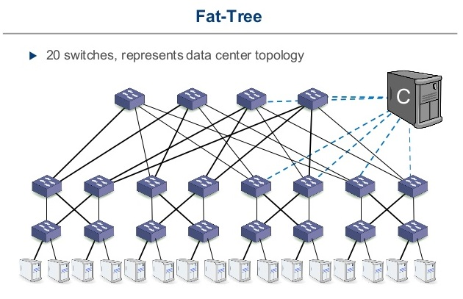
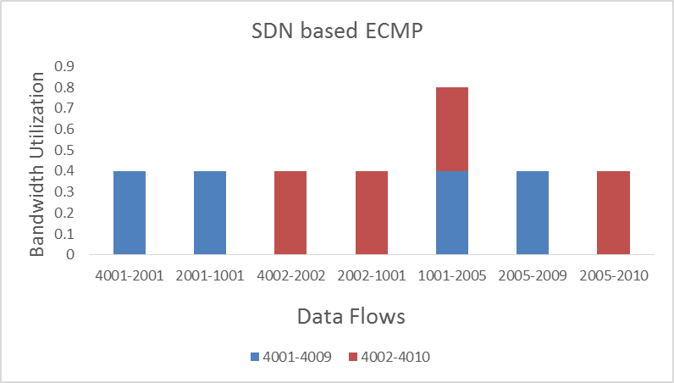
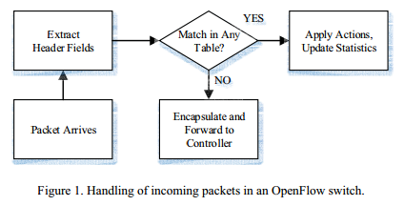
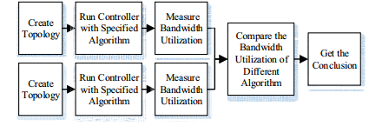
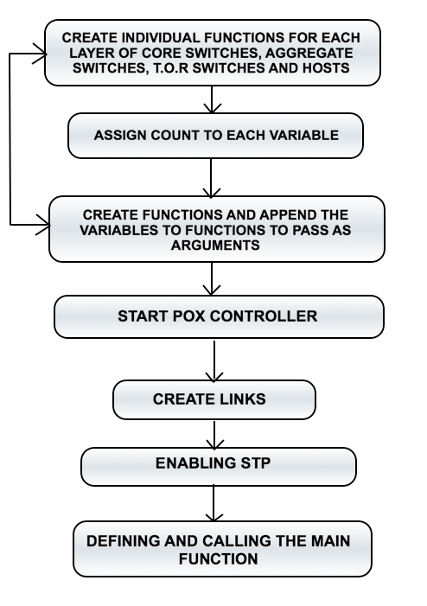
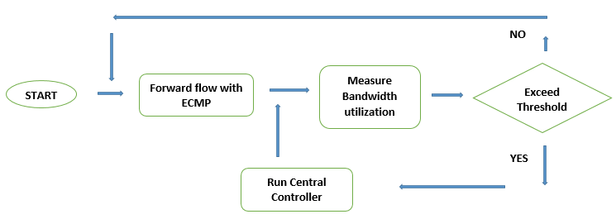
Analysis of SDN-Based ECMP For Data Center Networks
Nirmal Karia, Dharmesh Bhanushali
Department of Electrical Engineering, San Jose State university, San Jose, California 95192
Introduction
A Data Center has to be optimized to balance the workload and provide efficient results to the network. Data center network performance can characteristically be illustrated using well accredited metrics such as bandwidth, reliability, throughput, power consumption, latency and cost. To optimize and balance the workload to provide efficient results to the network, we propose the implementation of multipath routing using Software Defined Network (SDN) in DCN. Introducing SDN in the datacenter networks, we separate the control plane and the data plane providing a software abstraction of the physical network that allows the network to be programmable with open flow environment and specifically tied to the needs of applications. This gives the ability of centralized management for components and routing paths in the whole network topology. The most deployed controller in SDN is POX controller which provides a framework for communicating with SDN switches using either the Open Flow or OVSDB protocol. Emulating the Load balancing and the multiple path routing using Stock component bundled in the POX controller and implementing it with our Fat Tree topology. Ideally Data Center Networks function according to the assigned metrics such as bandwidth, reliability, throughput, power consumption, latency and cost where POX SDN controller takes the control of the network by updating the flow tables on the SDN switches in a simulated network so every host on the network can forward packets to another host.
KEY COMPONENTS
POX CONTROLLER - POX is an open source development platform for software-defined networking (SDN) control applications. POX, which enables rapid development and prototyping in the Network for routing paths between different hosts.
OPEN V SWITCH – Is an open-source virtual switch software designed for virtual servers. The main purpose of Open vSwitch is to provide a switching stack for hardware virtualization environments, while supporting multiple protocols and standards used in computer networks and secondly to forward traffic between different virtual machines (VM) within the same host and even traffic between a VM and a physical network.
Other key components are Mininet emulator tool, Spanning TreeAlgorithm (STP) and Equal Cost Multipath Protocol (ECMP)
Design Approach
Mini-net is network emulator that can conveniently create virtual topology comprised of many virtual open flow switches. At the beginning of our scheme we create a virtual data center network topology based on Fat tree architecture. This topology is presented in the above diagram and proved to have a better performance in throughput and cost. The c in the above topology represents the central controller. The controller we used here is POX. This network is built from K-port switches, there are k pods. Each pods consists of two layers forming the edge and aggregation switches. Each layer switches manages k/2 pods. The k pods are interconnected by (k/2)^2 core switches. There are (K/2)^2 equal cost path between any two communicating edge switches, each belong to different pods. There are 4 equal cost paths between two host and each of the equal cost path contains core switch. In this case we specify a central controller which will dynamically adjust the flows according to the bandwidth utilization and if any of the links threshold increases by a specified value the controller will redirect that flow to a least used path.
The diagram below shows how the open flow switch handles the incoming packets.
Flow chart of our experiment.
Flow chart of SDN based ECMP with central controller.
Results
We calculate the possible bandwidth utilization of flows (4001- 4009), (4002-4010)as shown in TABLE 1
Table 1 shows the bandwidth utilization when ECMP is used with SDN based Environment
Here two flows (4001-4009) and (4003 -4009) are forwarded through same equal cost path and scheduler cannot select the forwarding path according to the link status, the core switches bandwidth utilization of core links exceed the threshold. The flows (4001-4009) and (4003-4009) are forwarded through the same equal cost path. Both the Host select the same path to reach the destination. This exceed the set threshold of 0.7 and the total bandwidth utilization of core links will exceed as both the flows flowing through the sane path lead to a bandwidth utilization of 0.8. The controller than redirects one of the flow to a least utilized path.
Thus we find that when SDN based ECMP is used the throughput of data center network is improved. The reason is that the central controller here dynamically adjust flows according to bandwidth utilization of links. The central controller here will dynamically adjust the forwarding. When the core switch links exceed the threshold the controller will redirect the flow for example, 4003-4009 to flow from 4001-4010 and 4001- 4009 to flow from 4003-4010.This proves that SDN architecture is suitable for data center networks.
DATA | FLOW | Bandwidth Utilization
4001 – 2001 | 4002 – 2002 | 0.4
2001 – 1001 | 2002 - 1001 | 0.4
1001 – 2005 | 1001 – 2005 | 0.4 + 0.4 = 0.8
2005 – 4009 | 2005 - 4010 | 0.4
CODEFLOW
Conclusions
The fat free with multi-path capability is a suitable solution which outperforms limitations of traditional data center topology with increased bandwidth and fault tolerance. In this project we propose a load balanced multipath routing scheme which can distribute the traffic load and efficiently utilize available bandwidth in fat tree network topology. As a practical solution, we propose use of load balanced multipath routing scheme for SDN-based data center networks. The algorithm specified makes use of central controller to collect information about network state and makes optimized load balancing decision when admitting new flows to the network. We implemented the topology in mini-net and with the use of ECMP throughput of data center network will be greatly improves but lacks flexibility. With the use of EMP in SDN based Environment we find a way to solve the problem of ECMP. The work proposed shows that the central controller will dynamically adjust flows when the bandwidth utilization of core links exceeds the threshold which increases the throughput and network performance. Experiment results show that our proposed work with the used SDN controller consistently outperforms ECMP in fat free data centers. We believe that SDN based data center network solutions are the future trends.
Key References
Software Defined Networks (EWSDN), 2013 Second European Workshop on, Issue Date: 10-11 Oct. 2013, Written by: Teixeira, J.; Antichi, G.; Adami, D.; Del Chiaro, A.; Giordano, S.; Santos, A.
M. Al-Fares, A. Loukissas, and A. Vahdat, ``A scalable, commodity data center network architecture,'' in Proc. ACM SIGCOMM, 2008, pp. 63_74.
Hailong Zhang School of Information Engineering, Communication University of China, Beijing, China Xiao Guo ; Jinyao Yan ; Bo Liu ; Qianjun Shuai - SDN Based ECMP Algorithm for data center networks.
Yi-Chi Lei ,Kuochen Wang and Yi- Huai - Hsu ,Department of Computer Science, National Chiao Tung University, “Multipath Routing in SDN based Datacenter “, 2015
Acknowledgments
We might want to express our earnest appreciation to Dr. Balaji Venkatraman, Professor, Department of Electrical Engineering, SJSU and our co-advisor Dr. Nader F. Mir, for managing and educating every one of us along the advancement regarding this Project. Making a free learning environment he gave us the chance to express our perspectives and views with respect to the paper. We would also like to take this opportunity to thank the Electrical Engineering department, SJSU for providing us the tools, necessary resources and best help provided.

