Slide 1








Welcome Everyone
Present:
Nirmal Khadka
Abishek pokhrel
Bibek shahi

Slide 2
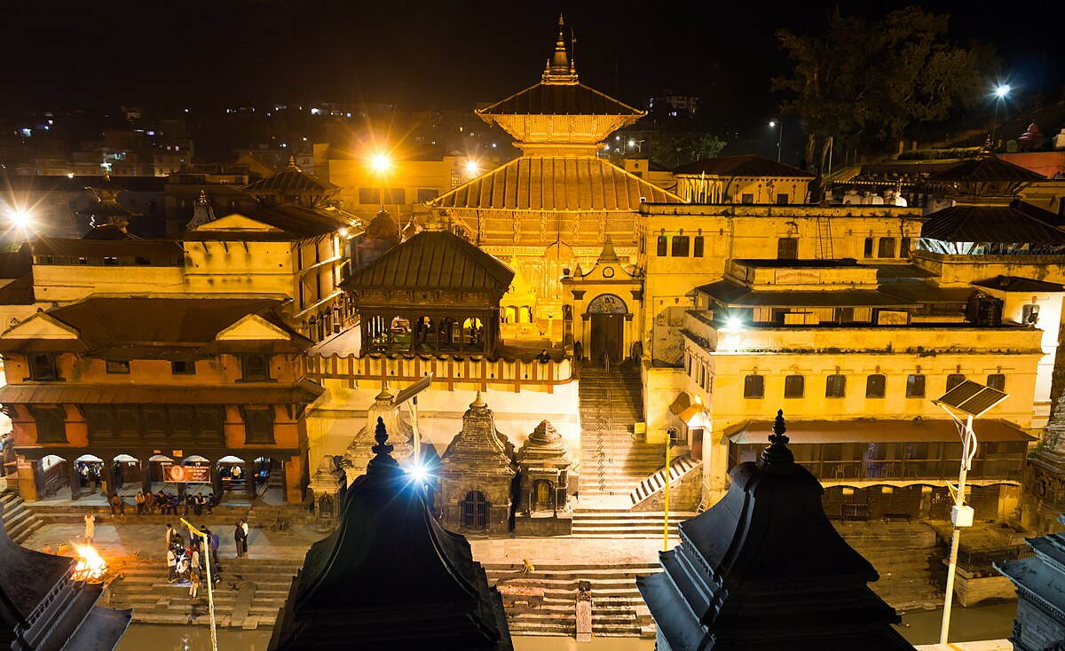

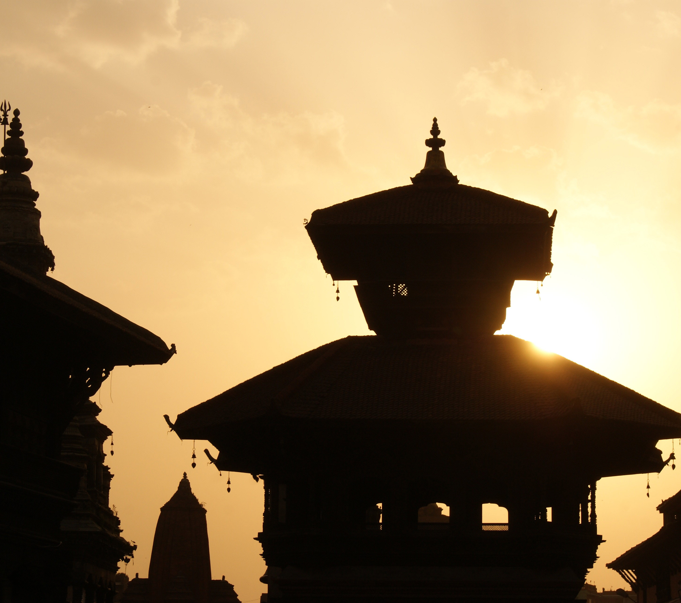
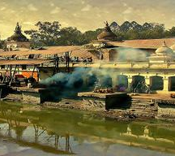
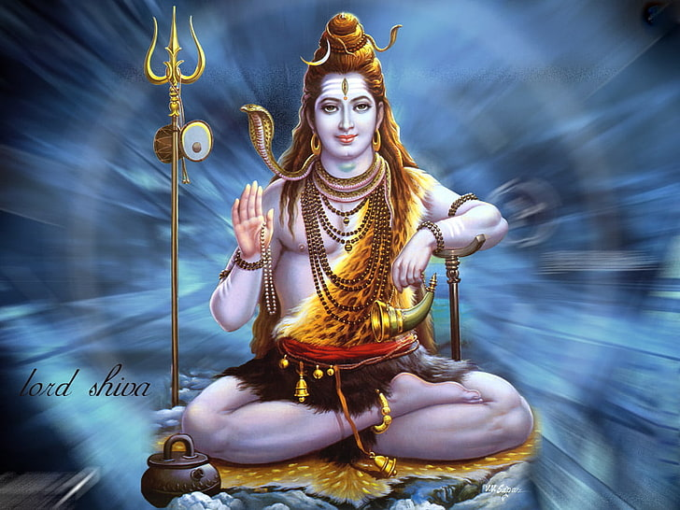
Presentation on Pashupatinath Temple
Kathmandu
City where the temple is located
ThePhoto by PhotoAuthor is licensed under CCYYSA.
Bagmati River
banks of the Bagmati River
ThePhoto by PhotoAuthor is licensed under CCYYSA.
Lord Shiva
dedicated to Lord Shiva
World Heritage Site
UNESCO World Heritage Site, listed in 1979
ThePhoto by PhotoAuthor is licensed under CCYYSA.

Slide 3
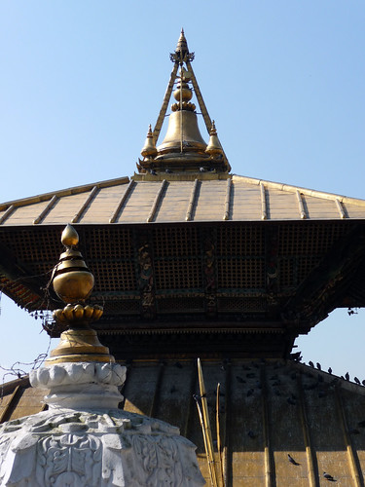
History and Architecture
Built in the 5th Century
Pashupatinath Temple was built in the 5th century by King Prachanda Deva.
Renovated in the 14th Century
It was later renovated by King Jayasthiti Malla in the 14th century.
Pagoda-Style Design
The temple has a pagoda-style design with a golden roof and silver doors.
Shiva Lingam & Nandi
Inside the temple, there is a Shiva Lingam and a statue of Nandi (bull).
ThePhoto

Slide 4


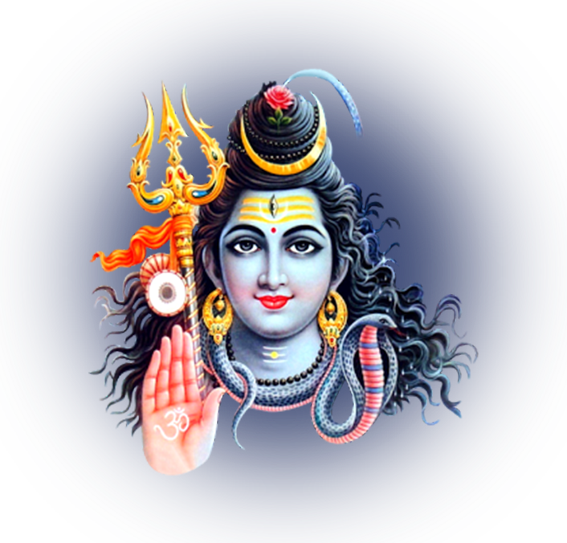

Importance and Challenges
Sacred Hindu Site
Pashupatinath is an important religious place for Hindus.
Maha Shivaratri Attraction
Many people visit during the Maha Shivaratri festival.
Monasteries & Cremation Sites
Pollution challenges conservation efforts.

Slide 5
Challenges Faced by Pashupatinath Temple
Pollution in the Bagmati River.
Need for better preservation of old structures.
Overcrowding during festivals.
Management and financial issues.

Slide 6
Conclusion
Pashupatinath is a holy and historical place.
It needs proper care and preservation.
ThePhoto

Slide 7
Thanks!
ThePhoto by PhotoAuthor is licensed under CCYYSA.

