Slide 1

BASICS
By Nirmal Kumar

Slide 2
Agenda:
Understanding Client Side MVC Framework
Understanding the Basic Features of AngularJS MVC
AngularJS Core Topics
Understanding Single Page Application[SPA]
Developing SPA using AngularJS

Slide 3
Day 1
What in Client Side MVC
What is AngularJS?
Basic Concepts of AngularJS
Two way Bindings
Module
$scope || $root Scope
Controller
Filters
Directives
Core Directives
Display Directives
Form Directives
Event Directives
Angular Built in Functions

Slide 4
Day 2
AngularJS Form Validation
Custom Filters
Custom Directives
AngularJS Services
Router Services
Http Services
Custom Services
HANDS ON DEMO

Slide 5
What is Client Side MVC Framework ?
MVC - Design Pattern
Model - Data
View - Template
Controller - Business Logic
Model
View
Controller

Slide 6
Server Side MVC
Browser
Server
Model
+
View
Static HTML
Controller

Slide 7
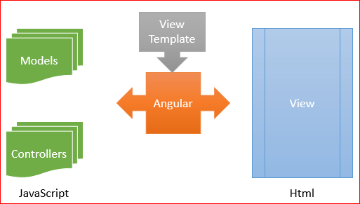
Client Side MVC
It is otherwise called as JavaScript MVC Framework

Slide 8
What is AngularJS ?
is not a JavaScript library (e.g jQuery)
is not a Platform (e.g .Net, Java) or a Language (e.g C#)
is not a Plugin or a browser extension
doesn’t abstract away HTML, CSS, or JavaScript
doesn’t require jQuery or inheritance from proprietary types
doesn’t use one-way data binding
doesn’t require boilerplate code
is not that complicated

Slide 9
….then what it is….!!!!!
Its an awesome JavaScript MVC Framework bundle of features.
Two Binding
Dirty Checking
Dependency Injection
Service Integration
And lot more..

Slide 10
AngularJS Components
Views
[Directives]
Controllers
Services

Slide 11
Basic Concepts of AngularJS
Two way Bindings
Module
$scope || $rootScope
Controller

Slide 12
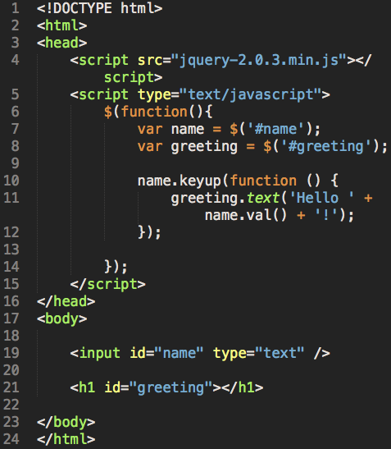
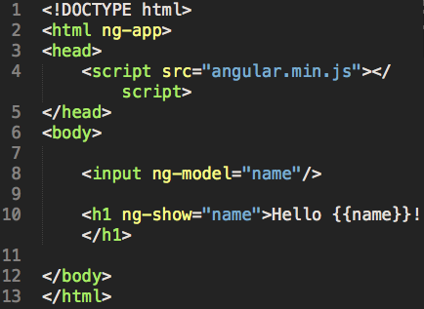
Two Way Binding
In AngularJS
In Jquery

Slide 13
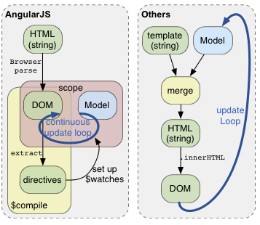
Two way Binding Continues…

Slide 14
Module
a module is the main way to define an AngularJS app. The module of an app is where we'll contain all of our application code.
An app can contain several modules, each one containing code that pertains to specific functionality
Using modules gives us a lot of advantages, such as:
Keeping our global namespace clean
Making tests easier to write and keeping them clean so as to more easily target isolated functionality
Making it easy to share code between applications
Allowing our app to load different parts of the code in any order
angular.module('myApp', []);

Slide 15
Scopes
Scopes are a core fundamental of any Angular app.
The scopes of the application refer to the application model. Scopes are the execution context for expressions.
The $scope object is where we define the business functionality of the application, the methods in our controllers, and properties in the views.
Scopes provide the ability to watch for model changes.
When Angular starts to run and generate the view, it will create a binding from the root ng-app element to the $rootScope. This $rootScope is the eventual parent of all $scope objects.
This $scope object is a plain old JavaScript object.
It’s the glue between the view and the controller.

Slide 16
Life Cycle of Scope Object
Creation
When we create a controller or directive, Angular creates a new scope with the $injector and passes this new scope for the controller or directive at runtime.
Linking
When the $scope is linked to the view, all directives that create $scopes will register their watches on the parent scope. These watches watch for and propagate model changes from the view to the directive.
Updating
During the $digest cycle, which executes on the $rootScope, all of the children scopes will perform dirty digest checking. All of the watching expressions are checked for any changes, and the scope calls the listener call back when they are changed.
Destruction
When a $scope is no longer needed, the child scope creator will need to call scope.$destroy() to clean up the child scope.

Slide 17
Controllers
The controller in AngularJS is a function that adds additional functionality to the scope of the view.
We use it to set up an initial state and to add custom behaviour to the scope object.
function FirstController($scope) {
$scope.message = "hello";
}
//OR
//Best Practice
var app = angular.module('app', []);
app.controller('FirstController', function($scope) {
$scope.message = "hello";
});

Slide 18
Filters
Filter provides a way to format the data we display to the user.
Angular gives us several built-in filters as well as an easy way to create our own.
We invoke filters in our HTML with the | (pipe).
{{ name | uppercase }}
We can also use filters from within JavaScript by using the $filter service.
$scope.name = $filter('lowercase')('Ari');
To pass an argument to a filter in the HTML form, we pass it with a colon after the filter name
<!-- Displays: 123.46 -->
{{ 123.456789 | number:2 }}

Slide 19
Built in Filters
Currency
Date
Number
Lowercase
Uppercase
Object || JSON filters
Function

Slide 20
Directives
Directives are the most important components of AngularJS application.
Directives in AngularJS are used to make custom HTML elements and simplify DOM manipulation.
They can modify the behaviour of new and existing DOM elements, by adding custom functionality
AngularJS comes with its own set of built-in directives, as well as the ability to add your own ones

Slide 21
Core Directives
ngApp
ngController
ngBind
ngInit
ngModel
ngRepeat
ngSrc
ngSwitch
ngView
ngHref
ngList

Slide 22
Display Directives
ngClass
ngClassOdd
ngClassEven
ngHide
ngShow
ngStyle

Slide 23
Event Directives
ngChange
ngChecked
ngClick
ngDblclick
ngKeydown
ngKeypress
ngKeyup
ngMousedown
ngMouseenter
ngMouseleave
ngMousemove
ngMouseup
ngSubmit

Slide 24
AngularJS : Writing Custom Filter
To create your own custom filter in AngularJS, you simply create a module first and then create a filter very similar to creating a controller.
angular.module(‘moduleName', [])
.filter(‘filterName', function() {
return function(input) {
//process input
return ‘filtered output’; //any object
};
});
The first function allows you to inject any dependencies that you may need to access while performing the operation on the object. The filter function returns a function that is invoked on the bound value within the expression. This is then returned when the binding occurs. When the bound variable changes, the filter expression will be re-run.

Slide 25
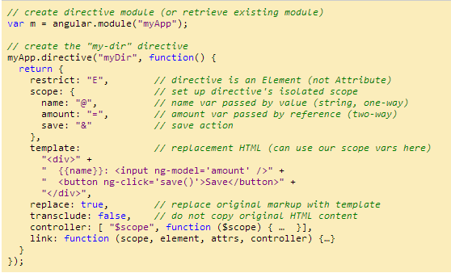
AngularJS : Writing Custom Directive
It is a really clever and powerful way to extend HTML to do new things. Directives give a new trick to HTML.
Angular JS Doc:
https://docs.angularjs.org/guide/directive

Slide 26
Form Directives
ngForm
ngChange
ngChecked
ngDisabled
ngList
ngModel
ngMultiple
ngReadonly
ngSelected
ngSubmit

Slide 27
AngularJS Form Validation
Reference : http://jsfiddle.net/nirmalkumar_86/9F89Q/77/
Client-side form validations are one of the coolest features inside of AngularJS.
AngularJS form validation enables you to write a modern HTML5 form that is interactive and responsive.
There are many form validation directives available in AngularJS. Some of the common directives are.
Required
ngMinLength
ngMaxLength
ngPattern
Email
Number
Url
And Validation using Custom Directives.

Slide 28
Form Validation Continues…
AngularJS makes properties available on the containing $scope object available to us as a result of setting a form inside the DOM. These enable us to react to the form in real time (just like everything else in AngularJS). The properties that are available are:
Form validation properties are access by below format
formName.inputFieldName.property
$pristine
$dirty
$valid
$invalid
.$error
$error.required
$error.minlength
$error.maxlength
$error.number
$error.email

Slide 29
AngularJS : Routing Service
The magic of Routing is taken care by a service provider that Angular provides out of the box called $routeProvider.
An Angular service is a singleton object created by a service factory. These service factories are functions which, in turn, are created by a service provider.
Application routes in Angular are declared via the $routeProvider, which is the provider of the $route service. This service makes it easy to wire together controllers, view templates, and the current URL location in the browser.
var sampleApp = angular.module(‘moduleName', []);
sampleApp.config(['$routeProvider', function($routeProvider) {
$routeProvider. when('/addOrder', {
templateUrl: 'templates/add-order.html',
controller: 'AddOrderController'
}). when('/showOrders', {
templateUrl: 'templates/show-orders.html',
controller: 'ShowOrdersController'
}).
otherwise({
redirectTo: '/addOrder'
});
}]);

Slide 30
AngularJS : $http Service
The $http service is a core Angular service that facilitates communication with the remote HTTP servers via the browser's XMLHttpRequest object or via JSONP.
The $http API is based on the deferred/promise APIs exposed by the $q service
The $http service is a function which takes a single argument — a configuration object — that is used to generate an HTTP request and returns a promise with two $http specific methods names success and error.
$http({method: 'GET', url: '/someUrl'})
. success(function(data, status, headers, config) {
// this callback will be called asynchronously
// when the response is available })
. error(function(data, status, headers, config) {
// called asynchronously if an error occurs
// or server returns response with an error status.
});
AngularJS Doc:
https://docs.angularjs.org/api/ng/service/$http

Slide 31
AngularJS : Writing custom services
Angular services are substitutable objects that are wired together using dependency injection (DI). You can use services to organize and share code across your app.
The service factory function generates the single object or function that represents the service to the rest of the application. The object or function returned by the service is injected into any component (controller, service, filter or directive) that specifies a dependency on the service.
var myModule = angular.module('myModule', []);
myModule.factory(‘serviceName', function() {
var serviceInstance= {};
//factory function body that constructs serviceInstance
return serviceInstance;
});

Slide 32
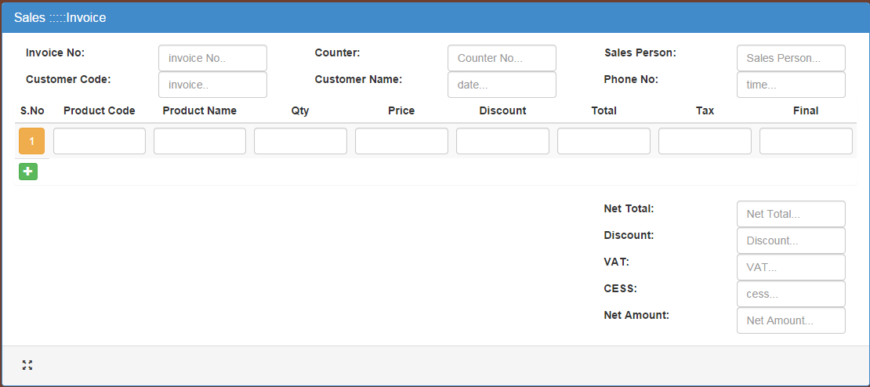
Demo Project

Slide 33
Questions?

Slide 34
END

