Slide 1
COLLEGE CA2 PROJECT EVALUATION - 2026
Student Record Management System
A Robust Full-Stack Web Application Powered by Python, Flask, PyMongo, and MongoDB
CANDIDATE AND SUBMISSION CREDENTIALS
CORE TECHNOLOGIES AND TOOLS
Candidate Name: Nirmal Kumar
Registration No: 12311185
Course Program: B.Tech (Computer Science and Engineering)
Department: Department of Computer Science and Engineering
Evaluation Mode: Continuous Assessment 2 (CA2)
Academic Term: Spring 2026
[x] Python 3.10 (Application Backend Logic)
[x] Flask 3.1 (WSGI Micro Web Framework)
[x] MongoDB (NoSQL Document Database)
[x] PyMongo 4.18 (Python Database Driver)
[x] HTML5 and CSS3 (Responsive UI and Cards)
[x] Python-Dotenv (Secure Environment Config)

Slide 2
01 | INTRODUCTION
Modernizing Academic Record Management
Background and Context
Key Advantages and Architecture
Academic institutions handle vast quantities of student academic, personal, and enrollment data across departments every term.
Legacy reliance on physical paper registers and unlinked spreadsheets introduces data duplication, calculation mistakes, and slow retrieval.
The Student Record Management System provides a centralized, secure web-based registry accessible via any modern web browser.
Developed specifically for college continuous assessment (CA2), offering complete student lifecycle management with zero operational friction.
Zero Installation Barrier: Runs smoothly in any web browser without requiring heavy desktop client software.
Document-Oriented Storage: Utilizes MongoDB BSON documents instead of rigid tables, reflecting natural student profile structures.
High Fault Tolerance: Built-in connection ping check, server fault isolation, and safe input parsing prevent application crashes.
Live KPI Analytics: Instant visual calculation of total enrolled students, overall average CGPA, and top academic scores upon every visit.
Student Record Management System | College CA2 Project | Nirmal Kumar (12201458)

Slide 3
02 | PROBLEM STATEMENT
Challenges in Traditional Student Record Systems
1. Data Redundancy
2. Inefficient Retrieval
3. Data Safety and Integrity
Duplicate Enrollments: Manual entry frequently leads to duplicate roll numbers assigned to multiple students.
Inconsistent Records: Changes made in local spreadsheets fail to propagate to department heads.
Rigid Schemas: Adding custom fields in legacy SQL systems requires complex, disruptive database migrations.
Slow Querying: Manually searching through hundreds of paper records or spreadsheet rows causes delays.
No Filter Controls: Inability to instantly filter student cohorts by academic department or semester standing.
Fragmented Analytics: Lack of high-level overview metrics such as class CGPA averages and department enrollment numbers.
Accidental Deletion: Unprotected record modification with no confirmation prompts or undo awareness.
Validation Omissions: Invalid CGPAs (e.g. greater than 10.0) or malformed emails enter the system unchecked.
Hardcoded Secrets: Storing database passwords directly in source code creates severe security vulnerabilities.
Student Record Management System | College CA2 Project | Nirmal Kumar (12201458)

Slide 4
03 | PROJECT OBJECTIVES
Key Goals and Architectural Milestones
1. Complete CRUD Functionality
2. Strict Data Integrity and Validation
Deliver complete Create, Read, Update, and Delete operations for student academic profiles.
Ensure instantaneous user interface updates with automated HTTP redirects and flash alerts.
Enforce unique registration numbers at both application logic and MongoDB index layers.
Validate CGPA bounds (0.00 to 10.00), semester limits (1 to 8), and institutional email syntax.
3. Real-Time Search and Dashboard
4. Production-Grade Configuration
Provide regex-powered live searching by registration number or student name.
Display dynamic analytics cards: Total Students, Average CGPA, Highest CGPA, and Active Courses.
Isolate environment settings via .env and provide sample templates (.env.example).
Guarantee database fault tolerance with automatic connection recovery and ping monitoring.
Student Record Management System | College CA2 Project | Nirmal Kumar (12201458)

Slide 5
04 | TECHNOLOGY STACK
Technologies Used and Their Architectural Roles
Python 3.10 (Core Backend)
Flask 3.1 (WSGI Web Framework)
Core programming language powering backend business logic and input sanitation.
Handles mathematical rounding, regex validation, and environment variable parsing.
Lightweight WSGI framework handling RESTful routing (@app.route decorators).
Manages Jinja2 HTML rendering, session cookies, and contextual flash alert notifications.
MongoDB and PyMongo 4.18 (Database Layer)
HTML5 and Vanilla CSS3 (Frontend Layer)
High-throughput NoSQL document database storing BSON student records.
PyMongo driver provides connection pooling, CRUD queries, and unique index enforcement.
Responsive, clean layout built with CSS custom properties and Google Fonts.
Features interactive data tables, CGPA performance badges, and confirmation modals.
Student Record Management System | College CA2 Project | Nirmal Kumar (12201458)

Slide 6
05 | SYSTEM ARCHITECTURE
Multi-Tier Web Application Workflow
1. Client Layer
(Browser / UI)
2. Server Layer
(Flask / Python)
3. Driver Layer
(PyMongo)
4. Data Store
(MongoDB)
HTML5 Templates:
(index, add, edit)
Responsive CSS3 Styling
User HTTP Requests
(GET and POST)
Form Submissions
JS Confirmation Alerts
Flash Notification Banners
app.py Application
URL Routing Engine
(/, /add, /edit, /delete)
Regex Data Sanitizer
Duplicate Validator
Statistics Calculator
Jinja2 Template Engine
MongoClient Pool
BSON Object Mapping
ObjectId Translation
Query Execution:
(insert_one, find,
update_one, delete)
Index Management
Error Handling
Database:
student_records_db
Collection:
students
Document Storage
Unique Index
on reg_no
WiredTiger Engine
Persistent Disk
Student Record Management System | College CA2 Project | Nirmal Kumar (12201458)

Slide 7
06 | MAIN FEATURES
Core CRUD Operations and Application Capabilities
Add Student (CREATE)
View Registry (READ)
Search and Filter (QUERY)
Route: POST /add
Captures: Name, Reg No, Course, Semester, Email, and CGPA.
Uniqueness Check: Queries MongoDB to block duplicate reg_no.
Route: GET /
Formatted table with custom badges for courses and semesters.
Color-coded CGPA pills: Outstanding (>=8.5), Good (>=7.0), Low.
Routes: GET / and GET /search
Case-insensitive regex search by Reg Number or Name.
Course filter dropdown plus instant Clear Filters reset button.
Update Record (UPDATE)
Delete Record (DELETE)
Route: POST /edit/<id>
Pre-fills existing student credentials into edit template.
Conflict Prevention: Ensures updated reg_no is not held by another student.
Route: POST /delete/<id>
Client-side safety confirmation: JavaScript onsubmit confirm() prompt.
Permanent document removal followed by friendly flash notice.
Student Record Management System | College CA2 Project | Nirmal Kumar (12201458)

Slide 8
07 | DATABASE DESIGN
MongoDB Collection and BSON Document Schema
Database and Collection Architecture
Document Schema and Field Types
Database Name: student_records_db
Collection Name: students
Storage Format: BSON (Binary JSON) documents
Index Rule: create_index([('reg_no', 1)], unique=True)
Schema Flexibility: Allows adding timestamps (created_at, updated_at) without schema alteration scripts.
High Performance: WiredTiger storage engine handles concurrent document reads and writes efficiently without table lockups.
_id : ObjectId (12-byte primary key generated by MongoDB)
name : String (Full legal name of enrolled student)
reg_no : String (Unique student registration number)
course : String (Academic program, e.g. B.Tech CSE, BCA)
semester : Integer (Current term, integer between 1 and 8)
email : String (Valid institutional email address)
cgpa : Double (Cumulative GPA on a scale of 0.00 to 10.00)
created_at : DateTime (Timestamp of initial document creation)
Student Record Management System | College CA2 Project | Nirmal Kumar (12201458)

Slide 9
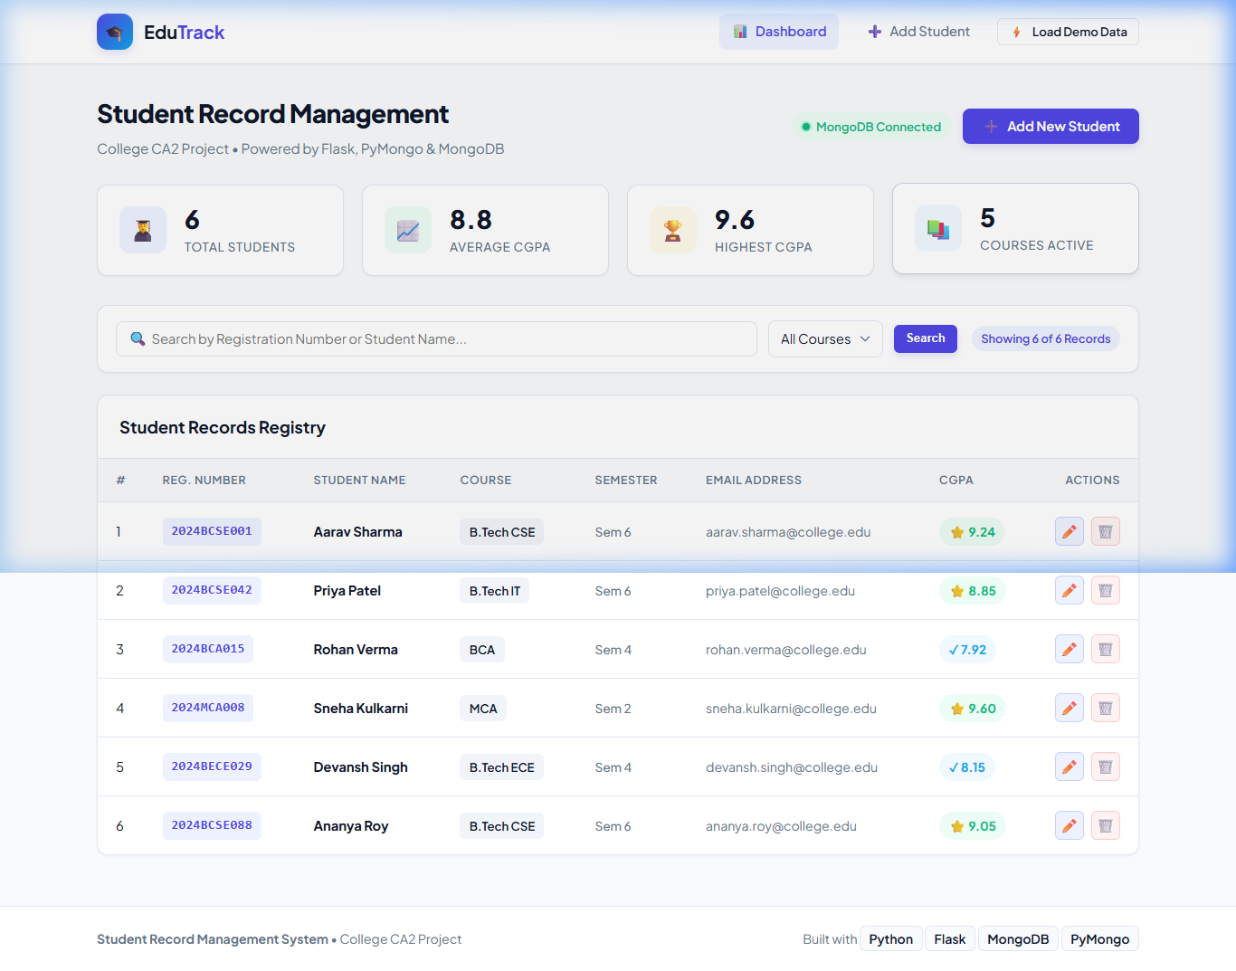
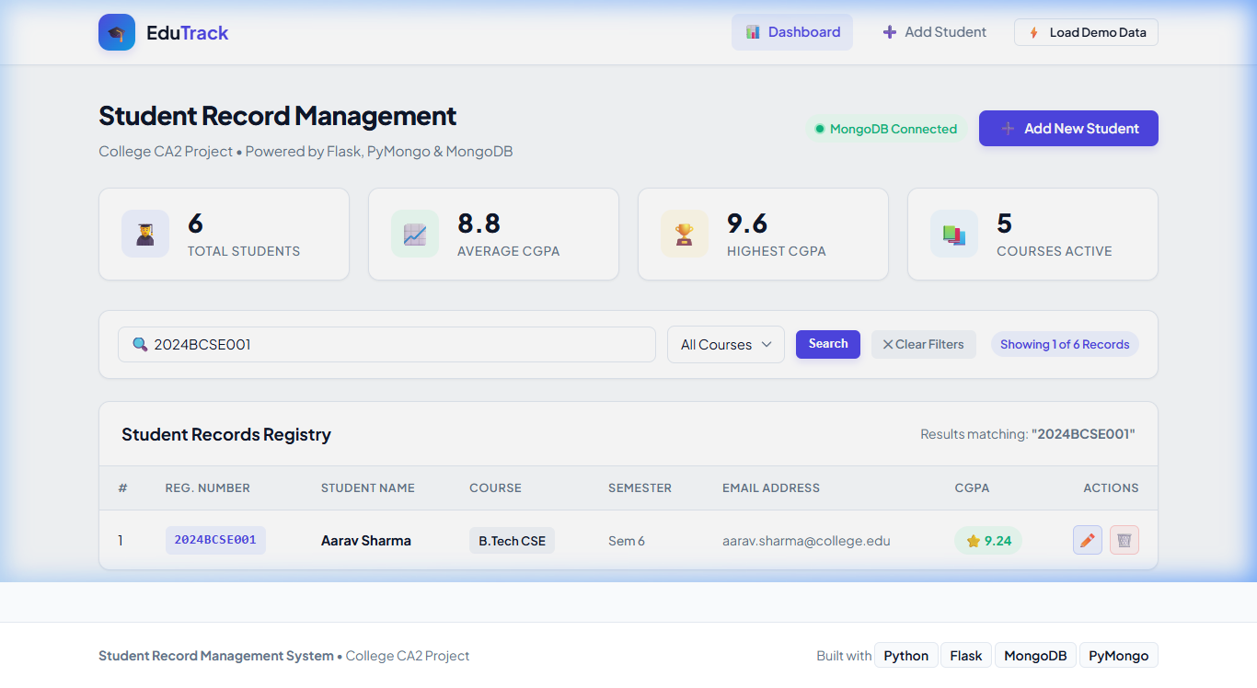
08 | PROJECT SCREENSHOTS AND OUTPUT
Live Application Demonstration and Actual Output Screenshots
Figure 1: Main Dashboard and Student Registry
- Live Analytics: Total Students, Avg CGPA, Highest CGPA, Courses
- MongoDB Connected badge verifying active database status
- Responsive registry table with action buttons and CGPA pills
Figure 2: Real-Time Search and Query Operation
- Instant lookup matching Registration Number (2024BCSE001)
- Dynamic record counter badge ('Showing 1 of 6 Records')
- Instant 'Clear Filters' button returning to the full registry
Student Record Management System | College CA2 Project | Nirmal Kumar (12201458)

Slide 10
09 | CONCLUSION AND FUTURE SCOPE
Project Summary and Future Enhancement Roadmap
Project Summary and Achievements
Future Enhancement Roadmap
[x] Complete CRUD Implementation: Fully functional web application satisfying all college CA2 requirements.
[x] 100% Automated Test Pass: All 7 integration tests verified for route availability, duplicate prevention, and bounds.
[x] Robust Database Architecture: MongoDB NoSQL backend with automatic reconnection, index uniqueness, and schema resilience.
[x] User-Centric Design: Clean academic dashboard featuring live analytics, color-coded grade badges, and intuitive navigation.
Role-Based Access Control (RBAC): Dedicated portals and permissions for Administrators, Faculty, and Students.
Automated Marksheet Generation: Exporting semester report cards into downloadable PDF certificates.
Attendance and Fee Tracking: Extending the schema to record class attendance percentages and college tuition clearance.
REST API and Mobile Integration: Exposing JSON endpoints for future cross-platform Android and iOS mobile apps.
Student Record Management System | College CA2 Project | Nirmal Kumar (12201458)

