Slide 1


Generic view of Software engineering
Software Engineering
By:
CE 2
BATCH : B
NAME: Vivek Patel
EN.No:170410107085

Slide 2
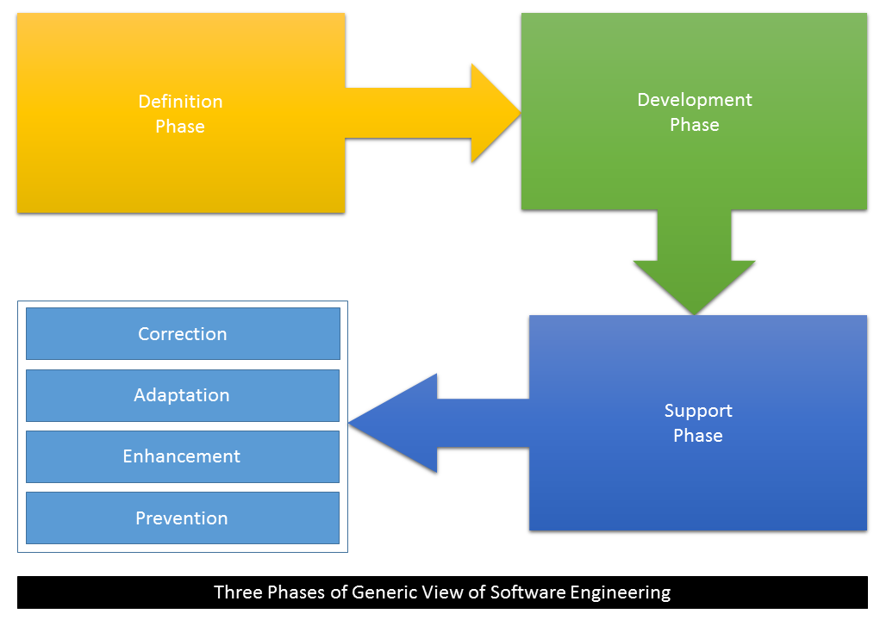
The process of software engineering developed phase is three
1) Definition Phase
2) Development Phase
3) Support Phase

Slide 3
1.Defination Phase
Definition phase is the base phase of the software engineering. In this phase experts get knowledge about “What”.
Information needed for processing
Which function is required
Expectation about the capacity
Interface which is stabilized
Area of validation
This phase defines all the acceptation dependent standard of software engineering . It contains three steps
Analysis of system
Planning of project
Requirement of analysis

Slide 4
2. Development Phase:
The focus of the development phase is “how”. After the explanation of WHAT it turns to HOW.
Many types of questions raised in the development that are :
how to design the data structure and architecture of software
Procedural detail how to implemented and how to design convert in a programming language and testing software how to perform.
Three special step always are taken in this phase which are the
Design
Coding
Testing

Slide 5
3. Support Phase:
The support phase focuses on “change” associated with error correction, adaptations required as the software's environment evolves, and changes due to enhancements brought about by changing customer requirements.
Four types of change are encountered during the support phase:
Correction
Adaptation
Enhancement
Prevention

Slide 6
1.Correction:
Even with the best quality assurance activities, it is likely that the customer will uncover defects in the software. Corrective maintenance changes the software to correct defects.
2.Adaptation:
Over time, the original environment, that is, CPU, operating system, business rules etc for which the software was developed is likely to change. Adaptive maintenance results in modification to the software to accommodate changes to its external environment.

Slide 7
3.Enhancement:
As software is used, the customer/user will recognize additional functions that will provide benefit. Perfectible maintenance extends the software beyond its original functional requirements.
4.Prevention:
Computer software deteriorates due to change, and because of this, preventive maintenance, often called software re-engineering, must be conducted to enable the software to serve the needs of its end users.

Slide 8
THANK YOU

