Slide 1
Software Process Model
NAME: VRAJ D. PATEL
ENROLL: 170410107086
CLASS: TY CE-2
BATCH: B

Slide 2
Software process model
ο
Process models prescribe a distinct set of activities, actions, tasks, milestones, and work products required to engineer high quality software.
Process models are not perfect, but provide roadmap for software engineering work.
Software models provide stability, control, and organization to a process that if not managed can easily get out of control
Software process models are adapted to meet the needs of software engineers and managers for a specific project.
ο
ο
ο

Slide 3
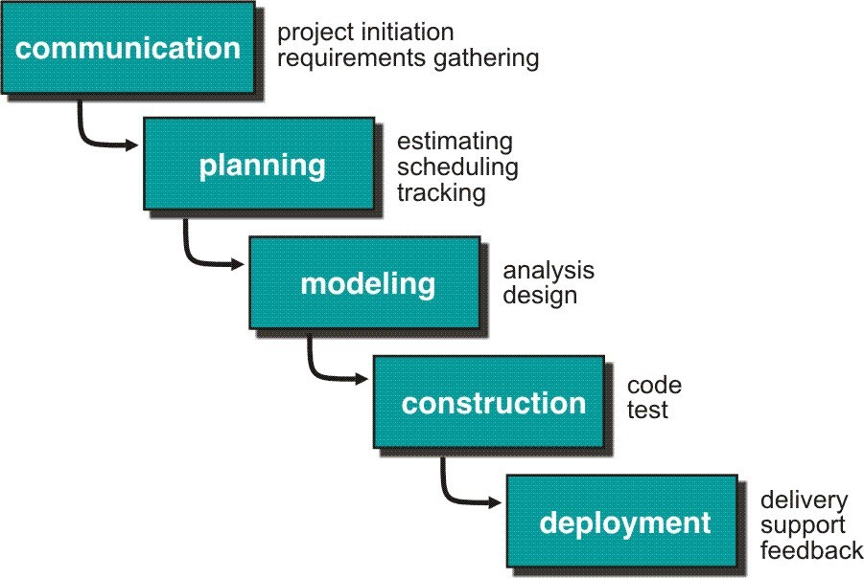
Waterfall Model or Classic Life Cycle

Slide 4
Waterfall Model or Classic Life Cycle/Sequential model
ο
Requirement Analysis and Definition: What - The systems services, constraints and goals are defined by customers with system users.
Scheduling tracking -
ο
Assessing progress against the project plan. Require action to maintain schedule.
ο
System and Software Design: How –It establishes and overall system architecture. Software design involves fundamental system abstractions and their relationships.
Integration and system testing: The individual program unit or programs are integrated and tested as a complete system to ensure that the software requirements have been met. After testing, the software system is delivered to the customer.
Operation and Maintenance: Normally this is the longest phase of the software life cycle. The system is installed and put into practical use. Maintenance involves correcting errors which were not discovered in earlier stages of the life- cycle.
ο
ο

Slide 5
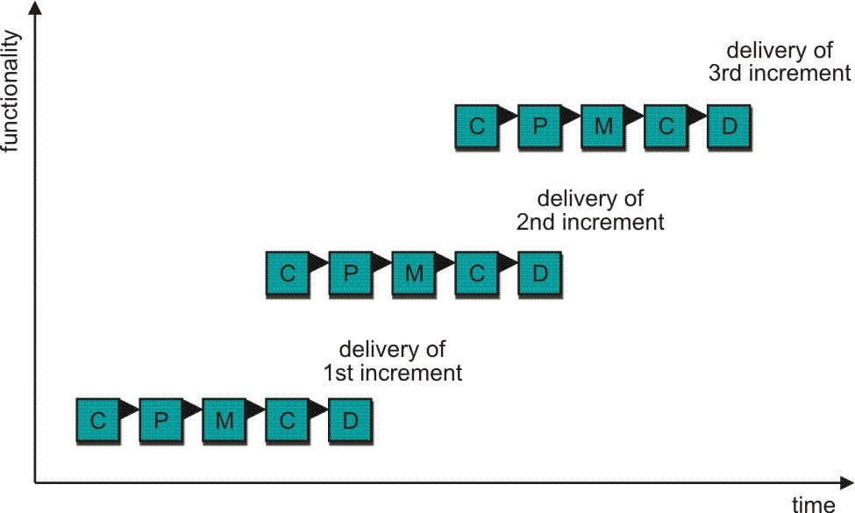
Incremental Process Model
C- Communication
P - Planning
M – Modeling
C - Construction
D - Deployment
Delivers software in small but usable pieces, each piece builds on pieces already delivered

Slide 6
The Incremental Model
ο
Rather than deliver the system as a single delivery, the development and delivery is broken down into increments with each increment delivering part of the required functionality.
First Increment is often core product
ο
ν
ν
Includes basic requirement
Many supplementary features (known & unknown) remain undelivered
ο
A plan of next increment is prepared
ν
ν
Modifications of the first increment Additional features of the first increment
ο
It is particularly useful when enough staffing is not available for the whole project
Increment can be planned to manage technical risks.
Incremental model focus more on delivery of operation product with each increment.
ο
ο

Slide 7
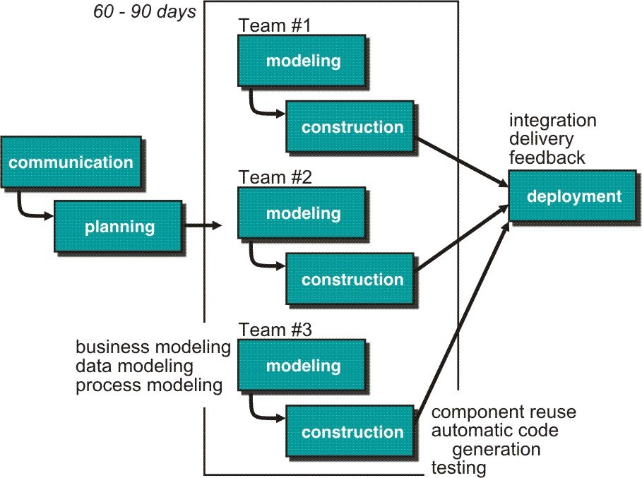
Rapid Application Development (RAD) Model
Makes heavy use of reusable software components with an extremely short development cycle

Slide 8
RAD model
ο
ο
Communication – to understand business problem.
Planning – multiple switch teams works in parallel on diff. system.
Modeling –
ο
ν
Business modeling – Information flow among business is working.
Ex. What kind of information drives?
Who is going to generate information? From where information comes and goes?
ν
Data modeling – Information refine into set of data objects that are needed to support business.
Process modeling – Data object transforms to information flow necessary to implement business.
ν

Slide 9
RAD Model
ο
If application is modularized (“Scalable Scope”), each major function to be completed in less than three months.
Each major function can be addressed by a separate team and then integrated to form a whole.
ο
Drawback:
ο
For large but scalable projects
ν
RAD requires sufficient human resources
ο
Projects fail if developers and customers are not committed in a much shortened time-frame
Problematic if system can not be modularized
Not appropriate when technical risks are high ( heavy use of new technology)
ο
ο

Slide 10
Evolutionary Process Model
Produce an increasingly more complete version of the software with each iteration.
Evolutionary Models are iterative.
Evolutionary models are:
Prototyping
Spiral Model
Concurrent Development Model
Fourth Generation Techniques (4GT)

Slide 11
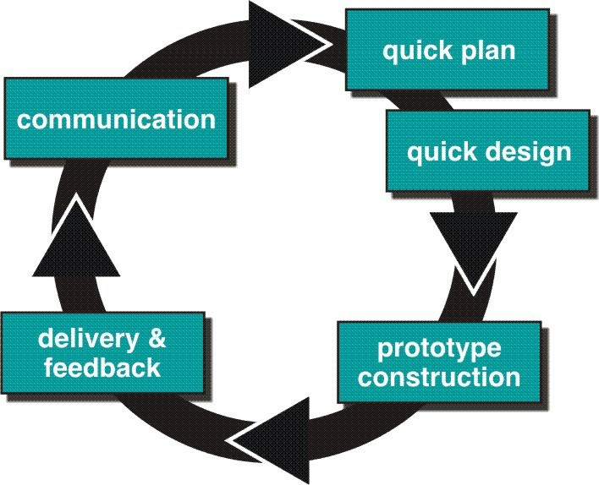
Evolutionary Process Models : Prototyping

Slide 12
Prototyping cohesive
ο
Best approach when:
ν
Objectives defines by customer are general but does not have details like input, processing, or output requirement.
Developer may be unsure of the efficiency of an algorithm, O.S., or the form that human machine interaction should take.
ν
ο
ο
It can be used as standalone process model.
Model assist software engineer and customer to better understand what is to be built when requirement are fuzzy.
Prototyping start with communication, between a customer and software engineer to define overall objective, identify requirements and make a boundary.
Going ahead, planned quickly and modeling (software layout visible to the customers/end-user) occurs.
Quick design leads to prototype construction.
Prototype is deployed and evaluated by the customer/user. Feedback from customer/end user will refine requirement and that is
ο
ο
ο
ο
ο
how iteration occurs during prototype to satisfy the needs of the customer.

Slide 13
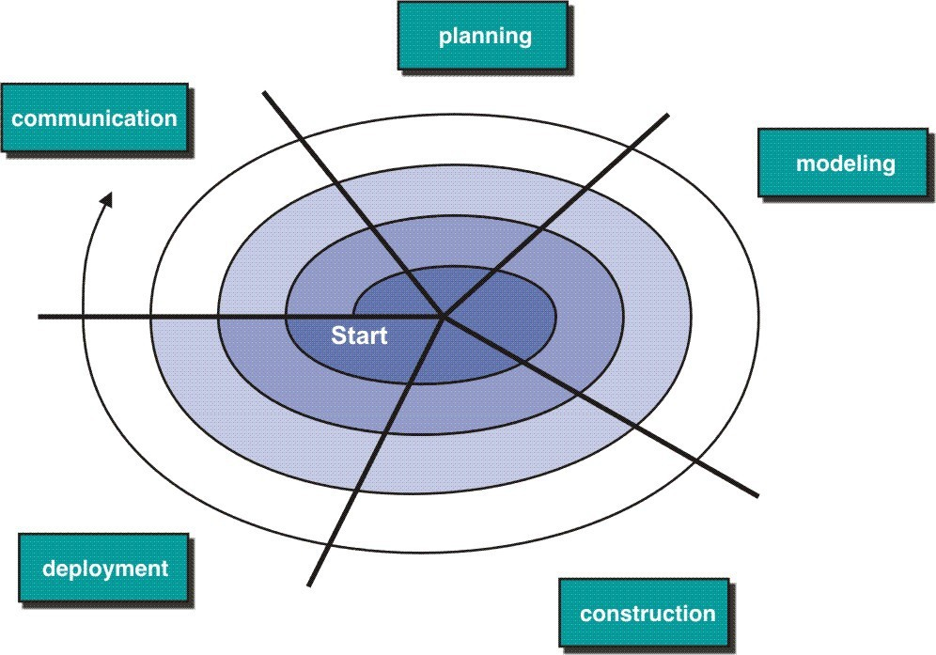
Evolutionary Model: Spiral Model

Slide 14
Spiral Model
Couples iterative nature of prototyping with the controlled and systematic aspects of the linear sequential model
It provide potential for rapid development of increasingly more complete version of the software.
Using spiral, software developed in as series of evolutionary release.
ο
Divided into framework activities (C,P,M,C,D). Each activity represent one segment.
Evolutionary process begins in a clockwise direction, beginning at the center risk.
First circuit around the spiral might result in development of a product specification. Subsequently, develop a prototype and then progressively more sophisticated version of software.
Unlike other process models that end when software is delivered.
It can be adapted to apply throughout the life of software.
ο
ο
ο
ο

Slide 15
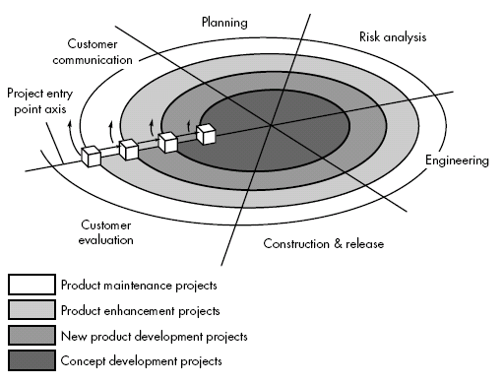
Spiral Model

Slide 16
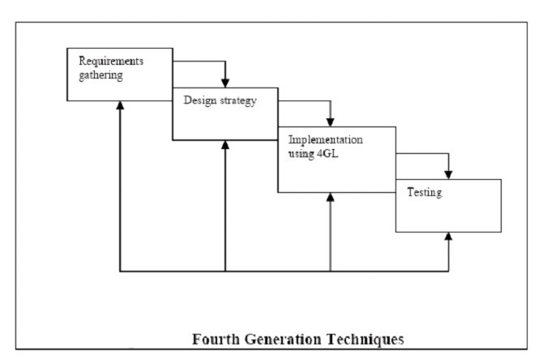
Fourth Generation Techniques(4GT)

Slide 17
4GT
ο
Like all other models, 4GT begins with a requirements gathering phase.
Ideally, the customer would describe the requirements, which are directly translated into an operational prototype.
Practically, however, the client may be unsure of the requirements, may be ambiguous in his specs or may be unable to specify information in a manner that a 4GT tool can use.
For small applications, it may be possible to move directly from the requirements gathering phase to the implementation phase using a nonprocedural fourth generation language.
However for larger projects a design strategy is necessary. Otherwise, the same difficulties are likely to arise as with conventional approaches.
ο
ο
ο
ο

Slide 18
4GT
ο
4GT Software tool is used to generate the source code
for a software system from a high level specification representation
Commonly used 4GT in development models are mentioned below:
ο
ν
ν
ν
ν
ν
ν
ν
Report Generation
Data base query language Data Manipulation
Screen definition and interaction Code Generation
Web engineering Tools high-level graphics

Slide 19
Component Based Development
ο
component-based development (CBD) model incorporates many of the characteristics of the spiral model.
It is evolutionary by nature and iterative approach to create software.
CBD model creates applications from prepackaged software components (called classes).
ο
ο

Slide 20
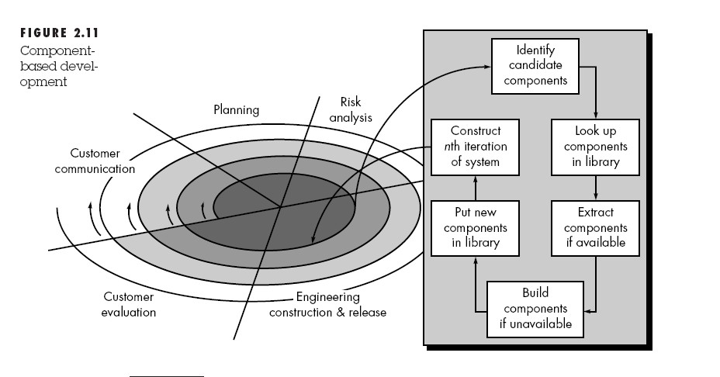
CBD Model

