Slide 1

Coding Standards & guidelines
Software Engineering (2160701)
Presented by : Nirmal M Rabari
170410107092
` TY-CE-2(BATCH-B)

Slide 2

Coding Standards
Good software development organizations normally require their programmers to adhere to some well-defined and standard style of coding called coding standards.

Slide 3

Most software development organizations formulate their own coding standards that suit them most, and require their engineers to follow these standards strictly.
The purpose of requiring all engineers of an organization to adhere to a standard style of coding is the following:
A coding standard gives a uniform appearance to the codes written by different engineers.
It enhances code understanding.
It encourages good programming practices.

Slide 4

A coding standard lists several rules to be followed such as, the way variables are to be named, the way the code is to be laid out, error return conventions, etc.
The following are some representative coding standards
1
Rules for limiting the use of global
These rules list what types of data can be declared global and what cannot.
2
Naming conventions for global & local variables & constant identifiers
A possible naming convention can be that global variable names always start with a capital letter, local variable names are made of small letters, and constant names are always capital letters.

Slide 5
Contents of the headers preceding codes for different modules
The information contained in the headers of different modules should be standard for an organization.
The exact format in which the header information is organized in the header can also be specified.
3
The following are some standard header data
Module Name
Creation Date
Author’s Name
Modification history
Synopsis of the module
Global variables accessed/modified by the module
Different functions supported, along with their input/output parameters

Slide 6
Sample Header
/*
* MyClass <br>
*
* This class is merely for illustrative purposes. <br>
*
* Revision History:<br>
* 1.1 – Added javadoc headers <br>
* 1.0 - Original release<br>
*
* @author N. M. Rabari
* @version 1.1, 25/02/2020
*/
public class MyClass {
. . .
}

Slide 7

Error return conventions and exception handling mechanisms
The way error conditions are reported by different functions in a program are handled should be standard within an organization.
For example, different functions while encountering an error condition should either return a 0 or 1 consistently.
4

Slide 8
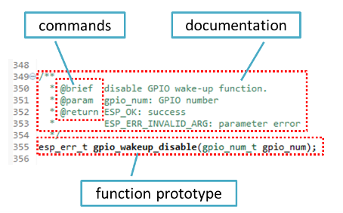
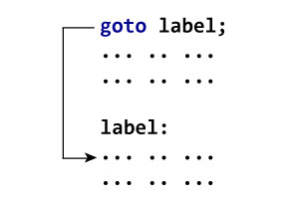
Coding guidelines
The following are some representative coding guidelines
Do not use a coding style that is too clever or too difficult to understand
Do not use an identifier for multiple purposes
The code should be well-documented
The length of any function should not exceed 10 source lines
Do not use goto statements
Well Documented
Do not use goto

Slide 9
Avoid obscure side effects:
The side effects of a function call include modification of parameters passed by reference, modification of global variables, and I/O operations.
An obscure side effect is one that is not obvious from a casual examination of the code.
Obscure side effects make it difficult to understand a piece of code.
For example, if a global variable is changed obscurely in a called module or some file I/O is performed which is difficult to infer from the function’s name and header information, it becomes difficult for anybody trying to understand the code.

Slide 10
THANK YOU

