Slide 1
Subject : Software Engineering Topic : Testing Tools Name : Mrugesh Raulji Enroll No : 170410107095 Batch : B

Slide 2
What is Software Testing?
Software testing is a process of executing a program or application with the intent of finding the software bugs. It can also be stated as the process of validating and verifying that a software program or application or product: Meets the business and technical requirements that guided it's design and development.

Slide 3
This work started from the subject of my pro gradu thesis “The newest methods and tools for
software testing”. After a long search there were nearly 600 (six hundred) tools found. I am sure, that there are tools much more than these now occurred. A very good aid to me was the list in Internet (www.testingfaqs.org), which Brian Marick made famous and is now maintained by Danny Faught. Other sources have been Internet overall, the brochures of the products and the literature. Because the amount of the tools was so large, I had to restrict them and to take up only the most interesting once. The division to the main groups was: Design, GUI (Graphical User Interface), Load and Performance, Management, Implementation, Evaluation, Static Analysis and outside of inspection: Defect Tracking, Web Sites and Miscellaneous. The limits between the groups are out of focus, because there are many tools, which can belong to several classes.

Slide 4
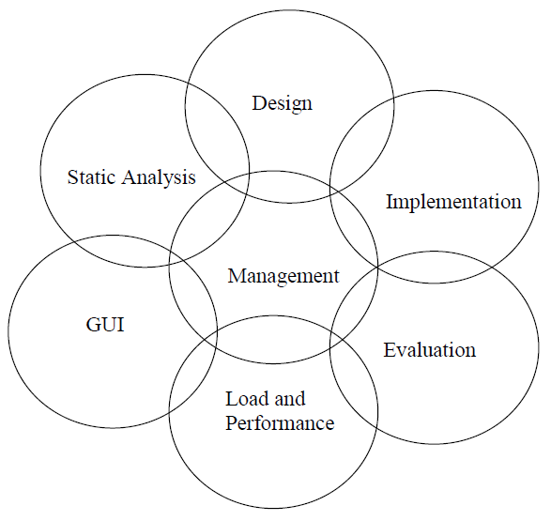

Slide 5
A short description of the main groups:
Test Design Tools
Tools that help you decide what tests need to be executed. Test data and test case
generators. Total 15 tools.
GUI Test Drivers
Tools that automate execution of tests for products with graphical user interfaces.
Client/server test automation tools, including load testers, also go here. Total 28 tools.
Load and Performance Tools
Tools that specialize in putting a heavy load on systems (especially client-server
systems). These tools are often also GUI test drivers. Total 21 tools.

Slide 6
Test Management Tools
Tools that automate execution of tests for products without graphical user interfaces. Also tools that help you work with large test suites.Total 43 tools.
Test Implementation Tools
Miscellaneous tools that help you implement tests. For example, tools that automatically generate stub routines go here, as do tools that attempt to make failures more obvious (assertion generators, etc.) Total 27 tools.
Test Evaluation Tools
Tools that help you evaluate the quality of your tests. Code coverage tools go here. Total 31 tools.

Slide 7
Static Analysis Tools
Tools that analyse programs without running them. Metrics tools fall in this category.
Total 33 tools.
Total sum 198 tools.

Slide 8
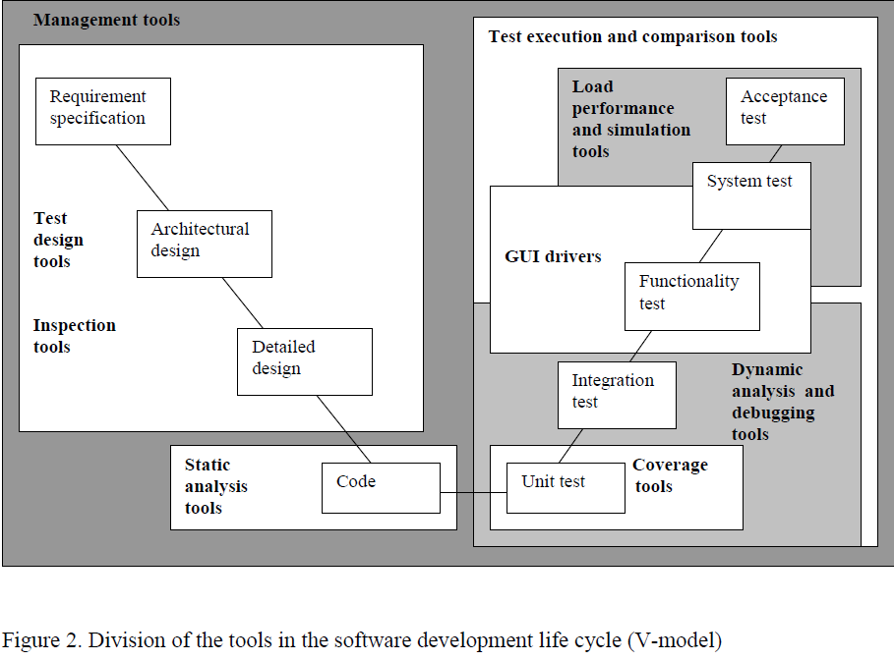

Slide 9
List of Software Testing Tool
Web Load
This software testing tool works best for any internet application and many more technologies too.
The tool helps in analysis of web tool and it checks out product performance and functionality precisely.
Apache Jmeter
This is an open source performance testing tool based on Java platform.
The best part is that it can be attached with test plan and works well on different development phases.

Slide 10
HP invent LoadRunner
As the name suggest, tool is released by HP and used to check performance of the product under different load conditions.
The key benefit of the product is that it may handle multiple users together.
LoadComplete
This is one of the best performance testing tools that is quite affordable and working solution for software developers.
It allows you to create or execute load tests on your website quickly. It works well for web application and software programs too.
IBM Rational
This is an automated performance testing tool that can be used by web application or server based apps worldwide.
It works best for the apps where significant amount of inputs and output is involved.

