Slide 1
Re-Engineering & Reverse Engineering
MADE BY:SAKSHI SANGHAVI
EN.NO:170410107098
CLASS:CE-2
BATCH:B

Slide 2
SOFTWARE RE-ENGINEERING:
Reengineering is a rebuilding activity
Consider an analogous activity: the rebuilding of a house
Question??
Consider the following situation. You’ve purchased a house in another state. You’ve never actually seen the property, but you acquired it at an amazingly low price, with the warning that it might have to be completely rebuilt. How would you proceed?

Slide 3
Some Important Points:
Before you can start rebuilding, it would seem reasonable to inspect the house.
Before you tear down and rebuild the entire house, be sure that the structure is weak.
Before you start rebuilding be sure you understand how the original was built.
If you begin to rebuild, use only the most modern, long-lasting materials.
If you decide to rebuild, be disciplined about it. Use practices that will result in high quality—today and in the future.

Slide 4
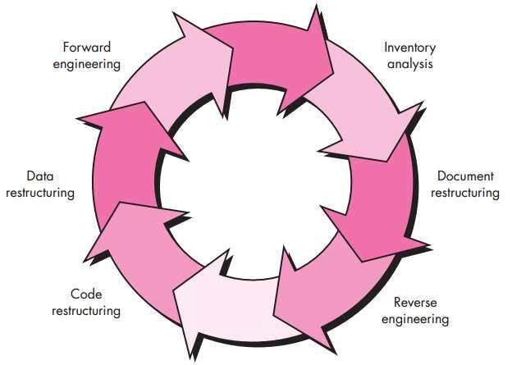
Diagram:

Slide 5
Software Re-Engineering Activities:
Inventory analysis.
Document restructuring.
Reverse engineering.
Code restructuring.
Data restructuring.
Forward engineering.

Slide 6
Reverse Engineering

Slide 7
REVERS EENGINEERING
How to define:
Reverse engineering is a process that can extract design information from source code

Slide 8
REVERSE ENGINEERING over view
Reverse engineering conjures an image of the “magic slot.” You feed a haphazardly
designed, undocumented source file into the slot and out the other end comes
a complete design description (and full documentation) for the computer program
Unfortunately, the magic slot doesn’t exist. Reverse engineering can extract design information from source code, but the abstraction level, the completeness of the documentation, the degree to which tools and a human analyst work together, and the directionality of the process are highly variable

Slide 9
Some important points
The abstraction level of a reverse engineering process and the tools used to effect. it refers to the
sophistication of the design information that can be extracted from
source code.
The abstraction level should be as high as possible. That is, the reverse engineering process should be capable of:
deriving procedural design representations (a low-level abstraction),
program and data structure information(a somewhat higher level of abstraction),
object models,
data and/or control flow models (a relatively high level of abstraction),
Entity relationship models (a high level of abstraction),
As the abstraction level increases, you are provided with information that will allow easier understanding of the program.

Slide 10
Some important points
The completeness of a reverse engineering process refers to the level of detail that is provided at an abstraction level.
In most cases, the completeness decreases as the abstraction level increases.
For example, given a source code listing, it is relatively easy to develop a complete procedural design representation. Simple architectural design representations may also be derived, but it is far more difficult to develop a complete set of UML diagrams or models.

Slide 11
Some important points
Completeness improves in direct proportion to the amount of analysis performed by the person doing reverse engineering.
Interactivity refers to the degree to which the human is “integrated” with automated tools to create an effective reverse engineering process.
In most cases, as the abstraction level increases, interactivity must increase or completeness will suffer.

Slide 12
Some important points
If the directionality of the reverse engineering process is one-way, all information extracted from the source code is provided to the software engineer who can then use it during any maintenance activity.
If directionality is two-way, The information is fed to a reengineering tool that attempts to restructure or regenerate the old program.

Slide 13
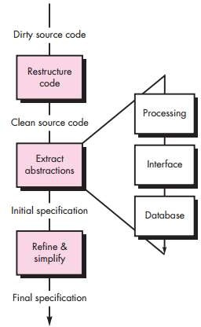
Representation of REVERSE ENGINEERING

Slide 14
Reverse Engineering to Understand Data
Reverse engineering of data occurs at different levels of abstraction and is often the first reengineering task.
At the program level,
Internal program data structures
must often be reverse engineered as part of an overall reengineering effort.
At the system level,
Global data structures (e.g., files, databases) are often reengineered to accommodate new database management paradigms (e.g., the move from flat file to relational or object-oriented database systems).

Slide 15
Internal data structures
Reverse engineering techniques for internal program data focus on the definition of classes of objects.
This is accomplished by examining the program code with the intent of grouping related
program variables.
In many cases,
The data organization within the code identifies abstract data types.
For example,
record structures, files, lists, and other data structures often provide an initial indicator of classes.

Slide 16
Database structure
Regardless of its logical organization and physical structure, a database allows the definition of data objects and supports some method for establishing relationships among the objects.
Therefore, reengineering one database schema into another requires an understanding of
existing objects and their relationships.

Slide 17
Database structure
The following steps may be used to define the existing data model:
Build an initial object model,
Determine candidate keys (the attributes are examined to determine whether they are used to point to another record or table; those that serve as pointers become candidate keys),
Refine the tentative classes,
Define generalizations,
Discover associations using techniques that are analogous to the CRC approach.

Slide 18
Reverse Engineering to Understand Processing
Reverse engineering to understand processing begins with an attempt to understand and then extract procedural abstractions represented by the source code
The overall functionality of the entire application system must be understood before more
detailed reverse engineering work occurs.
Each of the programs that make up the application system represents a functional abstraction at a high level of detail.
A block diagram, representing the interaction between these functional abstractions, is created.
Each component performs some sub-function and represents a defined procedural abstraction.
In some situations, system, program, and component specifications already exist. When this is the case, the specifications are reviewed for conformance to existing code.

Slide 19
Reverse Engineering User Interfaces
Sophisticated GUIs have become de rigueur for computer-based products and systems of every type. Therefore, the redevelopment of user interfaces has become one of the most common types of reengineering activity. But before a user interface can be rebuilt, reverse engineering should occur.
To fully understand an existing user interface, the structure and behavior of the interface must be specified. Merlo and his colleagues suggest three basic questions that must be answered as reverse engineering of the UI commences:

Slide 20
THANK YOU

